Slide 1






QUANG HIEP SECONDARY SCHOOL
WELCOME TO OUR CLASS !
Presented by: HỒ THỊ HỒNG THẮM

Slide 2


Crossword
LET’S DO
THIS CROSSWORD!
LET’ PLAY KIM’S GAME

Slide 3
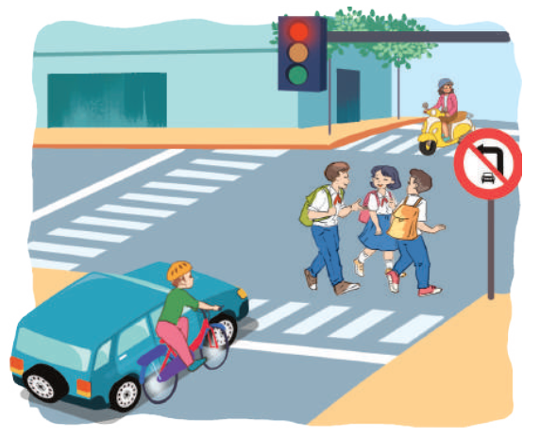
What can you see in this picture ?
Look at the picture and list the things, people you can see in the picture

Slide 4
3
12
9
43
31
42
34
30
7
15
1
10
59
38
35
44
52
5
26
57
27
60
21
0
48
22
36
41
28
49
14
4
47
19
53
39
45
13
51
32
29
8
2
18
56
46
33
50
55
11
20
37
6
40
17
16
24
54
25
23
58

Slide 5
What can you see in this picture ?
Look at the picture and list the things, people you can see in the picture

Slide 6
Can you see any danger in this picture ?

Slide 7
Unit 7.Traffic
Period 59:
Lesson 5. Skills 1

Slide 8
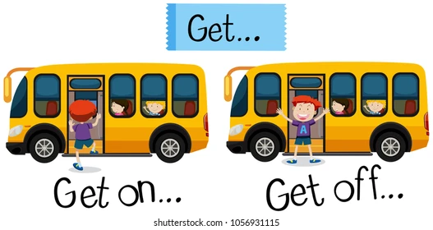
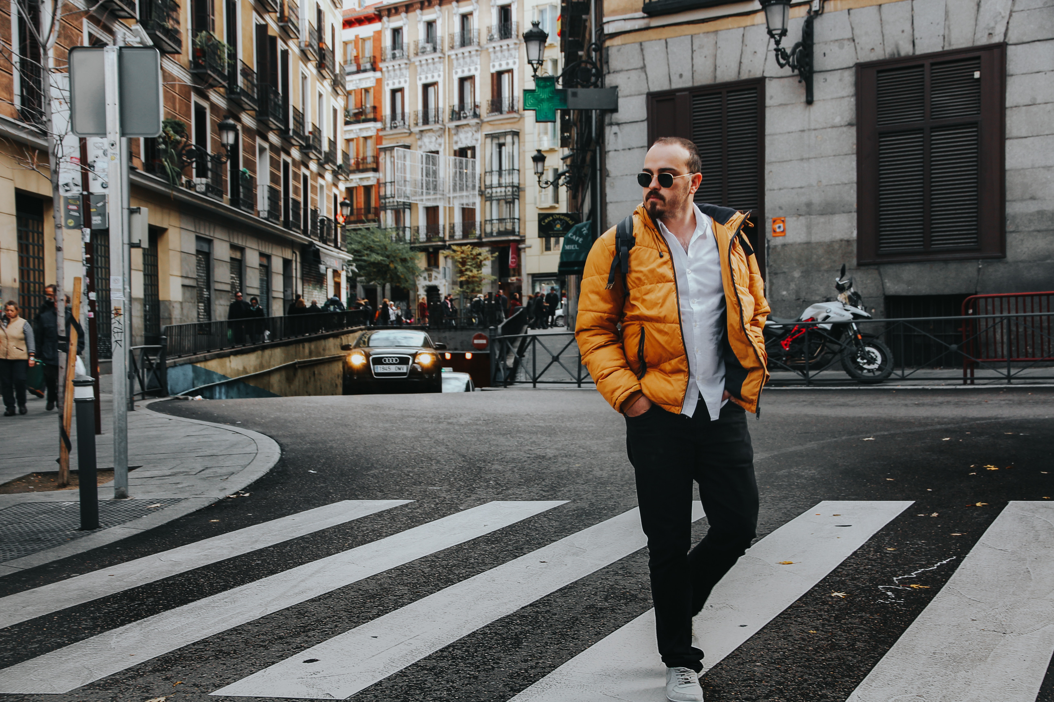
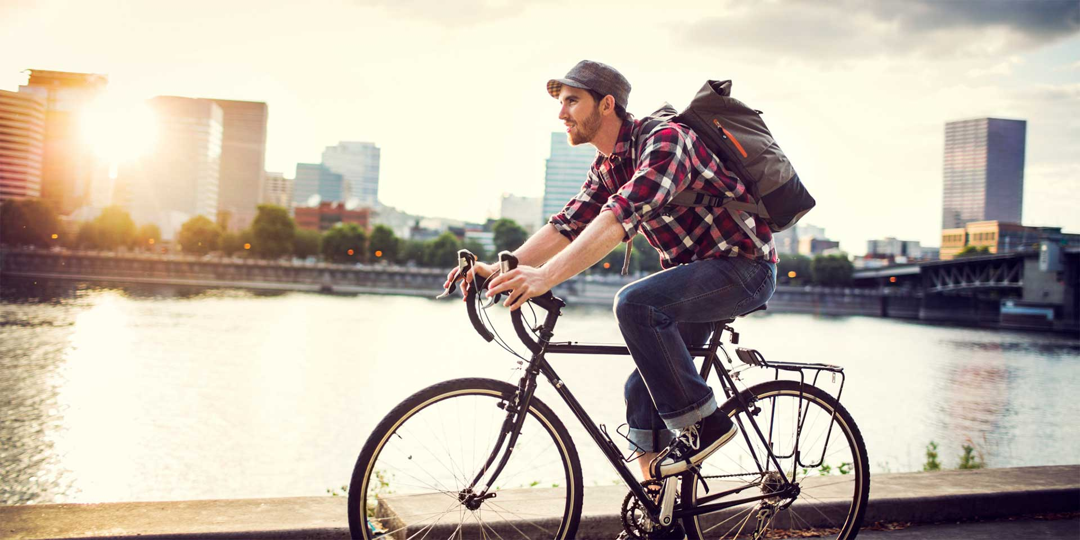
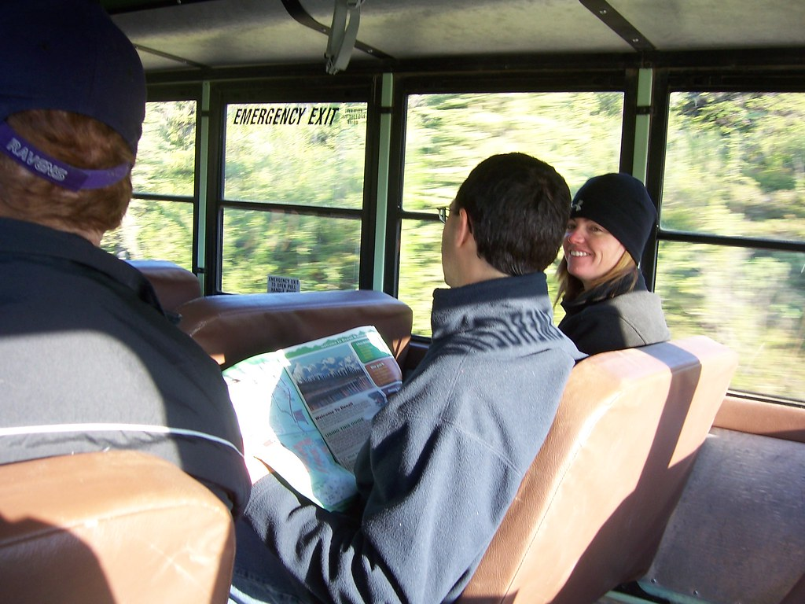
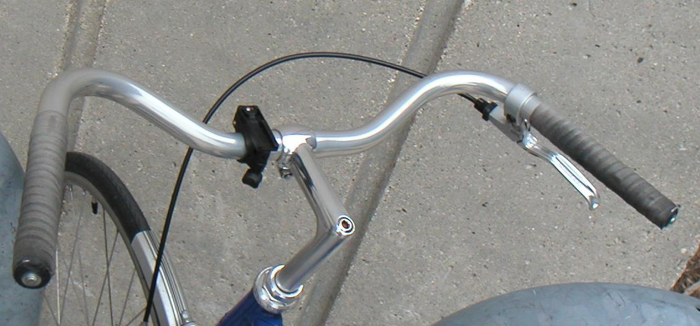
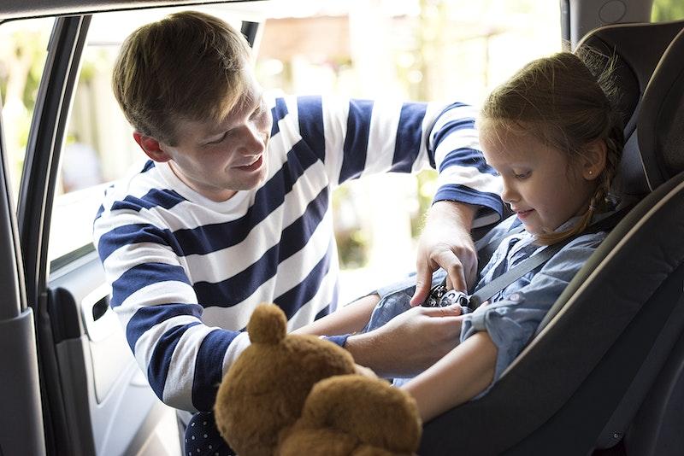
Vocabulary
1. cyclist /ˈsaɪklɪst/ (n)
2. pedestrian /pəˈdestriən/ (n)
3. zebra crossing /ˈziːbrə ˈkrɒsɪŋ/(n.phr)
4. passenger /ˈpæsɪndʒə(r)/(n)
5. get on /off / gɛt ɒn /ɒf/ (phr.v)
6. Fasten seatbelt /ˈfɑːsn jɔː ˈsiːtbɛlt/ (v.phr)
7. fully stop / ˈfʊli stɒp/ (n.phr)
8. handlebar / hændlbɑː/ (n.phr)

Slide 9
Speak out the words
Cyclist
: Người đi xe đạp
Pedestrian
: người đi bộ
Zebra crossing
: vạch kẻ đường
Pessenger
: hành khách
Fasten seat belt
:thắt dây an toàn
Fully stop
: ngừng hoàn toàn
handlebar
: tay lái

Slide 10
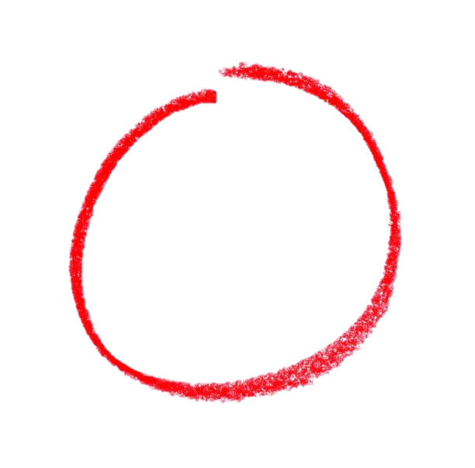
Ex 2. (p 78) Read the following text and choose the correct answer.
These are some rules about road safety. It is important to obey these rules when you are a road user.
These are some rules about road safety. It is important to obey these rules when you are a road user.
Pedestrians
1. Always look carefully when you cross the street.
2. Use the pavement or footpath.
3. Walk across the street at the zebra crossing.
4. Don't cross the road on a red light.
Pedestrians
1. Always look carefully when you cross the street.
2. Use the pavement or footpath.
3. Walk across the street at the zebra crossing.
4. Don't cross the road on a red light.
This text is about _________.
rules for pedestrians
traffic lights
traffic rules
Cyclists
1. Always keep both hands on the handlebars.
2. Wear helmets, and always use the cycle lane.
3. Give a signal before you turn.
4. Don't carry more than one passenger.
Cyclists
1. Always keep both hands on the handlebars.
2. Wear helmets, and always use the cycle lane.
3. Give a signal before you turn.
4. Don't carry more than one passenger.
Passengers
1. Fasten your seatbelt when you are in a car.
2. Wait for buses to fully stop before getting on or off.
3. Don't talk to the driver when he / she is driving.
4. Don't stick any body parts out of the window of a moving vehicle.
Passengers
1. Fasten your seatbelt when you are in a car.
2. Wait for buses to fully stop before getting on or off.
3. Don't talk to the driver when he / she is driving.
4. Don't stick any body parts out of the window of a moving vehicle.

Slide 11
Ex 3. (p 78) Read the text again and answer the question.
Ex 3. (p 78) Underline the keywords.
01
Where should pedestrians cross the street?
Where should pedestrians cross the street?
Which lane should you use when riding a bike?
02
Which lane should you use when riding a bike?
03
What should you do before you turn while riding a bike?
What should you do before you turn while riding a bike?
04
What must you do when you get on or off a bus?
What must you do when you get on or off a bus?
05
What mustn't you do when you are in a moving vehicle?
What mustn't you do when you are in a moving vehicle?

Slide 12
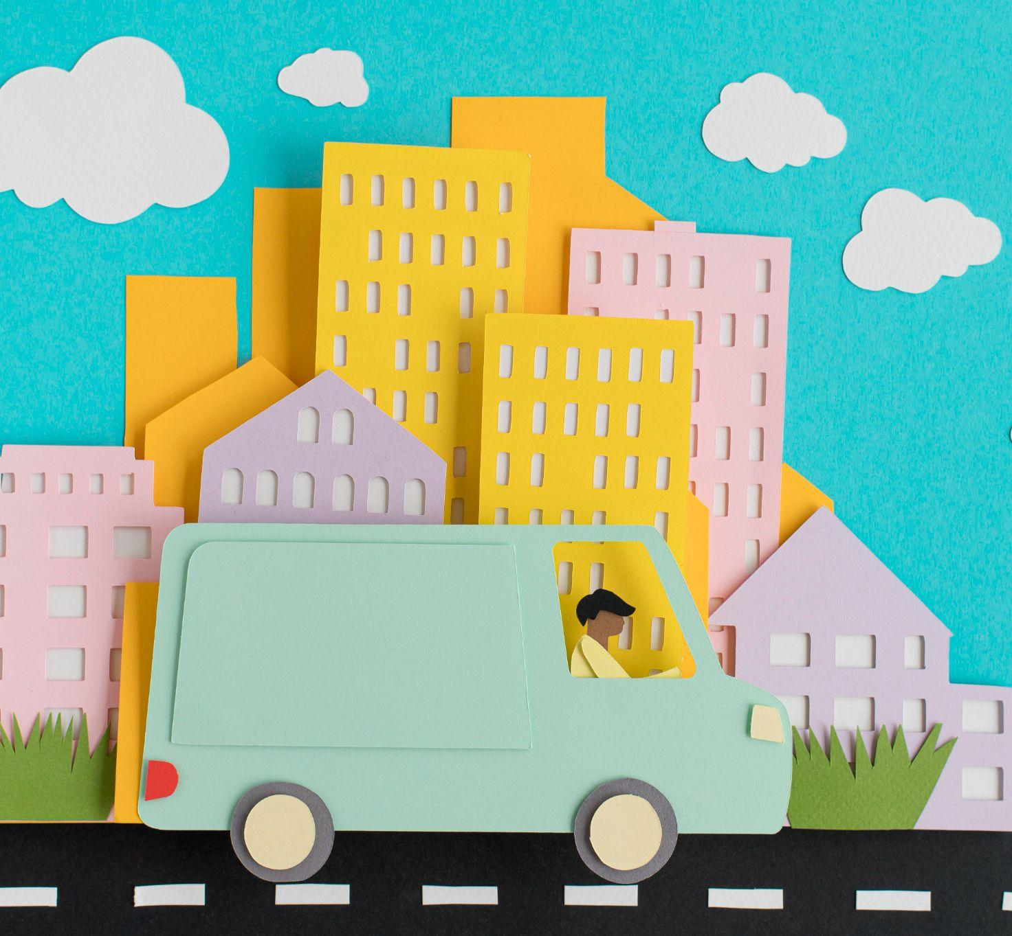
Ex 3. (p 78) Read the text again and answer the question.
Where should pedestrians
cross the street?
01
Answer: At the zebra crossing.
→ Walk across the street at the zebra crossing.

Slide 13
02. Which lane should you use when riding a bike?
Ex 3. (p 78) Read the text again and answer the question.
Answer: The cycle lane.
→ … and always use the cycle lane.

Slide 14
Ex 3. (p 78) Read the text again and answer the question.
What should you do before you turn while riding a bike?
03
Answer: Give a signal before you turn.
→… Give a signal before you turn.

Slide 15
Ex 3. (p 78) Read the text again and answer the question.
04. What must you do when you get on or off a bus?
Answer: Wait for buses to fully stop.
→…Wait for buses to fully stop before getting on or off.

Slide 16
Ex 3. (p 78) Read the text again and answer the question.
What mustn't you do when you are in a moving vehicle?
05
Answer: Don’t stick any body parts out of the window.
→…Don’t stick any body parts out of the window of a moving vehicle.

Slide 17
√
3
Read the text again and answer the questions:
1. Where should pedestrians cross the street?
2. Which lane should you use when riding a bike?
3. What should you do before you turn while riding a bike?
4. What must you do when you get on or off a bus?
5. What mustn’t you do when you are in a moving vehicle?
They shoud cross the street at the zebra crossing.
We should always use the cycle lane.
We should give a signal before we turn while riding a bike.
We must wait for buses to fully stop when you get on or off a bus.
We mustn’t stick any body parts out of the window
when you are in a moving vehicle.

Slide 18
Discuss: Who is being safe, who is unsafe ?
Ex 5. (p 78) Work in group.
1. Hoang is riding a bike, and he is wearing a helmet.
2. It is raining hard, but Mr Long is driving quickly.
3. The students are standing in a line to get on the school bus.
4. Mr Binh is taking his daughter to school on his motorbike. She is sitting in front of him.
5. Michelle is cycling to school and she is waving and shouting to her friends.
1. Hoang is riding a bike, and he is wearing a helmet.
2. It is raining hard, but Mr Long is driving quickly.
3. The students are standing in a line to get on the school bus.
4. Mr Binh is taking his daughter to school on his motorbike. She is sitting in front of him.
5. Michelle is cycling to school and she is waving and shouting to her friends.
Safe
unsafe
Safe
unsafe
unsafe

Slide 19
02
Speaking
When you are a road user, what should you NOT do?

Slide 20
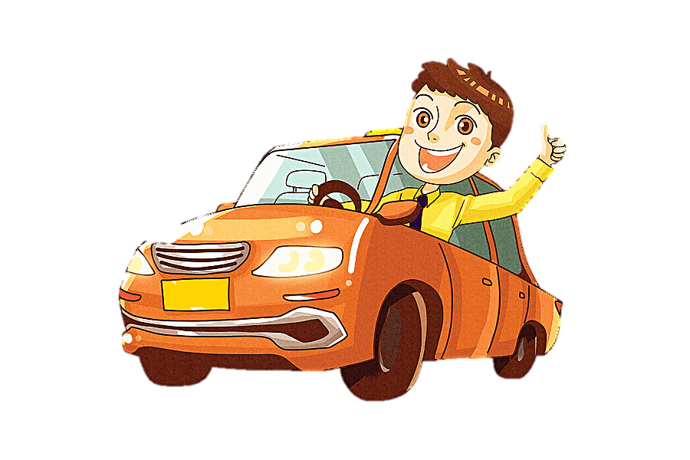
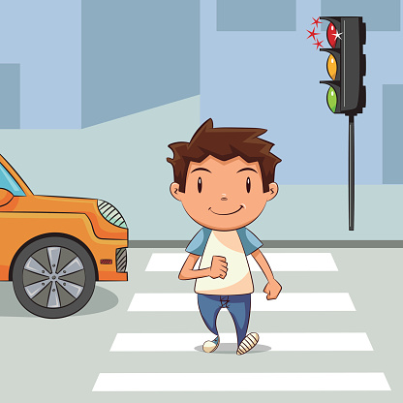
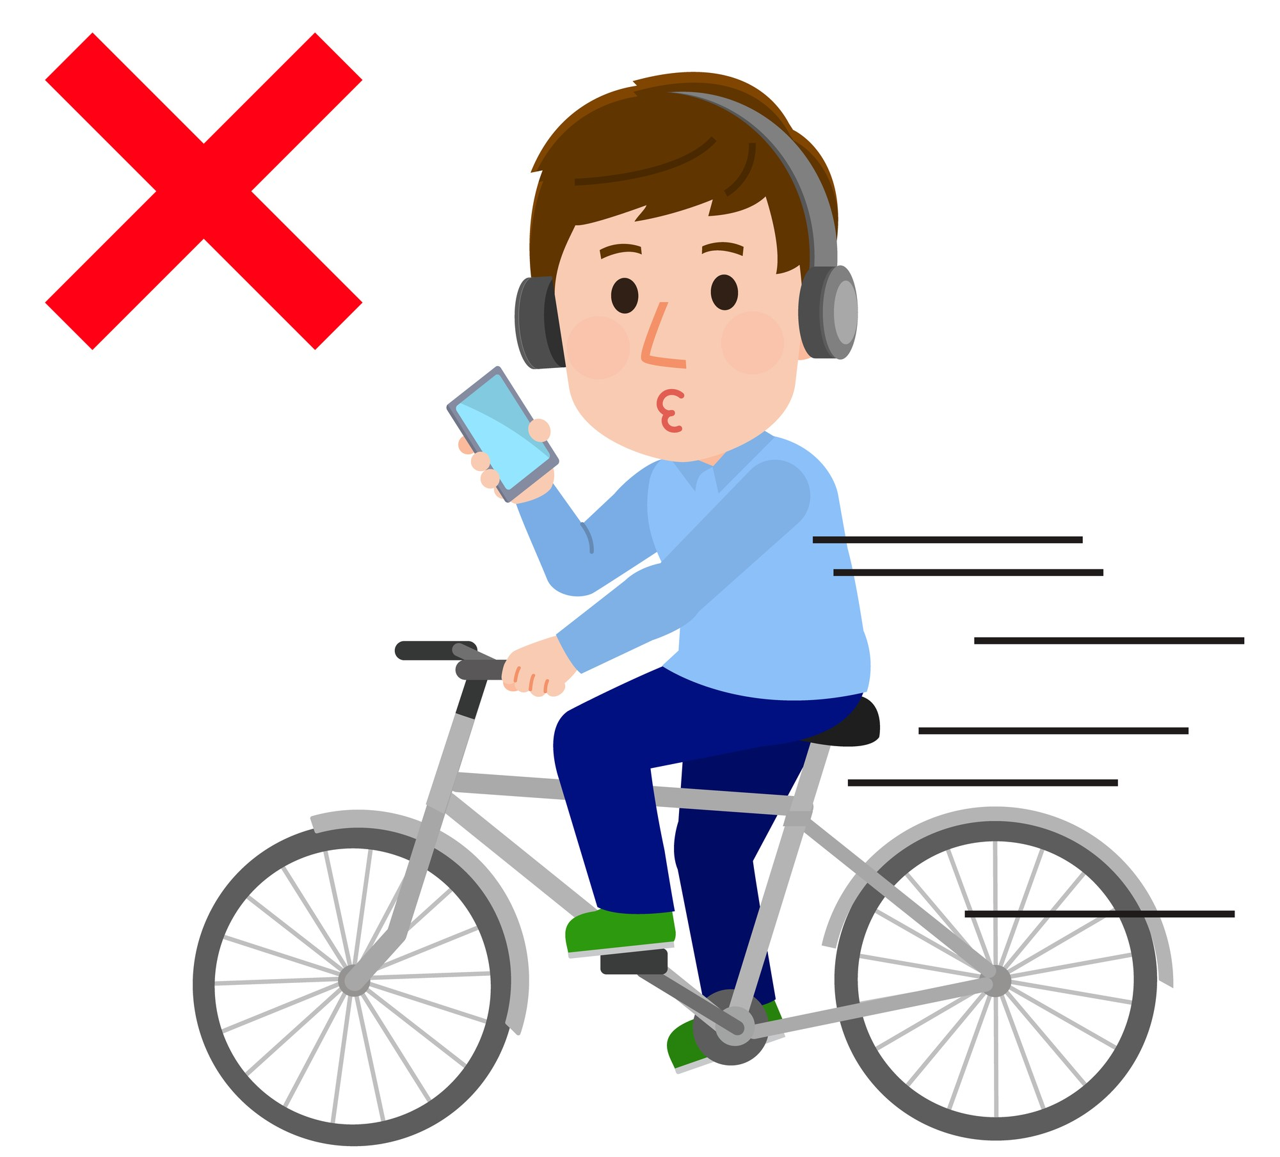
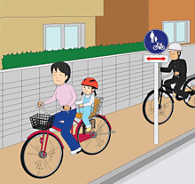
When being a road user, we had better not:
Ex 4. (p 78) Answer the following question.
Can you add more?
Don’t stick any body parts out of the window of a moving vehicle.
Cycle in the pavement or footpath.
Cross the road on a red light.
Use phone while driving.

Slide 21
About you
When you are a road user, what should you do?
what shouldnot you do ?

Slide 22



HOMEWORK
- Learn by heart new words.
Prepare skill 2.

Slide 23
Guess the mode of transportation
c_r
m_t_rc_cle
tr_uc_
sc_ot_r
el_ctr_c c_r
s_ilb_at
t_a_n
s_ubm_rin_

