Slide 1
Suggest
?
Bright Future school has many community activities for students. The school believes that a good way for students to develop themselves is through community service. All students can join any of these different projects:
- Tutoring: Upper grade students tutor lower grade students.
- Postcard-to-Help: Students make and sell postcards to raise money for local children.
- Visit-to-Read: Students visit a nursing home monthly and read books to the elderly.
- Garden-to-Give: Students grow vegetables and donate them to local schools.
- Paper-Plant-Exchange: Students collect paper and exchange it for plants. They then look after the plants in their school garden.
Students learn that they can help people and the world around them when they do community service. They feel useful and proud because they do good things.

Slide 2
Suggest
?
Bright Future school has many community activities for students. The school believes that a good way for students to develop themselves is through community service. All students can join any of these different projects:
- Tutoring: Upper grade students tutor lower grade students.
- Postcard-to-Help: Students make and sell postcards to raise money for local children.
- Visit-to-Read: Students visit a nursing home monthly and read books to the elderly.
- Garden-to-Give: Students grow vegetables and donate them to local schools.
- Paper-Plant-Exchange: Students collect paper and exchange it for plants. They then look after the plants in their school garden.
Students learn that they can help people and the world around them when they do community service. They feel useful and proud because they do good things.

Slide 3
Suggest
?
Bright Future school has many community activities for students. The school believes that a good way for students to develop themselves is through community service. All students can join any of these different projects:
- Tutoring: Upper grade students tutor lower grade students.
- Postcard-to-Help: Students make and sell postcards to raise money for local children.
- Visit-to-Read: Students visit a nursing home monthly and read books to the elderly.
- Garden-to-Give: Students grow vegetables and donate them to local schools.
- Paper-Plant-Exchange: Students collect paper and exchange it for plants. They then look after the plants in their school garden.
Students learn that they can help people and the world around them when they do community service. They feel useful and proud because they do good things.

Slide 4
Suggest
?
Bright Future school has many community activities for students. The school believes that a good way for students to develop themselves is through community service. All students can join any of these different projects:
- Tutoring: Upper grade students tutor lower grade students.
- Postcard-to-Help: Students make and sell postcards to raise money for local children.
- Visit-to-Read: Students visit a nursing home monthly and read books to the elderly.
- Garden-to-Give: Students grow vegetables and donate them to local schools.
- Paper-Plant-Exchange: Students collect paper and exchange it for plants. They then look after the plants in their school garden.
Students learn that they can help people and the world around them when they do community service. They feel useful and proud because they do good things.

Slide 5
Suggest
?
Bright Future school has many community activities for students. The school believes that a good way for students to develop themselves is through community service. All students can join any of these different projects:
- Tutoring: Upper grade students tutor lower grade students.
- Postcard-to-Help: Students make and sell postcards to raise money for local children.
- Visit-to-Read: Students visit a nursing home monthly and read books to the elderly.
- Garden-to-Give: Students grow vegetables and donate them to local schools.
- Paper-Plant-Exchange: Students collect paper and exchange it for plants. They then look after the plants in their school garden.
Students learn that they can help people and the world around them when they do community service. They feel useful and proud because they do good things.

Slide 7
Period 20
UNIT 3: COMMUNITY SERVICE
Lesson 5: Skills 1 (Page 34)
READING AND SPEAKING

Slide 8
WARM UP
Who is cleverer?

Slide 10
1. Listen and choose the English word
phát triển
A. bright
B. decorate
C. develop

Slide 11
2. Choose the correct meaning
raise money
A. thu thập
B. quyên góp tiền
C. nhặt lên

Slide 12
3. Listen and choose the English word
dịch vụ cộng đồng
A. community service
B. community activity
C. public service

Slide 13
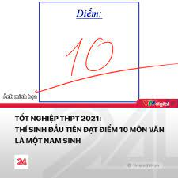
4. Choose the correct meaning
proud (adj)
/praʊd/
A. hài lòng, tự hào
B. sáng tạo
C. kiên nhẫn

Slide 14
5. Match the word pairs
1. trao đổi
A. sell
2. bán
B. receive
3. nhận
C. exchange

Slide 15
6. Choose the correct meaning
monthly (adj/adv)
/ˈmʌnθli/
A. tháng
B. hằng tháng
C. hằng năm

Slide 16
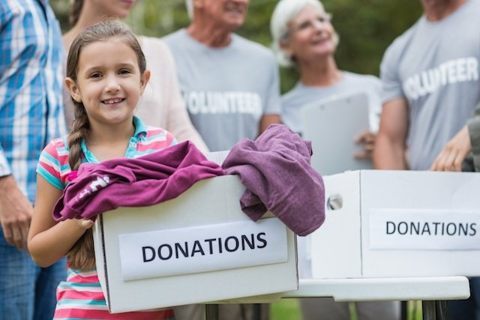
7. Listen and write the English word
donate
We ……………..clothes to homeless children.

Slide 17
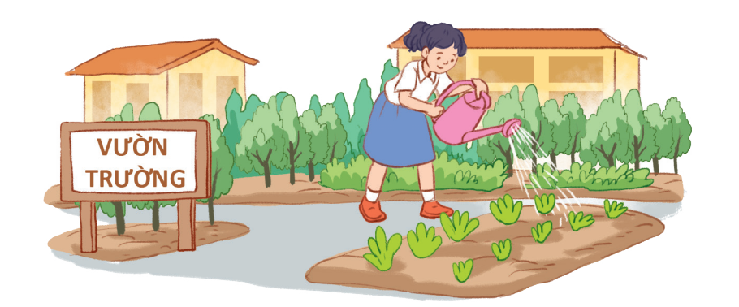
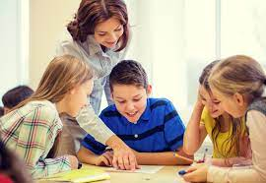
8. Matching the activities with the pictures
A. collecting books
B. growing vegetables
C. tutoring students
1.
2.
3.

Slide 18
Who is cleverer?

Slide 19
Task 1/P34. Circle the activities you would like to do at your school.
A. growing vegetables in the school garden
B. tutoring other students
C. collecting books for the school library
A.
B.
C.

Slide 20
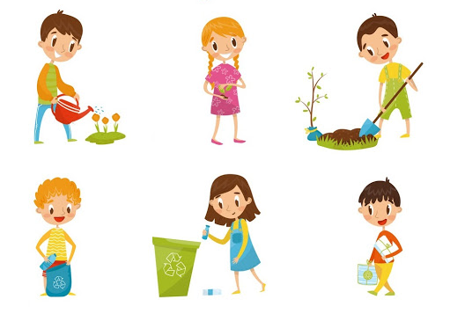
Unit
5
COMMUNITY SERVICE
LESSON 5: SKILLS 1
READING
SPEAKING
Unit
Projects in Bright Future School
What project you can do.

Slide 21
New words:
New words | Pronunciation | Meaning
develop (v) | /di'veləp/ | phát triển
raise money (v) | /reiz 'mʌni/ | quyên góp tiền
monthly (adj/adv) | /ˈmʌnθli/ | hằng tháng
proud (adj) | /praʊd/ | hài lòng, tự hào

Slide 22
Task2/P34.Read the passage and match the highlighted words with their meaning:
Bright Future school has many community activities for students. The school believes that a good way for students to develop themselves is through community service. All students can join any of these different projects:
- Tutoring: Upper grade students tutor lower grade students.
- Postcard-to-Help: Students make and sell postcards to raise money for local children.
- Visit-to-Read: Students visit a nursing home monthly and read books to the elderly.
- Garden-to-Give: Students grow vegetables and donate them to local schools.
- Paper-Plant-Exchange: Students collect paper and exchange it for plants. They then look after the plants in their school garden.
Students learn that they can help people and the world around them when they do community service. They feel useful and proud because they do good things.
1. give
2. give and receive
3. every month
4. pleased
5. teach

Slide 23
Task 2 / P34. Match the highlighted words with their meanings.
1. give
donate
2. give and receive
exchange
3. every month
monthly
4. pleased
proud
5. teach
tutor

Slide 24
Task 3 / P34. Read the passage again and tick True or False.
True
False
1. Community service allows students to develop themselves.
2. Each student can join only one project.
3. They tutor younger students.
4. Local children receive postcards from the Postcard-to-Help project.
5. Students receive plants when they give paper.
?
?
different projects
?
?
Students make and sell postcards to raise money for local children
?

Slide 25
Task 4 / P34. Write the names of the projects:
A. Tutoring
B. Postcard - to - Help
C. Visit - to - read
D. Garden – to - Give
E. Paper – Plant - Exchange
 | Projects
1. Nick likes reading books. He has a very nice voice, and he is also patient.
2. Ann is very good at maths and literature. She also loves children.
3. Minh loves collecting and making postcards.
4. Mark loves nature. He likes watching programmes about plants. He also likes being outdoors.
5. Tom likes collecting newspapers.

Slide 26
Unit 3: Community service Lesson 5 – Skills 1
II. SPEAKING
Task 5: Work in groups and discuss which project in 4 you would like to join and why. Then report to the class.

Slide 27
TASK 5 / P34. Work in groups and discuss which project in 4 you would like to join. Then report your groups’s answer
Which project do you want to join?
Why do you want to join the project?
Vocabulary
Pronunciation
Grammar
Fluency
Performance
Lan
Tutoring
Trang
Postcard - to - Help
- Be good at Maths and English.
- Love children.
Collect and make postcards.
Example: Lan will join the Tutoring project because she is good at maths and English. She also loves children.

Slide 28
CONSOLIDATION
Wrap-up
READING
SPEAKING
Projects in Bright Future School
What project you can do?

Slide 29
HOMEWORK
Learn new words
Write about your school activities last summer. (I planted trees. I…..)
Prepare for the next lesson:
Unit 3. Skills 2

Slide 30
GOOD BYE!
SEE YOU LATER

