Slide 1
Mary is having a dinner party tonight. Read the text and list out the things she has / hasn’t done
My name is Mary and today is a busy day for us. We are having a dinner party tonight. The dinner party is special because my husband has never invited his boss to dinner before and this is the first time he will be at our home.
We have had many parties before, but we have never had parties with people we work with.
There is a lot of cleaning and preparation that has to be done.
I have already done the dusting. I have already washed the dishes. I have already done the laundry. I have already washed the washrooms and I have already made the beds.
I haven’t finished the vacuuming yet. I haven’t done the grocery shopping yet. I haven’t made the salad yet. I haven’t prepared the supper yet. I haven’t baked a cake yet.
I would like to make a blackforest cake, but I have never made a blackforest cake. I have made pies many times, but I haven’t really baked too many cakes.
I hope our party will be a success.
Mary

Slide 2
Things Mary has already done | Things Mary hasn’t done yet
She has already done the dusting. | I haven’t finished the vacuuming yet.
She has already washed the dishes. | I haven’t done the grocery shopping yet.
She has already done the laundry. | I haven’t made the salad yet.
She has already washed the washrooms | I haven’t prepared the supper yet.
She has already made the beds. | I haven’t baked a cake yet.

Slide 3
Mary is having a dinner party tonight. Read the text and list out the things she has / hasn’t done
Mary
My name is Mary and today is a busy day for us. We are having a dinner party tonight. The dinner party is special because my husband has never invited his boss to dinner before and this is the first time he will be at our home.
We have had many parties before, but we have never had parties with people we work with.
There is a lot of cleaning and preparation that has to be done.
I have already done the dusting. I have already washed the dishes. I have already done the laundry. I have already washed the washrooms and I have already made the beds.
I haven’t finished the vacuuming yet. I haven’t done the grocery shopping yet. I haven’t made the salad yet. I haven’t prepared the supper yet. I haven’t baked a cake yet.
I would like to make a blackforest cake, but I have never made a blackforest cake. I have made pies many times, but I haven’t really baked too many cakes.
I hope our party will be a success.

Slide 4
PRESENT PERFECT
Completed actions at a time in the past (not mentioned)
Situation started in the past and are still true
Completed actions where the important thing is the result now.

Slide 5
PRESENT PERFECT
for
since
just
already
(not) yet
ever / never
It’s the first time

Slide 6
PAST SIMPLE
Completed actions in the past.
General truth about the past.
Main events in a story.

Slide 7
PAST SIMPLE
Yesterday
Last (week / summer / year....)
In (January / 2000 /......
An hour / a week / a year.....ago

Slide 8
Past Simple or Present perfect?
START

Slide 9
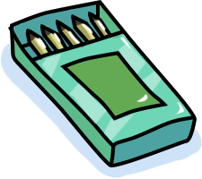
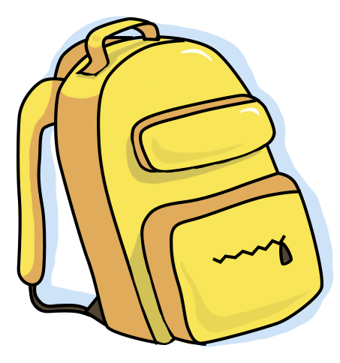
1.I ____ to school yesterday.
A. go
B. went
C. goes

Slide 10
2.____ Peter visit his grandparents last night ?
A. Do
B. Did
C. Does

Slide 11
3. Mrs. Jenkin _____ the head teacher for three years.
A. is
B. has been
C. was

Slide 12
4. What did you do yesterday morning? I____ chess with my father.
A. played
B. play
C. plays

Slide 13
5. We haven’t check the answer ____
A. yet
B. already
C. never

Slide 14
6. Did they ___ to the swimming pool yesterday afternoon?
A. going
B. went
C. go

Slide 15
7. This is the first time we _____ a video in class.
A. watch
B. watched
C. have watched

Slide 16
8.- Where ___ you yesterday? I ___ at home.
A. were /was
B. was / were
C. were /were

Slide 17
9. I ___ to the theatre four times last month.
A. go
B. went
C. has gone

Slide 18
10.I ___ on the beach and ___volleyball with my friends last weekend.
A. were , played
B. was , played
C. was, play

Slide 19
Excellent!

Slide 20
PRACTICE: ASK - ANSWER
A | B
1. Have you ever talked to a foreigner? | 1. Have you ever tried any special food? What was it?
2. When did you meet him / her? | 2. Where did you have it?
3. Where did you meet him / her? | 3. When did you have it?
4. What did you talk about? | 4. Whom did you have it with?
5. How did you feel? | 5. How did you feel about it?

Slide 21
WRITING:
Write three things you have already done today.
Write three things you haven’t done yet.
________________________________________________________________________________________________________________________________________________________________________________________________________________________________________________________________________________________________________________________________________________________________________________________________________________________________________________________________________________________________________________________________________________________________________________________________________________________________________________________________________________________________________________________________________________________________________________________________________________________________________________________________________________________________

Slide 22
SPEAKING
Describe a city that you have visited. You should say:
- Where it is
- When you went there
- What you did there
- And say how you felt about that place
________________________________________________________________________________________________________________________________________________________________________________________________________________________________________________________________________________________________________________________________________________________________________________________________________________________________________________________________________________________________________________________________________________________________________________________________________________________________________________________________________________________________________________________________________________

Slide 23
Model:
It is Bali which is an island in Indonesia. To get there from Ho Chi Minh city we need to take two flights: from Ho Chi Minh City to Kuala Lumpur, Malaysia or Singapore then another flight to Denpasar, Bali.
I go there in summer 2017 alone. Some people may think I was so lonely but actually, I really had a lot of fun on the trip all by myself.
When I was there, I went to see all the ancient temples and other historical places by bike. Besides, I have a chance to taste the local food, which is quite good. It was really a great trip because I can see so many nice natural scenes. The island also impressed me with its unique cultural identity. Finally, the local food is so yummy that I cannot forget them.
So that’s all I would like to say.
went
had
could

