Slide 1
LESSON 3:
Comparative adjectives

Slide 2
Grammar
Comparative adjectives
We can use comparative adjectives to compare two people or things.

Slide 3
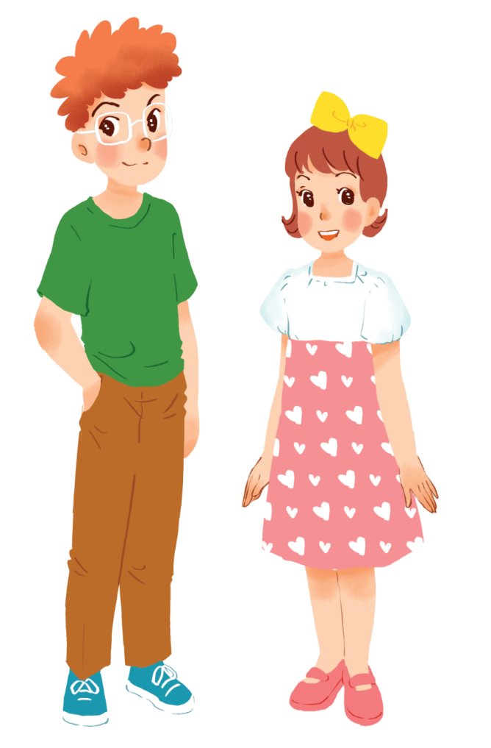
Example:
Tom is taller than Mary.

Slide 4
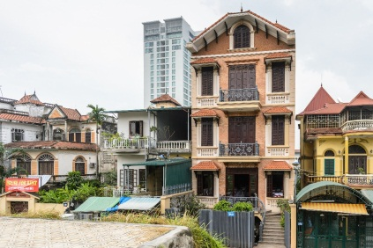
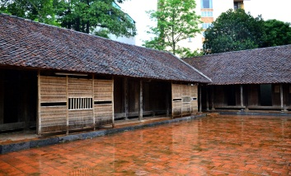
Example:
A house in a city is normally more expensive than a house in the countryside.

Slide 5
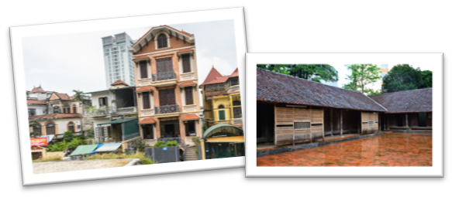
tall
expensive
1
>2
short adj
long adj
taller than
more expensive than
short adj + er +than
more + long Adj + than

Slide 6
short adj
long adj
old
hot
delicious
wide
exciting
near
crowded
big
modern
ER THAN
MORE
THAN
small
boring
quiet
cheap
peaceful
noisy
busy

Slide 7
short adj
long adj
old
delicious
exciting
near
crowded
ER (THAN)
MORE
modern
(THAN)
small
boring
quiet
peaceful
cheap
wide
-wider
hot
-hotter
big
-bigger
noisy
-noisier
busy
-busier

Slide 8
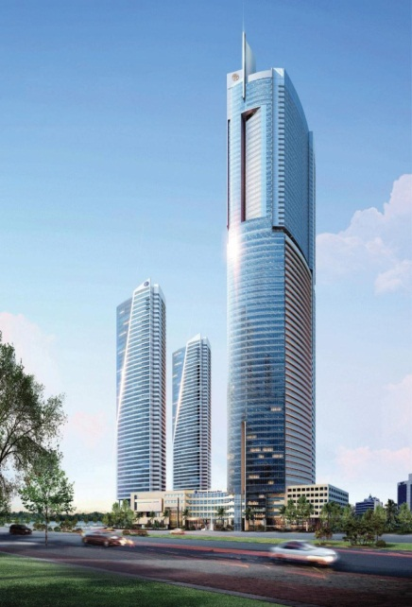
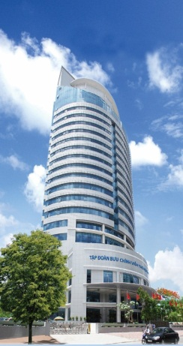
Complete the following sentences with the comparative form of the adjectives in brackets. Number 1 is an example.
1.
This building is taller than that building. (tall)

Slide 9
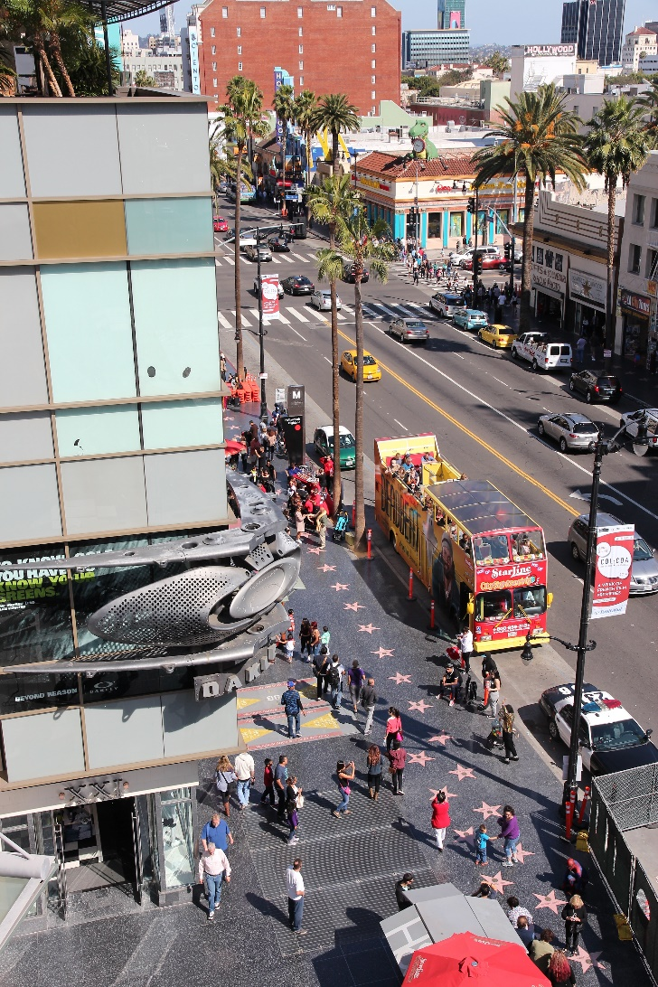
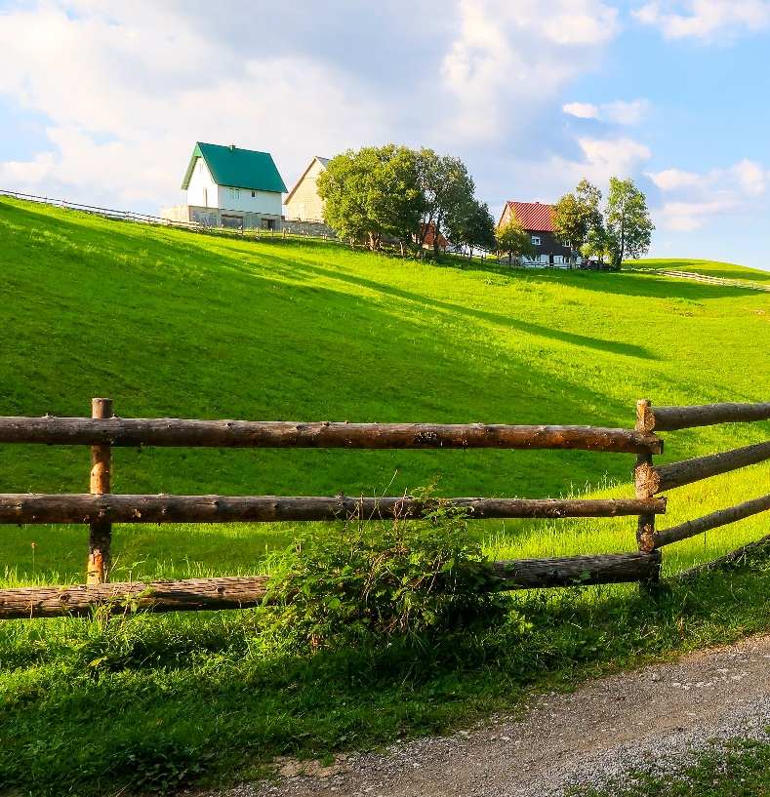
2.
My neighbourhood is than your neighbourhood. (noisy)
noisier

Slide 10
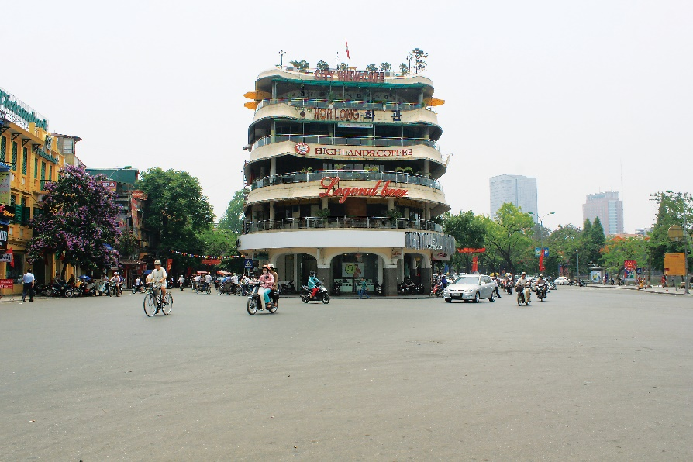
3.
The square in Ha Noi is than the square in Hoi An. (big)
bigger

Slide 11
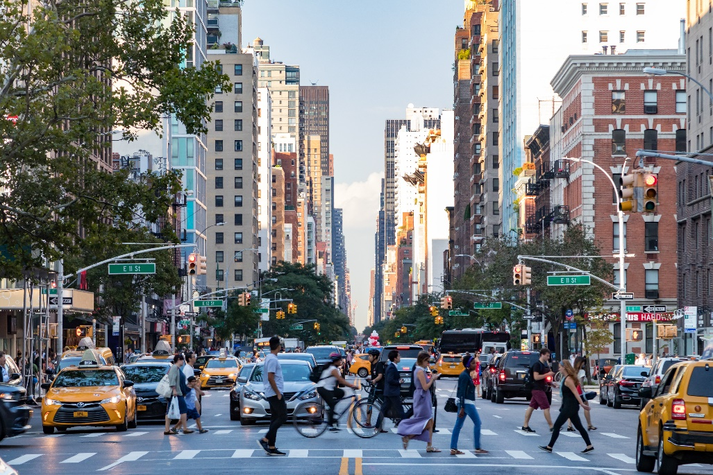
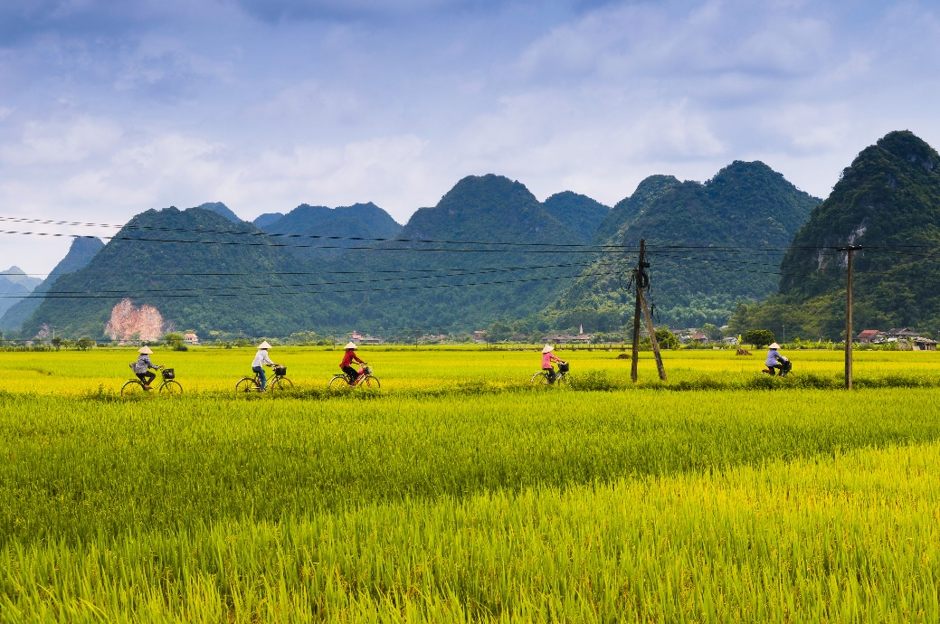
more peaceful
4.
Living in the countryside is
in a city. (peaceful)
than living
than living

Slide 12
Use the correct form of the words in brackets to complete the letter.
Dear Nick,
How are you?
Ha Noi is beautiful but it’s too busy for me. I’m having a great time at Cua Lo Beach now. The weather is (1. hot) hotter than that in Ha Noi. The houses and buildings are (2. small) …………….. and (3. old) …………………than those in Ha Noi.
The streets are (4. wide) ……………… with less traffic. the seafood here is (5. delicious) ………………………. and (6. cheap) …………….. than the seafood in Ha Noi.
See you soon,
Vy
smaller
older
wider
more delicious
cheaper

Slide 13
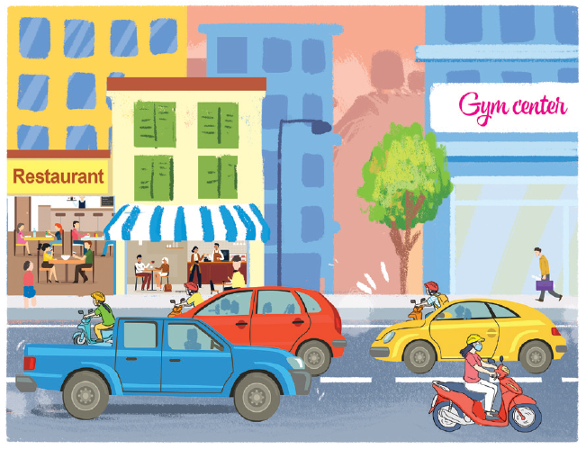
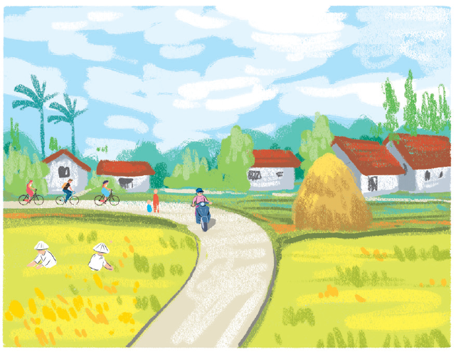
*Which adjectives can be used for Binh Minh /Long Son?
noisy
quiet
modern
boring
crowded
peaceful
busy
Binh Minh
Long Son

Slide 14
Compare two neighbourhoods. You can use the adjectives below.
noisy
quiet
modern
boring
crowded
peaceful
busy
Binh Minh
Long Son
Example:
Binh Minh is noisier than Long Son.
Long Son
quieter
Binh Minh.
Binh Minh
more modern
Long Son.
more boring
more crowded
more peaceful
busier

Slide 15
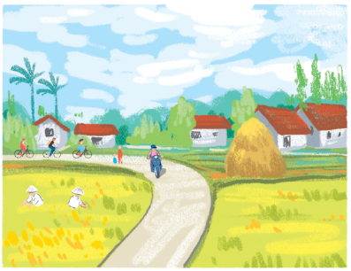
Work in pairs. Ask and answer questions about Binh Minh and Long Son neighbourhoods using the pictures in 3.
noisy
quiet
modern
boring
crowded
peaceful
busy
Example:
A: Is Binh Minh noisier than Long Son?
B: Yes, it is.
A: Is Long Son more modern than Binh Minh?
B: No, it isn’t.

Slide 16
*Which change is CORRECT.
A. near -> nearer.
B. far -> farer .
C. good -> gooder.
D. bad -> badder
farther/ further
better
worse

Slide 17
* WORK IN GROUPS. FILL IN THE MIND MAP.
old- older
adj + er than
short adj
hot-hotter
Comparative adj
long adj
noisy-noisier
more +adj + than
good/well -> better
bad -> worse
far -> farther/ further

Slide 18
*HOMEWORK.
Do the rest of B (W.B)
Prepare COMMUNICATION (p.43)

