Slide 1
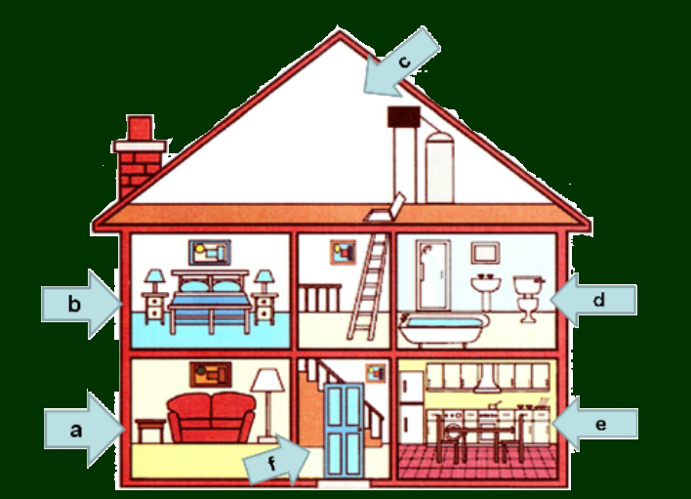
bedroom
bathroom
kitchen
living room
hall

Slide 2
Vocabulary
flat = apartment
town house
country house

Slide 3
Vocabulary
crazy
strange
window
cooker
shelf
desk
wardrobe
cupboard
lamp
+

Slide 4
I. Prepositions of place (giới từ chỉ vị trí)
- in
- on >< under
- in front of >< behind
- next to
- between … and …
+
II. Question words (Các từ hỏi)
Who
Why → Because
Where
How many

Slide 5
Unit 2: MY HOUSE
Lesson 5: SKILLS 2

Slide 6
A. Listening: (Nghe)
+

Slide 7
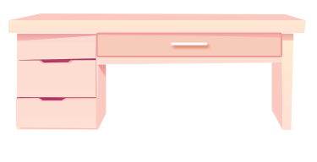
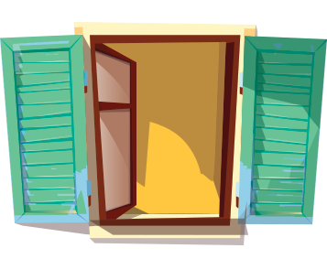
Look at the pictures. Name each of them.
Guess if they are mentioned in the listening text.
2
3
1
sofa
bookshelf
desk
4
5
clock
window

Slide 8
Listen and check your guesses.
2
3
1
sofa

desk

bookshelf
4
5
clock

window


Slide 9
Listen to Mai talking about her house.
Tick () T (True) or F (False).
 |  | T | F
1. | There are four people in Mai’s family.
2. | Mai’s house has seven rooms.
3. | The living room is next to the kitchen.
4. | In her bedroom, there’s a clock on the wall.
5. | She often listens to music in her bedroom.

three

six



reads books

Slide 10
A. Listening: (Nghe)
I. E.1 p.23
(1) bookshelf (kệ sách), (3) desk (bàn), (4) clock (đồng hồ), (5) window (cửa sổ)
II. E.2 p.23
F four three
F seven six
T
T
F listens to music (nghe nhạc) reads books
(đọc sách)
+

Slide 11
II. Writing
Answer the questions.
Where do you live?
2. How many rooms are there in your house?
What are they?
3. Which room do you like best in your house?
Why?
I live in a country house.
There are 5 rooms in my house: a living room, two bedrooms, a kitchen and a bathroom.
I like the living room best because I can watch TV with my parents and my sister.

Slide 12
Write an email to Mira, your pen friend. Tell her about your house. Use the answers to the questions in 3.
To: mira@webmail.com
Subject: My house
Hi Mira,
Thanks for you email. Now I’ll tell you about my house.
What about you? Where do you live? Tell me in your next email.
All the best,

Slide 13
Writing Tip: How to write an e-mail to a friend
Subject
To: mira@webmail.com
Subject: My house
Greeting
Hi Mira,
Introduction
Thanks for you email,…….
I live with my parents and younger brother in a town house, It's big. There are six rooms, …
Body
Dear / Hi / Hello...)
What about you? Where do you live? Tell me in your next e-mail.
Best wishes,
Conclusion

Slide 14
II. Writing
Answer the questions.
Where do you live?
2. How many rooms are there in your house?
What are they?
3. Which room do you like best in your house?
Why?
I live in a country house.
There are 5 rooms in my house: a living room, two bedrooms, a kitchen and a bathroom.
I like the living room best because I can watch TV with my parents and my sister.

Slide 15
Write an email to Mira, your pen friend. Tell her about your house.
To: mira@webmail.com
Subject: My house.
Hi Mira,
Thank s for your email. Now, I’ll tell you about my house.
I live (with my parents and sister) in a country house. It's big. There are 5 rooms in my house: a living room, a kitchen, two bedrooms and a bathroom. I like the living room best because I can watch TV with my parents and my sister together.
What about you? Where do you live? Tell me in your next e-mail.
All the best,
Mai

Slide 16
III. Homework:
- Do E.4 p.23 - TB
- Prepare Looking back p.24
+

