Slide 2
Unit
1
MY NEW SCHOOL
LESSON 5: SKILLS 1
READING
SPEAKING

Slide 3
LESSON 5: SKILLS 1
WARM-UP
Game: Lucky number
Task 1: Look at the picture and quickly read the passages. Match 1-3 with A - C.
Vocabulary teaching
Task 2: Read the passages again and complete the sentences.
READING
Task 4: Which school in Task 1 would you like to go to? Why? Then discuss your choice with your friends.
SPEAKING
CONSOLIDATION
Wrap-up
Homework

Slide 4
WARM-UP
LUCKY NUMBER
1
2
3
2 teams
4
5
6
7

Slide 5
WARM-UP
1
How many classes are there in our school?
HOME

Slide 6
WARM-UP
2
Do students have to wear uniforms when they go to school?
HOME

Slide 7
WARM-UP
3
How many computer rooms does our school have?
HOME

Slide 8
WARM-UP
4
Name some clubs in our school.
HOME

Slide 9
WARM-UP
5
Which subjects do you have at school?
HOME

Slide 10
WARM-UP
6
LUCKY NUMBER
HOME

Slide 11
WARM-UP
7
LUCKY NUMBER
HOME

Slide 12
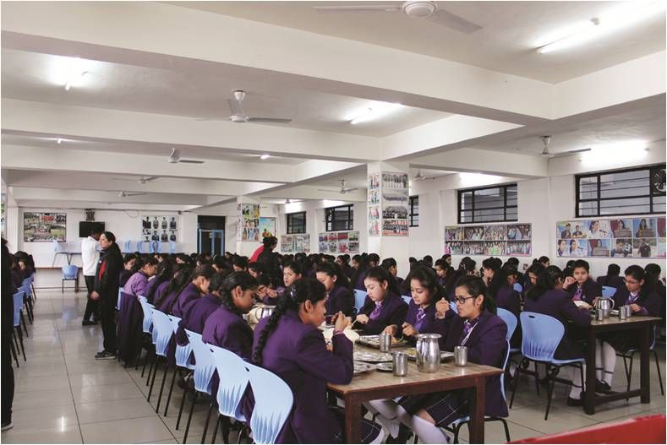
READING
boarding school (n)
A school where students live and study
/ˈbɔːdɪŋ ˌskuːl/
trường nội trú

Slide 13
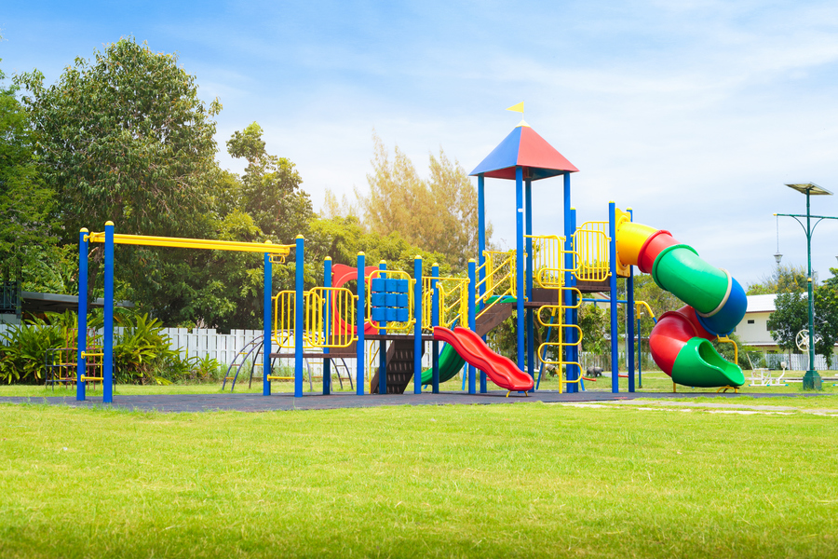
READING
playground (n)
/ˈpleɪɡraʊnd/
sân chơi

Slide 14
READING
international (adj)
/ˌɪntəˈnæʃənəl/
(mang tính)
quốc tế

Slide 15
READING
New words | Pronunciation | Meaning
1. boarding school (n) | /ˈbɔːdɪŋ ˌskuːl/ | trường nội trú
2. playground (n) | /ˈpleɪɡraʊnd/ | sân chơi
3. international (adj) | /ˌɪntəˈnæʃənəl/ | (mang tính) quốc tế

Slide 16
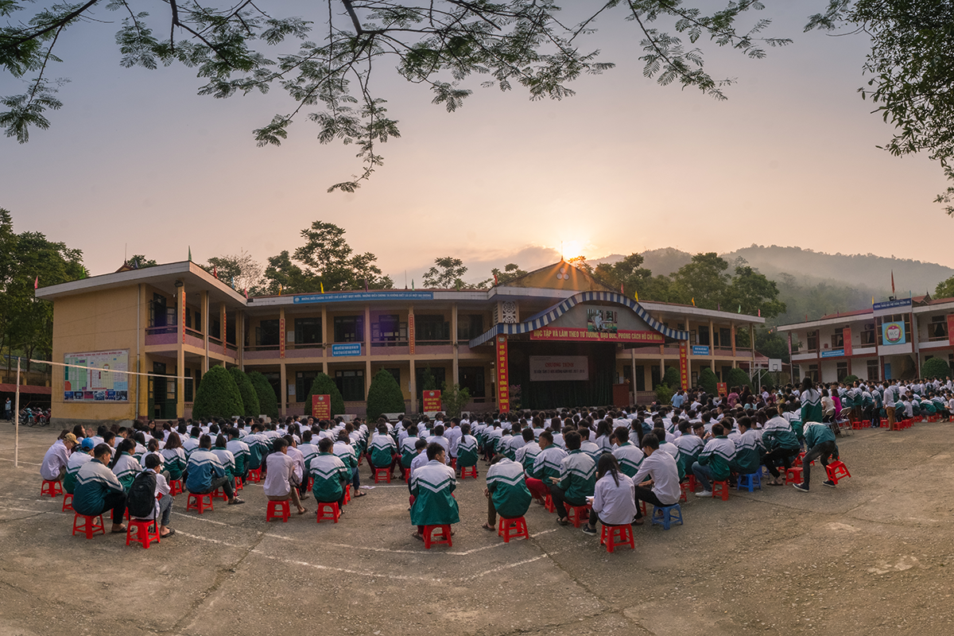
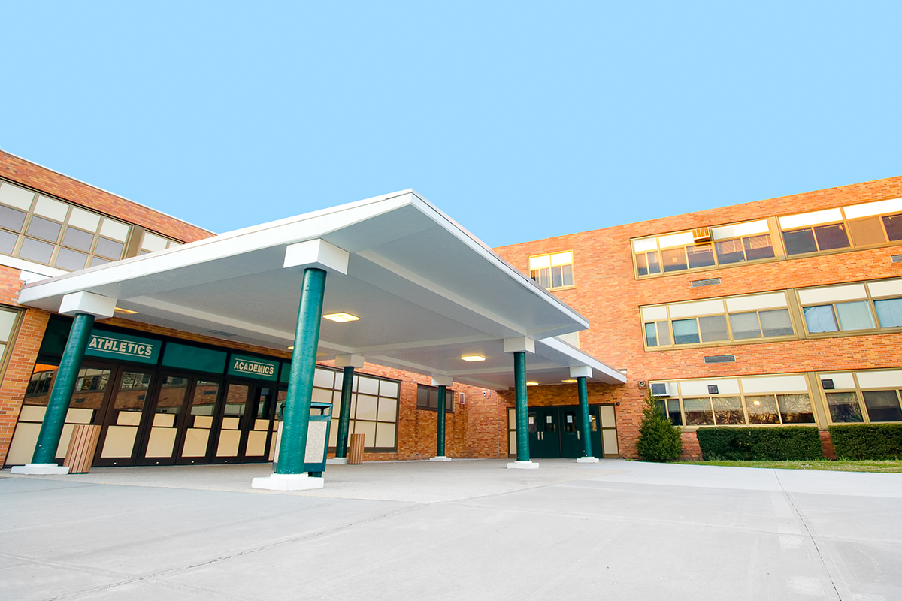
READING
1. What can you see in these pictures?
2. Are these schools in the same place?
3. Which school do you think is in Viet Nam?

Slide 17
READING

Slide 18
READING
1
Look at the picture and quickly read the passages. Match 1-3 with A-C.

Slide 19
READING
2
Read the passages again and complete the sentences.
1. Students live and study in a ________ school. They only go home at weekends.
2. Sunrise is a school in _______.
3. There are ______________________ around An Son School.
4. ____________ has an art club.
5. At Dream School, students learn English with _______________________.
boarding
Sydney
mountains and green fields
Dream School
English-speaking teachers

Slide 20
SPEAKING
3
Which school in Exercise 1 would you like to go to? Why
A. Which school would you like to go to? B. I would like to go to Dream School A. Why? B. Because I’d like to paint in the art club

Slide 21
SPEAKING
Discuss your choice with your friends.
A. Which school would you like to go to? B. I would like to go to ……………………….. A. Why? B. Because I’d like to…………………………… Or………………………………………………..
- Work in pairs.
- Share the answers.

Slide 22
CONSOLIDATION
1
Wrap-up
What have we learnt in this lesson?
Read about type of school
Speak about type of school you would like to go to

Slide 23
CONSOLIDATION
2
Homework
- Do exercises in the workbook.
- Write down your opinions about a school in your notebooks.

Slide 24
Website: hoclieu.vn
Fanpage: facebook.com/www.tienganhglobalsuccess.vn/

