Slide 1
TRƯỜNG THCS PHÚ HỘI
GIÁO VIÊN: TRẦN THỊ KIM LIÊN
UNIT 4/ PERIOD 28

Slide 2
Unit
4
ETHNIC GROUPS OF VIET NAM
LESSON 2: A CLOSER LOOK 1
VOCABULARY
PRONUNCIATION
Unit
HOBBIES

Slide 3
LESSON 2: A CLOSER LOOK 1
WARM-UP
Game: Word puzzles
Vocabulary
Task 1: Write a word or phrase from the box under each picture.
Task 2: Match the words and phrases with their meanings.
Task 3: Complete the sentences with the words and phrases from the box.
VOCABULARY
Task 4: Listen and repeat the words. Pay attention to the sounds /k/ and /g/.
Task 5: Listen and repeat the sentences. Pay attention to the underlined words.
PRONUNCIATION
CONSOLIDATION
Wrap-up
Homework

Slide 4
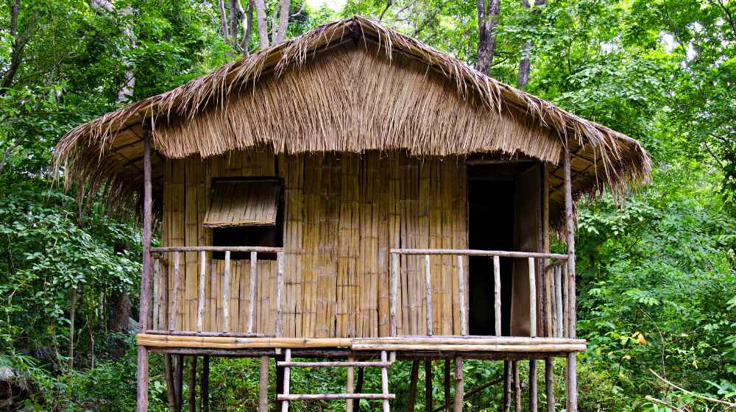
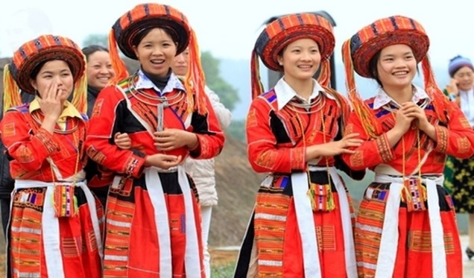
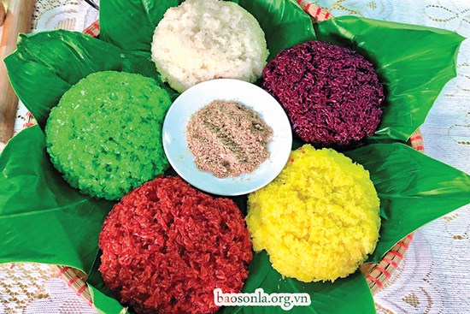
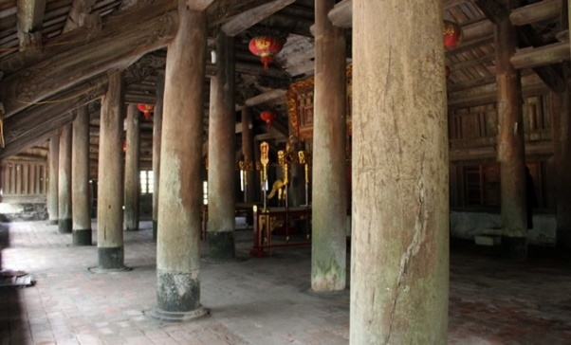
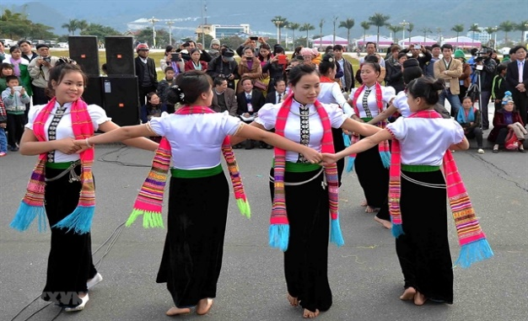
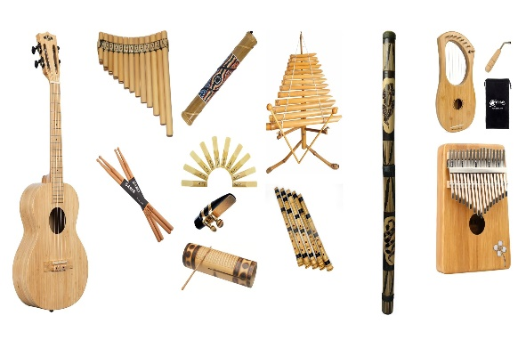
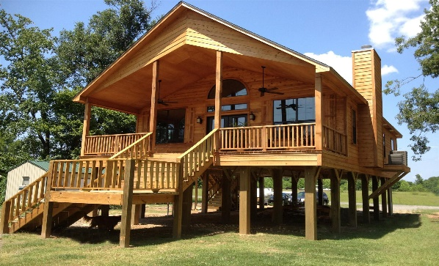
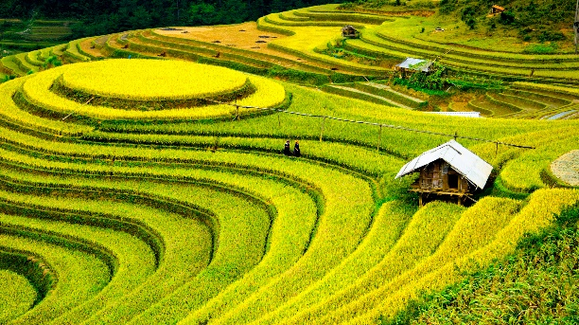
WARM-UP
bamboo house
costume
five-colour sticky rice
post
folk dance
musical instrument
stilt house
terraced field

Slide 5
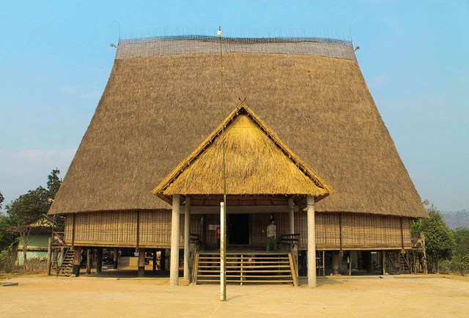
VOCABULARY
communal house (n)
/kəˈmjuːnəl haʊs/
nhà rông, nhà sinh hoạt cộng đồng

Slide 6
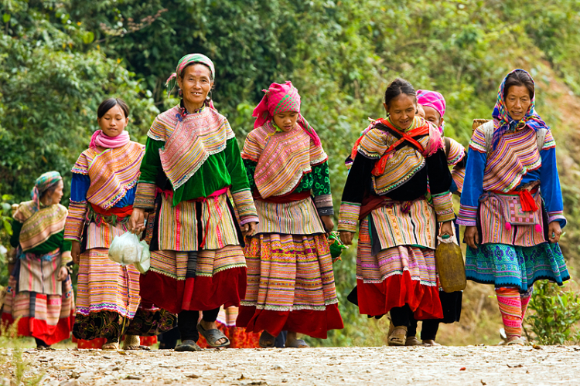
VOCABULARY
minority (n)
/maɪˈnɔːrəti/
dân tộc thiểu số

Slide 7
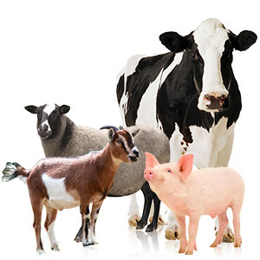
VOCABULARY
livestock (n)
/ˈlaɪvstɒk/
gia súc

Slide 8
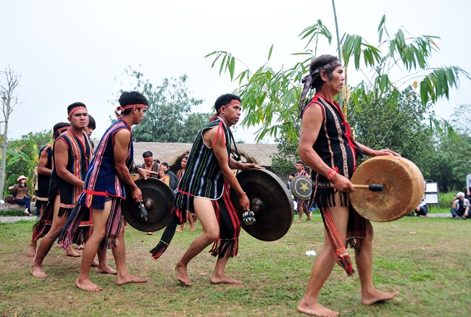
VOCABULARY
gong (n)
/ɡɒŋ/
cái cồng,
cái chiêng

Slide 9
VOCABULARY
New words | Pronunciation | Meaning
1. communal house (n) | /kəˈmjuːnəl haʊs/ | nhà rông, nhà sinh hoạt cộng đồng
2. minority (n) | /maɪˈnɔːrəti/ | dân tộc thiểu số
3. livestock (n) | /ˈlaɪvstɒk/ | gia súc
4. raise (v) | /reiz/ | chăn nuôi
5. gong (n) | /ɡɒŋ/ | cái cồng, cái chiêng

Slide 10
VOCABULARY
Communal house
Livestock
Minority
Gong
Raise

Slide 11
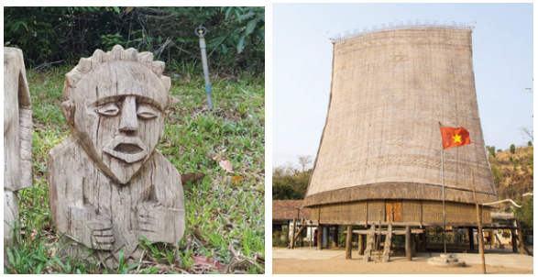
VOCABULARY
1
Write a word or phrase from the box under each picture.
Rong house weaving terraced fields
gong bamboo flute wooden statue
wooden statue
Rong house
1.___________________
2. __________________

Slide 12
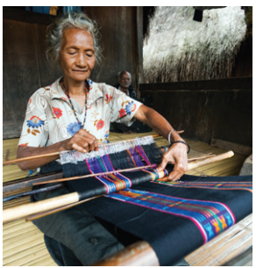
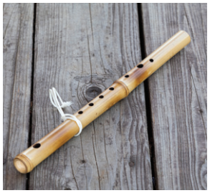
VOCABULARY
1
Write a word or phrase from the box under each picture.
Rong house weaving terraced fields
gong bamboo flute wooden statue
weaving
bamboo flute
3.___________________
4.___________________

Slide 13
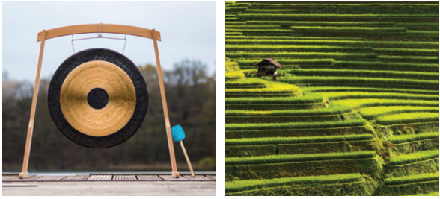
VOCABULARY
1
Write a word or phrase from the box under each picture.
Rong house weaving terraced fields
gong bamboo flute wooden statue
gong
terraced fields
5.___________________
6.___________________

Slide 14
VOCABULARY
2
Match the words and phrases with their meanings.
A |  | B
 |  | a. the animals we keep on a farm like cows and sheep
 |  | b. a large room for community activities
 |  | c. a group smaller in size than other groups in the same country
 |  | d. a traditional musical instrument
 |  | e. work like growing, watering, weeding, and harvesting
1. minority group
2. livestock
3. gardening
4. gong
5. communal house

Slide 15
VOCABULARY
3
Complete the sentences with the words and phrases from the box.
communal house unique features minority group
raise weave livestock
unique features
1. It’s interesting to learn about the _______________ of an ethnic group’s traditional culture.
2. Most mountain girls know how to ______ clothing.
3. The Cham in Ninh Thuan _____ sheep and cows.
weave
raise

Slide 16
VOCABULARY
3
Complete the sentences with the words and phrases from the box.
communal house unique features minority group
raise weave livestock
4. A _______________ is for community meetings and events.
5. There are fewer Nung than Kinh, so they are an ethnic ______________.
6. Children in both the lowlands and highlands help raise their family’s _________.
communal house
minority group
livestock

Slide 17
PRONUNCIATION
4
Listen and repeat the words. Pay attention to the sounds /k/ and /g/.
/k/ | /g/
cultural communal musical folk overlook | gong garden gathering tiger pig

Slide 18
PRONUNCIATION
5
Listen and repeat the sentences. Pay attention to the underlined words.
1. The kitchen is for family gatherings.
2. Tigers and monkeys live in the forest.
3. I love the five-colour sticky rice.
4. Yesterday, we harvested cucumbers from our garden.
5. Most girls know how to cook.
/k/ and /g/

Slide 19
CONSOLIDATION
1
Wrap-up
VOCABULARY
PRONUNCIATION

Slide 20
CONSOLIDATION
2
Homework
- Learn by heart all the learnt words.
- Do exercises in the workbook.
- Prepare for Lesson 3 - A closer look 2.

