Slide 1

UNIT 2 : LIFE IN THE COUNTRYSIDE
Lesson 6: Skills 2

Slide 2

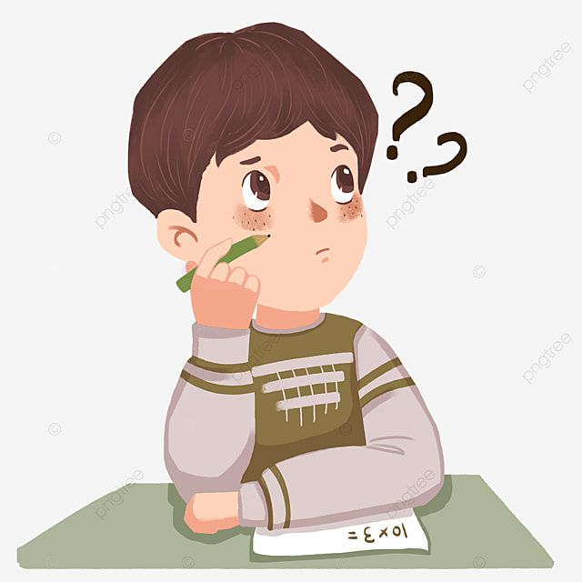
Unit
2
LIFE IN THE COUNTRYSIDE
LESSON 6: SKILLS 2

Slide 3

LISTENING
1
1
Work in pairs. Discuss the following question.
What do you like or dislike about life
in the countryside?

Slide 4

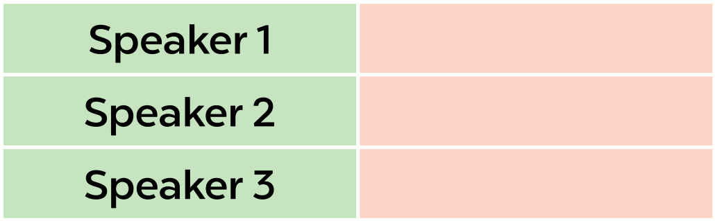
LISTENING
2
Listen to three people talking about life in the countryside. Choose the opinion (A - C) that each speaker (1 - 3) expresses.
B
A
C

Slide 5
LISTENING
3
Listen again and choose the correct answer A, B, or C.
1. According to speaker 1, there is a great sense of ______ in his village. A. security B. duty C. community 2. Speaker 1 says that people in his village are very ______. A. supportive B. unsociable C. well-trained 3. In speaker 2’s opinion, ______ is a big problem in the countryside. A. the cost of living B. safety C. transportation 4. Speaker 2 says that they should ______ in the countryside. A. improve the lives of people B. prevent crime C. protect nature 5. According to speaker 3, life in the countryside is peaceful and ______. A. slow B. simple C. safe

Slide 6
Speaker 1: I chose to live in a village because the relationships between people here are very good. There is a great sense of community here. The people welcome neighbours to their homes. They are always willing to help each other. They share almost everything with one another.
Speaker 2: There are many things I don't like about life in the countryside. There aren't many good schools or colleges. It's boring here because there aren't many places for entertainment like theatres, cinemas, etc. Transportation is another big problem. There are few means of public transport. And in general, there are many things that we should do to improve the life of villagers.
Speaker 3: I love to live in the countryside. It is spacious. We can do many, many things that are hard to do in the city. We can go swimming, play football, fly kites and do other interesting things. Life is also peaceful and simple here.

Slide 7

WRITING
4
Work in groups. Discuss and write what you like or dislike about life in the countryside.
LIKE | DISLIKE
– low cost of living – many cheap things | – not many entertainment places, such as theatres, cinemas, etc. – poor means of transport ...

Slide 8
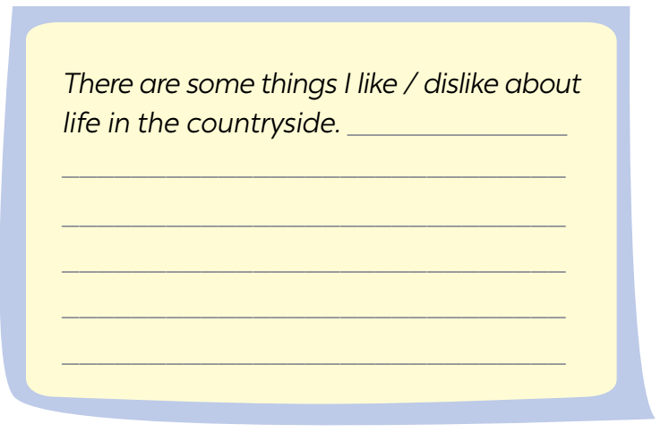
WRITING
5
Write a paragraph (80 - 100 words) about what you like or dislike about life in the countryside.

Slide 9
There are some things I like about life in the countryside. Firstly, it is a peaceful place with fresh air. We also don't worry much about air pollution. Secondly, people in the countryside are very friendly and hospitable. They are willing to help each other. Another thing is the beautiful landscapes as well as peaceful hills and forests. This makes me feel less stressed. I often take a lot of pictures of rural landscapes. In conclusion, I love to live in the countryside. It is spacious. We can do many, many things that are hard to do in the city. We can go swimming, play football, fly kites and do other interesting things. Life is also peaceful and simple here.

Slide 10

CONSOLIDATION
1
Wrap-up
What have we learnt in this lesson?
Listen to someone’s opinion about life in the countryside
Write a paragraph about what someone likes or dislikes about life in the countryside

Slide 11

CONSOLIDATION
2
Homework
Do exercises in the workbook.

Slide 12

Website: hoclieu.vn
Fanpage: facebook.com/www.tienganhglobalsuccess.vn/

