Slide 1
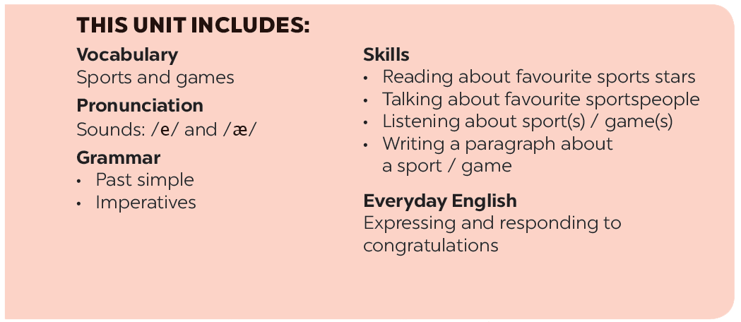

Slide 2
Vocabulary
Grammar
Find one odd word / phrase in each question.
Put the verbs in brackets in the correct form.
What do you say in these situations?
Put the correct form of the verbs play, do or go in the blanks.
Fill each blank with ONE word to complete the passage.

Slide 3
Vocabulary

Slide 4
Find one odd word / phrase in each question.
1.
A.
volleyball
B.
badminton
C.
bicycle
2.
A.
playground
B.
ball
C.
racket
3.
A.
running
B.
cycling
C.
driving
4.
A.
sports shoes
B.
winter sports
C.
goggles
5.
A.
sporty
B.
intelligent
C.
fit

Slide 5
Play : các môn thể thao với bóng hoặc thể thao đồng đội : play football
Do: các môn thể thao rèn luyện( võ):
do karate
Go: các môn thể thao kết thúc là động từ có đuôi “ing’’: go swimming

Slide 6
Put the correct form of the verbs play, do or go in the blanks.
1.
Duong can
_______ karate.
2.
Duy isn’t reading now. He
_______ table tennis with his friend.
3.
Michael
_______ swimming nearly every day.
4.
Phong didn’t play football yesterday. He
_______ fishing.
5.
Khang
_______ volleyball last Saturday.
6.
The girls
_______ aerobics in the playground now.

Slide 7
Put the correct form of the verbs play, do or go in the blanks.
1.
Duong can
_______ karate.
can+ V
do
2.
is playing
Duy isn’t reading now. He______ table tennis with his friend.
goes
3.
Michael _______ swimming nearly every day.
Phong didn’t play football yesterday. He_______ fishing.
4.
went
played
5.
Khang _______ volleyball last Saturday.
6.
are doing
The girls_______ aerobics in the playground now.

Slide 8
Grammar

Slide 9
Lan_____(cleaned/cleans) the house yesterday.

Slide 10
THÌ QUÁ KHỨ ĐƠN (THE PAST SIMPLE)
Structures( cấu trúc)
1. V "to be“ + S + was/ were + …
- S + was/were + not + …
? Were/ Was + S …?
2. V thường + S + V-ed/Vqkbqt
- S + did not + V (nguyên thể)
? Did + S + V (nguyên thể)?
II. Use(Cách sử dụng )
Dùng để diễn tả một hành động đã xảy ra và kết thúc trong quá khứ.

Slide 11
III. Note(Dấu hiệu nhận biết)
- yesterday: hôm qua
- last night/ last week/ last month/ last year: tối qua/ tuần trước/ tháng trước/ năm ngoái
- ago: cách đây (two hours ago: cách đây 2 giờ/ two weeks ago: cách đây 2 ngày …)
-this morning: sáng nay
- when: khi (trong câu kể)

Slide 12
Put the verbs in brackets in the correct form.
took
1.
The first Olympic Games (take)
_______ place in Greece in 776 BC.
2.
People (start)
started
_______ to use computers about 50 years ago.
My brother (not like)
didn’t like
3.
_______ to play games when he was small.
do
4.
What _______ you (do) _______ last weekend?
I (cycle) _______ round the lake with my friends. Then I (watch) _______ TV in the afternoon.
did
cycled
watched

Slide 13
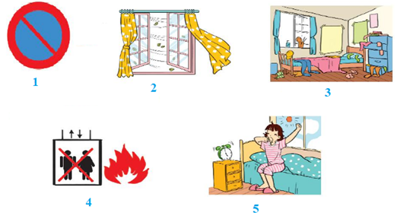
2. (Close / Open) the window. It's windy outside.

Slide 14
CÂU MỆNH LỆNH
1.Dạng khẳng định:
V (nguyên thể)!
Get up and make breakfast for me!
2. Dạng phủ định:
Do not/ Don’t + V nguyên thể
Don’t cross the road while looking at your phone.

Slide 15
What do you say in these situations?
1.
Your friends are making a lot of noise.
Please, stop
making noise.
_______.
2.
The boy is watching TV for too long.
_______ to play with your friends.
Go out to play with your friends.
3.
Some children are feeding the animals at the zoo, but it is not allowed.
_______ the animals.
Don’t feed the animals.
4.
The teacher wants the boys to stand in line.
Stand in line, boys.
_______.
5.
Your mother tells you not to touch the dog.
Don’t touch the dog.
_______.

Slide 16
Fill each blank with ONE word to complete the passage.
Sports and games are very important in our lives. We all can (1) _______ a sport, or a game, or watch sports events on TV or at the stadium. When you listen to the radio every day, you can always (2) _______ sports news. When you open a newspaper, you will always find an article about your (3) _______kind of game. Television programmes about (4) _______ are also very popular, and you can watch something interesting every day. Stories about (5) _______ sports stars are often very interesting.

Slide 17
Fill each blank with ONE word to complete the passage.
Sports and games are very important in our lives. We all can (1) play a sport, or a game, or watch sports events on TV or at the stadium. When you listen to the radio every day, you can always (2) hear sports news. When you open a newspaper, you will always find an article about your (3) favorite kind of game. Television programmes about (4) sports are also very popular, and you can watch something interesting every day. Stories about (5) famous sports stars are often very interesting.

Slide 18
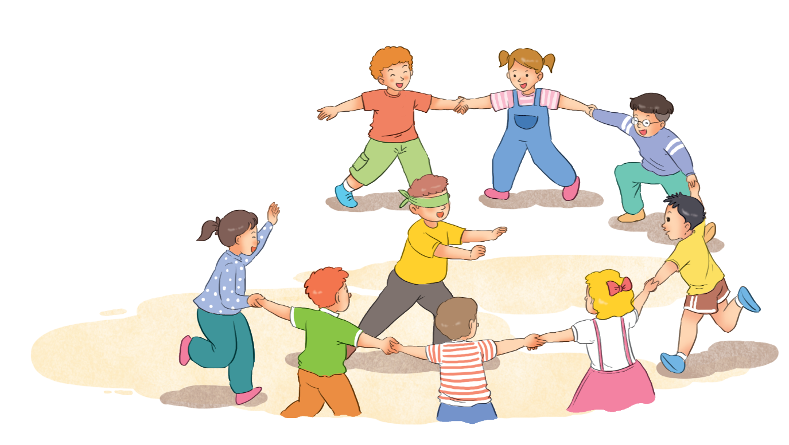
Read the information about a traditional game.
Name of the game: blind man’s buff
Number of players: five or more
Equipment: a blindfold, and open space
How to play:
1.
Players stand in a circle; one person blindfolded (the seeker) stands in the middle.
2.
The seeker tries to touch others without being caught.
3.
When the seeker catches a player, he / she tries to guess who it is by touching that player’s face and hair.
4.
When the seeker guesses that player’s name, he / she becomes the new seeker.

Slide 19
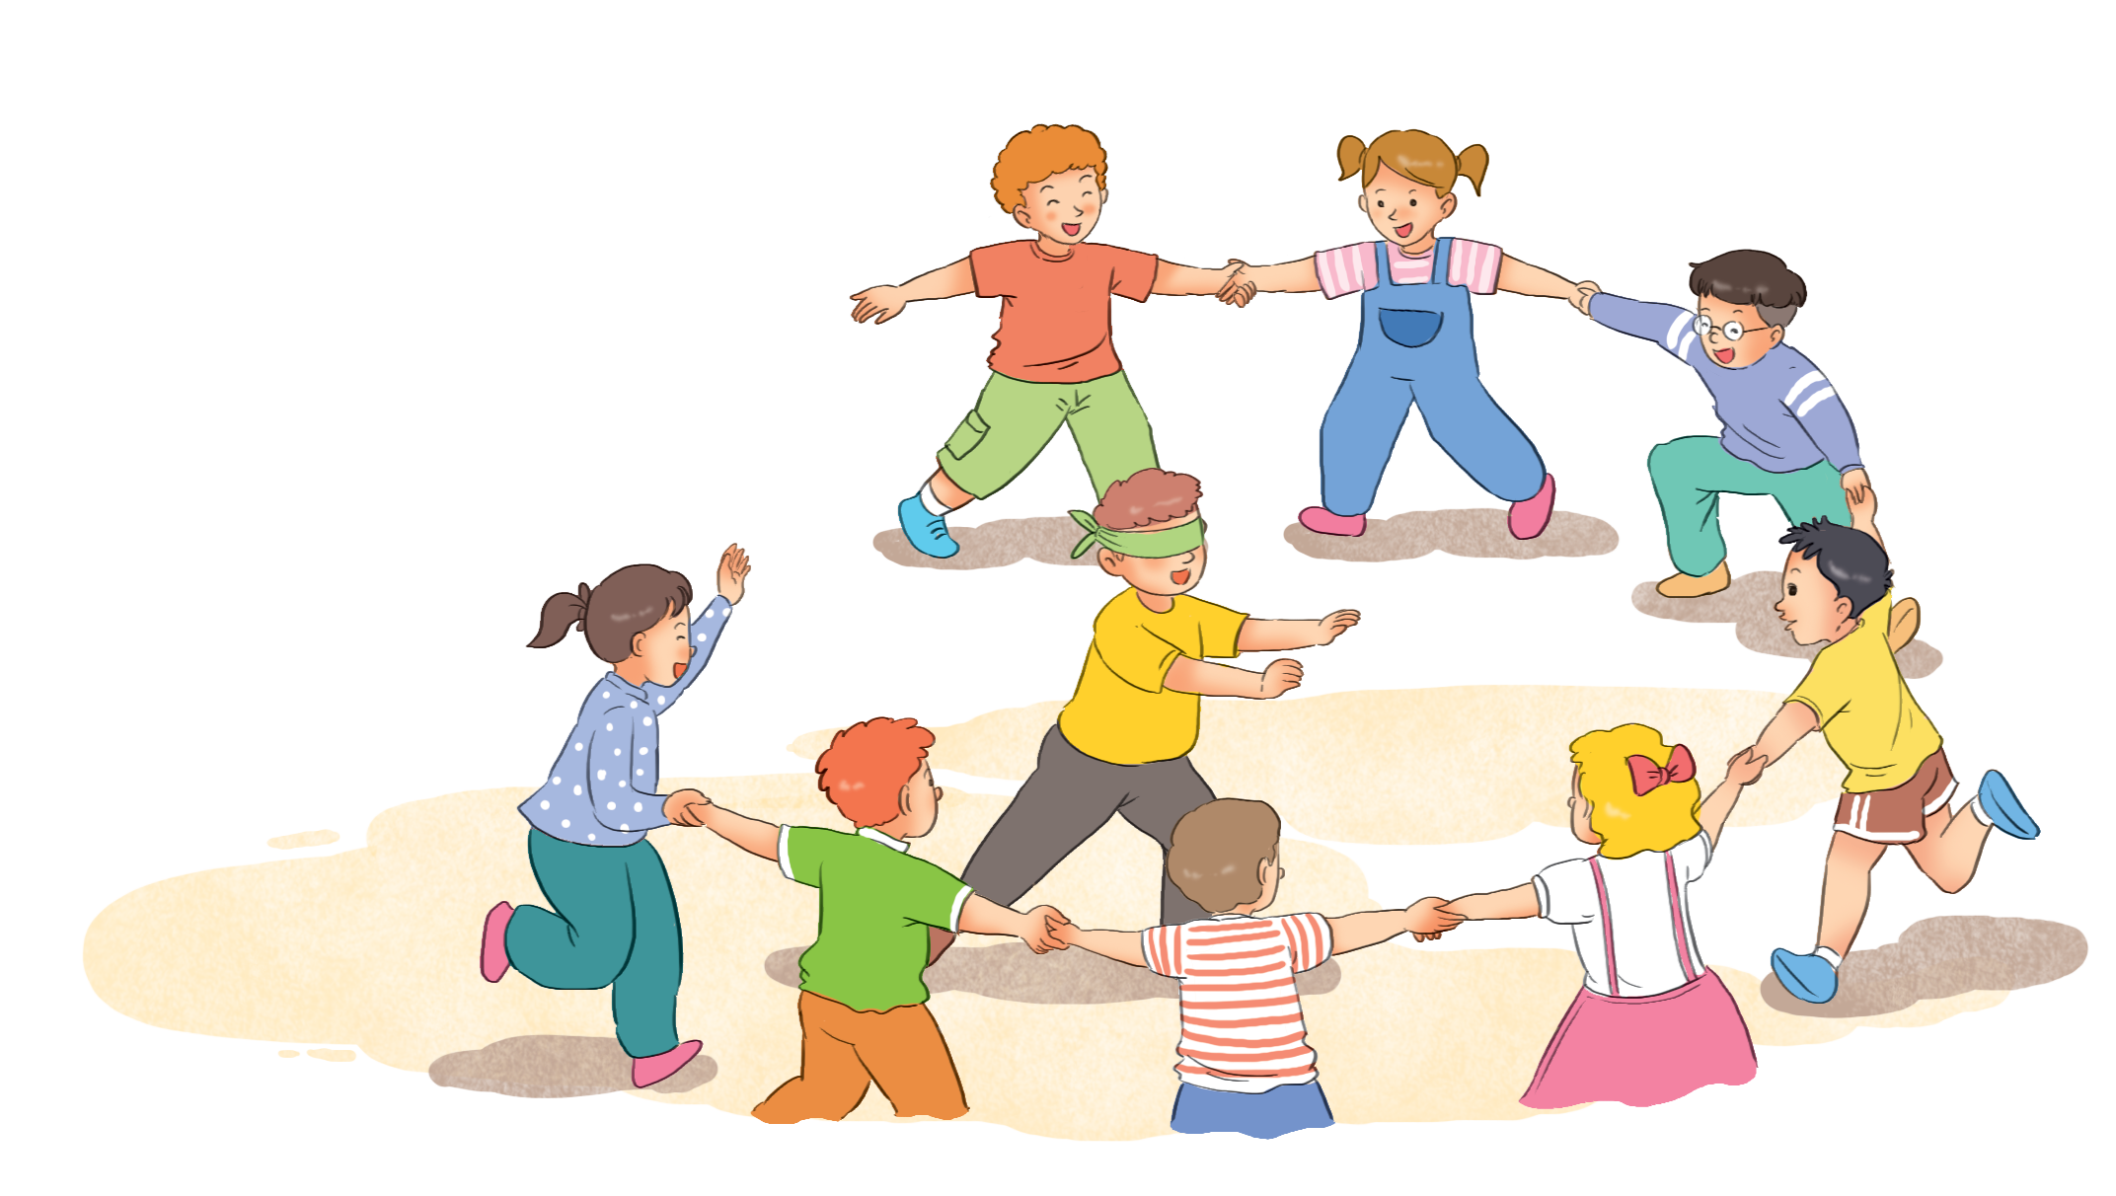
Choose one of the following games and write about it.
Tug of war (rope pulling)
Skipping
Wrestling
Cues:
Name of the game:
Number of players:
Equipment:
How to play:

Slide 20
Work in groups. Take turns to give presentation.

