Slide 1
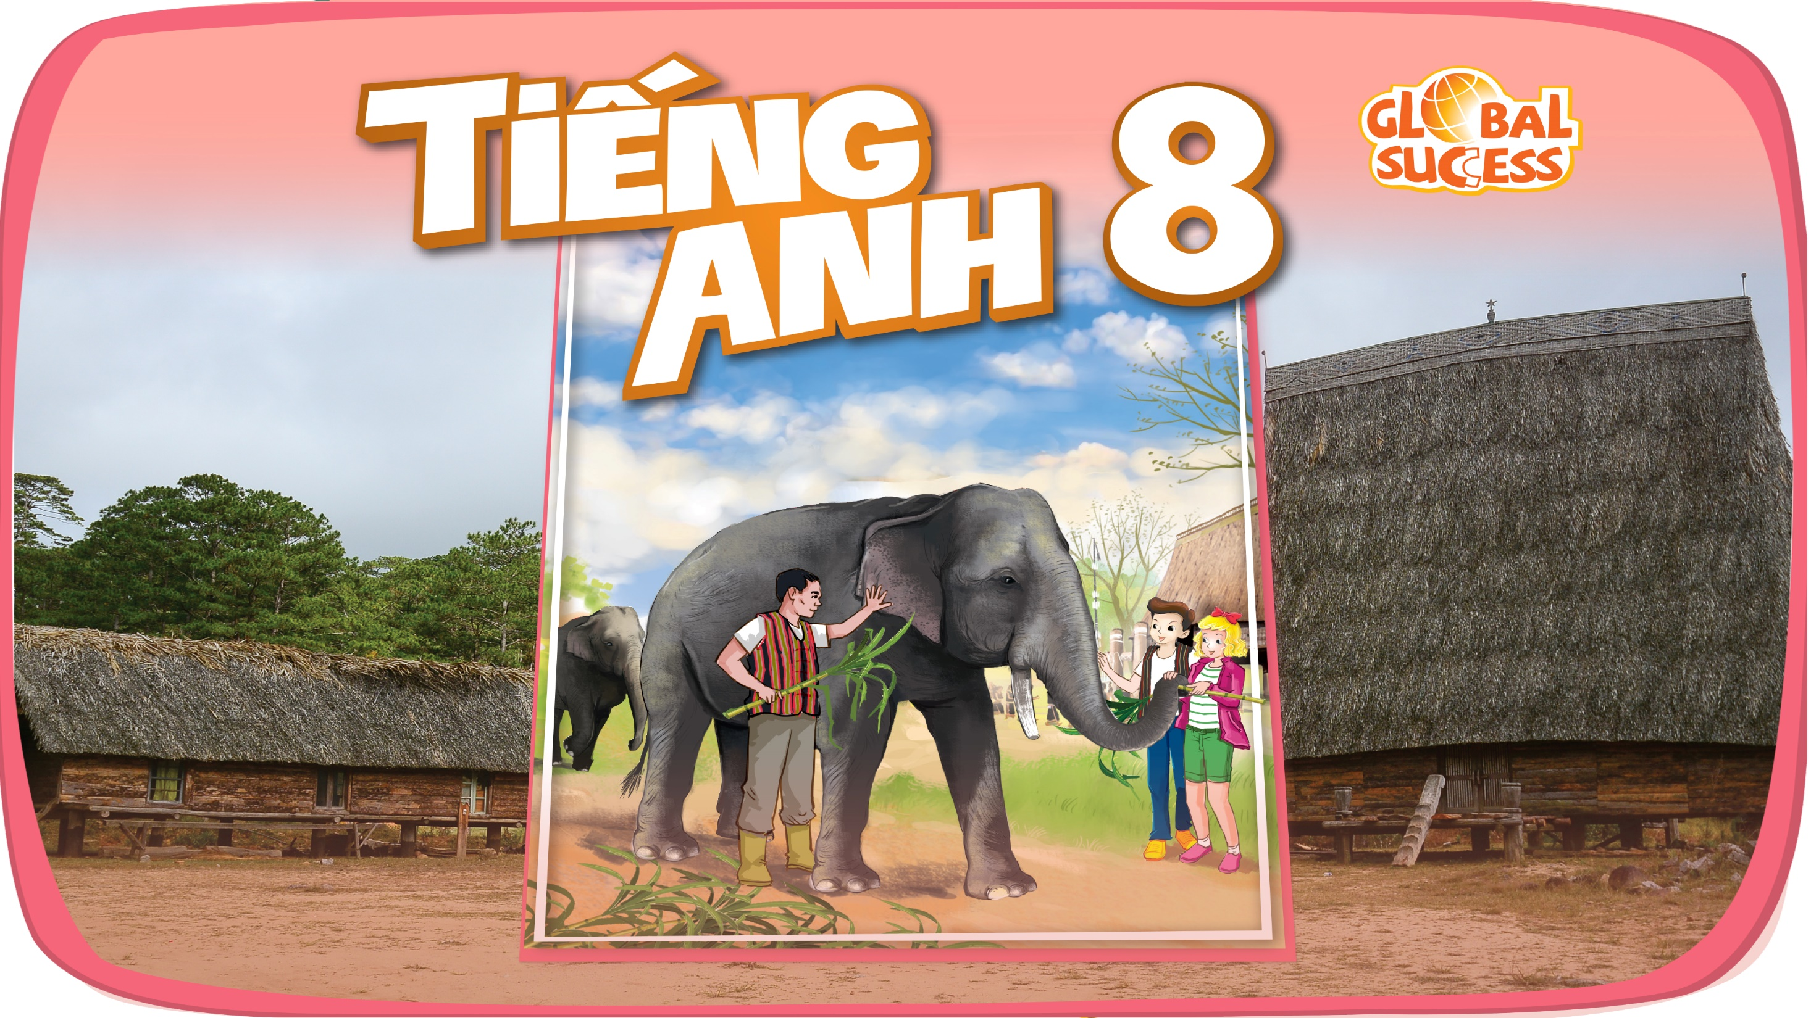

Slide 2
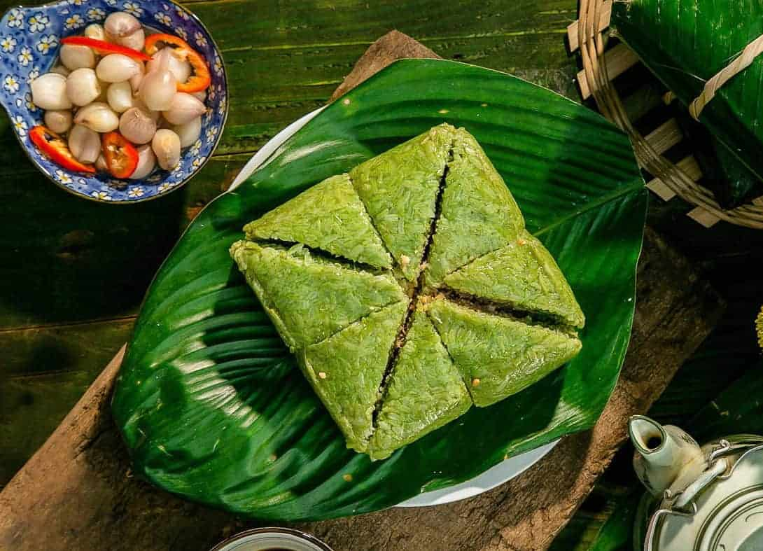
WARM-UP: GUESS THE FESTIVAL
TET ( LUNAR NEW YEAR)

Slide 3
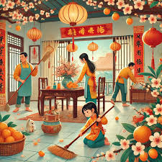
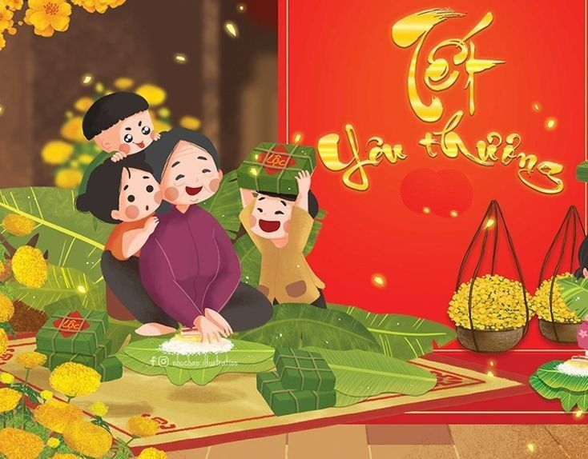
WARM-UP

Slide 4
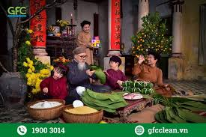
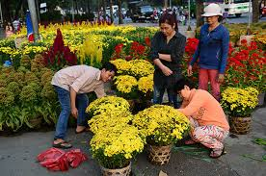
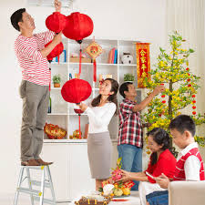
5
Unit 5
OUR CUSTOMS AND TRADITIONS
LESSON 1: GETTING STARTED
Tet is coming!

Slide 5

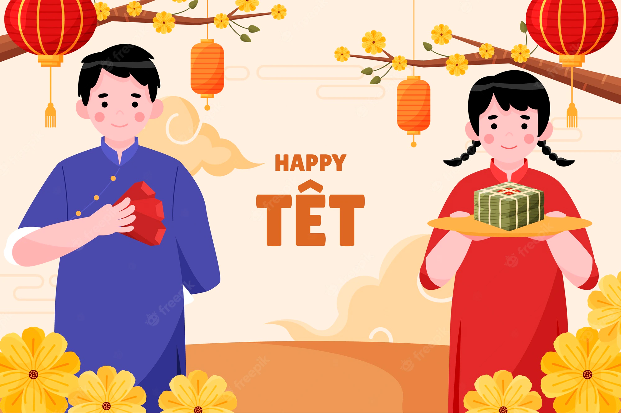
Unit
5
OUR CUSTOMS AND TRADITIONS
LESSON 1: GETTING STARTED
LESSON 1: GETTING STARTED
Tet is coming!

Slide 6

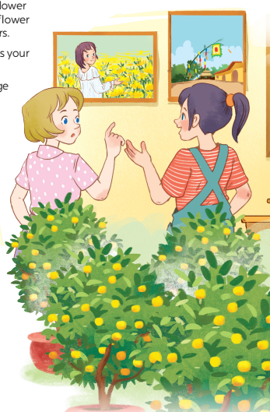

1
Listen and read.
1. What are Trangand Elena doing?
2. What are there in the photos ?

Slide 7
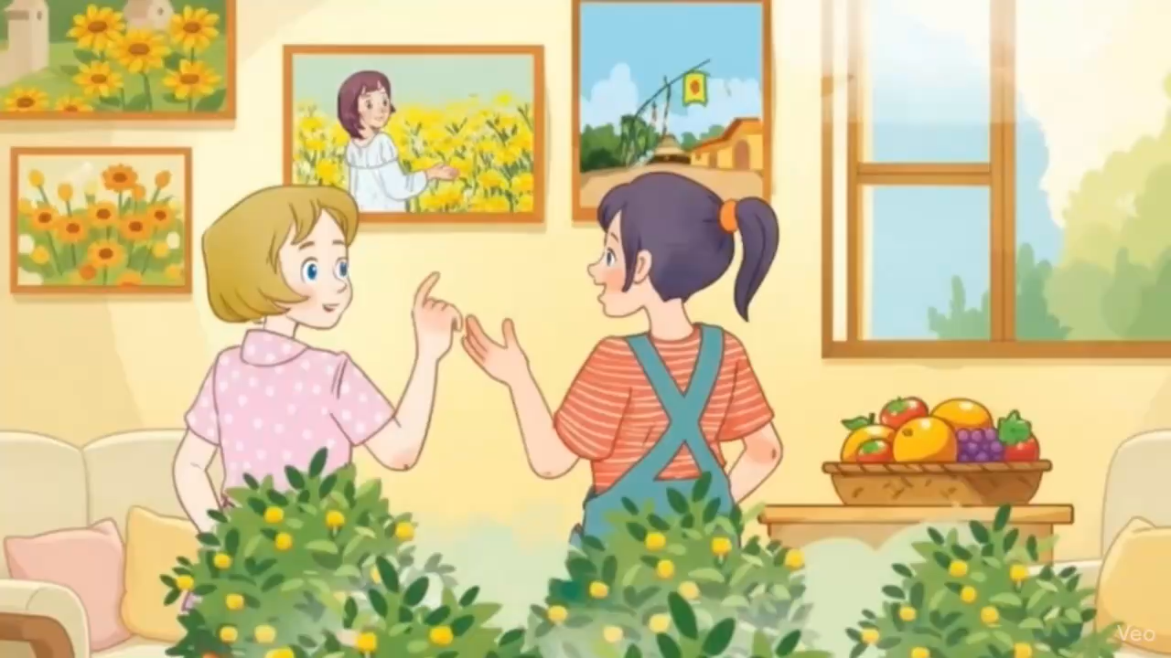

Slide 8
PRESENTATION
admire (v)
chiêm ngưỡng

Slide 9
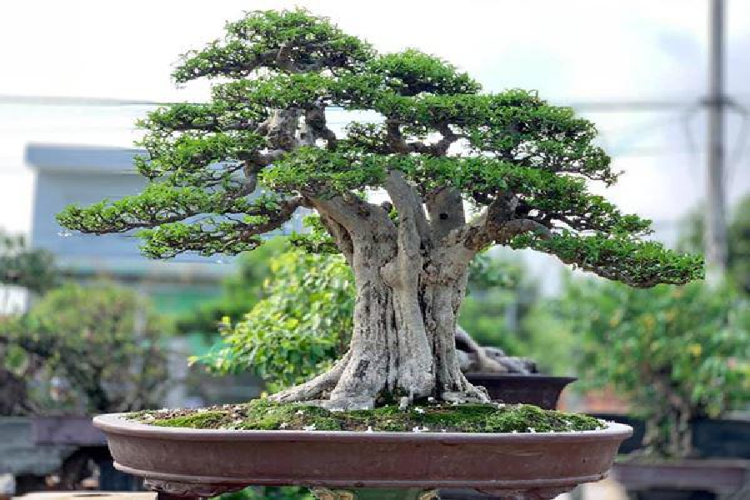
ornamental tree
cây cảnh

Slide 10
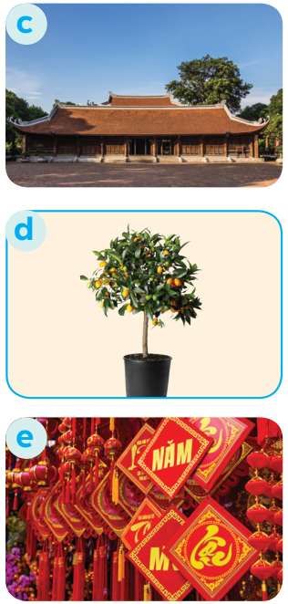
kumquat tree
cây quất

Slide 11
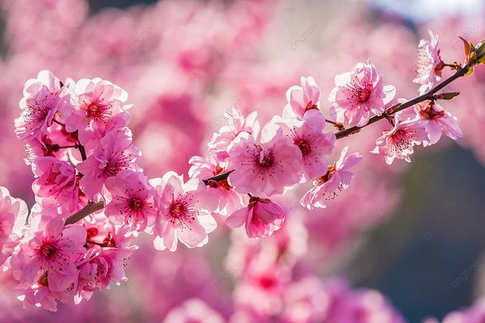
peach blossom

Slide 12
decoration

Slide 13
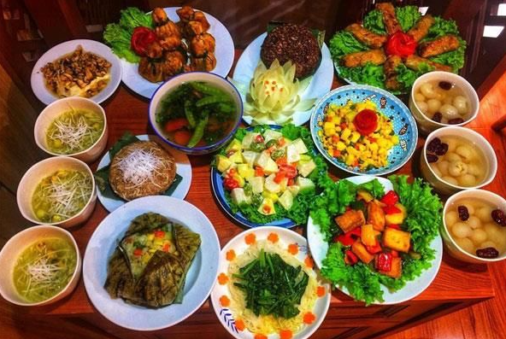
PRESENTATION
offering (n)
/ˈɒfərɪŋ/
đồ thờ cúng

Slide 14
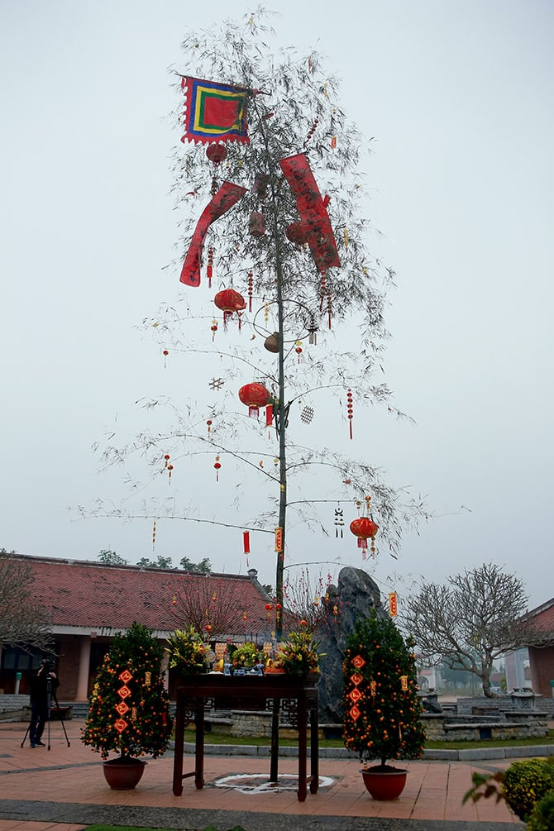
bamboo pole (n)

Slide 15
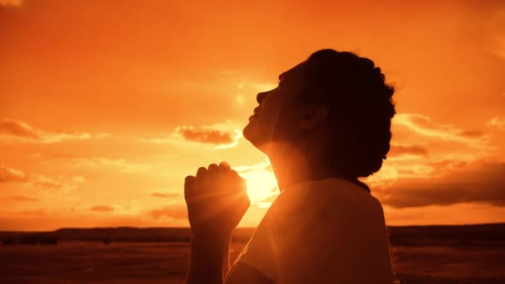
pray (v)
/preɪ/
cầu nguyện

Slide 16

PRESENTATION
chase away (v)
xua đuổi

Slide 17

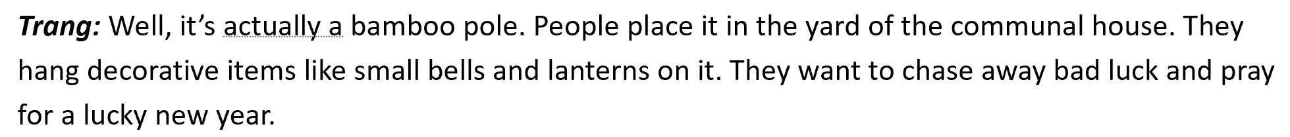
PRACTICE
2
Read the conversation again and tick T (True) or F (False).
Sentences | T | F
1. Elena and Trang are at Sa Dec Flower Village.
2. Many people visit ﬂower villages to take photos.
3. Trang’s family usually buys kumquat trees and peach blossoms at Nhat Tan Village.
4. Flowers are not part of any Vietnamese traditions.
5. People decorate bamboo poles with small bells and lanterns for New Years.
Trang’s cousin is at Sa Dec Flower Village
Plants and flowers are an important part of Tet

Slide 18
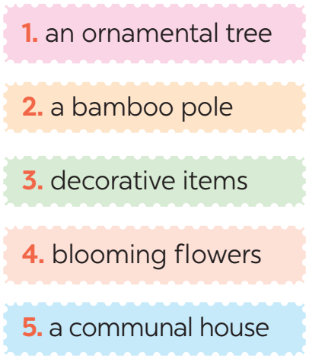
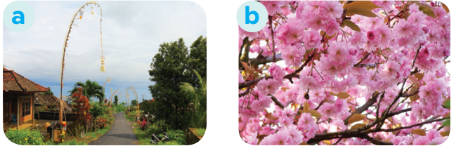
PRACTICE
3
Match the phrases with the correct pictures.

Slide 19
PRACTICE
3

Slide 20
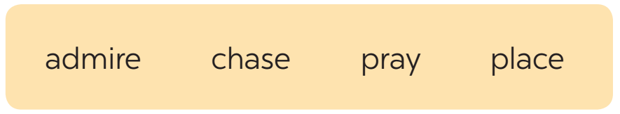
PRACTICE
4
Complete the sentences with the verbs from the box.
1. The British decorate their Christmas trees and ______ presents under them.
2. Tom likes to ______ the view from the hill.
3. In many cultures, knocking on wood is a way to ______ away bad spirits.
4. Many Asians go to Buddhist temples to ______ for good luck.
place
admire
chase
pray

Slide 21

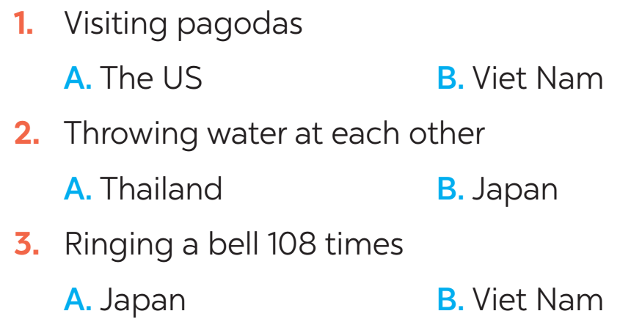
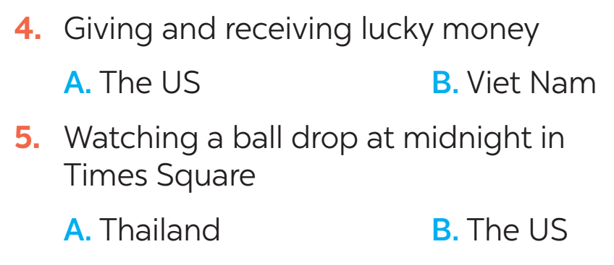
FURTHER PRACTICE
5
New Years around the world.
People around the world celebrate New Years differently. Choose the tradition below.

Slide 22
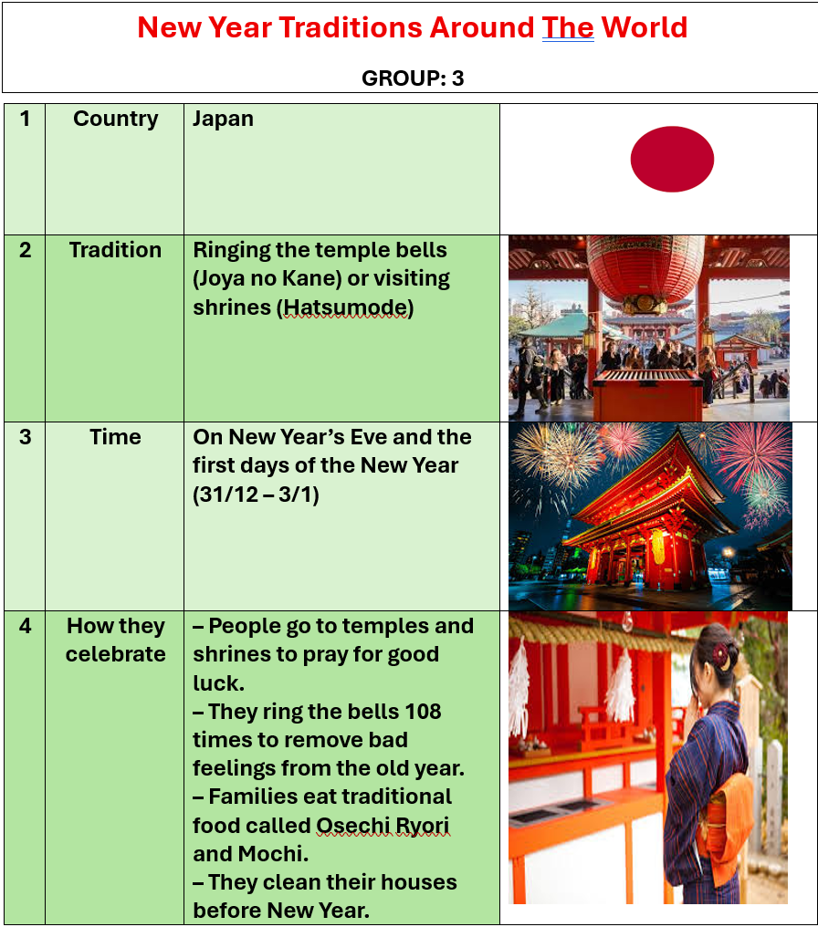
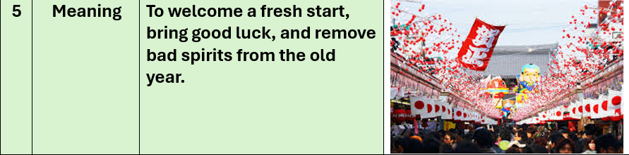
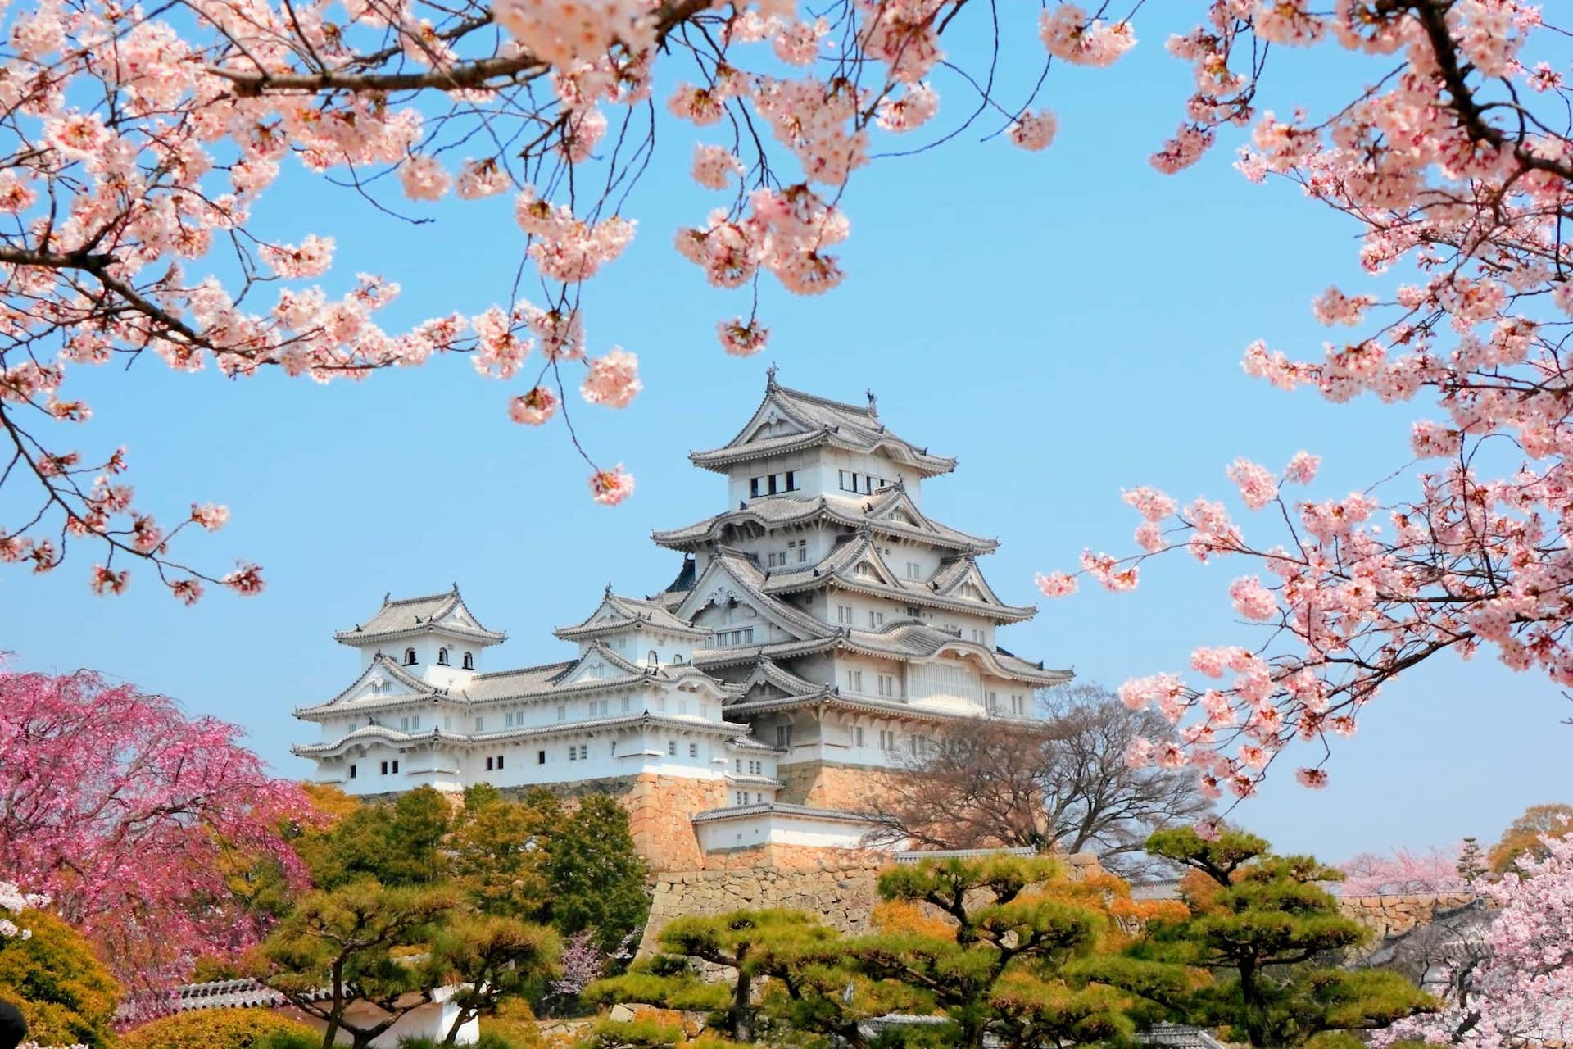

Slide 23
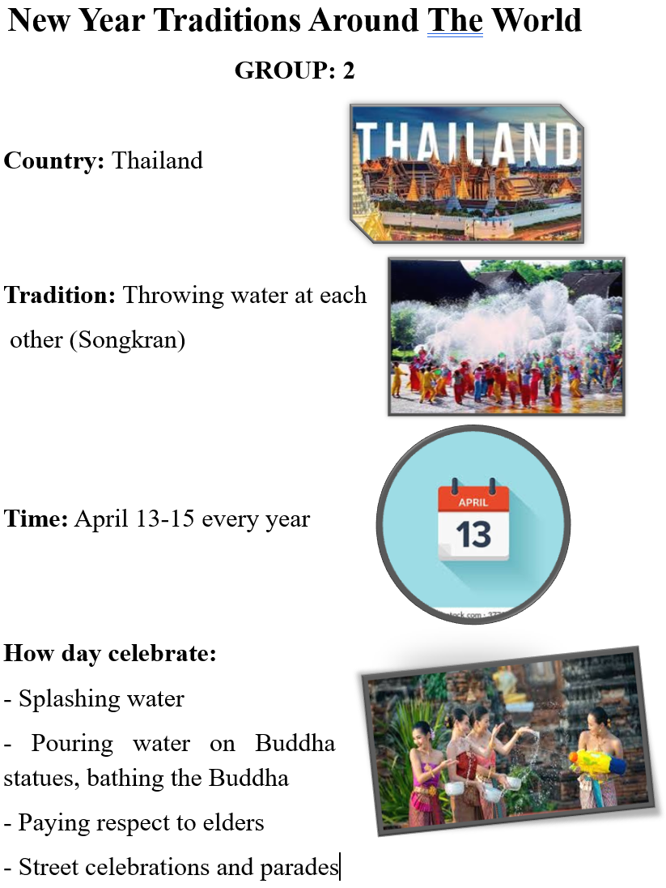
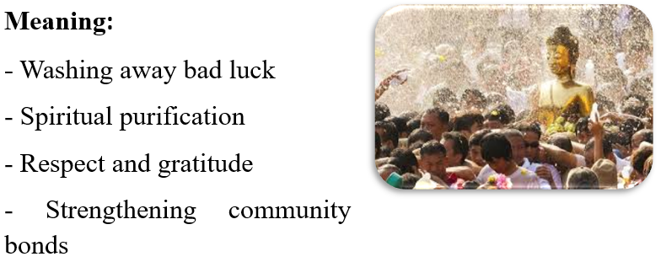
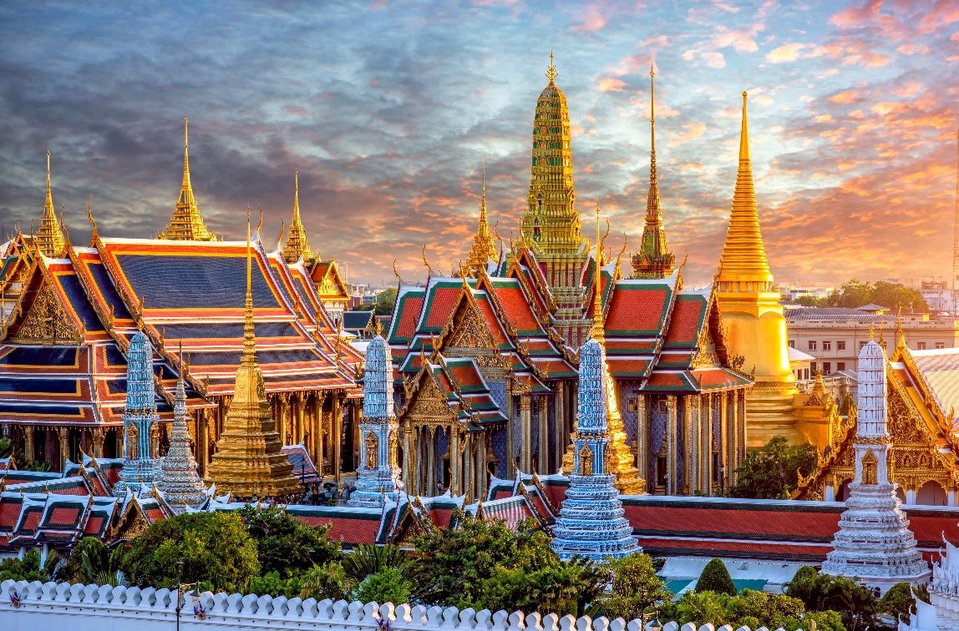

Slide 24
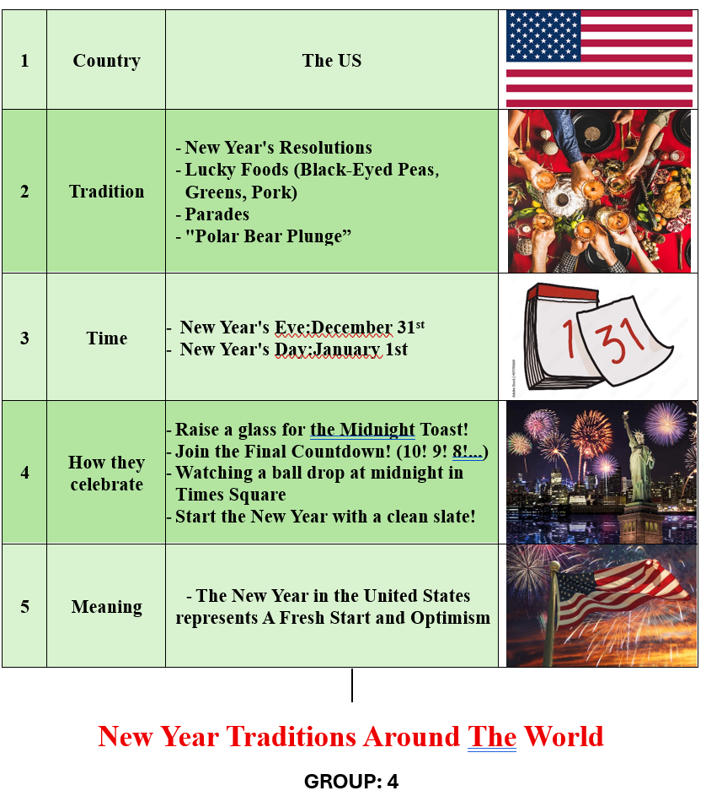
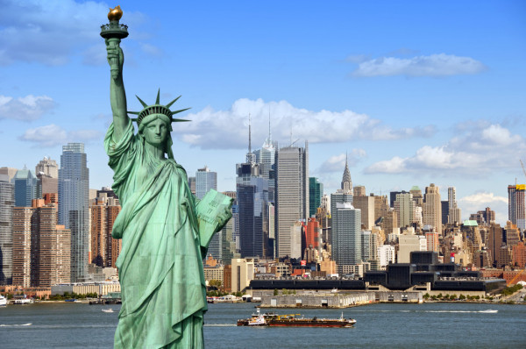

Slide 25
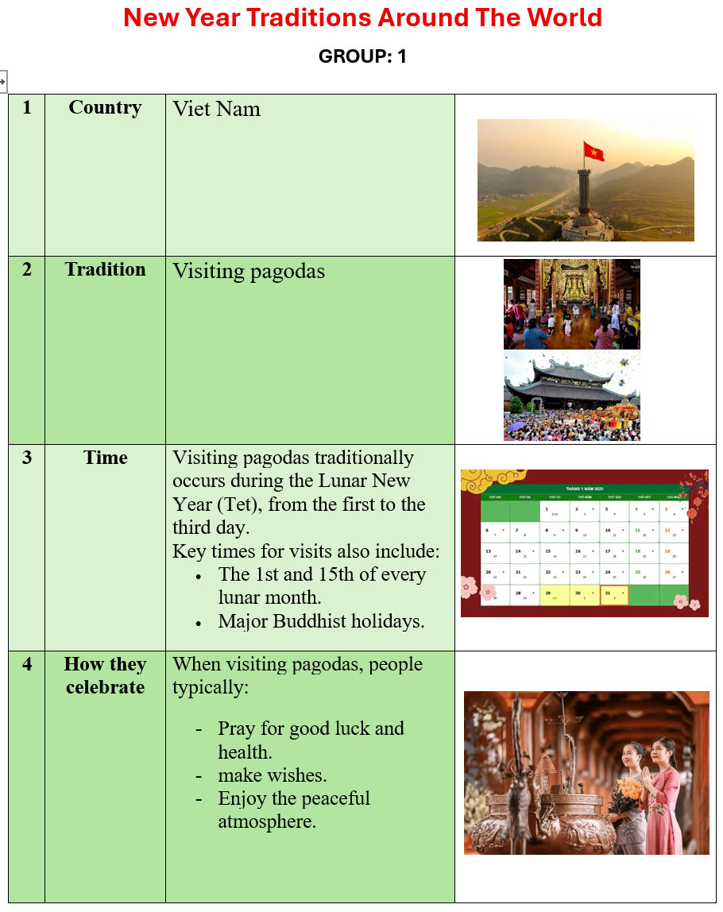
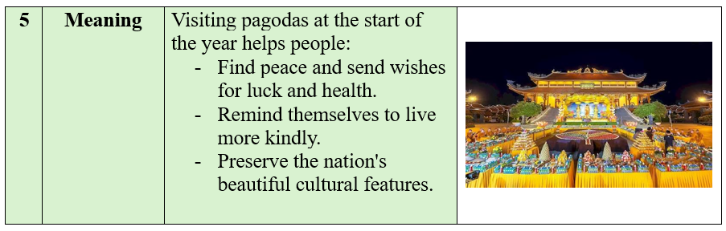

Slide 26
FURTHER PRACTICE
5
New Years around the world.
People around the world celebrate New Years differently. Choose the tradition below.

Slide 27

CONSOLIDATION
1
Wrap-up
What have we learnt in this lesson?
identify the topic of the unit
use lexical items related to Tet holiday

Slide 28

CONSOLIDATION
2
Homework
- Learn the new words by heart.
- Practise talking about Tet Holiday.

Slide 29

Website: hoclieu.vn
Fanpage: facebook.com/www.tienganhglobalsuccess.vn/

