Slide 2
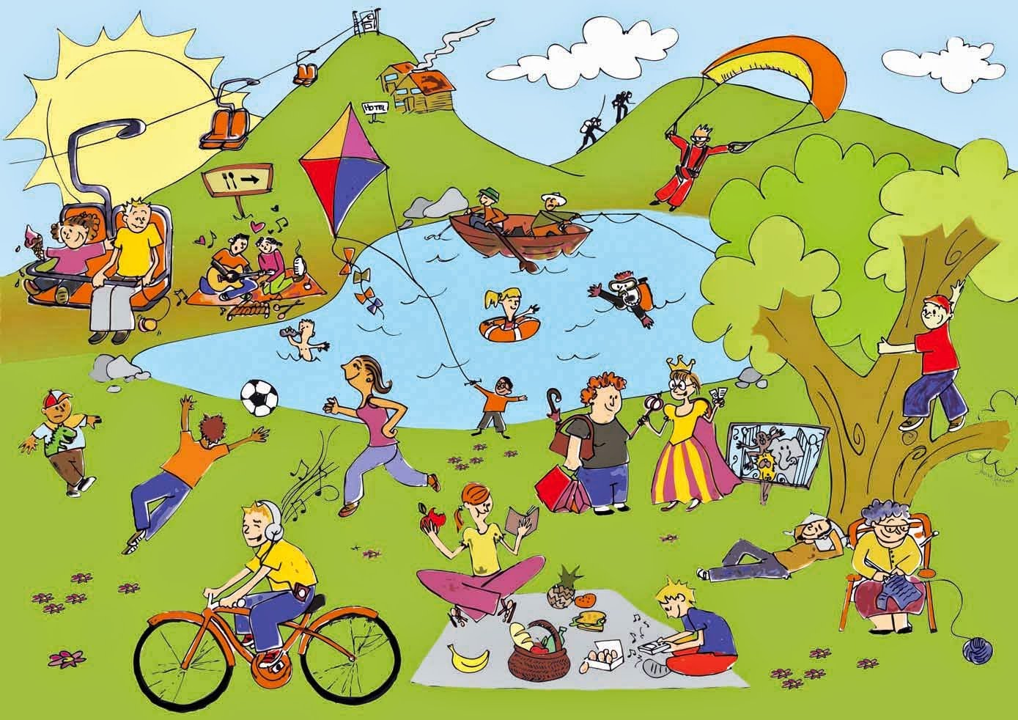
Unit
1
LEISURE TIME
LESSON 6: SKILLS 2
1

Slide 3
I. LISTENING
1
Answer the questions.
1. In your opinion, what activities can we do with our friends in our leisure time?
2. Why should we spend time
with our friends?

Slide 4
2
Listen to an interview with Mark about his leisure activities. Choose the correct answer.
1. When does Mark usually have free time?
A. At weekends. B. On Sundays. C. On Saturdays.
2. Who does he spend his free time with?
A. His neighbours and friends.
B. His family and relatives. C. His family and friends.

Slide 5
3
Listen to the interview again. Fill in each blank in the table with no more than two words.
Activities | Reason
Inviting friends to his house Cooking and watching a (1) ______ | Fun and better than going to the (2) ________
Going to the (3) ______ to play volleyball or skateboard | Stay in (4) ______
Going for a (5) ________ around our city | See different (6) ______
video
cinema
park
shape
bike ride
places

Slide 6
II. WRITING
4
Work in pairs. Ask and answer the questions.
Sample answers
Questions
1. When do you usually have free time?
2. What do you usually do with your friends in your free time?
3. Why do you do these activities?
1. I usually have free time at weekends.
2. I usually cook, play badminton, cycle around the park.
3. We do these activities because they help us improve our health and help reduce stress.

Slide 7
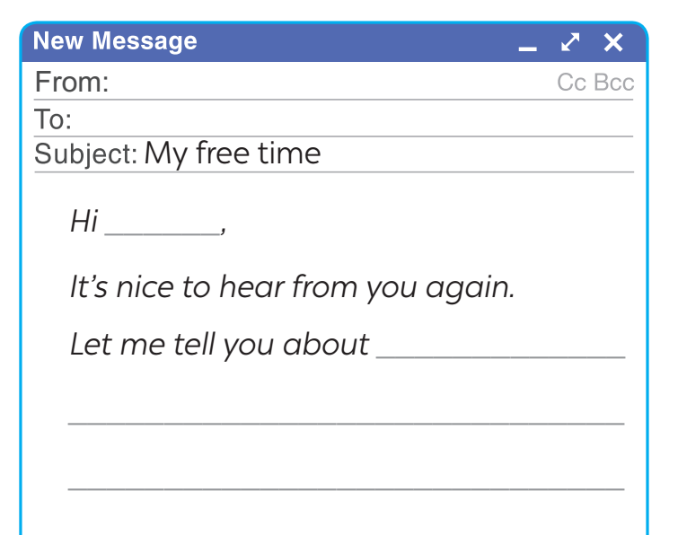
5. Write an email (80 - 100 words) to a penfriend to tell him / her about what you usually do with your friends in your free time. Use your answers in 4. Start and end the email as follows:

Slide 8
Hi Tom,
It’s nice to hear from you again.
Let me tell you about the activities I usually do with my friends in my free time. I usually have free time at weekends. I often spend Sunday mornings with my friends. On Sunday mornings, we usually play badminton together for about one hour in the playground. We are keen on cycling, so we often cycle around the park every Sunday afternoon. We also enjoy doing DIY together. We love to make paper flowers. We do these activities because they improve our health and help reduce stress.
What about you? What do you usually do with your friends in your free time?
Tell me in your next email.
Bye for now,
An

Slide 9
CONSOLIDATION
1
Wrap-up
What have we learnt in this lesson?
Listen to someone talking about their leisure activities
Write an email to talk about leisure activities

Slide 10
CONSOLIDATION
2
Homework
Do exercises in the workbook.

Slide 11
Website: hoclieu.vn
Fanpage: facebook.com/www.tienganhglobalsuccess.vn/

Slide 12
There are some things I like about life in the countryside. First, it is a peaceful place with fresh air. We can enjoy a healthy natural condition without worrying much about air pollution. We can do things that are hard to do in the city. We can go swimming, play football, fly kites and do other interesting things. Second, life in the countryside is a safer place than a city. Because most of the villagers are friendly and willing to help each other. Finally, I like living in the countryside because the cost of living here is usually cheaper than in the city. In short, life in the countryside is the best choice for people to live.

Slide 13
How to play:
One student goes to the board and gets one activity from the teacher.
This student acts the activity without saying.
The rest of class guess the activity.
HOT SEAT

