Slide 2
Unit
5
LOCAL COMMUNITY
LESSON 1: GETTING STARTED
Experiences in Da Lat
1

Slide 3
LESSON 1: GETTING STARTED
LESSON 1: GETTING STARTED
WARM-UP
Asking questions
Vocabulary
PRESENTATION
Task 1: Listen and read.
Task 2: Read the conversation again and circle the correct answers.
Task 3: Write the expressions from the conversation in the correct column.
Task 4: Complete the sentences with the words from the box.
PRACTICE
Task 5: Work in pairs. Decide if the statements below are True or False about life in Viet Nam 40 years ago. Share your answers with the class.
PRODUCTION
CONSOLIDATION
Wrap-up
Homework

Slide 4
WARM-UP
Answer the questions:
1. Work in 2 teams.
2. Look through the conversation and the picture in page 50 in 30 seconds and try to remember as many details as possible.
3. Answer the questions.
4. 10 points/correct answer
Memorizing game

Slide 5
WARM-UP
Answer the questions:
1. How many people can you see in the picture?
2. What type of vehicle are they riding?
3. Where are they?
6 people
Memorizing game
A jeep
Da Lat /Langbiang mountain

Slide 6
PRESENTATION
experience (n)
/ɪkˈspɪəriəns/
sự trải nghiệm

Slide 7
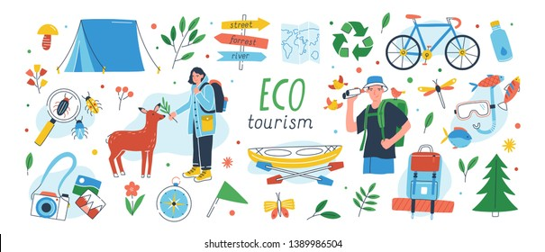
PRESENTATION
eco-tour (n)
/ˈiːkə-tʊə(r)/
du lịch sinh thái

Slide 8
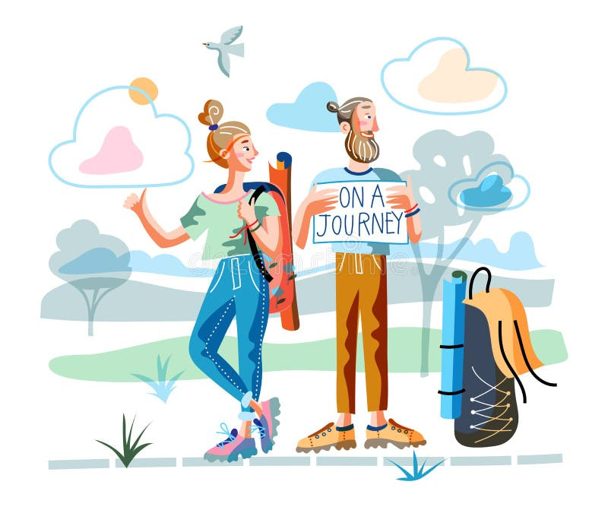
PRESENTATION
memorable (n)
/ˈmemərəbl/
đáng nhớ

Slide 9
PRESENTATION
brilliant (adj)
/ˈbrɪliənt/
rất ấn tượng

Slide 10
PRESENTATION
flora (n)
/ˈflɔːrə/
tất cả thực vật của một khu vực

Slide 11
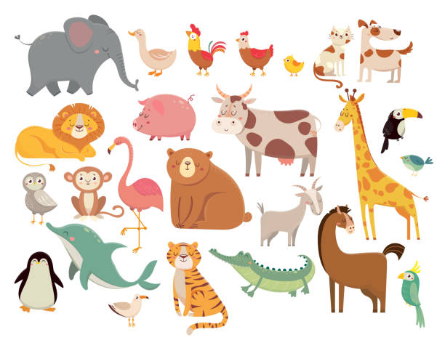
PRESENTATION
fauna (n)
/ˈfɔːnə/
tất cả động vật của một khu vực

Slide 12
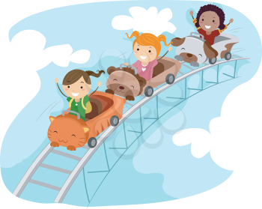
PRESENTATION
thrilling (adj)
/ˈθrɪlɪŋ/
phấn khích

Slide 13
PRESENTATION
explore (V)
/ɪkˈsplɔː(r)/
khám phá

Slide 14
PRESENTATION
seabed (n)
/ˈsi:bed/
đáy biển

Slide 15
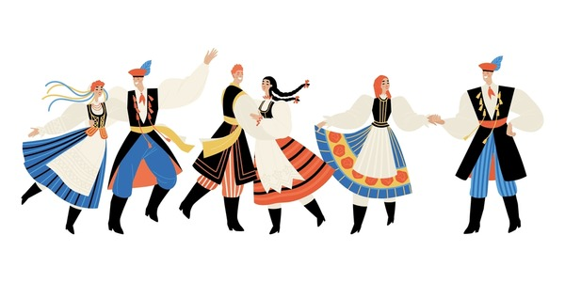
PRESENTATION
tribal dance (n)
/ˈtraɪbl dɑːns/
điệu múa của bộ tộc

Slide 16
PRESENTATION
New words | Pronunciation | Meaning
1. experience (n) | /ɪkˈspɪəriəns/ | sự trải nghiệm
2. eco-tour (n) | /ˈiːkə-tʊə(r)/ | du lịch sinh thái
3. memorable (adj) | / ˈmemərəbl/ | đáng nhớ
4. brilliant (adj) | /ˈbrɪliənt/ | rất ấn tượng
5. flora (n) | /ˈflɔːrə/ | tất cả thực vật của một khu vực

Slide 17
PRESENTATION
New words | Pronunciation | Meaning
6. fauna (n) | /ˈfɔːnə/ | tất cả động vật của một khu vực
7. thrilling (adj) | /ˈθrɪlɪŋ/ | phấn khích
8. explore (v) | /ɪkˈsplɔː(r)/ | khám phá
9. seabed (n) | /ˈsi:bed/ | đáy biển
10. tribal dance (n) | /ˈtraɪbl dɑːns/ | điệu múa của bộ tộc

Slide 18
PRACTICE
1
Listen and read.
Tom: Hi Mi, I’m back from Da Lat now. I have some local specialities for you.
Mi: Thanks Tom. I guess you and your family had a great time there.
Tom: Yeah. We visited LangBiang Mountain, and Cu Lan Village. We saw a gong show in the evening.
Mi: What did you do on LangBiang Mountain?
Tom: We rode a jeep to the top. It was a thrilling ride up there. Then we took an eco-tour of LangBiang Mountain. They said that the area is rich in flora and fauna with more than 150 plant and animal species.
Mi: Sounds amazing! What did you do then?
Tom: We took pictures of the magnificent scenery. It was really enjoyable!
Mi: Then did you explore Cu Lan Village?
Tom: Yes. We had a brilliant tour around the village. We also rode horses and a jeep along a stream.
Mi: That must have been exciting, Tom.
Tom: It definitely was. In the evening we saw an interesting gong show. We danced and sang with the locals. And we tried grilled pork. It was a really memorable evening. I’ll show you some pictures I took there.

Slide 19
PRACTICE
2
Read the conversation again and write T (true) or F (False).
F
1. Mi and Tom had a great time in Da Lat. ______
2. Tom had an eco-tour of Langbiang Mountain. ______
3. There are more than 150 plant and animal species ______
on Langbiang Mountain.
4. Tom didn’t like his experiences in Cu Lan Village. ______
5. Tom danced and sang with the local people ______
at a gong show.
T
T
F
T

Slide 20
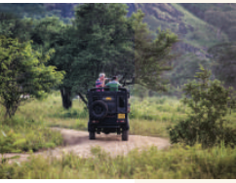
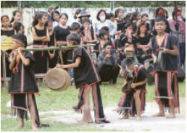
PRACTICE
3
Write activities under the pictures.
riding a jeep
seeing a gong show
1. _______________
2. _______________

Slide 21
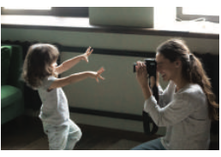
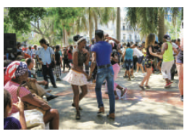
PRACTICE
3
Write activities under the pictures.
taking photos
dancing with local people
3. _______________
4. _______________

Slide 22
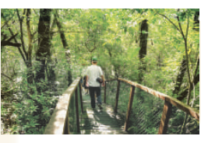
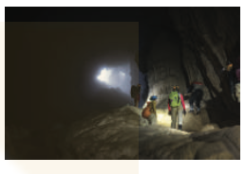
PRACTICE
3
Write activities under the pictures.
taking an eco-tour
exploring a site
5. _______________
6. _______________

Slide 23
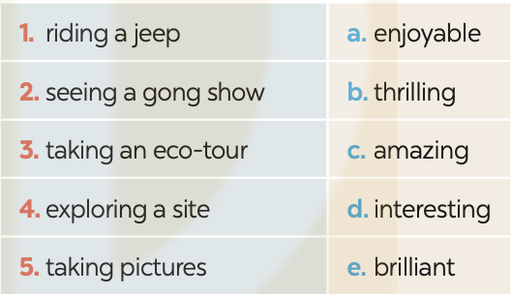
PRACTICE
4
Read the conversation again and match the activities with the adjectives.

Slide 24
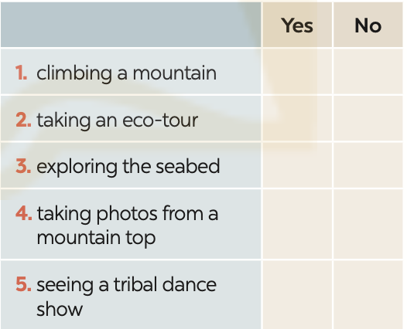
PRODUCTION
5
Work in groups. Carry out a survey. Then report your group’s findings to the class. Do you like ...?
Example:
I did a survey with 3 peers. Two like climbing a mountain, 3 like taking eco-tours, nobody likes exploring the seabed….

Slide 25
CONSOLIDATION
1
Wrap-up
What have we learnt in this lesson?
identify the topic of the unit
use lexical items related to experiences
identify the language features that are covered in the unit

Slide 26
CONSOLIDATION
2
Homework
Do exercises in the workbook.
Make a list of adjectives to describe experience.
Start preparing for the Project of the unit 5.

Slide 27
Website: hoclieu.vn
Fanpage: facebook.com/www.tienganhglobalsuccess.vn/

