Slide 2
UNIT 6: CON’T
LESSON 3: A CLOSER LOOK 1

Slide 3
I. New words
entrance examination/ exam:
final exam :
midterm test:
outdoor activity:
# indoor activity:
5. gifted student:
6. take an examination/ exam
7. pass the exam
# fail the exam
8. facility:

Slide 4
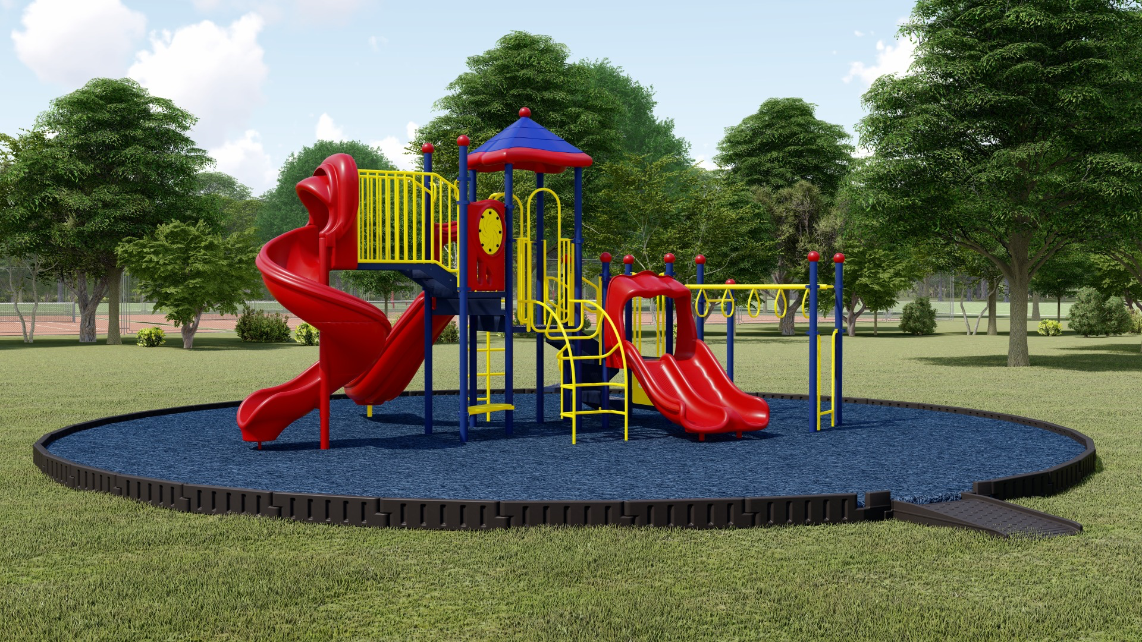
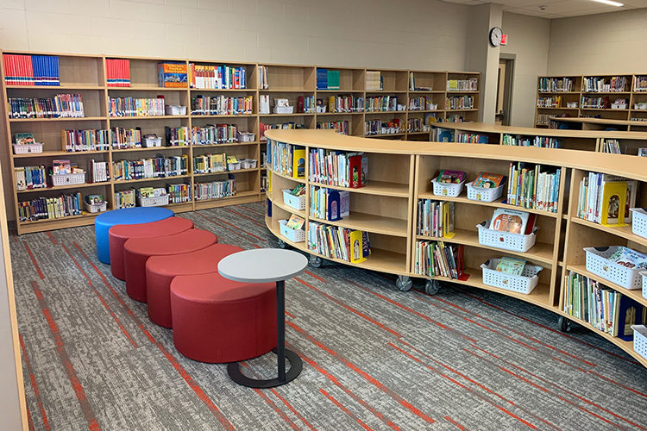
WARM-UP
school playground
school library
computer room

Slide 5
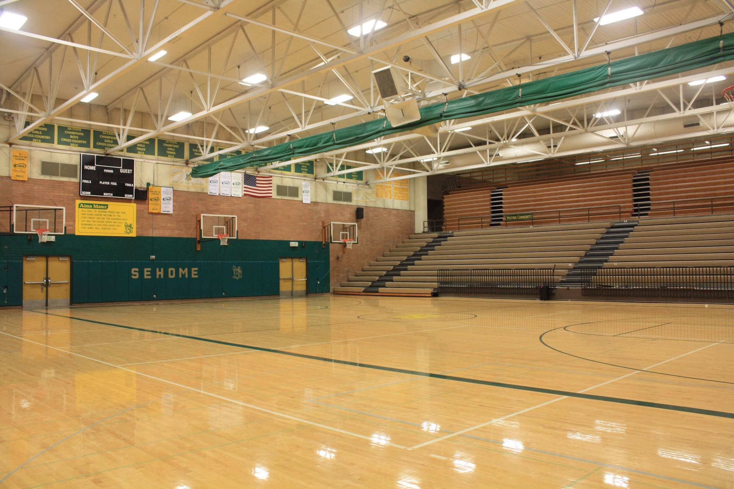
WARM-UP
gym
science lab

Slide 6
VOCABULARY
1
Match the words in columns A and B to form phrases. Then say them aloud.
A | B
1. entrance | a. students
2. school | b. activities
3. outdoor | c. facilities
4. midterm | d. examination
5. gifted | e. test
1. d
2. c
3. b
4. e
5. a

Slide 7
VOCABULARY
2
Complete the sentences with the phrases in Task 1.
1. Binh Minh Lower Secondary School is for _____________ in the city. 2. Our ____________ usually covers the first three units. 3. Students in my school take part in many _______________ during the school year. 4. Our school has a lot of modern _____________.
5. In order to study in Quoc Hoc – Hue you have to pass a(n) __________________.
gifted students
midterm test
outdoor activities
school facilities
entrance examination

Slide 8
VOCABULARY
3
Work in pairs. Answer the questions about your school.
Can you name some gifted student in your school?
When does the first-term test take place?
Do you have to take an entrance examination to study at your school?
What kind of facilities does your school have?
What types of outdoor activities do you like to take part in?

Slide 9
LESSON 2: A CLOSER LOOK 1
WARM-UP
Game: Pass the secret
Task 1: Match the words in columns A and B to form phrases. Then say them aloud.
Task 2: Complete the sentences with the phrases in 1. Task 3: Work in pairs. Answer the questions about your school.
VOCABULARY
Task 4: Listen and repeat the words. What letters can we use to make the /dʒ/ sound?
Task 5: Listen and repeat the chant. Pay attention to the sounds /tʃ/ and /dʒ/.
PRONUNCIATION

Slide 10
PRONUNCIATION
/tʃ/ and /dʒ/
Aims of the stage:
to let students listen and notice the targeted sounds in individual words
to let students practice pronouncing the targeted sounds in sentences

Slide 11
PRONUNCIATION
4
Listen and repeat the words. What letters can we use to make the /dʒ/ sound?
/tʃ/ | /dʒ/
cherry cheaper children lunch teacher | jam gym juice large project intelligent
Notes:
Link video hướng dẫn phát âm: https://www.youtube.com/watch?v=Oq_9Hq-U8W0&t=2s

Slide 12
PRONUNCIATION
5
Listen and repeat the chant. Pay attention to the sounds /tʃ/ and /dʒ/.
Orange juice, orange juice,
Who likes orange juice?
Children do, children do.
Children like orange juice.
Chicken chop, chicken chop,
Who likes chicken chop?
John does, John does.
John likes chicken chop.
Notes:
Link video hướng dẫn phát âm: https://www.youtube.com/watch?v=Oq_9Hq-U8W0&t=2s

Slide 13
LESSON 2: A CLOSER LOOK 1
WARM-UP
Game: Pass the secret
Task 1: Match the words in columns A and B to form phrases. Then say them aloud.
Task 2: Complete the sentences with the phrases in 1. Task 3: Work in pairs. Answer the questions about your school.
VOCABULARY
Task 4: Listen and repeat the words. What letters can we use to make the /dʒ/ sound?
Task 5: Listen and repeat the chant. Pay attention to the sounds /tʃ/ and /dʒ/.
PRONUNCIATION
PRODUCTION
Game: Up and down

Slide 14
PRODUCTION
Game: Up and down
/tʃ/ | /dʒ/
maturity
teenager
exchange
project
chapped
jogging
kitchen
originate
picture
jeep

Slide 15
LESSON 2: A CLOSER LOOK 1
WARM-UP
Game: Pass the secret
Task 1: Match the words in columns A and B to form phrases. Then say them aloud.
Task 2: Complete the sentences with the phrases in 1. Task 3: Work in pairs. Answer the questions about your school.
VOCABULARY
Task 4: Listen and repeat the words. What letters can we use to make the /dʒ/ sound?
Task 5: Listen and repeat the chant. Pay attention to the sounds /tʃ/ and /dʒ/.
PRONUNCIATION
PRODUCTION
Game: Up and down
CONSOLIDATION
Wrap-up
Homework

Slide 16
CONSOLIDATION
1
WRAP-UP
VOCABULARY
PRONUNCIATION

Slide 17
CONSOLIDATION
2
HOMEWORK
Find some more words having the sounds /tʃ/ and /dʒ/.

Slide 18
Website: sachmem.vn
Fanpage: facebook.com/sachmem.vn/

