Slide 2
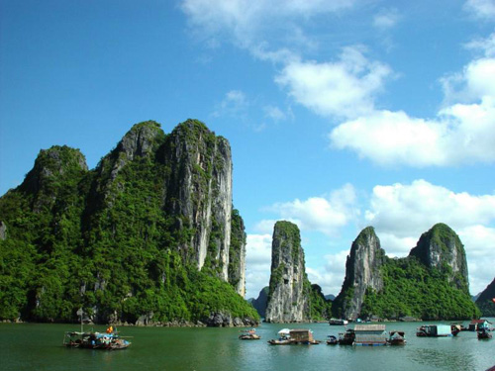
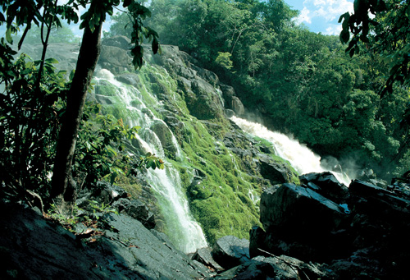
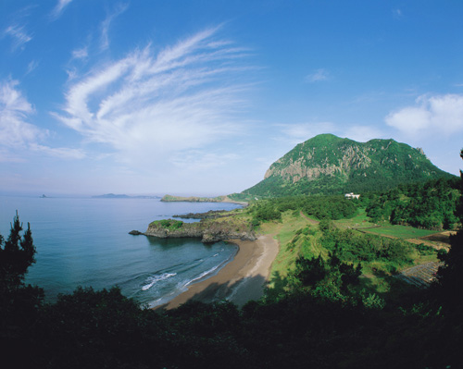
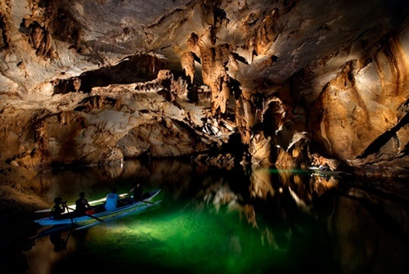
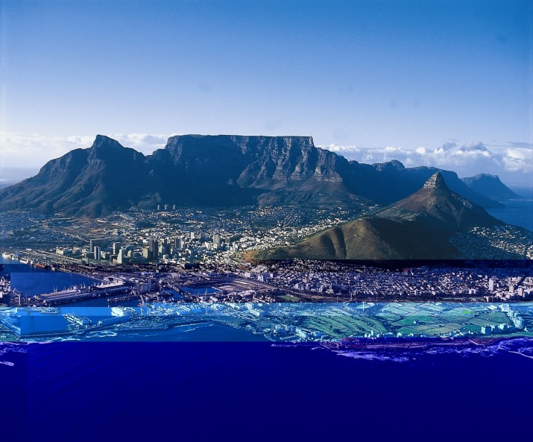
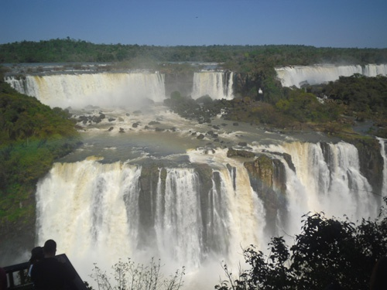
1. Ha Long Bay
2. Amazon rainforest
3. Jeju Island - Hàn Quốc
4. Underground river.
Princesa (Philippines)
5.Table Mountain –Châu phi
6. Waterfall - Brazil

Slide 3
Unit 5: Natural wonders of Viet Nam
LESSON 1: GETTING STARTED

Slide 4
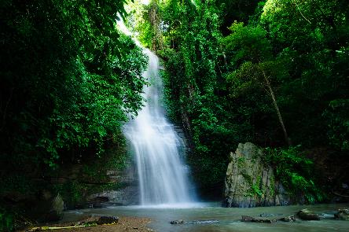
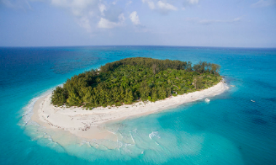
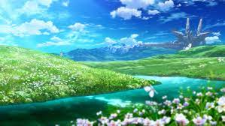
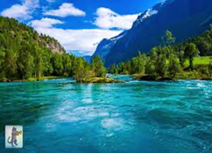
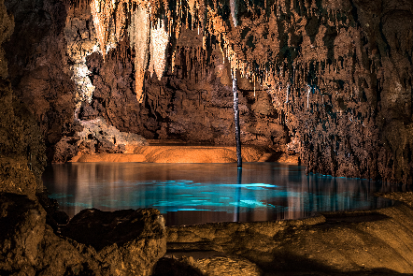
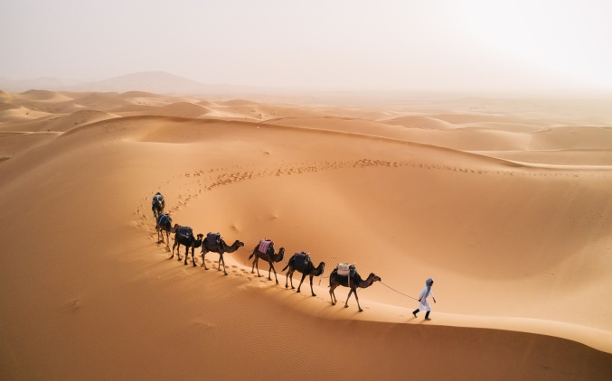
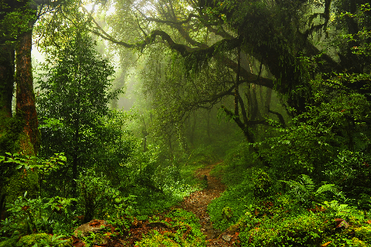
* New words:
- natural wonders :
kì quan thiên nhiên
- scenery (n):
phong cảnh
- islands :
hòn đảo
- desert :
sa mạc
- cave:
hang động
- waterfall:
thác nước
khu rừng
- forest:

Slide 5
* Checking vocab
What and Where
natural
wonders
forest
desert
scenery
islands
waterfall
cave

Slide 6
Listen and read.
Geopraphy Club
They are Alice, Elena and Nick.
1. Who are they?
2. What are they looking at?
3. What are they talking about?
They are looking at some photos/ pictures.
They are talking about attractive places in Viet Nam.
Notes:
Thiếu tên bài đọc.

Slide 7
Geopraphy Club
Alice: Hello, welcome to our Geography Club.
(Knock at door)
Alice: Come in, Elena. We’re just starting now.
But remember you must always be on time.
Elena: Sure. Sorry.
Alice: Today I’m going to talk about some natural wonders of Viet Nam.
Nick: Great! What’s that in the first picture?
Alice: It’s Ganh Da Dia in Phu Yen.
Elena: Wow. It looks amazing!
Nick: Is picture 2 Ha Long Bay?
Alice: Right. What do you know about it?
Nick: It has many islands.
Alice: Yeah! The scenery is wonderful. This picture shows Tuan Chau, a large island.
Tommy: How about picture 3?
…

Slide 8
Complete the following sentences with the words from the box.
scenery
amazing
natural
islands
wonders
1.
People didn’t make Ganh Da Dia.
They are rocks.
natural
Ha Long Bay has thousands of big and small .
2.
islands
Ha Long Bay is charming and the is wonderful.
3.
scenery
4.
Ganh Da Dia has rock columns of different shapes and sizes.
amazing
5.
wonders
There are many natural and man-made in Viet Nam.

Slide 9
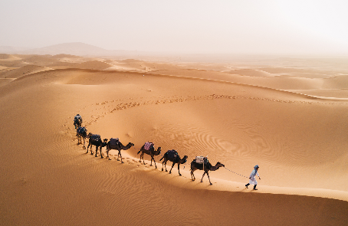
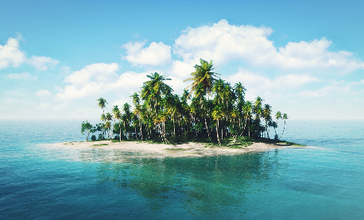
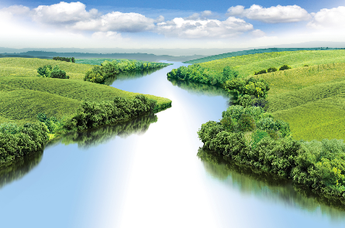
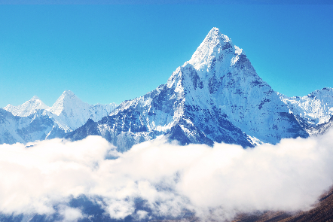
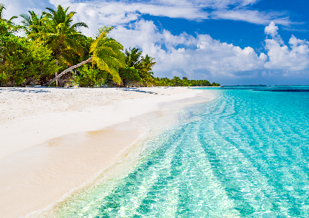
Listen and repeat the words, then label the pictures.
1. mountain
3. waterfall
5. cave
7. beach
2. river
4. forest
6. desert
8. island
a.
b.
c.
d.
e.
f.
g.
h.

Slide 10
Listen and repeat the words, then label the pictures.
1. mountain
3. waterfall
5. cave
7. beach
2. river
4. forest
6. desert
8. island
a.
b.
c.
d.
e.
f.
g.
h.

Slide 11
Work in groups. Choose the correct answer to each of the questions.
1.
Which is an island in Viet Nam?
A.
Con Dao
B.
Son Doong
2.
Where is Mount Fansipan?
A.
In Lao Cai
B.
In Quang Binh
3.
Which of the following is a national park?
A.
Thong Nhat Park
B.
Cat Tien Park
4.
Which of the following wonders is a cave?
A.
Cuc Phuong
B.
Phong Nha
5.
Which waterfall is in Cao Bang?
A.
Giang Dien Waterfall
B.
Ban Gioc Waterfall

Slide 12
* Production
* List about a natural place of interest in your province
* Answer.
Lien Khuong waterfall in Duc Trong
Prenn Waterfall, Cam Ly waterfall in Dalat.
Langbian mountain in Lac Duong.
……….

Slide 13
* Homework
Đọc, học, chép từ

Slide 14
Thank you for your attention!

