Slide 2
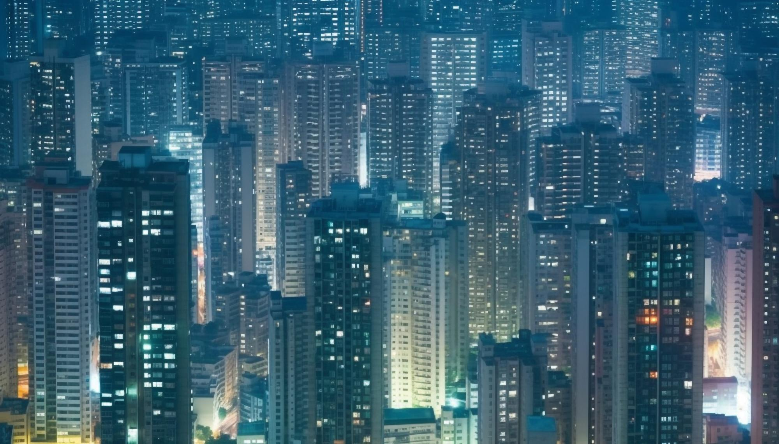


Unit
2
CITY LIFE
LESSON 2: A CLOSER LOOK 1

Slide 3
LESSON 2: A CLOSER LOOK 1
LESSON 2: A CLOSER LOOK 1
WARM-UP
Option 1: Game: Jumble words
Option 2: Game: Emoji quiz
Vocabulary teaching
Task 1: Match the words/phrases with their explanations.
Task 2: Choose the correct answer A, B, C, or D to complete each sentence.
Task 3: Complete the texts, using the words and phrase from the box.
VOCABULARY
Task 4: Put the words in the correct column. Then listen and check.
Task 5: Read the sentences. Circle the words with /aʊ/, underline those with /əʊ/, and put a tick (√) next to those with /eə/. Then listen, check, and practise the sentences.
PRONUNCIATION
CONSOLIDATION
Wrap-up
Homework

Slide 4
WARM-UP
OPTION 1
J
B
M
U
E
L
O
R
W
S
D

Slide 5
WARM-UP
OPTION 1
HOW TO PLAY
- There are some JUMBLE WORDS.
- Work in teams to unscramble them.
J
M
B
E
U
L
W
O
R
D
S

Slide 6
WARM-UP
OPTION 1
O | N | C | E | S | E | D | T | G
 |  |  | D | A | R | O
C | O | N | G | E | S | T | E | D
 |  |  | R | O | A | D

Slide 7
WARM-UP
OPTION 1
N | E | R | R | G | N | D | U | O
U | D | E | R | G | R | O | U | N | D

Slide 8
WARM-UP
OPTION 1
c | e | e | h | y | i | t | y
i | t | c | h | y |  | e | y | e

Slide 9
WARM-UP
OPTION 1
o | n | d | t | n | o | w | w
d | o | w | n | t | o | w | n

Slide 10
WARM-UP
OPTION 1
r | f | a | i | f | c | t | m | a | j
t | r | a | f | f | i | c |  | j | a | m

Slide 11
WARM-UP
OPTION 1
O | N | C | T | S | U | C | R | N | O | T | I
 |  |  | I | E | T | S
C | O | N | S | T | R | U | C | T | I | O | N
 |  |  | S | I | T | E

Slide 12

WARM-UP
OPTION 2
EMOJI/PICTURES QUIZ

Slide 13
WARM-UP
OPTION 2
- Each round, one student from each team stands up.
- There are some emojis/pictures.
- Try to guess the secret word from the emojis/pictures and make a sentence using that word.

Slide 14
WARM-UP
OPTION 2
EXAMPLE:

Slide 15

WARM-UP
OPTION 2
🚌
bus driver

Slide 16
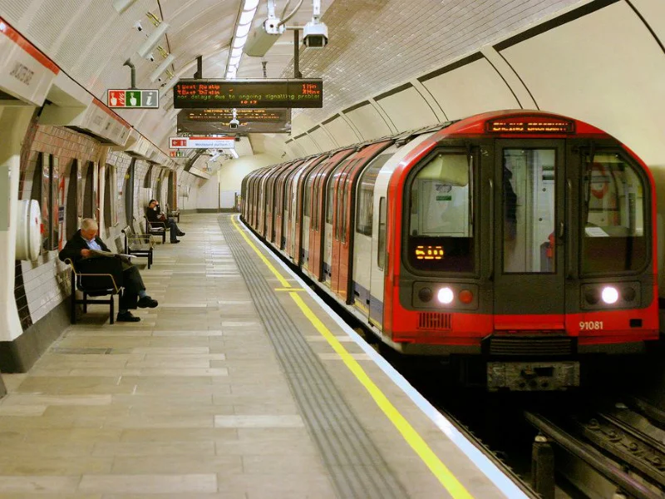
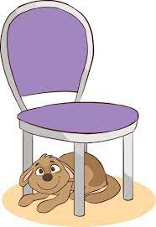

WARM-UP
OPTION 2
underground

Slide 17
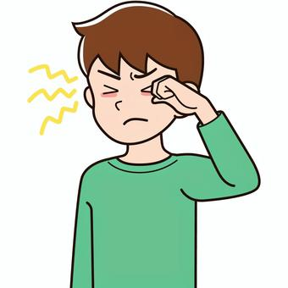

WARM-UP
OPTION 2
👁️
itchy eye

Slide 18


WARM-UP
OPTION 2
downtown

Slide 19
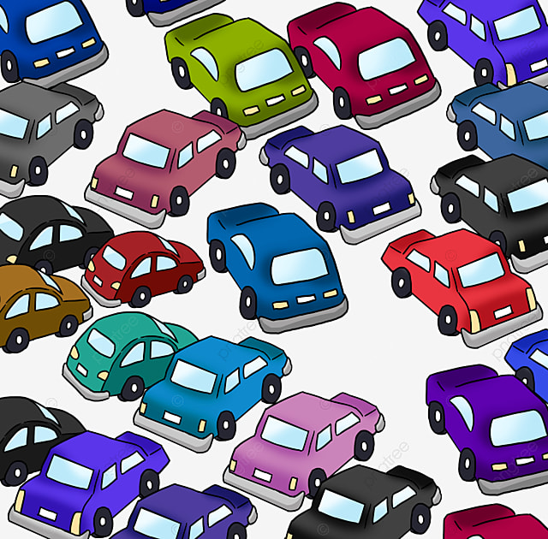
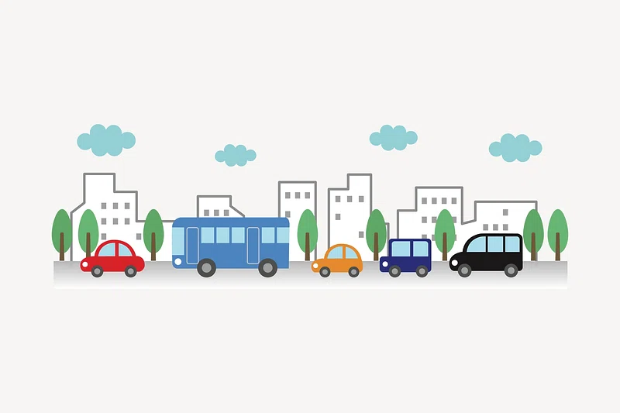

WARM-UP
OPTION 2
traffic jam

Slide 20
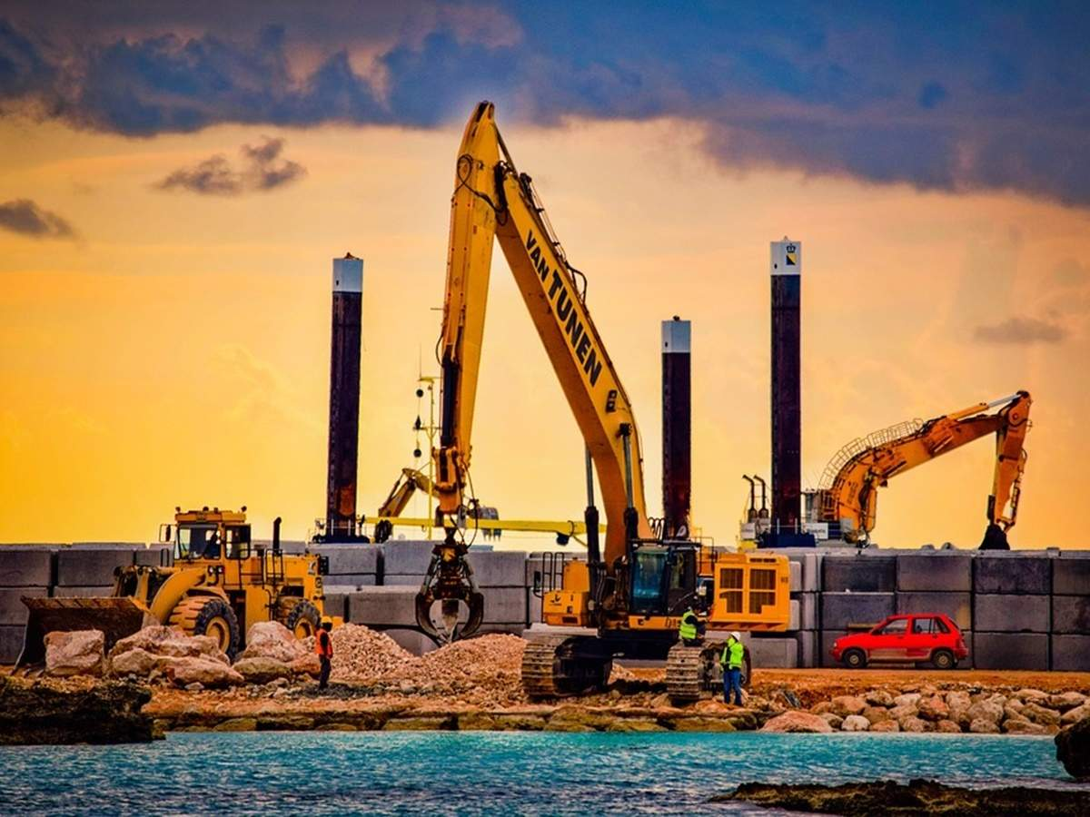

WARM-UP
OPTION 2
🚧
construction site

Slide 21
WARM-UP
OPTION 2
THE END

Slide 22
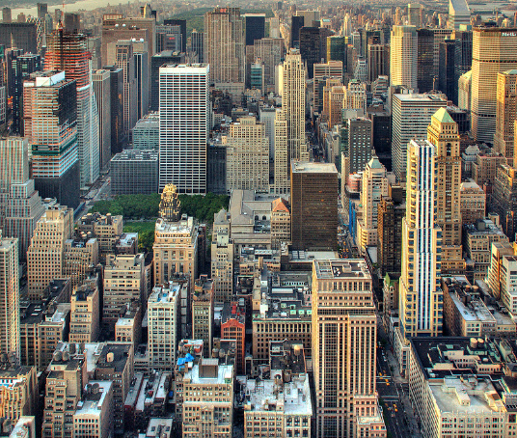

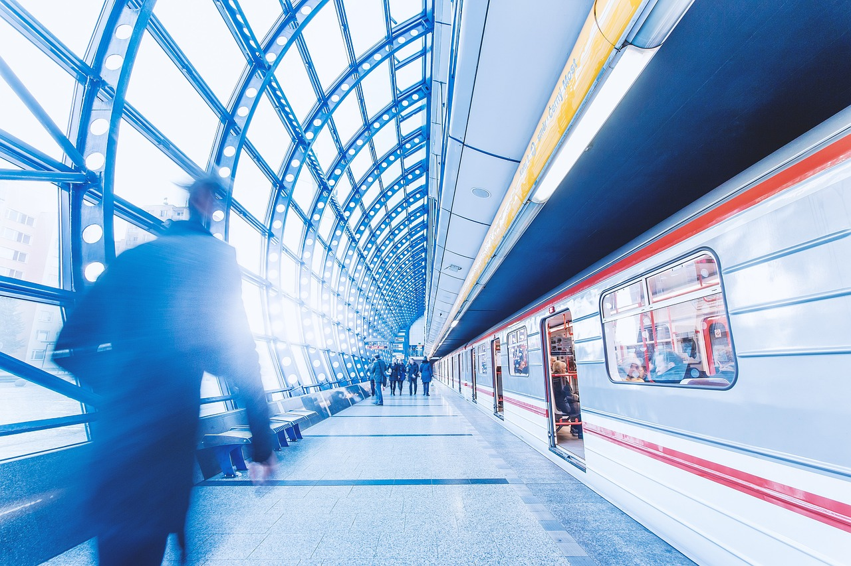
VOCABULARY
concrete jungle (n)
/ˌkɒŋkriːt ˈdʒʌŋɡl/
rừng bê tông

Slide 23
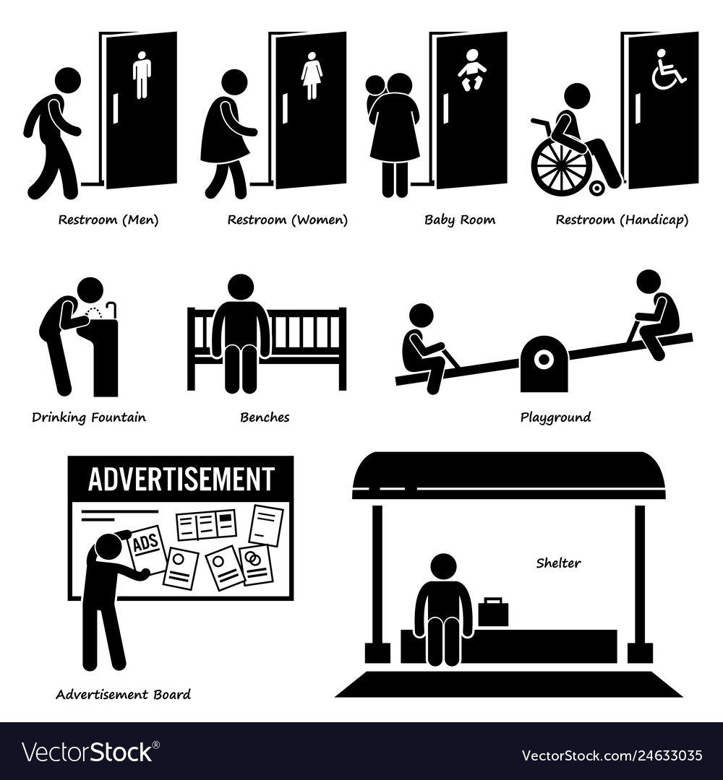

VOCABULARY
metro (n)
/ˈmetrəʊ/
hệ thống
tàu điện ngầm

Slide 24

VOCABULARY
public amenity
/ˈpʌblɪk əˈmiːnəti/
tiện ích công cộng

Slide 25
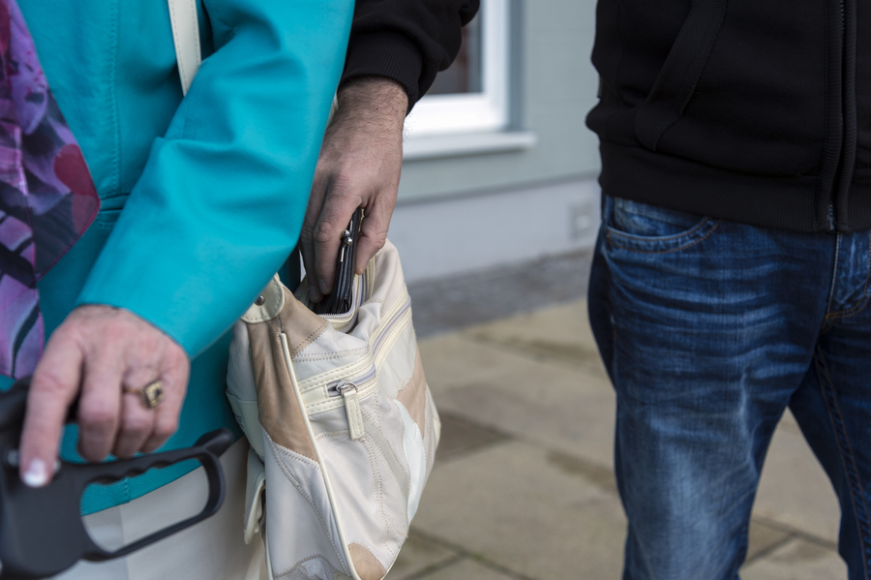
VOCABULARY
commuter (n)
/kəˈmjuːtə(r)/
người đi làm xa

Slide 26
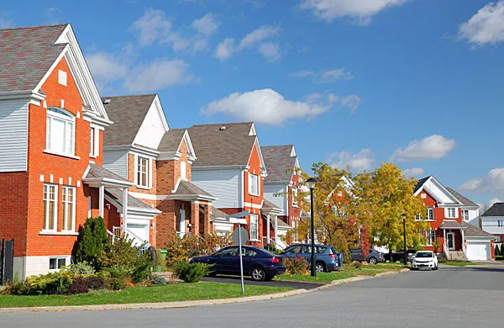
VOCABULARY
pickpocket (n)
/ˈpɪkpɒkɪt/
móc túi

Slide 27

VOCABULARY
suburb (n)
/ˈsʌbɜːb/
ngoại ô

Slide 28
VOCABULARY
bustling (adj)
/ˈbʌslɪŋ/
hối hả, nhộn nhịp, náo nhiệt.

Slide 29
VOCABULARY
liveable (adj)
/ˈlɪvəbl/
suitable or good for living in
(nơi, địa điểm) đáng sống

Slide 30
VOCABULARY
New words | Pronunciation | Meaning
1.concrete jungle (n) | /ˌkɒŋkriːt ˈdʒʌŋɡl/ | rừng bê tông
2. metro (n) | /ˈmetrəʊ/ | hệ thống tàu điện ngầm
3.public amenity | /ˈpʌblɪk əˈmiːnəti/ | tiện ích công cộng
4. commuter (n) | /kəˈmjuːtə(r)/ | người đi làm

Slide 31
VOCABULARY
New words | Pronunciation | Meaning
5. pickpocketing (n) | /ˈpɪkpɒkɪt/ | móc túi
6. suburb (n) | /ˈsʌbɜːb/ | ngoại ô
7. bustling (adj) | /ˈbʌslɪŋ/ | hối hả, nhộn nhịp, náo nhiệt
8. liveable (adj) | /ˈlɪvəbl/ | (nơi, địa điểm) đáng sống

Slide 32

VOCABULARY
1
Match the words/ phrases with their explanations.
1. downtown |  | a. an underground train system
2. concrete jungle |  | b. a city or part of a city with many buildings next to each other
3. sky train |  | c. the centre of a city, especially its main business area
4. metro |  | d. things in a neighbourhood that make life more comfortable such as parks and shopping centres
5. public amenities |  | e. a type of train that runs on a railway high above the ground

Slide 33
VOCABULARY
EXTRA ACTIVITY
- Work in teams.
- Each team choose 4 members to join the game and stand in a line.
- When you hear a word / phrase, you need to run quickly to the board and write that word/ phrase on the board.
- The team with the most number of correct answers will be the winner.

Slide 34
VOCABULARY
EXTRA ACTIVITY
LET’S PLAY

Slide 35
VOCABULARY
2
Choose the correct answer A, B, C, or D to complete each sentence.
1. The sky train is ______ with commuters at rush hour.
A. packed B. full C. busy D. interesting
2. The town’s public amenities make it a ______ place for its residents.
A. crowded B. boring C. liveable D. dull
3. It’s not always ______ on the metro. Pickpocketing sometimes takes place.
A. careful B. dangerous C. noisy D. safe

Slide 36
VOCABULARY
2
Choose the correct answer A, B, C, or D to complete each sentence.
4. It is often more ______ to live in the downtown than in the suburbs.
A. convenient B. peaceful C. quiet D. silent
5. Hong Kong is like a concrete jungle with so many people in it. It’s a ______ city.
A. calm B. quiet C. bustling D. high

Slide 37
VOCABULARY
3
Complete the texts, using the words and phrases from the box.
metro safe liveable
concrete jungles downtown public amenities
John: City life is great! People can travel by public transport, like buses and the (1) ______. There are good schools and hospitals, and other (2) ______________ such as parks, cinemas, and sports facilities. They make cities (3) _______ places for people.
Jenny: City life is terrible! The (4) _________ area is too crowded. Public transport is always packed with people. Some cities are like (5) ______________ with so many buildings. Some cities are not
(6) ______ because of high crime rates.
downtown
metro
public amenities
concrete jungles
safe
liveable

Slide 38
VOCABULARY
3
Complete the texts, using the words and phrase from the box.
- Who you agree with, John or Jenny, and explain why.
Example answers:
I agree with John. I think that life in the city is great. There are many good public amenities. The public transport system is convenient, too.

Slide 39
VOCABULARY
Example answers:
I agree with Jenny. City life is terrible. Cities are often too crowded. They don’t have much green space. They are not liveable.

Slide 40

PRONUNCIATION
Notes:
Video link: https://www.youtube.com/watch?v=-NO1NElTXDU&list=PL8_ETpRL2xNa7hp3KtZP2F3VZpMbUUlXp&index=2

Slide 41


PRONUNCIATION
4
Put the words in the correct column. Then listen and check.
/aʊ/ | /əʊ/ | /eə/
crowded
locate
repair
outdoor
coastal
square
council
overseas
airport

Slide 42

CONSOLIDATION
1
Wrap-up
What have we learnt in this lesson?
Use the lexical items related to the topic City life;
Pronounce the diphthong sounds /aʊ/, /əʊ/, and /eə/ in words and sentences correctly.

Slide 43

CONSOLIDATION
2
Homework
- Do exercises in the workbook.
- Find 3 more words that have the diphthong sounds /aʊ/, /əʊ/, and /eə/.

Slide 44
Website: hoclieu.vn
Fanpage: facebook.com/www.tienganhglobalsuccess.vn/

