Slide 1
NATURAL WONDERS
OF THE WORLD
Unit
7
LESSON 3: A CLOSER LOOK 2

Slide 2
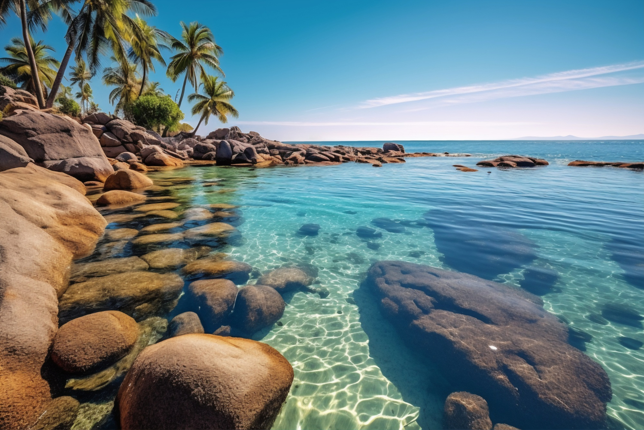
NATURAL WONDERS
OF THE WORLD
Unit
7
LESSON 3: A CLOSER LOOK 2

Slide 3
OBJECTIVES
By the end of the lesson, students will be able to:
Change Yes / No questions into reported speech

Slide 4
LESSON 3: A CLOSER LOOK 2
LESSON 1: GETTING STARTED
WARM-UP
Option 1: Review
Option 2: Rumour Detective
Grammar Explanation
Task 1: Choose the correct answer A, B, C, or D to complete each question
PRESENTATION
Task 2: Complete the following reported questions.
Task 3: Rewrite the sentences in reported questions
Task 4: Read the passage and underline the Yes/No questions. Then write them in reported questions.
PRACTICE
PRODUCTION
Task 5: Work in two groups. Take turns to give and change the Yes/No questions into reported speech.
CONSOLIDATION
Wrap-up
Homework

Slide 5
WARM-UP
OPTION 1
- Recall the rules of changing statements and Wh-questions into reported speech.

Slide 6
WARM-UP
OPTION 1
- Look at the examples:
Statements:
‘I’m tired,’ I said.
-> I told them (that) I was tired.
Wh-questions:
He said, 'What time does the film begin?'
=> He wanted to know what time the films began.

Slide 7
WARM-UP
OPTION 2
Rumour Detective

Slide 8
WARM-UP
OPTION 2
- Work in teams
- One team prepares a short story with several characters and events
- The other team act as “rumor detectives” who listen to the story and then ask questions using Wh- questions using reported speech to clarify the details.
HOW TO PLAY
- The storytelling team can only answer using reported speech
Ex: He said that she had gone to the store.

Slide 9
WARM-UP
OPTION 2
LET’S PLAY

Slide 10
PRESENTATION
In reporting Yes / No questions, we often use the verb ask or want to know; we use the word order of statements.
In reporting Yes / No questions, we normally use if / whether + clause.
Example:
Anna: “Do you plan to climb any mountains this summer, Joe?”
→ Anna asked Joe if / whether he planned to climb any mountains that summer.

Slide 11
PRESENTATION
1
Choose the correct answer A, B, C, or D to complete each question
1. “Will pollution endanger the wildlife here?” Kate asked.
→ Kate ______ if pollution would endanger the wildlife there.
A. told me
C. wanted to know
B. said to me
D. questions me
2. “Are you enjoying your flight?” the stewardess asked me.
→ The stewardess asked me if I ______my flight.
A. am enjoying
C. enjoyed
B. was enjoying
D. would enjoy

Slide 12
PRESENTATION
1
Choose the correct answer A, B, C, or D to complete each question
3. “Is Ganh Da Dia in Phu Yen Province, Phong?”
→ She asked Phong ______ in Phu Yen Province.
A. was Ganh Da Dia
C. whether Ganh Da Dia was
B. if Ganh Da Dia is
D. if it is Ganh Da Dia
4. “Can I take a photo inside the cave?” he said to the guide.
→ He ______ the guide if he could take a photo inside the cave.
A. asked
C. advised
B. said
D. ordered

Slide 13
PRESENTATION
1
Choose the correct answer A, B, C, or D to complete each question
5. “Is the weather good in Sa Pa in the winter?”
→ She wanted to know_____________________
A. was the weather good in Sa Pa in the winter?
B. if the weather is good in Sa Pa in the winter.
C. whether was the weather good in Sa Pa in the winter.
D. if the weather was good in Sa Pa in the winter.

Slide 14
LESSON 3: A CLOSER LOOK 2
LESSON 1: GETTING STARTED
WARM-UP
Option 1: Review
Option 2: Rumour Detective
Grammar Explanation
Task 1: Choose the correct answer A, B, C, or D to complete each question
PRESENTATION
Task 2: Complete the following reported questions.
Task 3: Rewrite the sentences in reported questions
Task 4: Read the passage and underline the Yes/No questions. Then write them in reported questions.
PRACTICE

Slide 15
PRACTICE
2
Complete the following reported questions.
1. “Are you excited about your upcoming trip to Mui Ne?”
He asked the children if they were _______________________.
excited about their up-coming trip to Mui Ne
2. “Do you often meet Angela at school?”
often met Angela at school.
She asked us whether we ______________________________.
3. “Will you visit Giang Dien Waterfall next week?”
She wanted to know if Mark____________________________.
would visit Giang Dien Waterfall the following week.

Slide 16
PRACTICE
2
Complete the following reported questions.
4. “Is Con Dao National Park rich in flora and fauna?”
I asked the teacher ___________________________________.
if / whether Con Dao National Park was rich in flora and fauna.
5. “Can we go to the campsite by bike?”
Arthur wanted to know ______________________________.
if / whether they could go to the camp site by bike.

Slide 17
PRACTICE
3
Rewrite the sentences in reported questions.
1. “Are you still working from home?” I asked my dad.
I asked my dad if / whether he was still working from home.
___________________________________________________.
2. “Do you have to pack your suitcase, Anne?” said Mark.
Mark asked Anne if / whether she had to pack her suitcase.
___________________________________________________.
3. Lan: “Are you interested in visiting Phu Quoc Island, Tom?”.
Lan asked / wanted to know if / whether Tom was interested
in visiting Phu Quoc Island.
______________________________________________________________________________________________________.

Slide 18
PRACTICE
3
Rewrite the sentences in reported questions.
4. “Can we afford to go to Niagara Falls, Mum?” said Kay.
Kay asked her mum if / whether they could afford to
go to Niagara Falls.
______________________________________________________________________________________________________.
5. . “Will they visit Sa Pa and climb Mount Fansipan this summer?”
I asked / wanted to know if/ whether they would visit Sa Pa
and climb Fansipan that summer.
______________________________________________________________________________________________________.

Slide 19
PRACTICE
4
Read the passage and underline the Yes/No questions. Then write them in reported questions.
1. The guide said to them: “Is it your first time here?”
A tour guide is taking a group of tourists to visit Tonle Sap Lake in Cambodia. The guide said to them: “Is it your first time here?” Some said yes and some said no. Olivia asked the guide: “Do the people live on fishing?” He said most of them did. Then Mark said: “Do their children go to school on land?” “Yes, they do,” said the guide. ...
______________________________________________________________________________________________________.
2. Olivia asked the guide: “Do the people live on fishing?”
______________________________________________________________________________________________________.

Slide 20
PRACTICE
4
Read the passage and underline the Yes/No questions. Then write them in reported questions.
1. The guide said to them: “Is it your first time here?”
The guide asked them / wanted to know
if / whether it was their first time there.
______________________________________________________________________________________________________.
2. Olivia asked the guide: “Do the people live on fishing?”
Olivia asked / wanted to know
if / whether the people there lived on fishing.
______________________________________________________________________________________________________.
3. Mark said: “Do their children go to school on land?”

Slide 21
PRACTICE
4
Read the passage and underline the Yes/No questions. Then write them in reported questions.
3. Mark said: “Do their children go to school on land?”
Mark asked / wanted to know
if / whether their children went to school on land.
______________________________________________________________________________________________________.

Slide 22
LESSON 3: A CLOSER LOOK 2
LESSON 1: GETTING STARTED
WARM-UP
Option 1: Review
Option 2: Rumour Detective
Grammar Explanation
Task 1: Choose the correct answer A, B, C, or D to complete each question
PRESENTATION
Task 2: Complete the following reported questions.
Task 3: Rewrite the sentences in reported questions
Task 4: Read the passage and underline the Yes/No questions. Then write them in reported questions.
PRACTICE
PRODUCTION
Task 5: Work in two groups. Take turns to give and change the Yes/No questions into reported speech.

Slide 23
PRODUCTION
Work in two groups. Take turns to give and change the Yes/No questions into reported speech.
5
- Work in 2 groups.
- Study the example.
Group A:
“Is the Atacama Desert in Chile?”
Group B:
She asked if the Atacama Desert was in Chile.

Slide 24
PRODUCTION
Work in two groups. Take turns to give and change the Yes/No questions into reported speech.
5
- Work independently and prepare for your performance.
- Group A gives three Yes / No questions, and group B changes them into reported questions.
- Then swap roles.

Slide 25
EXTRA ACTIVITY
Reported questions into direct questions
- Work in pairs.
- One student makes a reported Yes / No question, and the other turns it into a direct question.
Example:
A: She asked me if / whether I lived near the sea.
B: “Do you live near the sea?”

Slide 26
LESSON 3: A CLOSER LOOK 2
LESSON 1: GETTING STARTED
WARM-UP
Option 1: Review
Option 2: Rumour Detective
Grammar Explanation
Task 1: Choose the correct answer A, B, C, or D to complete each question
PRESENTATION
Task 2: Complete the following reported questions.
Task 3: Rewrite the sentences in reported questions
Task 4: Read the passage and underline the Yes/No questions. Then write them in reported questions.
PRACTICE
PRODUCTION
Task 5: Work in two groups. Take turns to give and change the Yes/No questions into reported speech.
CONSOLIDATION
Wrap-up
Homework

Slide 27
CONSOLIDATION
1
Wrap-up
What have we learnt in this lesson?
Change Yes / No questions into reported speech

Slide 28
CONSOLIDATION
2
Homework
- Do exercises in the workbook.
- Make 5 sentences by using Yes/No questions in Reported Speech

Slide 29
Website: hoclieu.vn
Fanpage: facebook.com/www.tienganhglobalsuccess.vn/

