Slide 1

HIEP AN SECONDARY SCHOOL
Welcome to our class
7

Slide 2
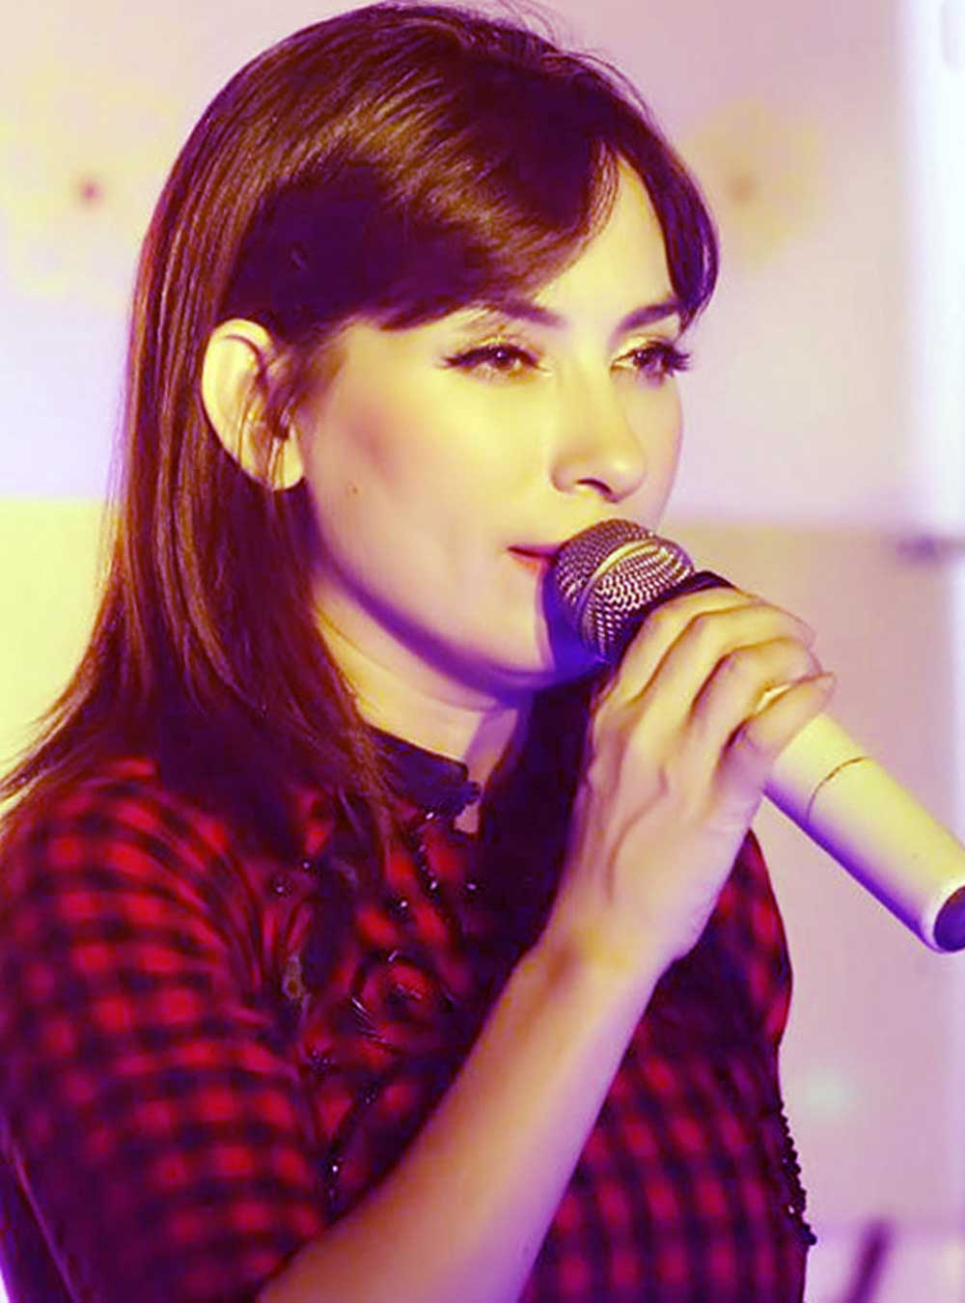
What is her job?
➔ She is a singer

Slide 3

What is he doing?
➔ He is taking a photo.

Slide 4

What is this boy doing?
➔ He is painting

Slide 5
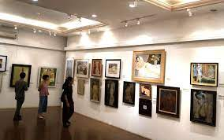
Which place is it?
➔ Art gallery

Slide 6
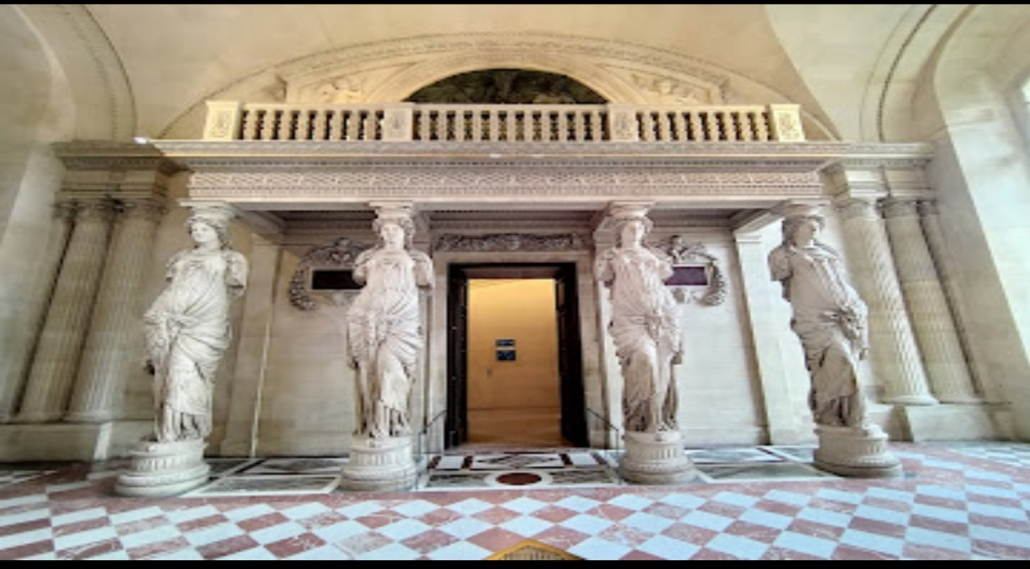
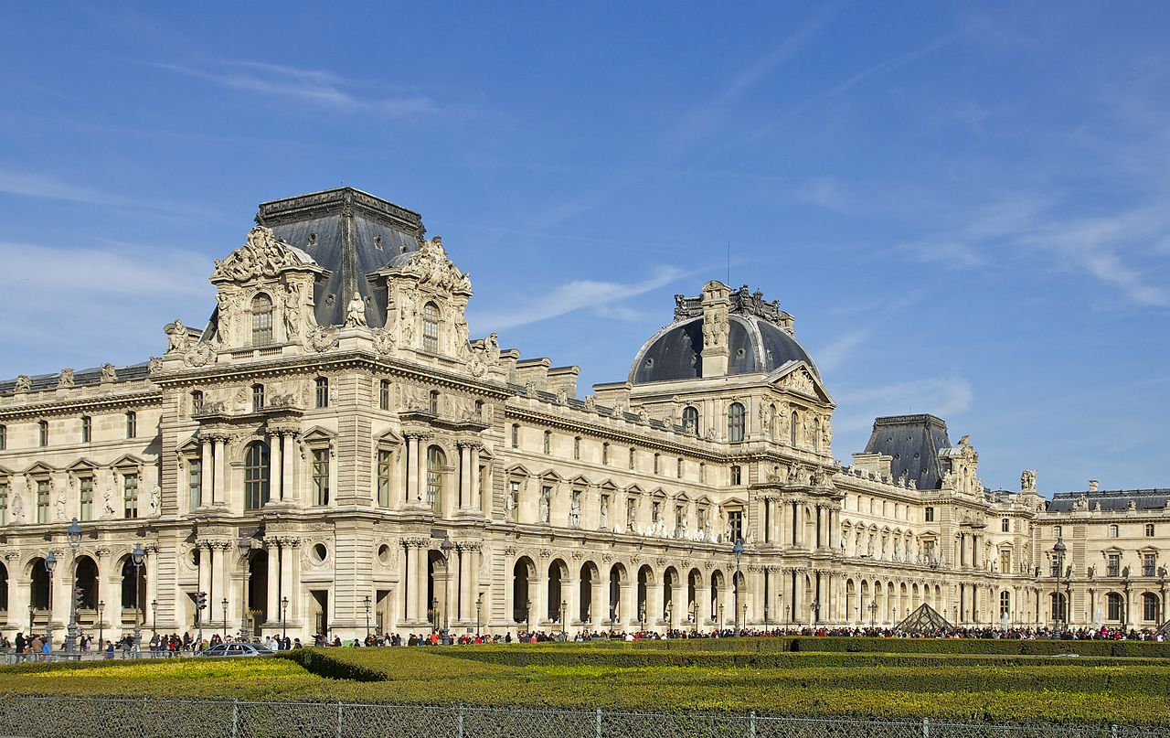
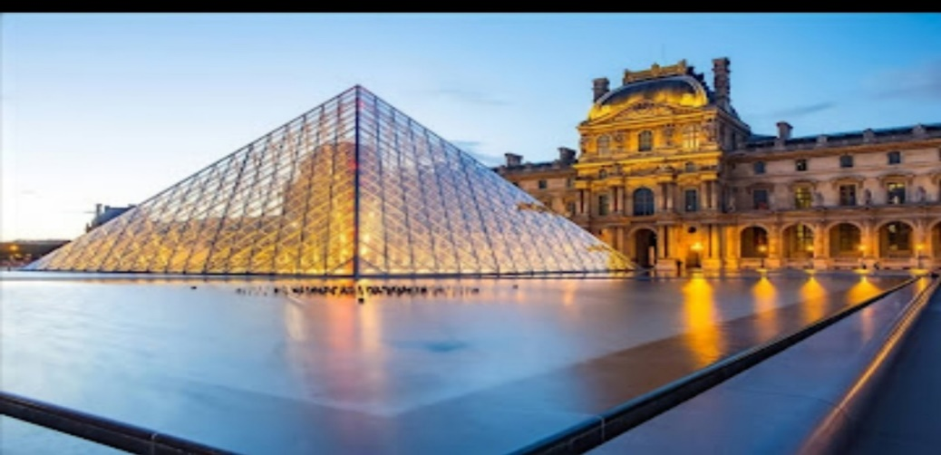
Which place is it?
➔ The Louvre in Paris

Slide 7



Unit
4
MUSIC AND ARTS
LESSON 2: A CLOSER LOOK 1
VOCABULARY
PRONUNCIATION
Unit
HOBBIES

Slide 8

OBJECTIVES
By the end of the lesson, students will be able to:
Vocabulary: use the lexical items related to the topic Music and arts.
Pronunciation: pronounce and recognize the sounds /ʃ/ and /ʒ/.

Slide 9
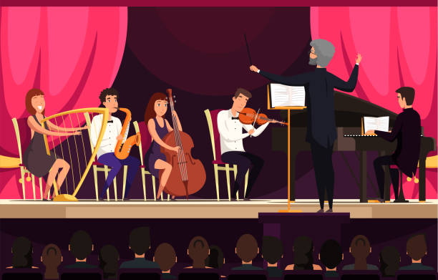

VOCABULARY
concert hall (n)
/ˈkɒnsət ˌhɔːl/
phòng hòa nhạc

Slide 10

VOCABULARY
(a) actress (n)
/ˈæktrəs/
diễn viên nữ

Slide 11
VOCABULARY
(an) artist (n)
/ˈɑːtɪst/
họa sĩ, nghệ sĩ

Slide 12
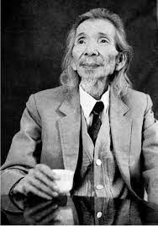
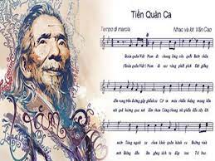
VOCABULARY
composer (n)
/kəmˈpəʊzər/
nhà soạn nhạc

Slide 13
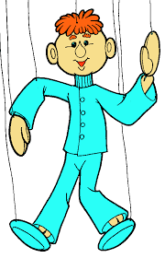

VOCABULARY
puppet (n)
/ˈpʌpɪt/
con rối

Slide 14
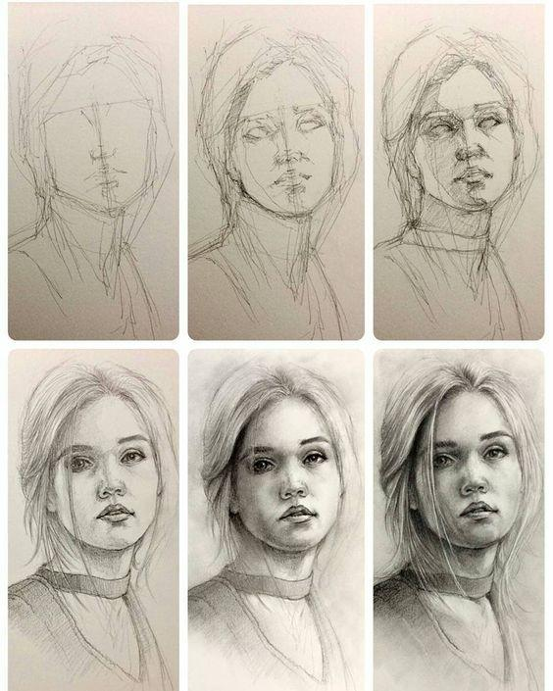
VOCABULARY
portrait (n)
/ˈpɔːtrət/
chân dung

Slide 15
VOCABULARY
photography (n)
/fəˈtɒɡrəfi/
nhiếp ảnh

Slide 16

VOCABULARY
perform (v)
/pəˈfɔːm/
thực hiện, trình diễn

Slide 17
VOCABULARY
New words | Pronunciation | Meaning
1. concert hall (n) | /ˈkɒnsət ˌhɔːl/ | phòng hòa nhạc
2. actress (n) | /ˈæktrəs/ | nữ diễn viên
3. artist (n) | /ˈɑːtɪst/ | họa sĩ, nghệ sĩ
4. composer (n) | /kəmˈpəʊzər/ | nhà soạn nhạc
5. puppet (n) | /ˈpʌpɪt/ | con rối
6. portrait (n) | /ˈpɔːtrət/ | chân dung
7. photography (n) | /fəˈtɒɡrəfi/ | nhiếp ảnh
8. perform (v) | /pəˈfɔːm/ | thực hiện/ trình diễn

Slide 18

Listen and repeat these words and phrases, then write them in the correct columns.
1
art gallery
actress
composer
painter
concert hall
artist
musician
puppet theatre
Write them in the correct columns
People | Places

Slide 19
VOCABULARY
2
Match a word in A with a word or phrase in B.
A | B
1. compose 2. paint 3. perform 4. play 5. take | a. show b. a photo c. the guitar d. a portrait e. music

Slide 20

VOCABULARY
3
Underline the correct word to complete each sentence.
The little girl’s drawing/ photography of her kitten shows a lot of talent.
Van Cao was a great Vietnamese scientist/ composer. He was also a painter and poet.
The Louvre in Paris is the world’s largest museum/ puppet theater.
The orchestra will perform its final portrait/ concert of the season tomorrow.
Did you see the film Amazon Jungle on TV last night? The photography/ drawing was excellent.

Slide 21

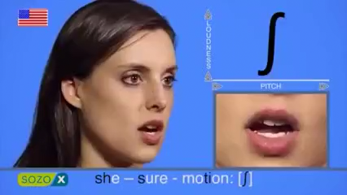

/ʃ/ and /ʒ/
PRONUNCIATION
/ʃ/: musician, show, share, nation
/ʒ/: television, visual, unusual, decision

Slide 22
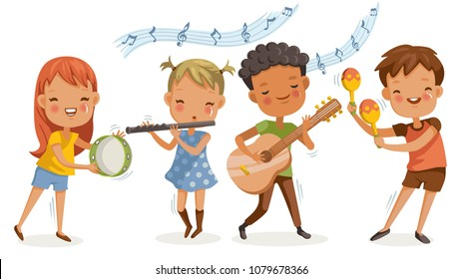
PRONUNCIATION
4
Listen and repeat the words. Pay attention to the sounds /ʃ/ and /ʒ/.
/ʃ/ | /ʒ/
musician show share nation | television visual unusual decision

Slide 23

PRONUNCIATION
Listen and repeat, and single – underline the words with the sound /ʃ/ and double – underline the words with the sound /ʒ/.
5
We finally came to a decision.
Did you watch the talent show on T`V last night?
Let’s share the pictures we took last week.
She often paints in her leisure time.
It was a pleasure to listen to the musicians performing yesterday.
/ʃ/ and /ʒ/

Slide 24
PRONUNCIATION
Listen and repeat, and single – underline the words with the sound /ʃ/ and double – underline the words with the sound /ʒ/.
5
We finally came to a decision.
/ʃ/ and /ʒ/
/ʒ/

Slide 25
PRONUNCIATION
Listen and repeat, and single – underline the words with the sound /ʃ/ and double – underline the words with the sound /ʒ/.
5
2. Did you watch the talent show on TV last night?
/ʃ/
/ʃ/ and /ʒ/

Slide 26
PRONUNCIATION
Listen and repeat, and single – underline the words with the sound /ʃ/ and double – underline the words with the sound /ʒ/.
5
3. Let’s share the pictures we took last week.
/ʃ/
/ʃ/ and /ʒ/

Slide 27
PRONUNCIATION
Listen and repeat, and single – underline the words with the sound /ʃ/ and double – underline the words with the sound /ʒ/.
5
4. She often paints in her leisure time.
/ʃ/ and /ʒ/
/ʃ/
/ʒ/

Slide 28
PRONUNCIATION
Listen and repeat, and single – underline the words with the sound /ʃ/ and double – underline the words with the sound /ʒ/.
5
5. It was a pleasure to listen to the musicians performing yesterday.
/ʒ/
/ʃ/
/ʃ/ and /ʒ/

Slide 29
PRONUNCIATION
Listen and repeat, and single – underline the words with the sound /ʃ/ and double – underline the words with the sound /ʒ/.
5
We finally came to a decision.
Did you watch the talent show on T`V last night?
Let’s share the pictures we took last week.
She often paints in her leisure time.
It was a pleasure to listen to the musicians performing yesterday.
/ʃ/ and /ʒ/
/ʒ/
/ʃ/
/ʃ/
/ʃ/
/ʒ/
/ʃ/
/ʒ/

Slide 30
Photography
2. Actress
3. Artist
4. Puppet
5. Composer
a. Someone who writes music
b. woman who performs in plays, in movie, or on the TV
c. The activity or job of taking photography
d. A toy in the shape of a person or animal that you can move with strings or by putting your hand inside
e. Someone who makes art, especially paitings and drawings

Slide 31


- Find 5 more words with the sound /ʃ/ and 5 more words with the sound /ʒ/. Write them down and practice pronouncing the words.
- Prepare A closer look 2
Notes:
It’s necessary to preview the show!
tranvanbinhtv@gmail.com

Slide 32
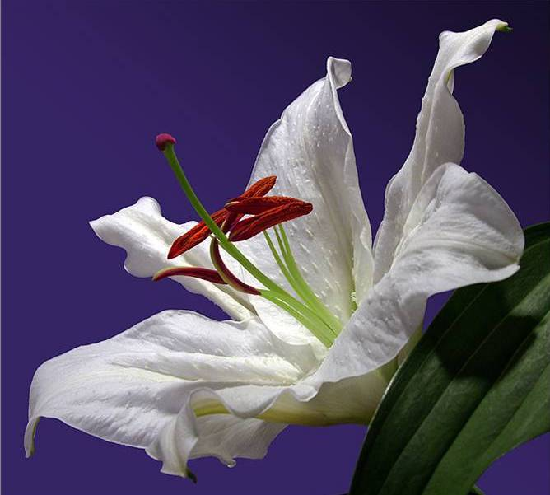


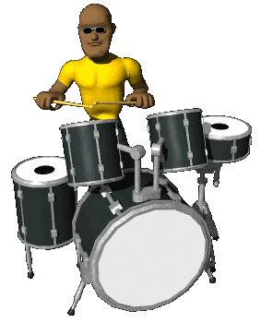
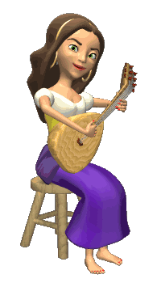

THANK YOU FOR ATTENTION!
the end
GOOD BYE!

