Slide 1


Slide 2



Unit
6
A VISIT TO A SCHOOL
LESSON 1: GETTING STARTED
A visit to Binh Minh Secondary School
Unit
HOBBIES

Slide 3

OBJECTIVES
By the end of the lesson, students will be able to:
identify the topic of the unit
use lexical items: school activities
identify the language features that are covered in the unit.

Slide 4
LESSON 1: GETTING STARTED
WARM-UP
Chatting
PRESENTATION
Vocabulary
Task 1: Listen and read.
Task 2: Read the conversation again and answer the questions by circling A, B or C.
Task 3: Name the places, using the words and phrases from the box.
Task 4: Complete the following sentences with the phrases in 3.
PRACTICE
PRODUCTION
Task 5: Work in pairs. Ask and answer questions about Nick’s timetable, using when and where.
CONSOLIDATION
Wrap-up
Home work

Slide 5
LESSON 1: GETTING STARTED
WARM-UP
Chatting
Aims of the stage:
To introduce the topic
To lead in the lesson.

Slide 6

WARM-UP
What did you see when you first came to our school?
How did you feel?
Have you ever take a visit to Chu Van An Secondary school?

Slide 7
WARM-UP
What is the girl doing?
She’s preparing to visit Binh Minh Lower secondary School.
What are they talking about?
They are talking about some things they want to do during the visit.

Slide 8

LESSON 1: GETTING STARTED
WARM-UP
Chatting
PRESENTATION
Vocabulary
Aims of the stage:
To provide students with vocabulary.
To help students well-prepared for the listening and reading tasks.

Slide 9
NEW WORDS:
1.Lower secondary school (n)
2.Member (n)
3.Remind (v)
4.Forget (v)
Trường t. h. c.sở
Thành viên
Nhắc nhở
Quên

Slide 10
PRESENTATION
lower secondary school
/ˈləʊ.ər ˈsek.ən.drɪ skuːl/
trường trung học cơ sở

Slide 11
PRESENTATION
member (n)
/ˈmem.bər/
thành viên

Slide 12
PRESENTATION
remind (v)
/rɪˈmaɪnd/
gợi nhớ/ nhắc nhở

Slide 13
PRESENTATION
New words | Pronunciation | Meaning
lower secondary school | /ˈləʊ.ər ˈsek.ən.drɪ skuːl/ | trường trung học cơ sở
member | /ˈmem.bər/ | thành viên
remind | /rɪˈmaɪnd/ | gợi nhớ/ nhắc nhở

Slide 14
LESSON 1: GETTING STARTED
Chatting
WARM-UP
Vocabulary
PRESENTATION
Task 1: Listen and read.
Task 2: Read the conversation again and answer the questions by circling A, B or C.
Task 3: Name the places, using the words and phrases from the box.
Task 4: Complete the following sentences with the phrases in 3.
PRACTICE

Slide 15

PRACTICE
1
Listen and read
Aim of the task:
to have students get to know the topic.

Slide 16
PRACTICE
2
Read the conversation again and answer the questions by circling A, B or C.
Aim of the task:
to have students get specific information of the text.

Slide 17
PRACTICE
2
Read the conversation again and answer the questions by circling A, B or C.
1. What are they talking about?
a. A visit to a computer room.
b. A visit to a school.
c. A visit to a school library.
Phong: What are you doing, Mi?
Mi: I’m preparing to visit Binh Minh Lower Secondary School.

Slide 18
PRACTICE
2
Read the conversation again and answer the questions by circling A, B or C.
2. Who is going to visit the school?
a. Mi and her teacher.
b. Mi and her classmates.
c. Mi, her teacher and her classmates.
Phong: Sounds great! I think that’s one of the best schools in my neighbourhood. Who is going with you and when?
Mi: My teacher and my classmates. We’re going in the afternoon.

Slide 19
PRACTICE
2
Read the conversation again and answer the questions by circling A, B or C.
3. Where is the school?
a. In the city.
b. In the countryside.
c. In Phong’s neighbourhood.
Phong: Sounds great! I think that’s one of the best schools in my neighbourhood. Who is going with you and when?

Slide 20
PRACTICE
2
Read the conversation again and answer the questions by circling A, B or C.
4. When are they going?
a. In the morning.
b. In the afternoon.
c. At noon.
Phong: Sounds great! I think that’s one of the best schools in my neighbourhood. Who is going with you and when?
Mi: My teacher and my classmates. We’re going in the afternoon.

Slide 21
PRACTICE
3
Name these places, using the words and phrases from the box.
Aim of the task:
to review school facilities

Slide 22
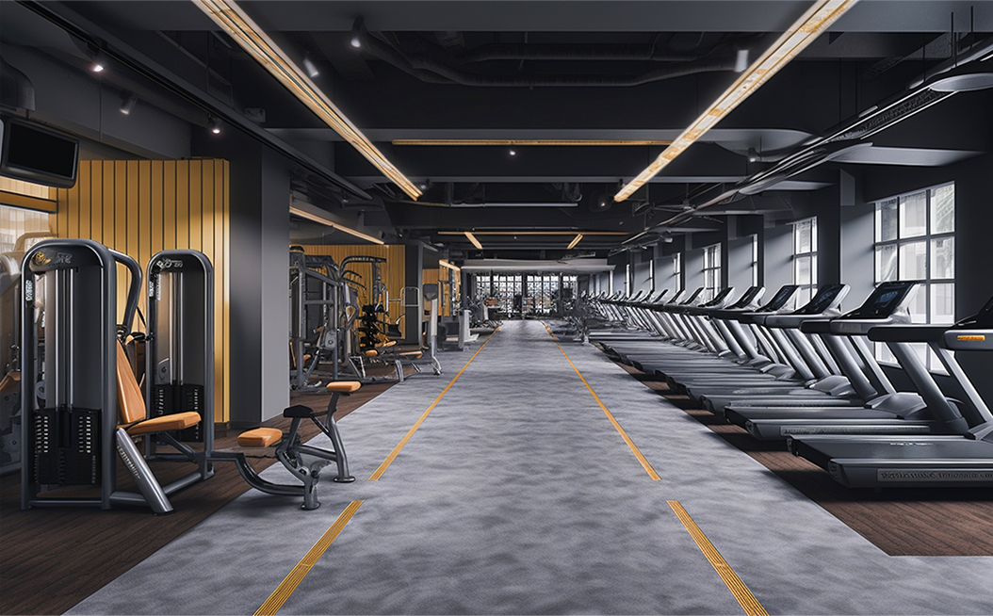
PRACTICE
3
Name these places, using the words and phrases from the box.
GYM

Slide 23
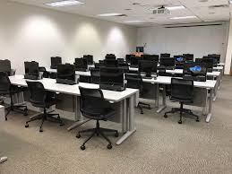
PRACTICE
3
Name these places, using the words and phrases from the box.
COMPUTER ROOM

Slide 24
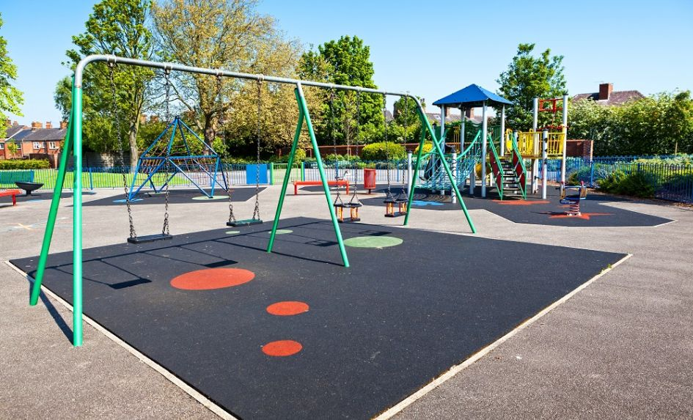
PRACTICE
3
Name these places, using the words and phrases from the box.
PLAY GROUND

Slide 25
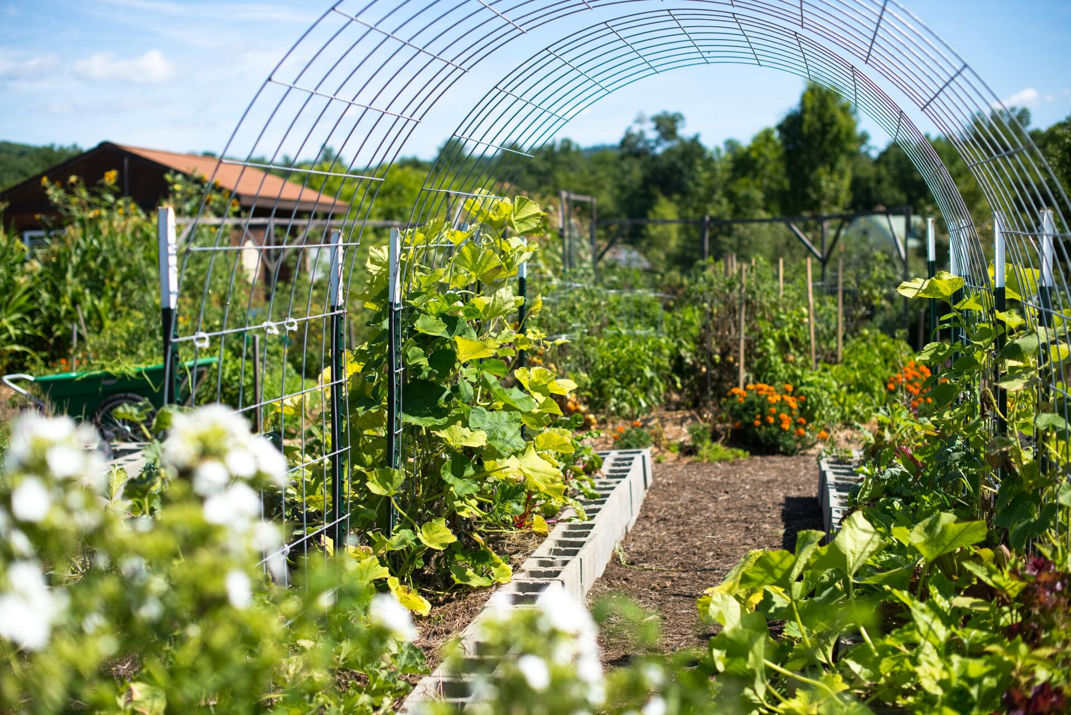
PRACTICE
3
Name these places, using the words and phrases from the box.
SCHOOL GARDEN

Slide 26
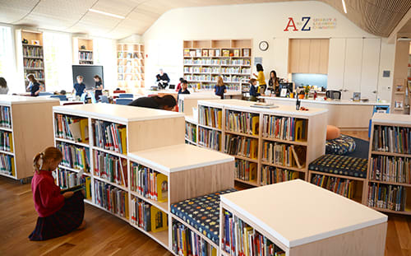
PRACTICE
3
Name these places, using the words and phrases from the box.
SCHOOL LIBRARY

Slide 27
PRACTICE
4
Complete the sentence with the words and phrases in 3.
computer room
school library
school garden
playground
gym
Aim of the task:
To use the words in 3 to complete the sentences.

Slide 28
PRACTICE
4
Complete the following sentences with the words in the box.
computer room
school library
school garden
playground
gym
1. The school _______________ is very small, so not many children can play in it.
2. We learn how to use the Internet in the _______________ twice a week.
3. They have school meetings in the _______________ when it rains.
4. There are a lot of books, magazines, and newspapers in the _______________.
5. Our class usually waters the vegetables in the _______________ on Friday afternoon.
playground
computer room
gym
school library
school garden

Slide 29
LESSON 1: GETTING STARTED
WARM-UP
Chatting
PRESENTATION
Vocabulary
Task 1: Listen and read.
Task 2: Read the conversation again and answer the questions by circling A, B or C.
Task 3: Name the places, using the words and phrases from the box.
Task 4: Complete the following sentences with the phrases in 3.
PRACTICE
PRODUCTION
Task 5: Work in pairs. Ask and answer questions about Nick’s timetable, using when and where.
CONSOLIDATION

Slide 30
PRODUCTION
5
Work in pairs. Ask and answer questions about Nick’s timetable, using when and where.
Subject | Time | Place
Maths | 8 a.m. Monday, Tuesday, Friday | Classroom (room 302)
Biology | 9 a.m. Thursday | Science lab
Information Technology | 2 p.m. Wednesday | Computer room
Physical Education | 3 p.m. Monday, Thursday | School gym
History | 3:30 p.m. Tuesday | School library
Example:
A: When does Nick have Maths?
B: At 8 a.m. on Monday, Tuesday, and Friday.
A: And where does he have it?
B: In his classroom, room 302.

Slide 31
LESSON 1: GETTING STARTED
WARM-UP
Chatting
PRESENTATION
Vocabulary
Task 1: Listen and read.
Task 2: Read the conversation again and answer the questions by circling A, B or C.
Task 3: Name the places, using the words and phrases from the box.
Task 4: Complete the following sentences with the phrases in 3.
PRACTICE
PRODUCTION
Task 5: Work in pairs. Ask and answer questions about Nick’s timetable, using when and where.
CONSOLIDATION
Wrap-up
Home work

Slide 32
Cách đặt câu hỏi với How much hoặc How many.
HOW MANY + dt số nhiều + are there…?
HOW MUCH + dt số ít + will + S + v…?
+ do/does + S + v…?
+ am/is /are + S + v-ing..?
+ did + S + v ….?....
Ex1: He bought ten cakes for her.
→ How many cakes did he buy for her?
Ex 2: Ba will give me some milk.
→ How much milk will Ba give you?

Slide 33
MAKE QUESTIONS FOR UNDERLINED WORDS OR PHRASES USING HOW MUCH OR HOW MANY .
(Đật câu hỏi cho phần gạch chân sau sử dụng
How much hoặc How many)
There are two boys in the room.
2. They will need 200 grams of butter to make pancakes.
3. She buys ten books at the bookstore.
4.Nam gave Ba three pens yesterday.
5. We use a litter of oil for the party

Slide 34
CONSOLIDATION
1
WRAP-UP
A visit to a school
School facilities
Topic of the unit
Vocabulary

Slide 35
CONSOLIDATION
2
HOMEWORK
Exercises in workbook.
Learn by heart vocab.
Prepare: A closer look 1.

Slide 36


Slide 37
TÀI LIỆU THAM KHẢO
-https:// hanhtrangso.nxbgd.vn
-https://sachmem.vn
-web hoclieu.vn
- Tiếng Anh 7 Global success

