Slide 1


Slide 2
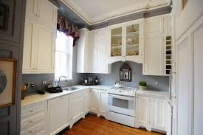
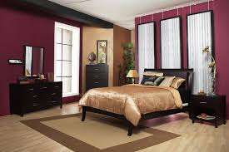
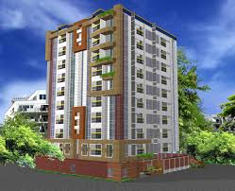
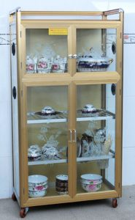
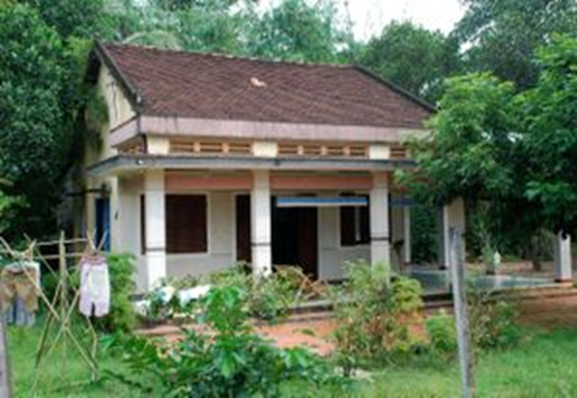
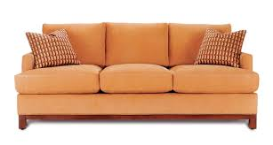
KIM’S GAME
Write the name of the pictures
kitchen
bedroom
flat ( apartment)
cupboard
country house
sofa

Slide 3
UNIT 3:
My friends
Lesson 1: Getting started

Slide 4
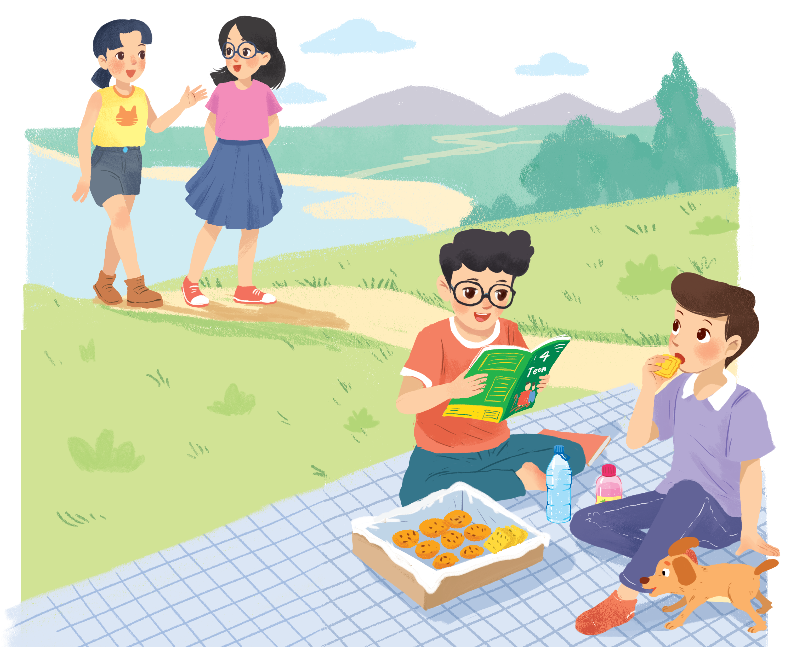
Look and answer.
1. Who are they?
They are Chau, Mai, Phong and Nam.
2. What is Phong doing?
He is reading a magazine.
Nam
3. What are Phong and Nam eating and drinking?
Chau
Mai
Biscuits and water.
4. What are they talking about?
Phong
Listen and check

Slide 5
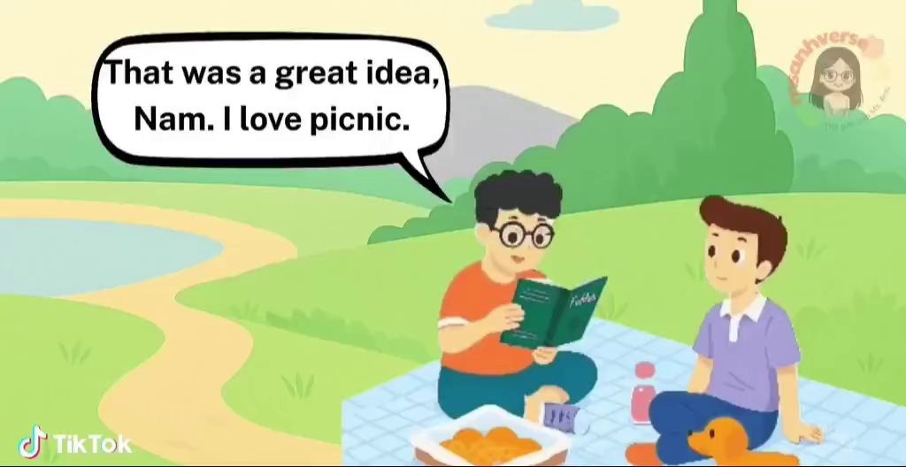

Slide 6
Let’s check!
4. What are they talking about?
A special guess.
Nam: Look! It's Mai. And she is with someone.
Phong: Oh, who's that? She has glasses and long black hair.
Nam: I don't know. They're coming over.
Mai: Hi there. This is my friend Chau.
Phong & Nam: Hi, Chau. Nice to meet you.
Chau: Nice to meet you, too.
Nam
Chau
Mai
Phong

Slide 7
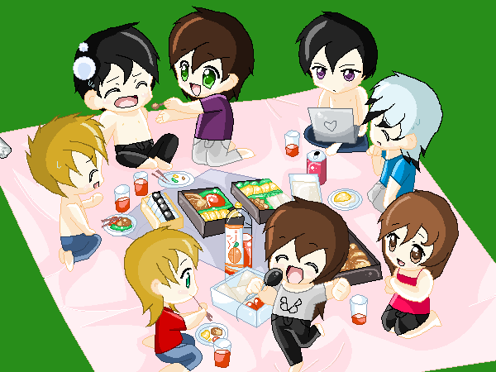


* Vocabulary:
- picnic (n):
dã ngoại
- surprise (adj):
bất ngờ, ngạc nhiên
pass (v) :
chuyển qua, đưa qua
glasses (n ) :
mắt kính
magazine (n):
tạp chí

Slide 8
2. Read again and fill in the blanks!
1. Phuc and Nam are having a ____________.
2. Teen is Phong's ____________________ .
3. Phong and Nam see _______ and ___________.
4. Chau has________, and _________________.
5. Mai and Chau _____________ the bookshop.

Slide 9
Let’s check!
1. Phuc and Nam are having a ____________.
picnic
Phong: That was a great idea, Nam. I love picnics!
Nam: Please pass me the biscuits.
2. 4Teen is Phong's __________________.
favourite magazine
Nam: Thanks. What are you reading, Phong?
Phong: 4Teen. It's my favourite magazine!

Slide 10
Let’s check!
3. Phong and Nam see ___________ and ___________.
Mai
Chau
Nam: Look! It's Mai. And she is with someone.
Phong: Oh, who's that? She has glasses and long black hair.
Nam: I don't know. They're coming over.
Mai: Hi there. This is my friend Chau.
Phong & Nam: Hi, Chau. Nice to meet you.

Slide 11
Let’s check!
4. Chau has _____________, and _________________.
glasses
long black hair
Nam: Look! It's Mai. And she is with someone.
Phong: Oh, who's that? She has glasses and long black hair.
Nam: I don't know. They're coming over.
Mai: Hi there. This is my friend Chau.
Phong & Nam: Hi, Chau. Nice to meet you.

Slide 12
Let’s check!
5. Mai and Chau _____________ the bookshop.
are going to
Phong & Nam: Hi, Chau. Nice to meet you.
Chau: Nice to meet you, too.
Nam: Would you like to sit down? We have lots of food.
Mai: Oh, sorry, we can't. We're going to the bookshop.

Slide 13
2. Read again and fill in the blanks!
1. Phuc and Nam are having a picnic.
2. Teen is Phong's favourite magazine .
3. Phong and Nam see Mai and Chau.
4. Chau has glasses, and long black hair.
5. Mai and Chau are going to the bookshop.

Slide 14

Watch and write as many body parts as you can

Slide 15
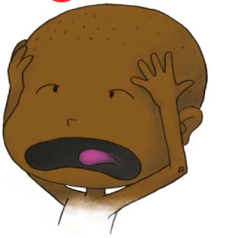
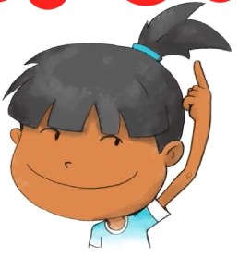
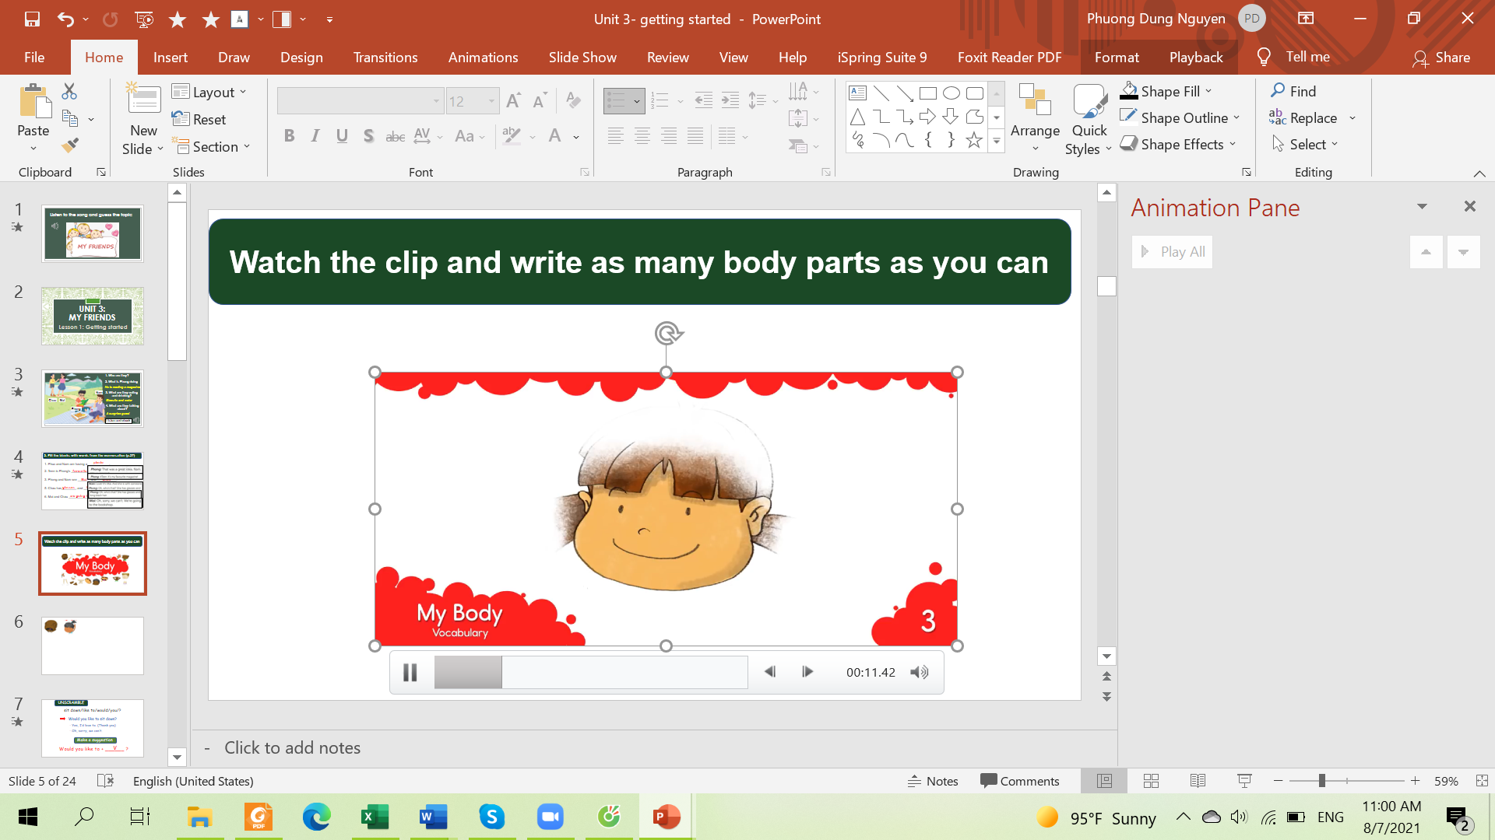
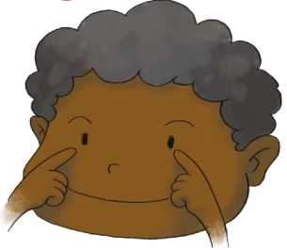
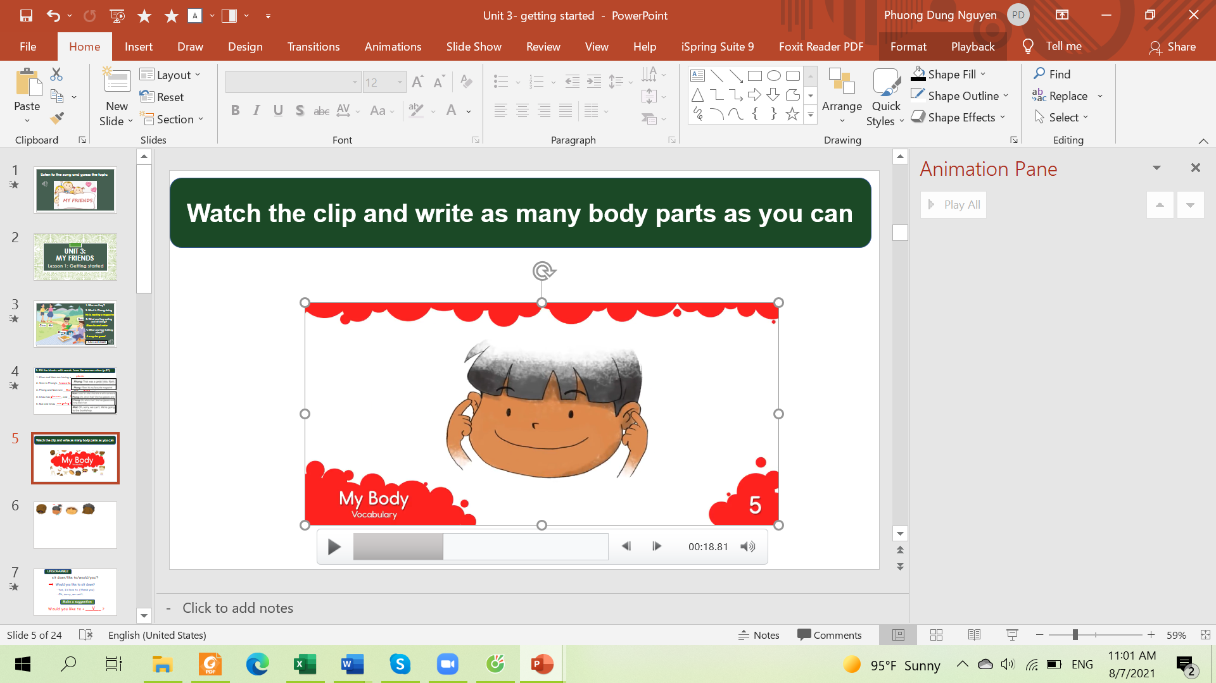
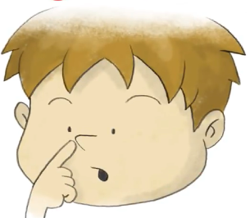
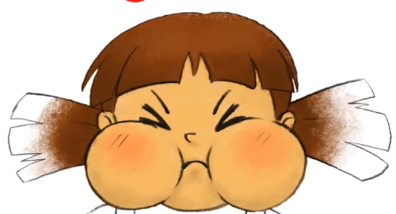
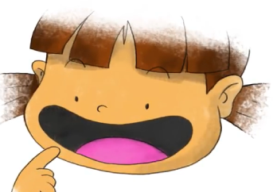


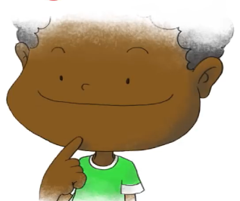
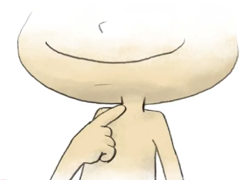
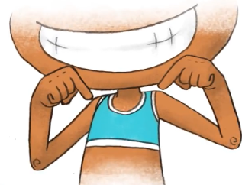

head
hair
face
eyes
ears
nose
cheeks
mouth
teeth
tongue
Listen and repeat
chin
neck
shoulders

Slide 16
3.Match the word with it’s meaning
cheek
Mắt
eye
Cánh tay
hand
Gò má
arm
Bàn tay
mouth
chân
leg
mũi
nose
Miệng
hair
tóc
shoulder
Bàn chân
foot
vai

Slide 17
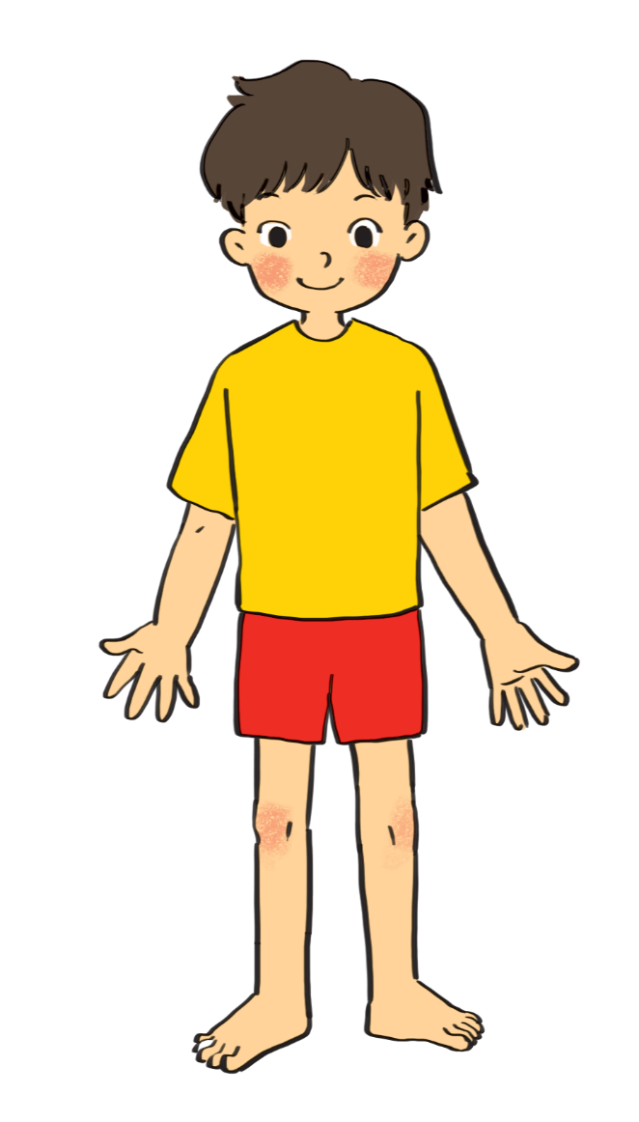

3. Label the body parts (p.27)
1.
eye
10.
hair
9.
cheek
Swap the answer with your partner
nose
2.
8.
mouth
3.
shoulder
7.
arm
4.
hand
5.
leg
6.
foot

Slide 18
Do you know any other words for body parts?
finger
ears
elbow
head
knee
face
fingers
tooth
lips
toes

Slide 19
How can you describe your friends?

She has long hair.
BFF
✗
She has long eyes.
Which one is correct?
Notes:
Some words go together but some don’t

Slide 20
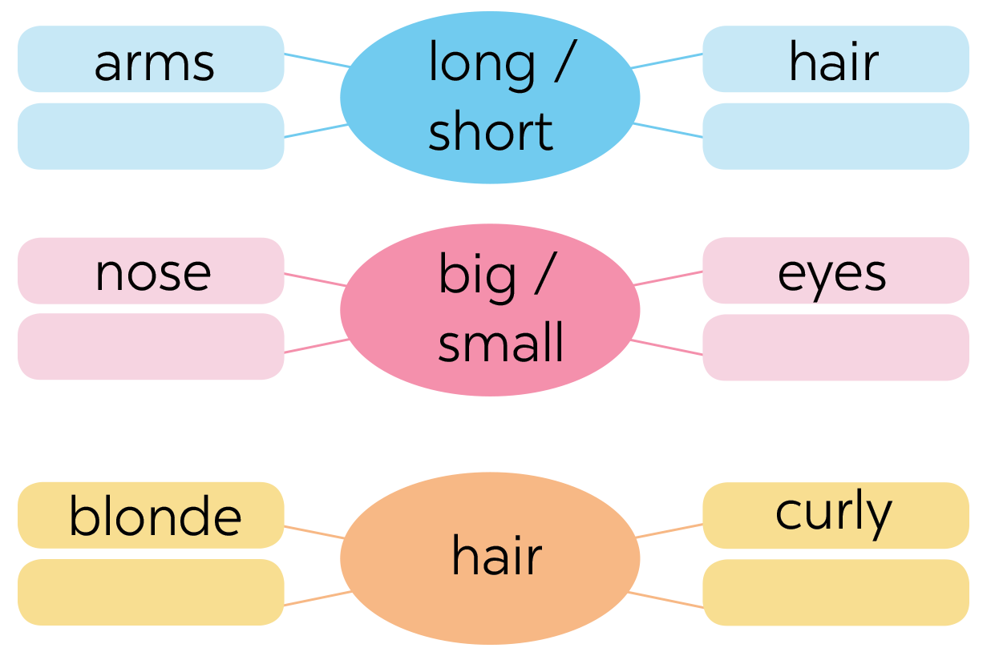

4. Work in group of 4. Complete the word webs.
legs
feet
hands
ears
black
straight

Slide 21

Work in groups. Complete the word webs.
arms
hair
long / short
leg

Slide 22
Work in groups. Complete the word webs.
nose
eyes
head
big / small
feet
hand
ears

Slide 23
Work in groups. Complete the word webs.
Xoăn, quắn
blonde
curly
long/short
black
hair
Gợn sóng
wavy
straight
fair

Slide 24
5. Mini game
Secret man

Slide 25
5. Game: Secret man.
Choose a friend in your class
Don’t tell his/her name to others
Write two sentences to describe that friend (2 mins)
Come to the board & ask others to guess your friend

Slide 26
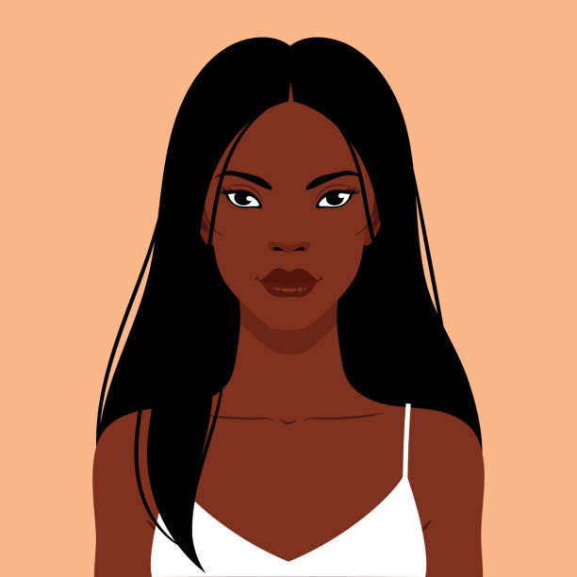
RECAP
What adjectives do we use to describe hair?
01


long
curly
small

blonde
big

straight
Which are correct?
02
She is black long hair.

She has long black hair.
She has straight long hair.

Slide 27
RECAP
What part of body do we use “long” and “short” to describe? hai
01


arms
eyes
hair

legs
mouth

feet
Which are correct?
02
He has a long mouth.

He has short arms.
He has long eyes.

Slide 28
RECAP
What part of body do we use “big” and “small” to describe?
01
nose, ears, hands, mouth, eyes….

Slide 29
Homework
- Learn by heart all the new words.
- Write each word two lines.
- Redo all exercises
- Prepare lesson 2 ( A closer look 1).

