Slide 1

Unit 5: Our customs and traditions
Grade 8 – Global success

Slide 2
Lesson 5: SKILLS 1

Slide 3
LAY - OUT
WARM-UP
Option 1: Asking questions
Option 2: Asking questions: Bamboozle
Vocabulary
Task 1: Work in pairs. Look at the picture and answer questions.
Task 2: Read the text. Choose the correct answer A, B, or C.
Task 3: Read the text again. Complete the mind map about a family party.
READING
Task 4: Work in pairs. Put the questions in the correct blanks to make a complete dialogue. Then role-play it.
Task 5: Make notes about a normal family event that you take part in. Then make a dialogue asking and answering about the event.
SPEAKING
CONSOLIDATION
Wrap-up
Homework

Slide 4

01
WARM – UP

Slide 5
WARM-UP
1. Have you ever been to a Festival?
2. Do you like it?
3. Can you describe it?
=> Yes, I have. / No, I haven’t.
=> Yes, I do. / No, I don’t.
=> Your own answer.

Slide 6
02
Vocabulary

Slide 7
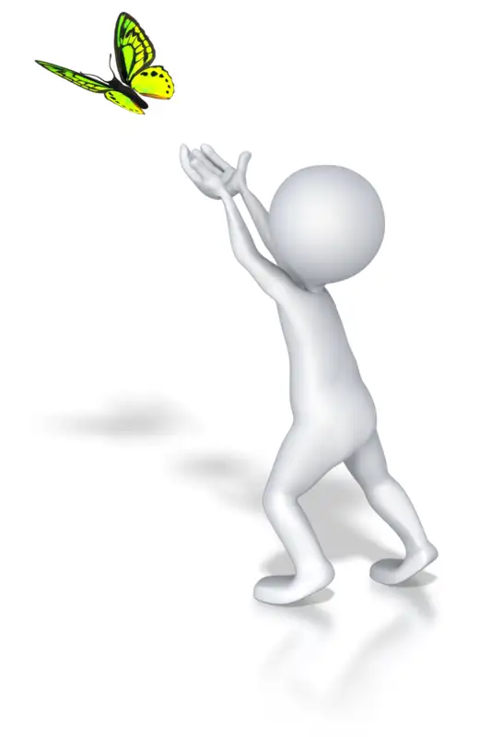

release (v)
/rɪˈliːs/
thả

Slide 8
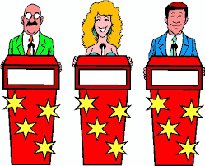
contestant (n)
/kənˈtestənt/
thí sinh,
người thi đấu

Slide 9
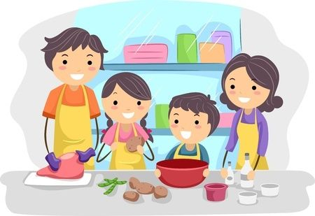
family bonding
/ˌfæməli ˈbɒndɪŋ/
sự gắn kết tình cảm gia đình

Slide 10
Vocabulary
New words | Pronunciation | Meaning
release (v) | /rɪˈliːs/ | thả
contestant (n) | /kənˈtestənt/ | thí sinh, người thi đấu
family bonding | /ˌfæməli ˈbɒndɪŋ/ | sự gắn kết tình cảm gia đình

Slide 11
03
Reading

Slide 12
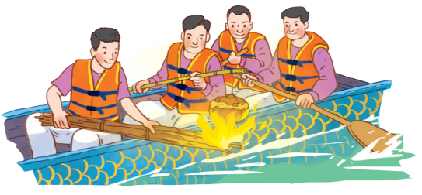
1
Work in pairs. Look at the picture and answer the following questions.
1. What are the men doing?
- They are rowing a boat. They are cooking rice on an open fire.
2. When do you think this event occurs?
- This event may occur in a festival in the North of Vietnam.

Slide 13
Reading
A village festival day
I live in a small village in northern Viet Nam. Every year, people in my village look forward to the third day of Tet. It is one of our most important festival days.
In the morning, we gather along the riverside to watch some competitions. First, there is a special boat race. Some team members cook rice on the boat while others row the boat as fast as they can. The fastest team with well-cooked rice wins the race. Then, the referee releases a duck into the middle of the river. Contestants jump into the river to catch it. The atmosphere becomes loud with the sound of drums and cheers of festival goers.
At noon, there is a village party at the communal house for the elders. Each family also holds a home party. We cook traditional dishes like sticky rice and steamed chicken. Sometimes, we include food that children love, such as bun cha or even pizzas!
The village festival helps us maintain our traditions, connect with other people, and strengthen our family bonds.

Slide 14
2
Read the text. Choose the correct answer A, B, or C.
1. What is the text mainly about?
A. A local tradition.
B. A family tradition.
C. A family tradition.
2. To win the boat race, a team must ______.
A. row the boat more quickly than the other teams B. row the boat the fastest and properly cook the rice
C. cook rice properly and catch the duck
I live in a small village in northern Viet Nam. Every year, people in my village look forward to the third day of Tet. It is one of our most important festival days.
The fastest team with well-cooked rice wins the race.

Slide 15
2
Read the text. Choose the correct answer A, B, or C.
3. The phrase “releases a duck” in the text means ______.
A. gives it freedom
B. catches it
C. takes it home
4. Why is the festival important?
A. Because it is exciting.
B. Because people win valuable prizes.
C. Because it keeps some village traditions alive.
Then, the referee releases a duck into the middle of the river.
The village festival helps us maintain our traditions, connect with other people, and strengthen our family bonds.

Slide 16
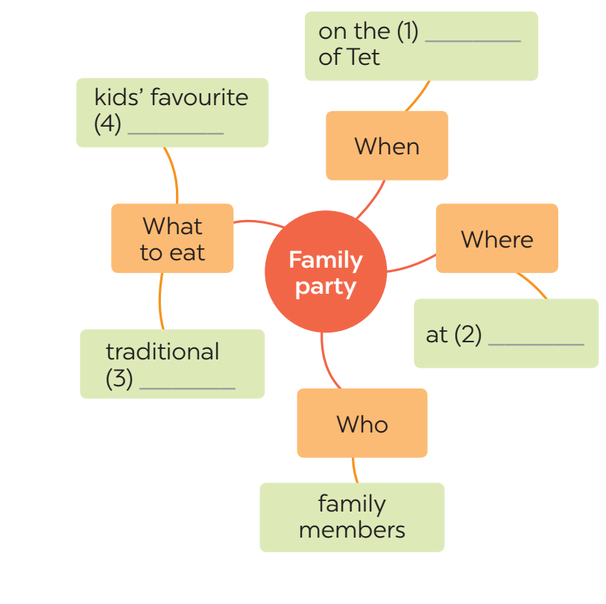
3
Read the text again. Complete the mind map about a family party.
third day
4. We cook traditional dishes like sticky rice and steamed chicken. Sometimes, we include food that children love, such as bun cha or even pizzas!
3. We cook traditional dishes like sticky rice and steamed chicken.
food
2. At noon, there is a village party at the communal house for the elders. Each family also holds a home party.
1. Every year, people in my village look forward to the third day of Tet.
home
dishes

Slide 17
04
Speaking

Slide 18
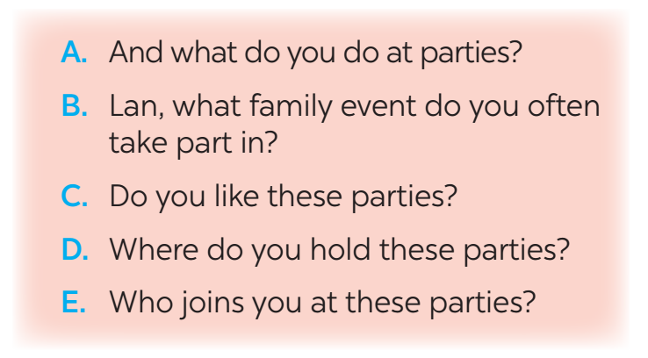
4
Work in pairs. Put the questions (A - E) in the correct blanks (1 - 5) to make a complete dialogue. Then role-play it.
Nick: (1) ______ Lan: Well, I join birthday parties of all my family members. Nick: (2) ______ Lan: In a Vietnamese restaurant. But sometimes we break with tradition by going to a Western one. Nick: (3) ______ Lan: Everyone in my family.
Nick: (4) ______ Lan: Well, the birthday person opens the gifts. and everyone has some good food. Nick: (5) ______ Lan: Yes, I always look forward to them. They are a great time for family bonding.

Slide 19
5
Make notes about a normal family event that you take part in. Use the questions below as cues.
1. What is the event?
2. Where and when does it happen?
3. Who joins with you?
4. What do you often do at that event?
5. Do you like it or not? Why or why not?
Full Moon Festival
Now work in pairs. Make a dialogue asking and answering about the event. You can use your notes.
On the 15th day of the 8th Lunar Month in Asia
My family, my friends,…
Eat moon cake, hang lantern....
Yes, I do. Because I can celebrate with my family.

Slide 20
Suggested conversation
An: Bao, what family event do you often take part in?
Bao: It’s the family reunion party at the end of the year.
An: Where do you hold these parties?
Bao: It holds in my grandparents’ house.
An: Who joins you at these parties?
Bao: Every family members gather at my grandparent’s house.
An: And what do you do at parties?
Bao: We have lots of good food and each other tells what happened to them in a year.
An: Do you like these parties?
Bao: Yes, I always look forward to them. They are a great time for family bonding.

Slide 21
04
Consolidation

Slide 22
Consolidation
01
02
- Reading: Read for specific information about village festival day.
- Speaking: Talk about family event.
- Do exercises in the workbook.
- Prepare “SKILLS 2“ part

Slide 23
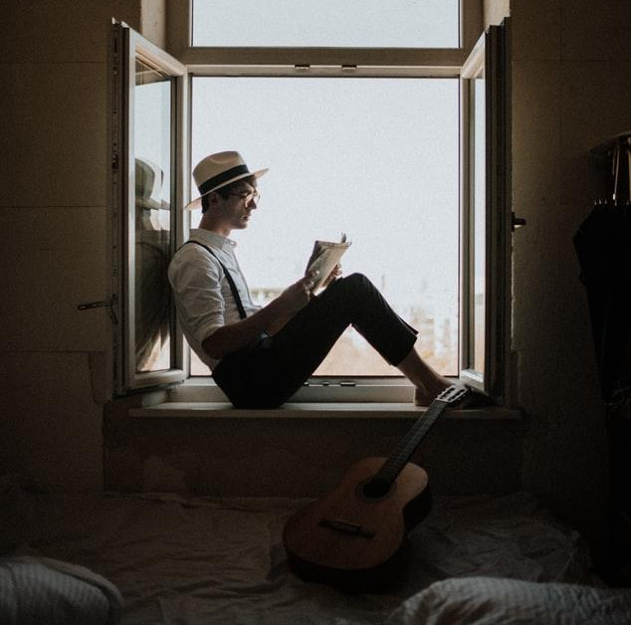

Thank you for your attention!

