Slide 1
WELLCOME TO OUR CLASS 7A1

Slide 2
What is he/ she like doing?

Slide 3
Dancing
Swimming
drawing
Cooking
Riding a bike
Petting a soft furry dog

Slide 4
My Hobby
Unit
1

Slide 5
Healthy Living
Unit
2

Slide 6
Community service
Unit
3

Slide 7
REVIEW 1 (UNITS 1-2-3) LANGUAGE

Slide 8
REVIEW 1 LANGUAGE
I
Pronunciation
II
Vocabulary
III
Grammar

Slide 9
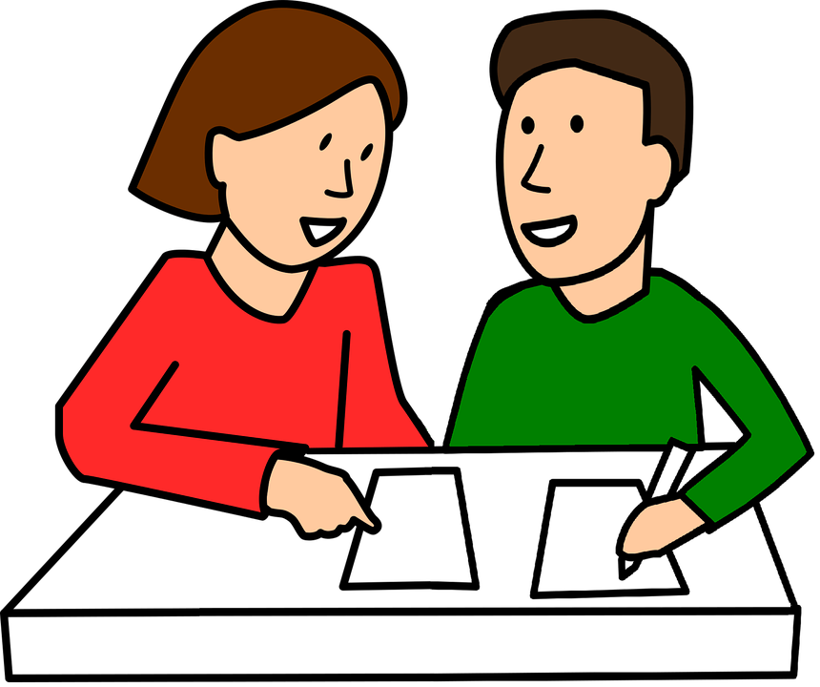
REVIEW 1 LANGUAGE
I
Pronunciation
1. Circle the word in which the underlined part is pronounced differently. Then listen, check and repeat
1. A. proverb B. together C. exercise 2. A. learn B. earn C. hear 3. A. collected B. cleaned C. decided 4. A. listened B. helped C. watched 5. A. laugh B. ghost C. rough

Slide 10
REVIEW 1 LANGUAGE
II
Vocabulary

Slide 11
VOCABULARY
2
Put the phrases below in the correct columns.
1. raising money for charity
4. helping street children
7. doing sports
2. cleaning your room
5. collecting stamps
8. donating clothes
3. doing volunteer work
6. doing judo
Activities you do for…
yourself | your community
2. cleaning your room
5. collecting stamps
6. doing judo
7. doing sports
8. donating clothes
3. doing volunteer work
4. helping street children
1. raising money for charity

Slide 12
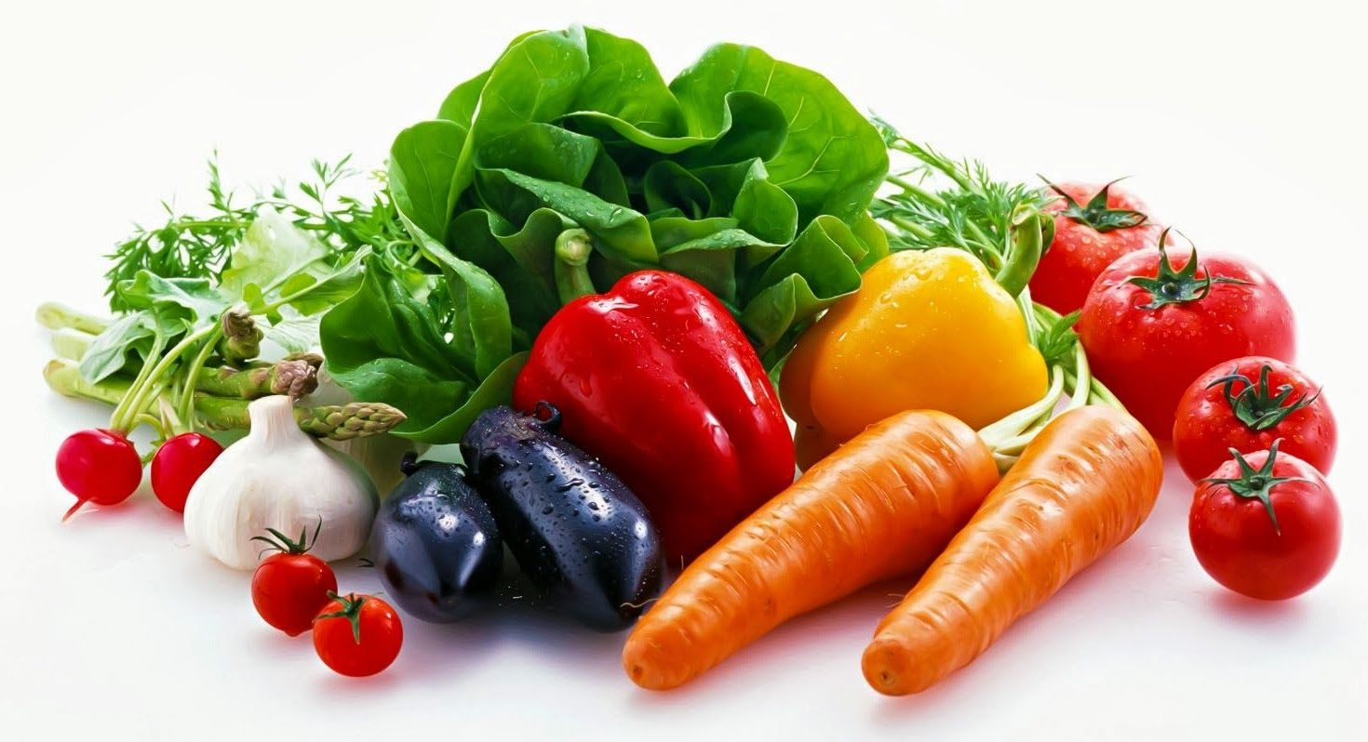
VOCABULARY
3
Complete the sentences with the words and phrases below.
hobby, coloured vegetables, chapped lips, mountainous areas, taking photos, community
1. Eating _______________________ and exercising can help you keep fit and stay healthy. 2. The Donate a Book event helps children in _______________________. 3. My brother spends a lot of time making models. that’s his ________________. 4. If you have ___________________, use lip balm. 5. There are many things you can do to help your ________________. 6. I love ________________ of the sunset
coloured vegetables
mountainous areas
hobby
chapped lips
community
taking photos

Slide 13
REVIEW 1 LANGUAGE
III
Grammar

Slide 14
Grammar:

Slide 15
The present simple
+)S+ is/am/are S+ V _s / es -) S + is/ am/ are + not S+ do/does+ not + V ?) Is/ am/are+ S? Do/ does + S + V? Signals: everyday, always, often, usually…

Slide 16
GRAMMAR
4
Fill in the blanks with the correct tense of the verbs in brackets.
1. He often (read) ___________ books in dim light, so his eyes hurt. 2. ___________ you (do) ___________ the gardening at the weekend? 3. Ordinary people (need) ___________ about 2,000 calories a day to stay healthy. 4. I (cannot) ___________ ride a bicycle when I was 6. 5. Last summer Phong (not volunteer) _________________ to teach maths to street children.
6. We (join) ___________ the project Plant a Tree in 2019 to make our area green.
reads
Do
do
need
could not
didn’t volunteer
joined

Slide 17
Gift box game

Slide 18
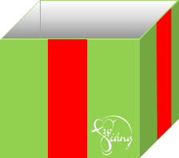
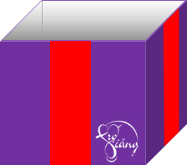
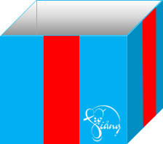
1
6

Slide 19
1. He often (read) ____ books in dim light, so his eyes hurt.
reads
You are given 3 candies
GO HOME

Slide 20
2. ____ you (do) ___ the gardening at the weekend?
Do/ do
You are given 4 candies
GO HOME

Slide 21
3. Ordinary people (need) ___________ about 2,000 calories a day to stay healthy
need
You are given 2 candies
GO HOME

Slide 22
4. I (cannot) ___________ ride a bicycle when I was 6.
couldn’t
You are given a secret gift
GO HOME

Slide 23
5. Last summer Phong (not volunteer) _________to teach maths to street children.
didn’t volunteer
You are given a secret gift
GO HOME

Slide 24
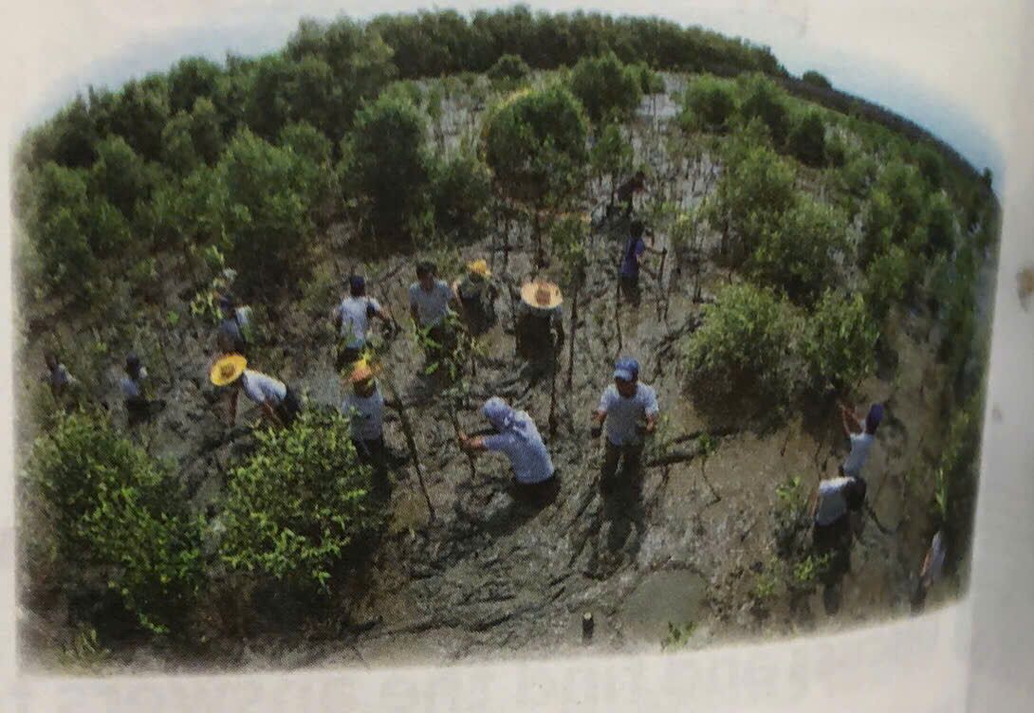
6. We (join) _____ the project Plant a Tree in 2019 to make our area green.
joined
GO HOME
You are given 2 pens

Slide 26
GRAMMAR
5
Turn the sentences into negative statements or questions.
1. She liked exercising. (not) → She ________________________________________________________. 2. My family always spends time doing housework together on Sundays. (not) → My family ___________________________________________________. 3. I used a lot of suncream during my holiday. (not) → I ___________________________________________________________. 4. My community organised a fair to raise money for the homeless last week. (?) → ____________________________________________________________? 5. Tim makes beautiful pieces of art from dry leaves and sticks. (?) → ____________________________________________________________?
didn’t like exercising
doesn’t always spend time doing housework together on Sunday
didn’t use a lot of sun cream during my holiday
Did your community organise a fair to raise money for the homeless last week
Does Tim make beautiful pieces of art from dry leaves and sticks

Slide 27
Language
Pronunciation
Vocabulary
Grammar

Slide 28
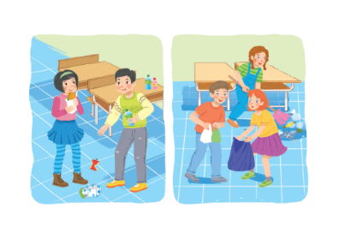

Slide 29
IV. HOMEWORK
Do again exercises
Review Unit 1,2,3

Slide 30
THANK YOU FOR YOUR ATTENDANCE
Good luck !
GOOD BYE ! SEE YOU AGAIN .

Slide 31
Thank you!

Slide 32
What did you do to help your community?

