Slide 1
WELCOME TO CLASS 8A1

Slide 3
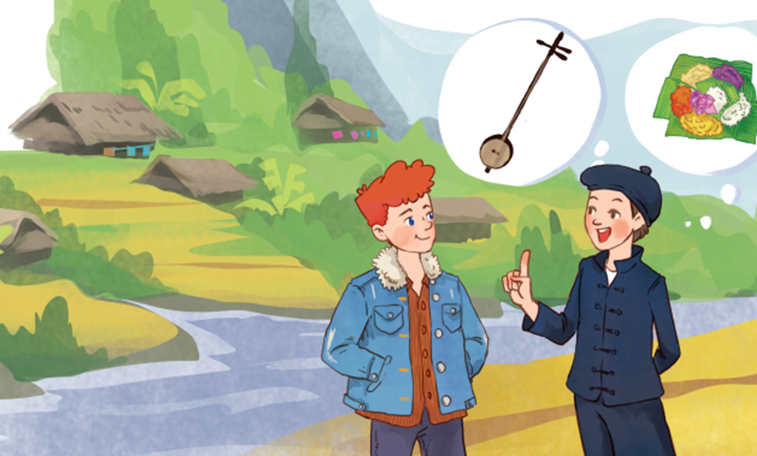
Unit
4
ETHNIC GROUPS OF VIET NAM
Unit
ETHNIC GROUPS OF VIET NAM
LESSON 1: GETTING STARTED
“I’m from the Tay ethnic group.”
Tom
Lai

Slide 4
* Listen and underline words that you want to know. (P40/textbook)
Tom: Hi, I’m Tom. You look new here.
Lai: I am. I’m Lai from Ha Giang.
Tom: Oh, I’ve heard about beautiful Ha Giang. Do you live in the mountains?
Lai: Yes, I do. I’m from the Tay ethnic group. We are the second largest ethnic group in Viet Nam, only after the Kinh.
Tom: Oh … I once saw a bamboo house on high posts in a travel brochure. Do you live in a home like that?
Lai: Yes, we call it a “stilt house”. Our house overlooks terraced fields.
Tom: Awesome. What is life in your village like?
Lai: It’s peaceful. There are 16 houses in my village. We live very close to nature.
Tom: I love it. Can you tell me something about your culture?
Lai: Certainly. We have our own culture. You can see it in our folk dances, musical instruments like the dan tinh, and our special five-colour sticky rice.
Tom: It sounds interesting. I hope to visit Ha Giang one day.

Slide 5
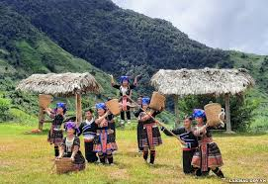
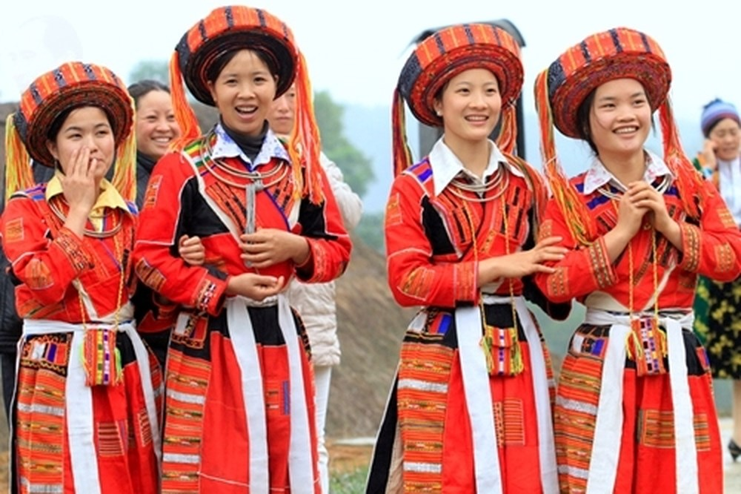
I. Vocabulary
1. ethnic group (n):
/ˈeθnɪk gru:p/

Slide 6
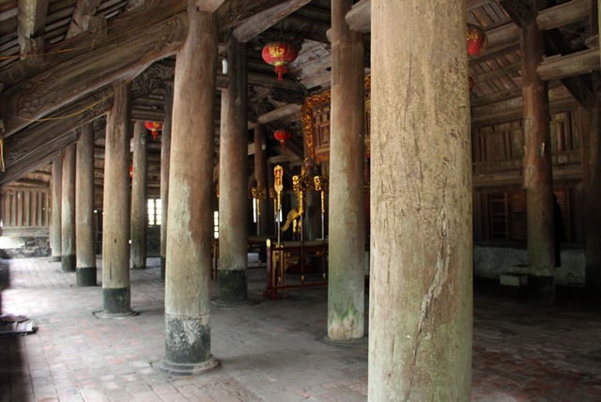
2. post (n):
/pəʊst/

Slide 7
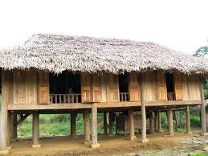
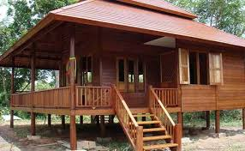
3. stilt house (n):
/stilt haus/
nhà sàn

Slide 8
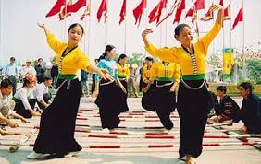
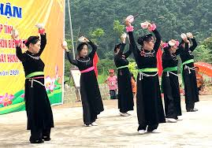
4. folk dance (n):
/ˈfəʊk dæns/

Slide 9
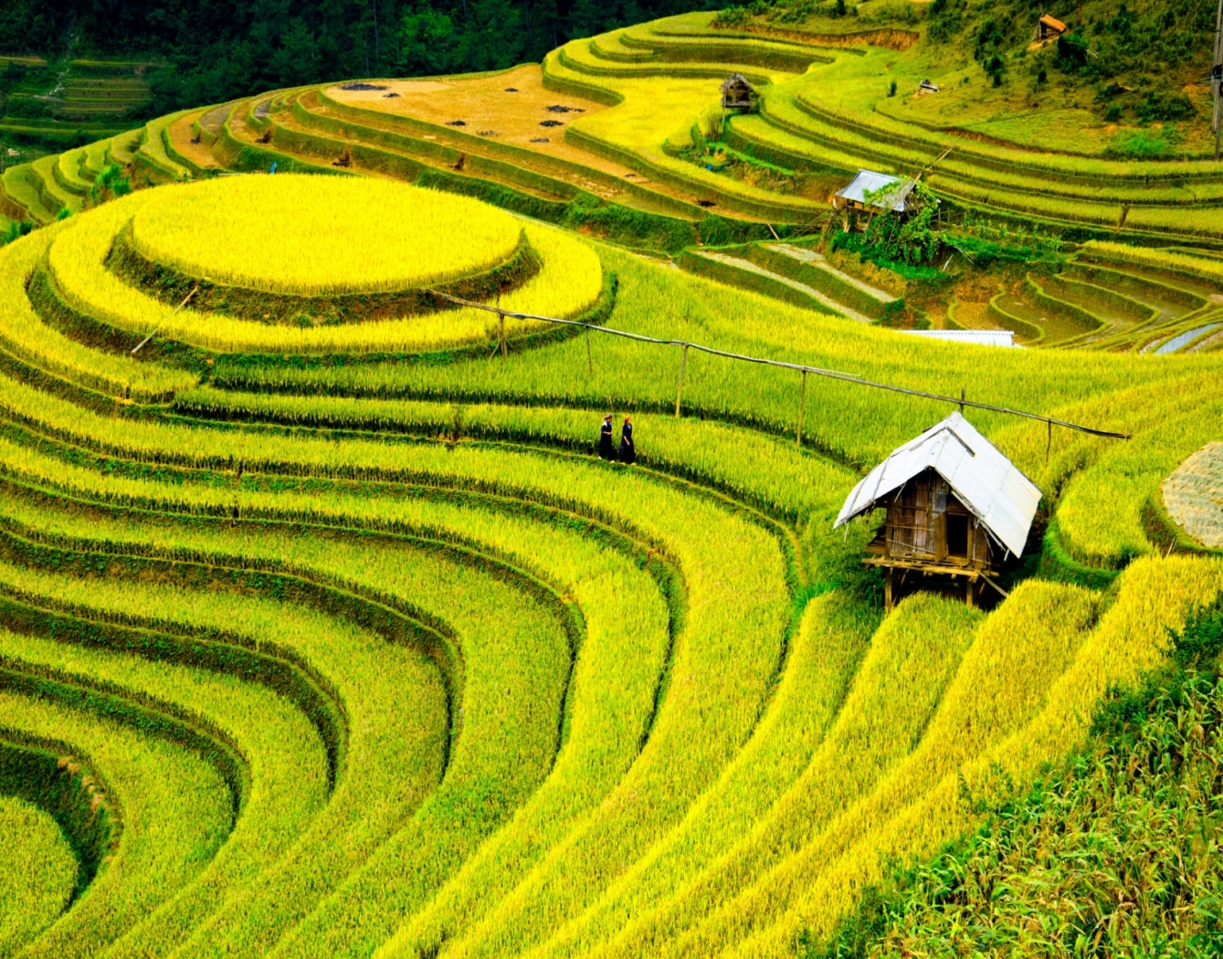
5. terraced field (n):
/ˈterəst fiːld /

Slide 10
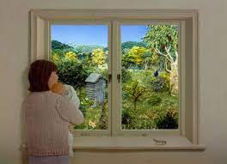
6. overlook (v):
/ˌəʊ.vəˈlʊk/

Slide 11
I. Vocabulary:
1. ethnic group (n) | /ˈeθnɪk gru:p/ | nhóm dân tộc
2. post (n) | /pəʊst/ | cột
3. overlook (v) | /ˌəʊ.vəˈlʊk/ | nhìn ra
4. stilt house (n) | /stilt haus/ | nhà sàn
5. folk dance (n) |  | điệu nhảy dân gian
6. terraced field (n) | /ˈter.əst fiːld / | ruộng bậc thang
/ˈfəʊk dæns/

Slide 12
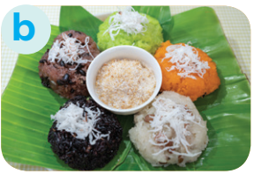
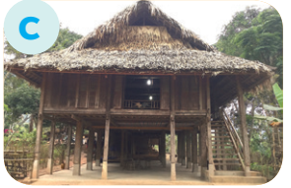
* Match the pictures with the word and phrases from the conversation.
1. stilt house
2. terraced fields
3. bamboo
4. five-colour sticky rice
e
5. folk dance
f
6. overlook

Slide 13
II. Task 2: Read the conversation again and circle the best answers.
1. What are Tom and Lai talking about?
A. Minority groups in Viet Nam.
B. Ha Giang.
C. Life of the Tay people.
2. A “stilt house” ______.
A. is a multi-storey home
B. is on high posts
C. always faces a field
3. Lai mentions ______ of the Tay people.
A. folk dances
B. popular festivals
C. costumes

Slide 14
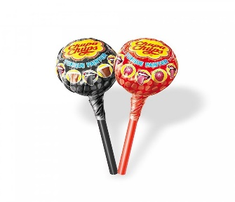
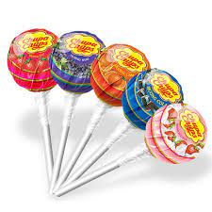
GAME: LUCKY BOX
1
2
3
4
4
1
2
3

Slide 15
3. Lai mentions ____ of the Tay people.
90
89
A. folk dances
GO HOME

Slide 16
Congratulation!
GO HOME

Slide 17
1. What are Tom and Lai talking about?
C. Life of the Tay people
GO HOME

Slide 18
2. A stilt house _______
C. always faces a field
GO HOME

Slide 19
II. Task 2: Read the conversation again and circle the best answers.
1. What are Tom and Lai talking about?
A. Minority groups in Viet Nam.
B. Ha Giang.
C. Life of the Tay people.
2. A “stilt house” ______.
A. is a multi-storey home
B. is on high posts
C. always faces a field
3. Lai mentions ______ of the Tay people.
A. folk dances
B. popular festivals
C. costumes

Slide 20
Task 4: Complete the sentences with the words and phrases from the box.
overlooks musical instrument ethnic groups
folk dance traditional
1. I love mua sap, a popular _________ of the Thai people.
2. Their beautiful stilt house _________ a large rice field.
3. A: What is the name of a popular Tay’s __________________?
B: It’s dan tinh.
4. Every ethnic group has their own __________ culture.
5. Of the 54 ______________ in Viet Nam, the Kinh is the largest

Slide 21
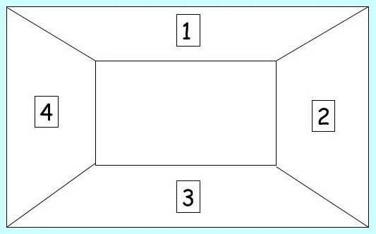
Task 4: Complete the sentences with the words and phrases from the box.
- Tablecloth: Work in groups of 4 – (4 minutes)
- Peer correction: Exchange extra board to check the answers.

Slide 22
Task 4: Complete the sentences with the words and phrases from the box.
folk dance
1. I love mua sap, a popular _________ of the Thai people.
2. Their beautiful stilt house _________ a large rice field.
3. A: What is the name of a popular Tay’s __________________?
B: It’s dan tinh.
4. Every ethnic group has their own __________ culture.
5. Of the 54 ______________ in Viet Nam, the Kinh is the largest
overlooks
musical instrument
traditional
ethnic groups

Slide 23
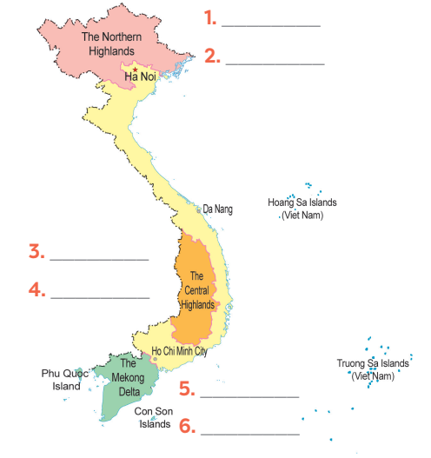
5
Game: Where are they?
Hmong
Nung
Ede
Bahnar
Khmer
Cham

Slide 24
* Wrap-up
ETHNIC GROUPS OF VIET NAM
About ethnic groups
Topic of the unit
Vocabulary
* Tell something about ethnic groups of Viet Nam that you know after you’ve learned the lesson.

Slide 26
III. Homework
- Learn by heart all the words + Write 3 lines.
- Copy Task 4 in notebooks.
- Prepare for the Project of the unit P.49.
- Prepare Review 1 (Units 1,2,3):
+ Vocabulary: Words related to topics
+ Grammar: Verbs of liking, Comparative abverbs, Simple sentences and compound sentences.

