Slide 1

DA LOAN LOWER SECONDARY SCHOOL
Welcome to our class
7

Slide 2


Slide 3
RULE
- There are some questions, and each question have 3 options A, B, C
- You have 10 second to read the question . Who raise hand first will have the right to give answer
- If you give the correct answer, you will receive a gift

Slide 4
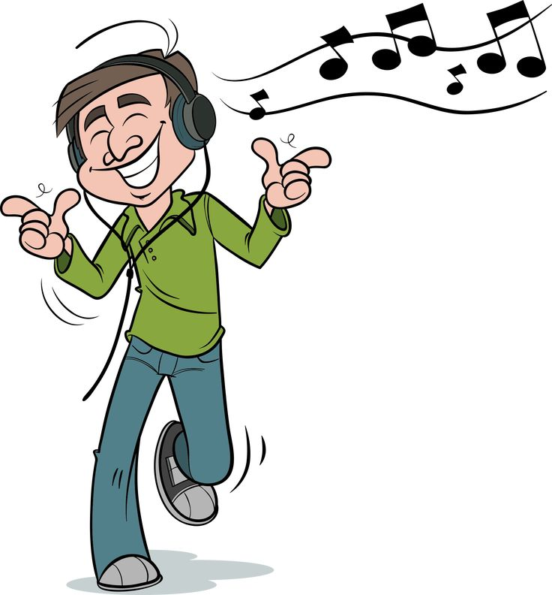







Question 1. Look at the picture. What is his favourite hobby?
A. Listening to music
B. Playing sports
C. Doing judo

Slide 5
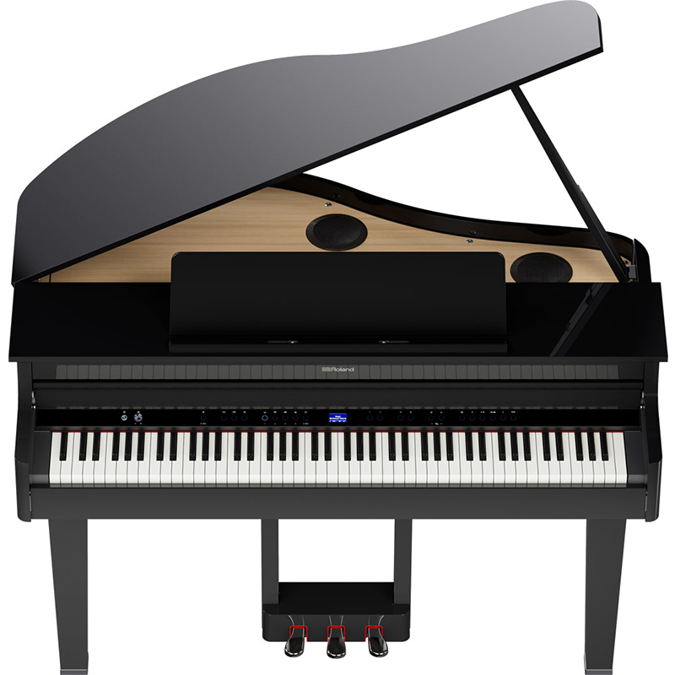

Question 2. What is this?
A. Guitar
B. Piano
C. Violin

Slide 6

Question 3. Look at the picture. What is she doing?
A. Taking photos
B. Drawing pictures
C. Sing a song

Slide 7
Question 4. Listen to a short song. What is the name of this song?
A. I love my family
B. How are you? I’m fine
C. Baby shark

Slide 8
Question 5. What is the title of UNIT 4 of your English textbook?
A. My house
B. Music and arts
C. Tet holiday

Slide 9




Unit
4
MUSIC AND ARTS
LESSON 1: GETTING STARTED
Unit
HOBBIES

Slide 10
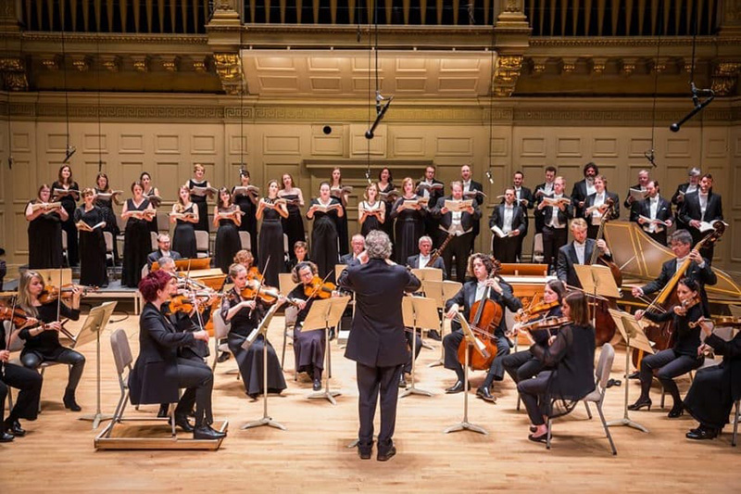
I. VOCABULARY
classical music (n)
Nhạc cổ điển

Slide 11
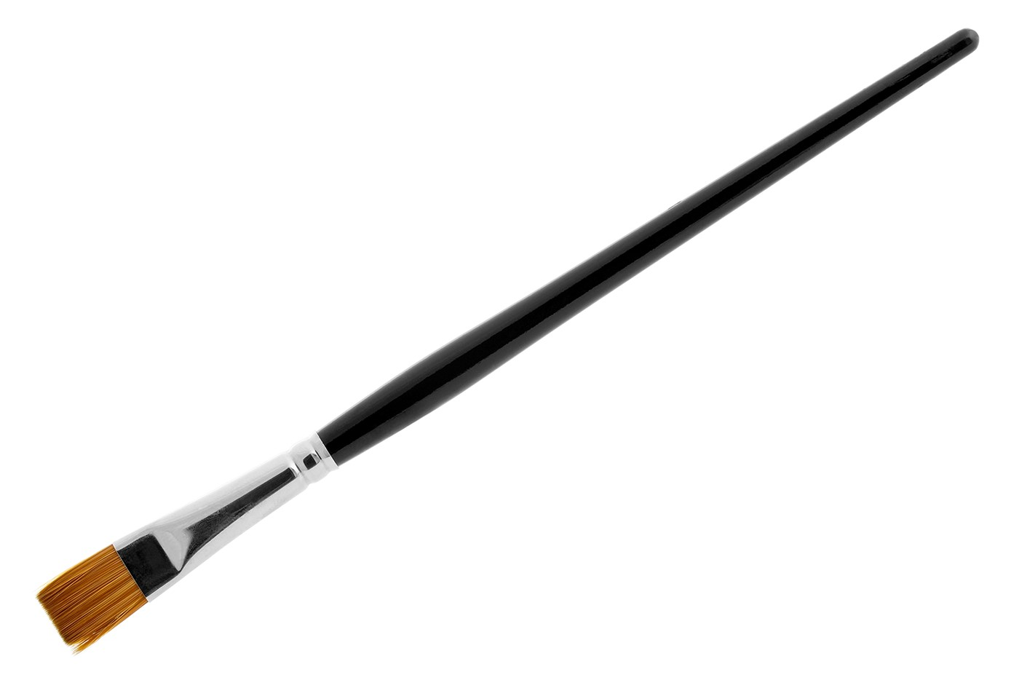
I. VOCABULARY
paintbrush (n)
cọ vẽ

Slide 12
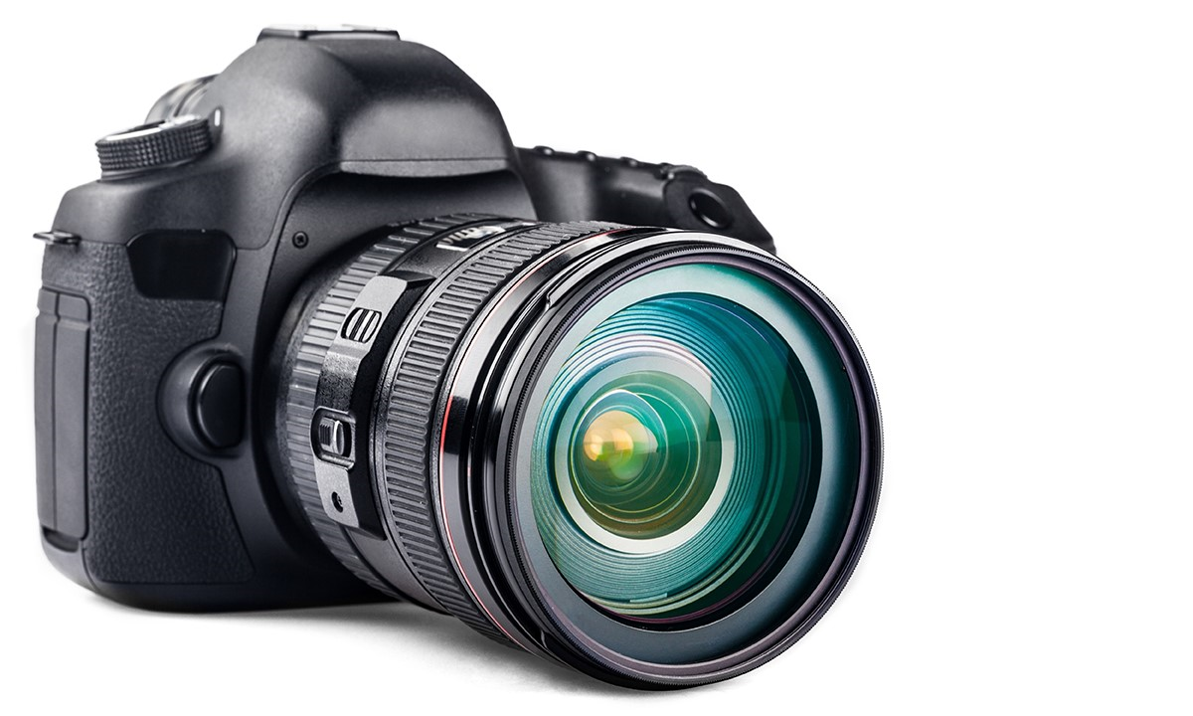
I. VOCABULARY
camera (n)
máy ảnh

Slide 13
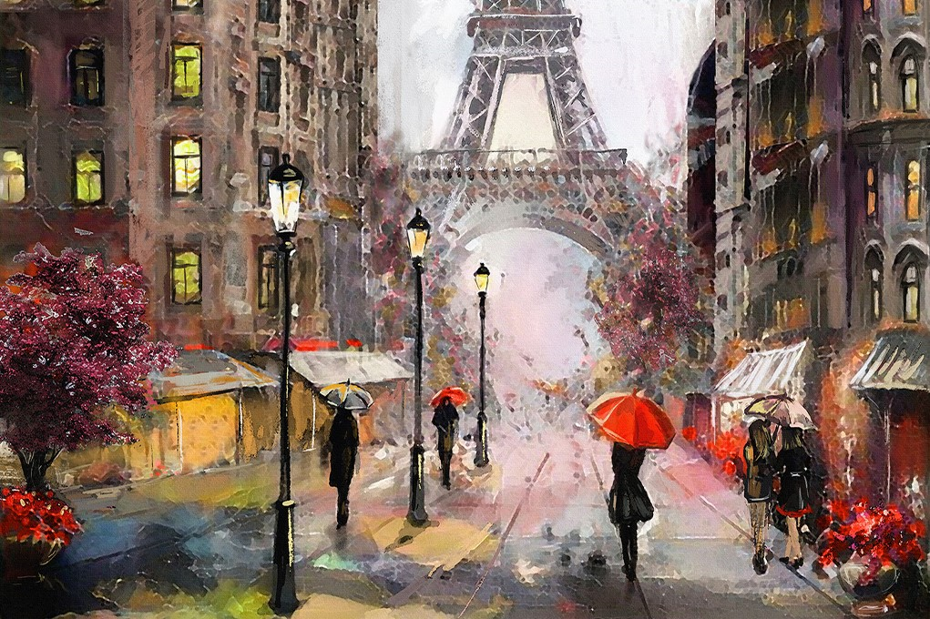
I. VOCABULARY
painting (n)
bức họa

Slide 14
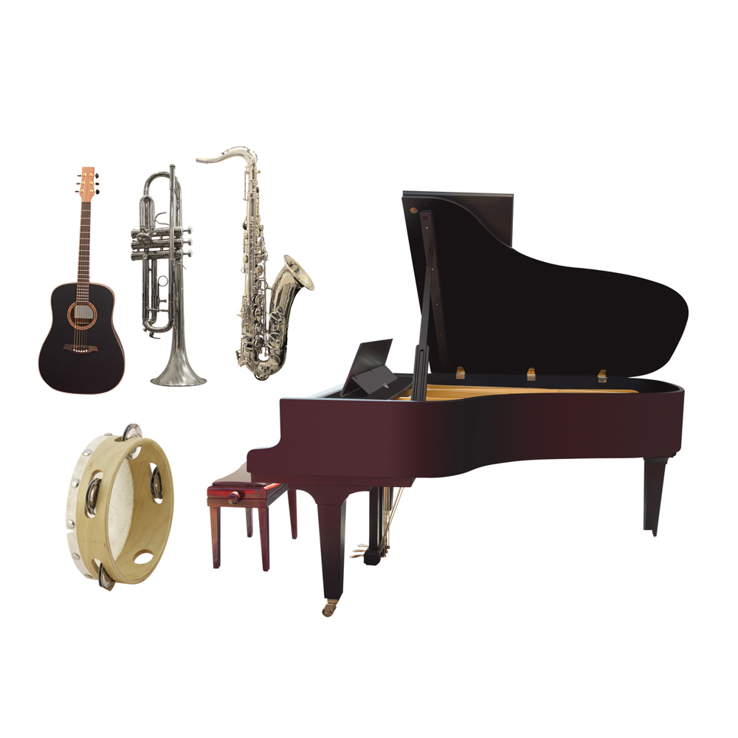
I. VOCABULARY
musical instrument (n)
nhạc cụ

Slide 15
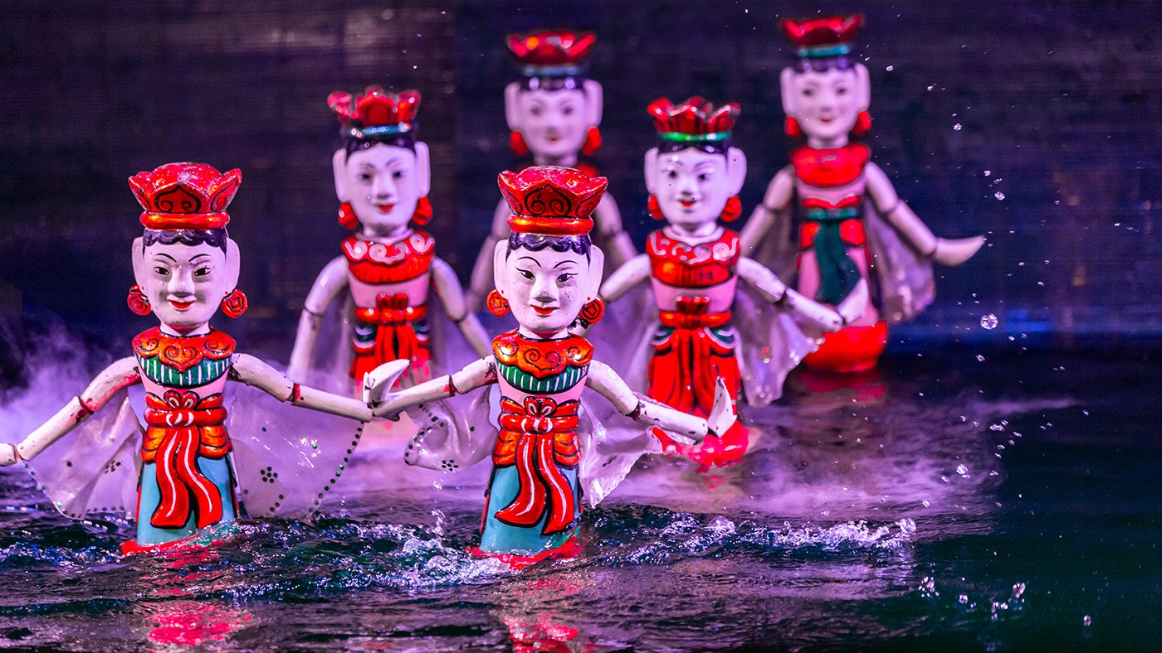
I. VOCABULARY
water puppet show (n)
chương trình múa rối nước

Slide 16
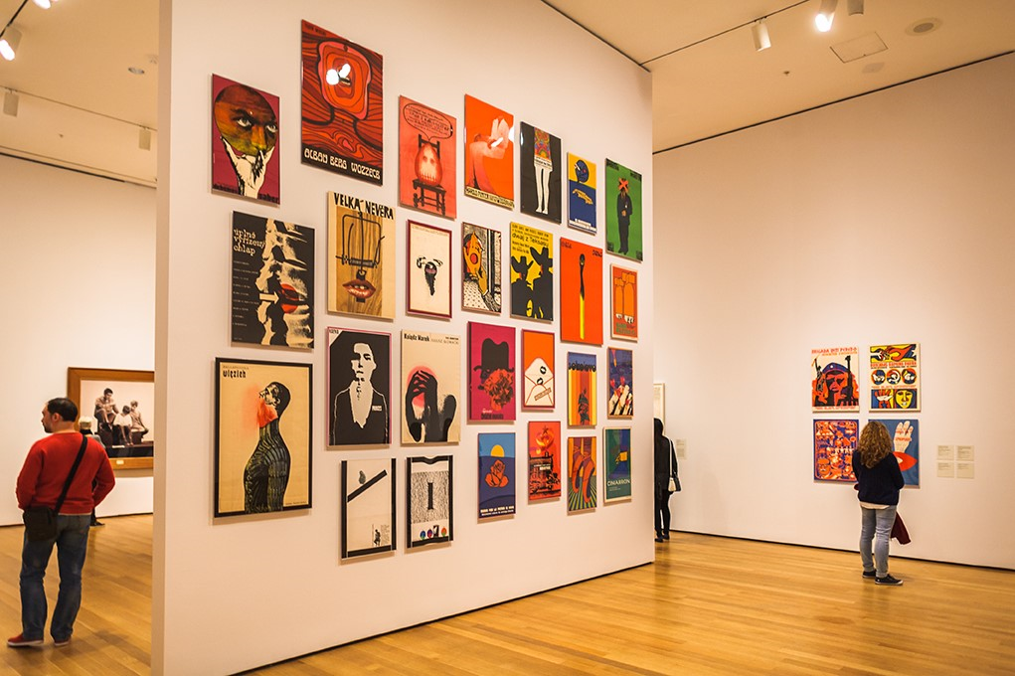
I. VOCABULARY
art gallery (n)
Phòng trưng bày nghệ thuật

Slide 17
I. VOCABULARY
New words | Meaning
1. classical music (n) | nhạc cổ điển
2. paintbrush (n) | cọ vẽ
3. camera (n) | máy ảnh
4. painting(n) | bức họa
5. musical instrument (n) | nhạc cụ
6. water puppet show(n) | chương trình múa rối nước
7. art gallery (n) | phòng trưng bày nghệ thuật

Slide 18
MATCHING
1-a 2-e 3-d 4-e 5-b 6-g 7-c
New words | Meaning
1. classical music | a. nhạc cổ điển
2. paintbrush (n) | b. nhạc cụ
3. camera (n) | c. phòng trưng bày nghệ thuật
4. painting(n) | d. máy ảnh
5. musical instrument (n) | e. cọ vẽ
6. water puppet show(n) | f. bức họa
7. art gallery (n) | g. chương trình múa rối nước

Slide 19
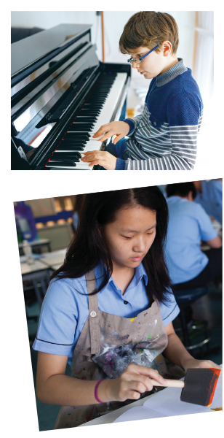

LISTEN AND READ.
A talk at the school gate
Trang: Hi Nick. What are you listening to?
Nick: I’m listening to music. I like classical music, and I often play the piano in my spare time.
Trang: Wow. I can’t play any instruments.
Nick: And what about you? What’s your hobby?
Trang: I like painting and taking photos.
Nick: Taking photo? I’ve never tried it. Is it fun?
Trang: Yeah, it is, but not as fun as painting.
Nick: Right. They seem quite different from each other. What do you normally paint?
Trang: Landscapes and animals, just for pleasure, you know. I sometimes share them with my friends.
Nick: Really? Um, maybe we should go to an art gallery next weekend?
Trang: Sounds good, but I’d prefer to go to the music festival at my school.
Nick: Well … OK. That’s fine.

Slide 20
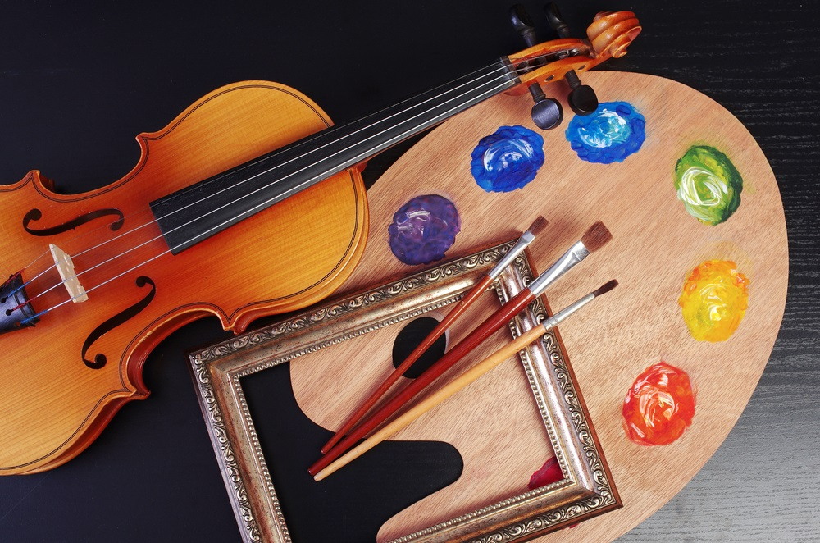
II. PRACTICE
Task 2: Circle the correct answer.
1. What are Trang and Nick talking about?
A. Playing the piano.
B. Drawing and painting.
C. Music and arts.
Trang: Hi Nick. What are you listening to?
Nick: I’m listening to music. I like classical music, and I often play the piano in my spare time.
Trang: I like painting and taking photos.

Slide 21
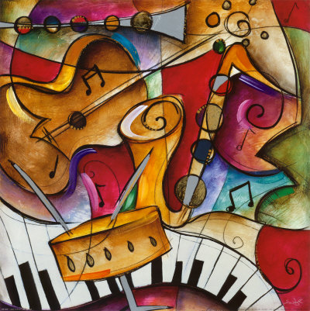
II. PRACTICE
3
Complete each of the sentences with a suitable word or phrase from the box.
photos like different from art gallery musical instruments
Nick wants to go to a(n) _____________ next week.
You can use your smartphone to take ________.
This photo is very bright. It is _____________ that dark one.
Nick and Trang agree that taking photos is not _____________ painting.
My friend David is very talented. He plays three _______________________.

Slide 22
II. PRACTICE
3
Complete each of the sentences with a suitable word or phrase from the box.
photos like different from art gallery musical instruments
art gallery
Nick wants to go to a(n) _____________ next week.
You can use your smartphone to take ________.
This photo is very bright. It is _____________ that dark one.
Nick and Trang agree that taking photos is not _____________ painting.
My friend David is very talented. He plays three _______________________.
photos
different from
like
musical instruments

Slide 23
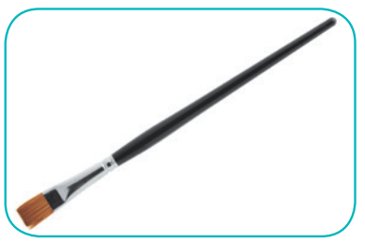

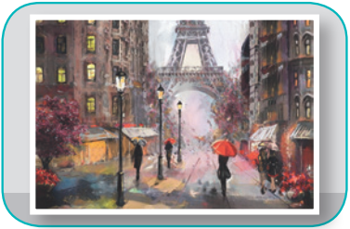
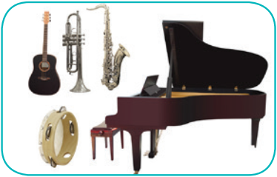
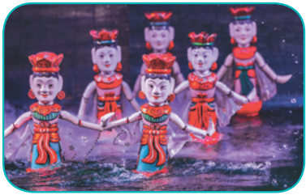
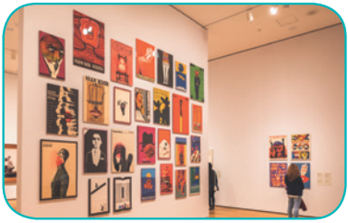
II. PRACTICE
3
Write the correct word or phrase under each picture. Then listen and repeat.
camera water puppet show art gallery
painting paintbrush musical instruments
paintbrush
camera
painting
1. ______________
2. ____________
3. ____________
musical instruments
water puppet show
4. __________________________
5. _________________________
art gallery
6. ____________

Slide 24
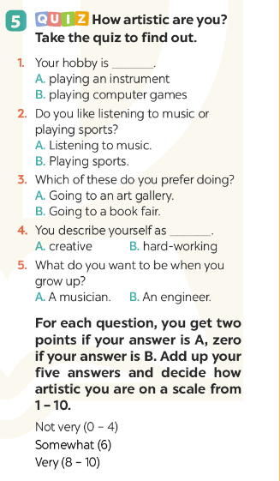

III. PRODUCTION
5
Quiz “How artistic are you?”.

Slide 25

Prepare for the next lesson: A closer look 1.
+ Find the meaning of some words: composer(n)/compose(v), concert hall(n), artist(n), actress(n),musician(n), painter(n), portrait(n)
+ Do tasks
+ Find how to pronounce 2 sounds /ʃ/ and /ʒ/
Notes:
It’s necessary to preview the show!
tranvanbinhtv@gmail.com

