Slide 1
ENGLISH 8
WELCOME TO OUR CLASS !

Slide 2
WARM UP
Meeting face to face
Using social media
Video chatting
Sending letters
Ways of communication
Using telepathy
Chatting online
Using voice message
Using body language
Having a video conference

Slide 3
Unit 10 : Communication in the future
Lesson 5 : Skill 1

Slide 4
I. READING
TELEPATHY
https://youtu.be/pyzy5seI2B0?si=9qHqd9FHe4Ds2sde

Slide 5
I. READING
2
Read an interview with two students, Minh and Tom. Then tick the speaker of each sentence.
TELEPATHY
MC: Hi everyone. Today, I'll ask some members of the Technology Club to predict how people will communicate in the future. Let’s meet Minh and Tom.
Minh & Tom: Hi everyone.
MC: Minh and Tom, how do you and your friends keep in contact?
Minh: Well, we mostly text each other. We also send voice messages.
Tom: I often see my friends in person, but sometimes we call via the Internet.
MC: Do you think these ways of communication will still be popular in 50 years?
Tom: Not really. We'll use more advanced ways, like telepathy. We'll pass our thoughts to another person without talking and...
MC: Hold on. I think only a very few people may have this ability.
Minh: Yes, but in the future, everyone will be able to use telepathy. We'll wear a tiny device to catch our thoughts and send them to other people.
MC: Cool! But will there be any problems with telepathy?
Tom: Hmm, telepathy devices can “read” one’s mind, so bad people might take advantage of it to control someone else.

Slide 6
I. READING
2
Read an interview with two students, Minh and Tom. Then tick the speaker of each sentence.
Who says that…? | Minh | Tom
1. he sends voice messages to friends
2. he calls his friends by using the Internet
3. everyone will be able to use telepathy in the future
4. people need a small device to send their thoughts to others
5. bad people can make use of telepathy to harm others

Slide 7
Minh: Well, we mostly text each other.We also send voice messages.

Slide 8
.
Tom: I often see my friends in person, but sometimes we call via the Internet

Slide 9
Minh: Yes, but in the future, everyone will be able to use telepathy.

Slide 10
Minh: Yes, but in the future, everyone will be able to use telepathy. We'll wear a tiny device to catch our thoughts and send them to other people.

Slide 11
.
Tom: Hmm, telepathy devices can “read” one’s mind, so bad people might take advantage of it to control someone else.

Slide 12
3
Read the interview again. Choose the correct answer A, B, or C.
1. What is the interview mainly about?
A. One way of future communication.
B. Voice chats and online calls.
C. Problems of telepathy.
2. Which way of communication below is NOT mentioned in the interview?
A. Meeting face to face
B. Writing an email
C. Telepathy

Slide 13
I. READING
2
Read an interview with two students, Minh and Tom. Then tick the speaker of each sentence.
TELEPATHY
MC: Hi everyone. Today, I'll ask some members of the Technology Club to predict how people will communicate in the future. Let’s meet Minh and Tom.
Minh & Tom: Hi everyone.
MC: Minh and Tom, how do you and your friends keep in contact?
Minh: Well, we mostly text each other. We also send voice messages.
Tom: I often see my friends in person, but sometimes we call via the Internet.
MC: Do you think these ways of communication will still be popular in 50 years?
Tom: Not really. We'll use more advanced ways, like telepathy. We'll pass our thoughts to another person without talking and...
MC: Hold on. I think only a very few people may have this ability.
Minh: Yes, but in the future, everyone will be able to use telepathy. We'll wear a tiny device to catch our thoughts and send them to other people.
MC: Cool! But will there be any problems with telepathy?
Tom: Hmm, telepathy devices can “read” one’s mind, so bad people might take advantage of it to control someone else.

Slide 14
3
Read the interview again. Choose the correct answer A, B, or C.
3. According to Tom, telepathy means ______.
A. making phone calls via the Internet
B. talking on tiny devices
C. communicating by thoughts
4. The MC says that ______.
A. telepathy is perfect
B. not all people can do telepathy
MC: Hold on. I think only a very few people may have this ability.
C. she disagrees with Minh’s opinion
We'll wear a tiny device to catch our thoughts and send them to other people.

Slide 15
3
Read the interview again. Choose the correct answer A, B, or C.
5. What does the MC think may be a problem with telepathy?
A. People won’t want to meet each other.
B. Telepathy devices can be expensive. C. Some people won’t want to talk anymore.
MC : Besides that,some people will be too lazy to even talk any more .

Slide 16
* VOCABULARY
1. Telepathy (n)
2. Text (v)/ (n)
3. Thought (n)

Slide 17
II. SPEAKING

Slide 18
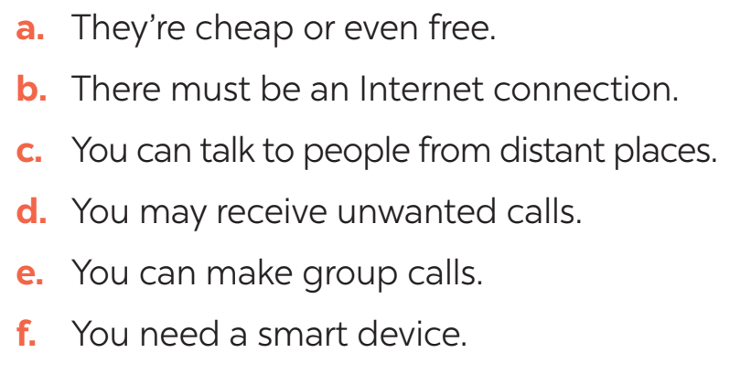
4
Work in pairs. Read the following ideas about online calls. Put the ideas in the correct column.
Advantages | Disadvantages
a
b
c
d
e
f

Slide 19
5
Work in groups. Choose a way of communication and discuss its advantages and disadvantages. Then report your answers to the class.
You can start your discussion as follows:
I think there are both advantages and disadvantages of online calls. ......................

Slide 20
* Homework
Prepair lesson 6 – Skills 2
Write a paragraph (80 – 100 words) to describe a way of modern communication based on the suggested questions :
1.What is it?
2.What are its advantages?
3.What are its disadvantages?
4. Will people use it in the future?

Slide 21
Thank you!
Goodbye!

