Slide 1
Unit 9
TOYS
Lesson 3

Slide 3
WHERE IS MY SKATEBOARD?
START

Slide 4
What number is it ?
one
two
three

Slide 5
Listen and choose
4
3
5

Slide 6
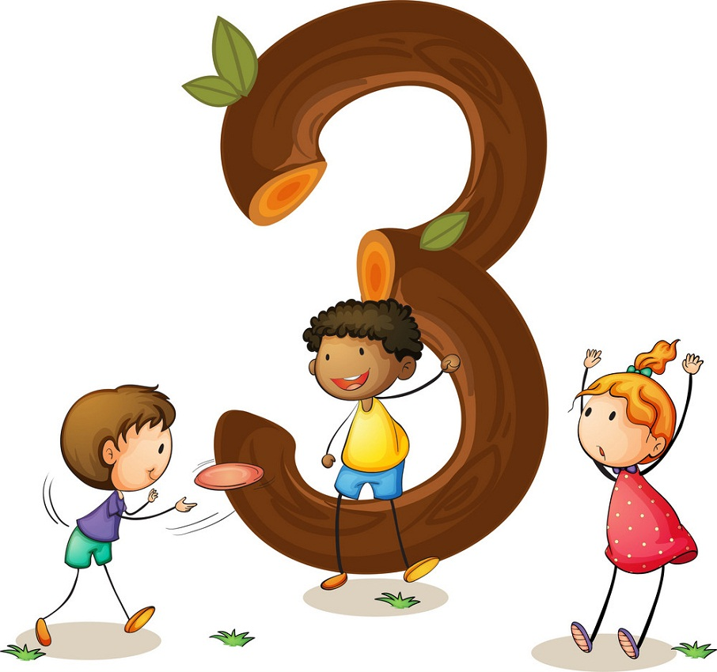
What number is it?
six
three
four

Slide 7
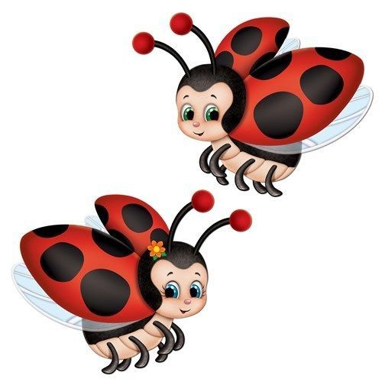
How many insects?
two
three
one

Slide 8
What is the missing letter in the word? f..ve
o
a
i

Slide 9
Uncreamble : x-i-s
sxi
six
xis

Slide 10
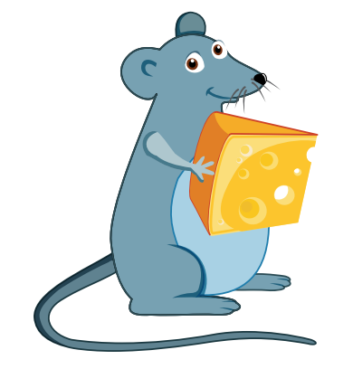
What is the begining
sound of the picture ?
e
m
n

Slide 11
Well done!

Slide 12
VOCABULARY

Slide 19
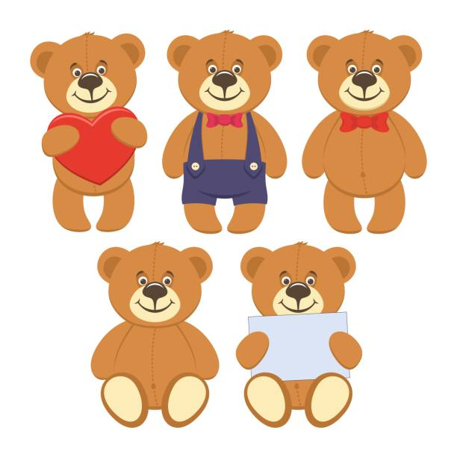
Ten teddy bears

Slide 20
seven books

Slide 21
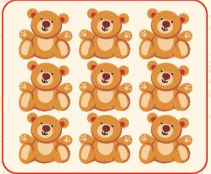
nine teddy bears

Slide 22
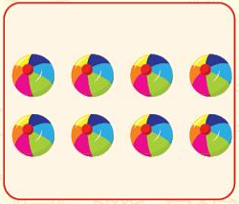
eight balls

Slide 23
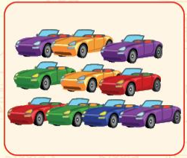
ten cars

Slide 24
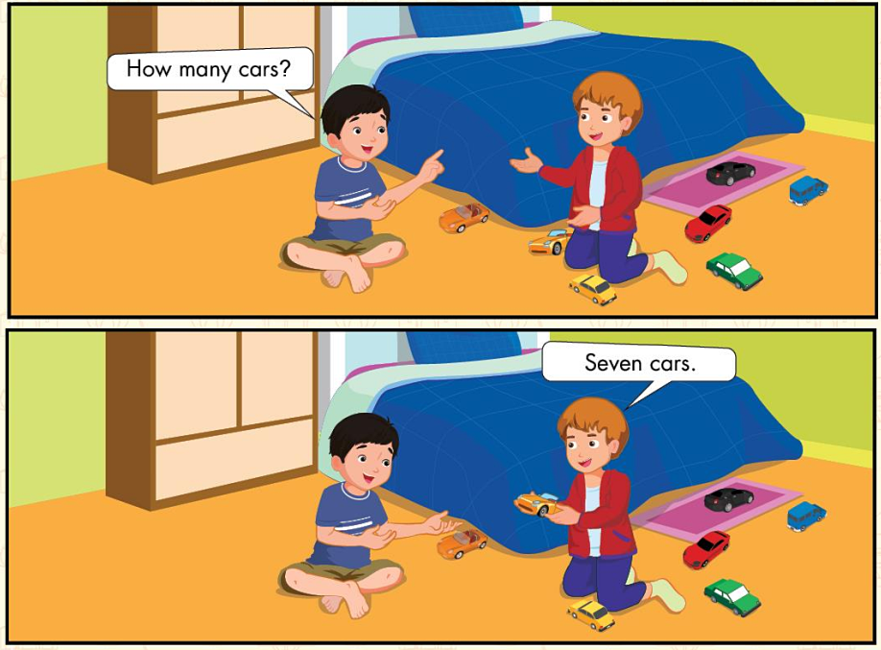

Slide 25
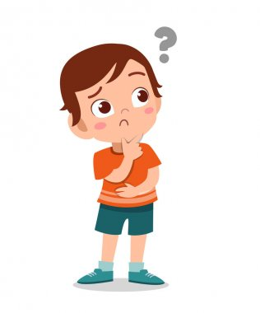
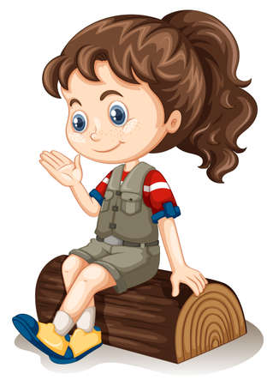
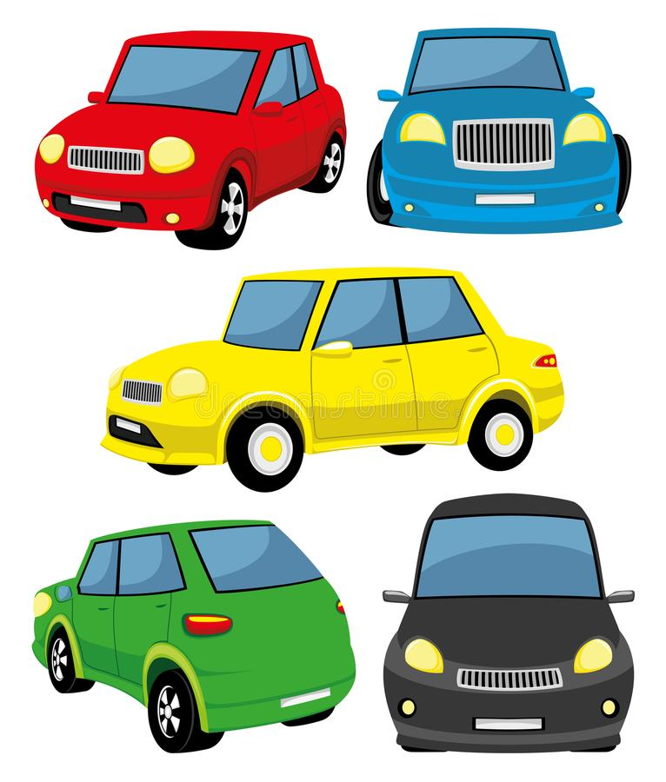
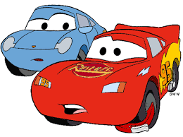
Seven
Cars.
How many
cars?

Slide 26
One
bag.
How many
bags?

Slide 27
GAME TIME

Slide 28
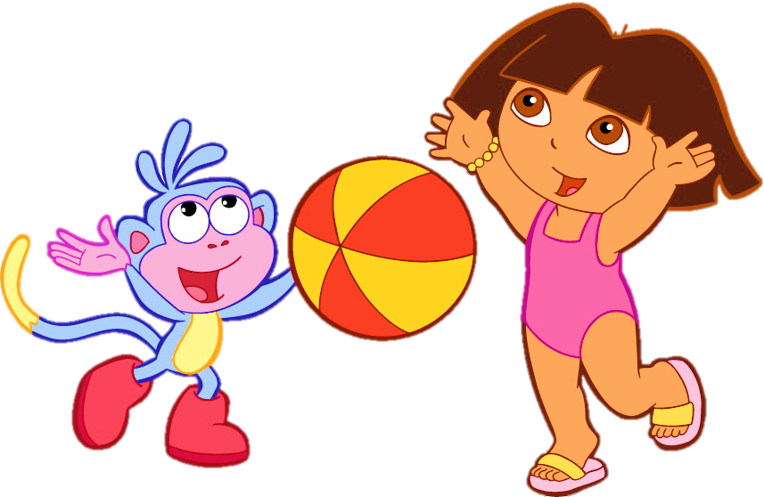

Slide 29
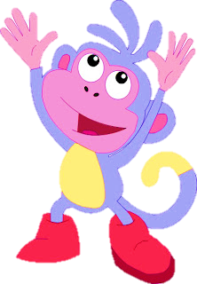
Listen and click on the right coconut
7
8
9
We did it!
seven
NEXT
Notes:
Thanh Yến Trần 0967 255 149 ZALO/ FB https://www.facebook.com/thanhyentrananhngutaymy/

Slide 30
Listen and click on the right coconut
nine
6
9
8
We did it!
9
NEXT

Slide 31
Listen and click on the right coconut
8
9
10
We did it!
ten
NEXT

Slide 32
Listen and click on the right coconut
8
9
7
We did it!
seven
NEXT

Slide 33
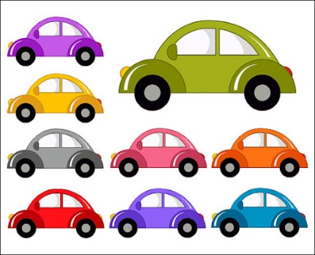
How many cars ?
nine
eight
ten
We did it!
nine
NEXT

Slide 34
Listen and click on the right coconut
….teddy bears
10
7
9
We did it!
10
NEXT

Slide 35
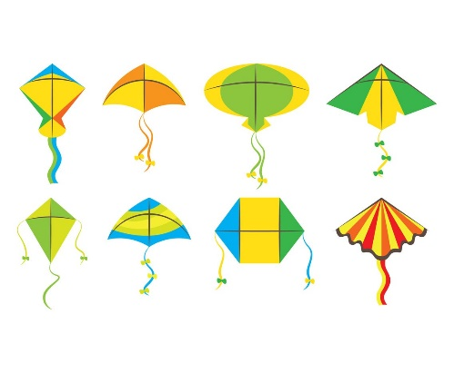
How many kites ?
8
9
10
We did it!
8
NEXT

Slide 36
Listen and click on the right coconut
….balls
8
10
9
We did it!
9
NEXT

Slide 37
Listen and click on the right coconut
……birds
eight
seven
nine
We did it!
eight
NEXT

Slide 38
Listen and click on the right coconut
How ?…cats?
5 cats
many
old
name
We did it!
eight
NEXT

Slide 39
GOOD BYE

