Slide 1
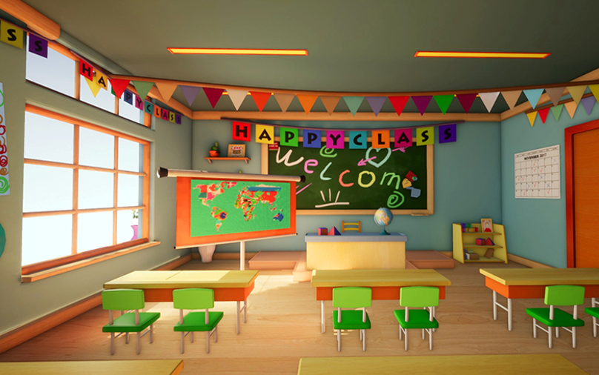

Slide 2

Hello song

Slide 3


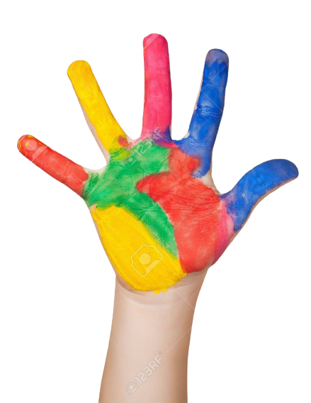



Give me five

Slide 4






Review
Game: What’s missing?
Look at the pictures.
Write the word about the missing picture.

Slide 5

That is his ruler.
Unit 2
Lesson Six – Skills Time

Slide 6
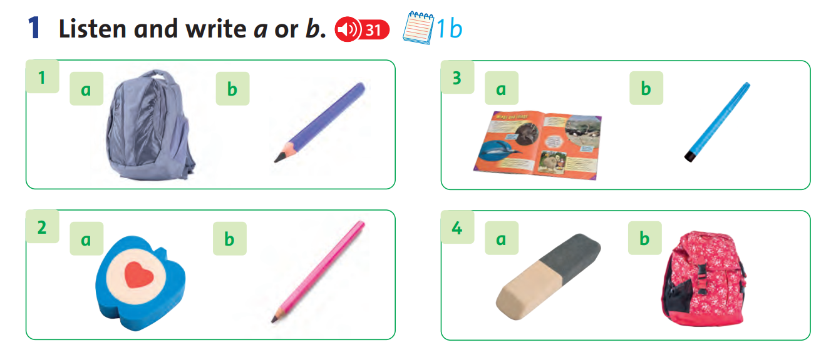
What can you see?
Notes:
Continue the recording. Ask students write the letter for the appropriate photo in their notebooks.

Slide 7
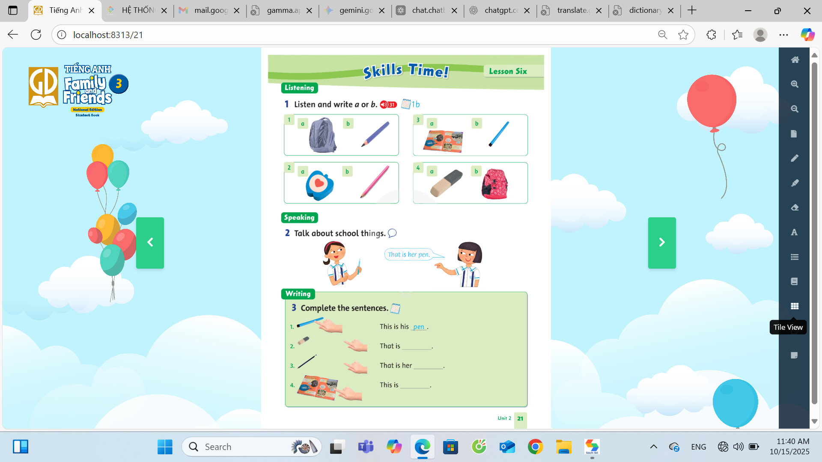
1. ___
b
2. ___
3. ___
4. ___
Notes:
Continue the recording. Ask students write the letter for the appropriate photo in their notebooks.

Slide 8

Listen and write a or b.
1. ___
b
Notes:
Ask students to look in their books at number 1. Elicit the letter next to each photo (a and b). Elicit the words (bag, pencil).
Explain to students that they are going to hear a recording with a sentence about one of the photos.
Play the recording and pause after the first item. Elicit which photo, a or b, the sentence was about (b). Tell students to write b in their notebooks.

Slide 9
1. ___
4. ___
b
2. ___
3. ___
Notes:
Continue the recording. Ask students write the letter for the appropriate photo in their notebooks.

Slide 10
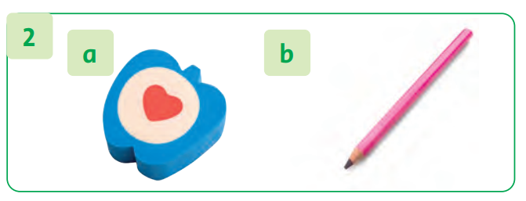
Let’s check!
2. ___
a
Notes:
Go over the answers as a class. Ask students to say the letter name and the school object.
Confirm the correct answers. Praise students if they have done well.
Answers:
1.b.pencil
2.a.eraser
3. b pen
4. b bag

Slide 11
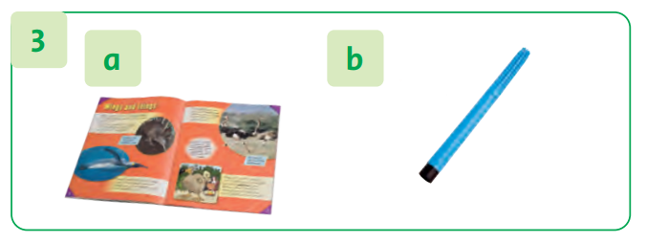
Let’s check!
3. ___
b
Notes:
Go over the answers as a class. Ask students to say the letter name and the school object.
Confirm the correct answers. Praise students if they have done well.
Answers:
1.b.pencil
2.a.eraser
3. b pen
4. b bag

Slide 12
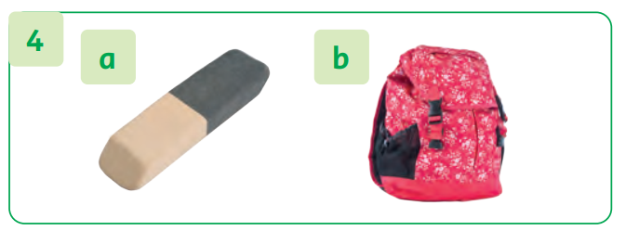
Let’s check!
4. ___
b
Notes:
Go over the answers as a class. Ask students to say the letter name and the school object.
Confirm the correct answers. Praise students if they have done well.
Answers:
1.b.pencil
2.a.eraser
3. b pen
4. b bag

Slide 13
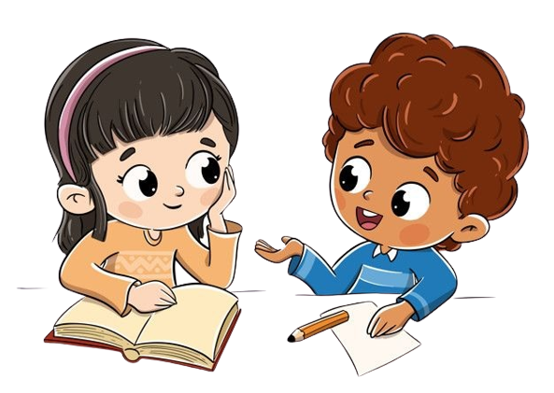
Change the book.
b
a
b
1. ___
2. ___
3. ___
b
4. ___
Notes:
Children work in pairs to peer-check their answers and talk about the school things in the picture.

Slide 14

Good job!

Slide 15

Listen to the song.
Notes:
Sing the song with actions all together funnily.

Slide 16
Work in group.
Notes:
Children work in pairs to peer-check their answers and talk about the school things in the picture.

Slide 17






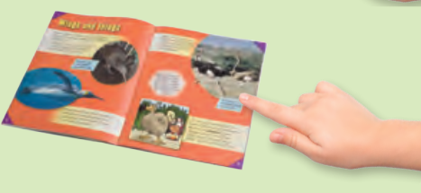


Look and answer.
blue pen
small eraser
black pencil
red book
Notes:
*Complete the sentences. (Page 21)
Put Flashcards 25–29 on the board. Write the words under them.
Tell students to look in their books. Prompt students to read the first sentence chorally. Copy the first sentence on the board. Prompt students to answer pen and write it.

Slide 18
Game: Make a caterpillar.
Look at the pictures again.
Write one word.
Complete the sentences.

Slide 19
Complete the sentences.
…blue pen.
…small eraser.
…black pencil.
…red book.
Notes:
*Complete the sentences. (Page 21)
Put Flashcards 25–29 on the board. Write the words under them.
Tell students to look in their books. Prompt students to read the first sentence chorally. Copy the first sentence on the board. Prompt students to answer pen and write it.

Slide 20


Look and say.
MY….
MY SCHOOL.
It makes me happy.
Notes:
* Game: Think – Pair – Share!
Ask children to think of their school things and their colors.
Ask children to work in pairs to talk about their school things.
Ask children to share their ideas with the whole class.

Slide 21
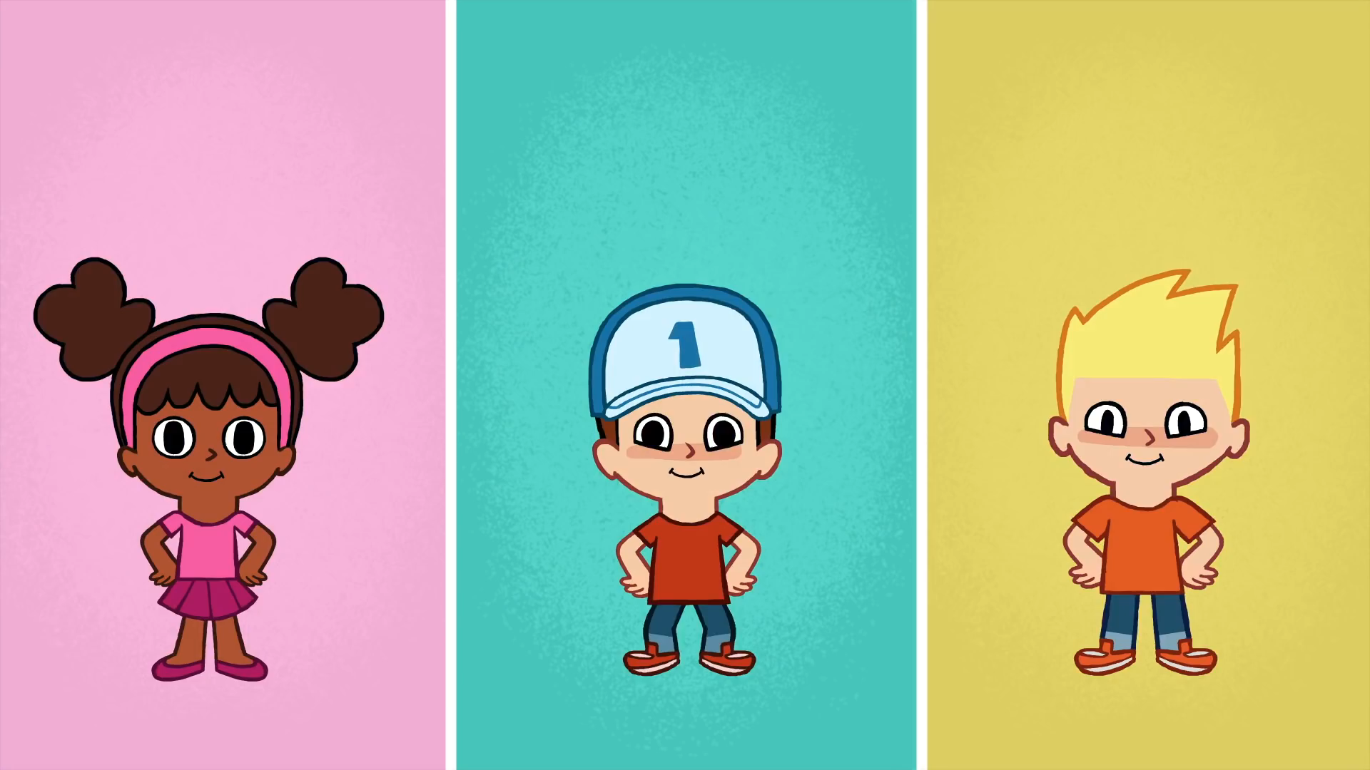
Goodbye! See you later!
Notes:
Click to the picture of a smiley face to play the Goodbye song.

