Slide 1

Unit 3: Colors
Lesson 3.1: Vocabulary & Sentence Patterns
Page: 25

Slide 2
Lesson Outline
Warm-up
Practice
Consolidation
Wrap-up

Slide 3
Objectives
By the end of this lesson, students will be able to gain the following:
Sentence pattern:
Thank you. You're welcome.
Skills:
Greetings.

Slide 4

WARM UP

Slide 5

SENTENCE PLANE
START

Slide 6

Look and say the sentence.
PLANE
It’s a pink flower.
CHECK

Slide 7

Look and say the sentence.
PLANE
It’s a red flower.
CHECK

Slide 8

Look and say the sentence.
PLANE
It’s a blue flower.
CHECK

Slide 9

Look and say the sentence.
PLANE
It’s a yellow flower.
CHECK

Slide 10

Look and say the sentence .
PLANE
It’s a white flower.
CHECK

Slide 11

Good job!

Slide 12

It’s time to learn …

Slide 13

Structures
Thank you.
You're welcome.

Slide 14



Thank you
You're welcome

Slide 15


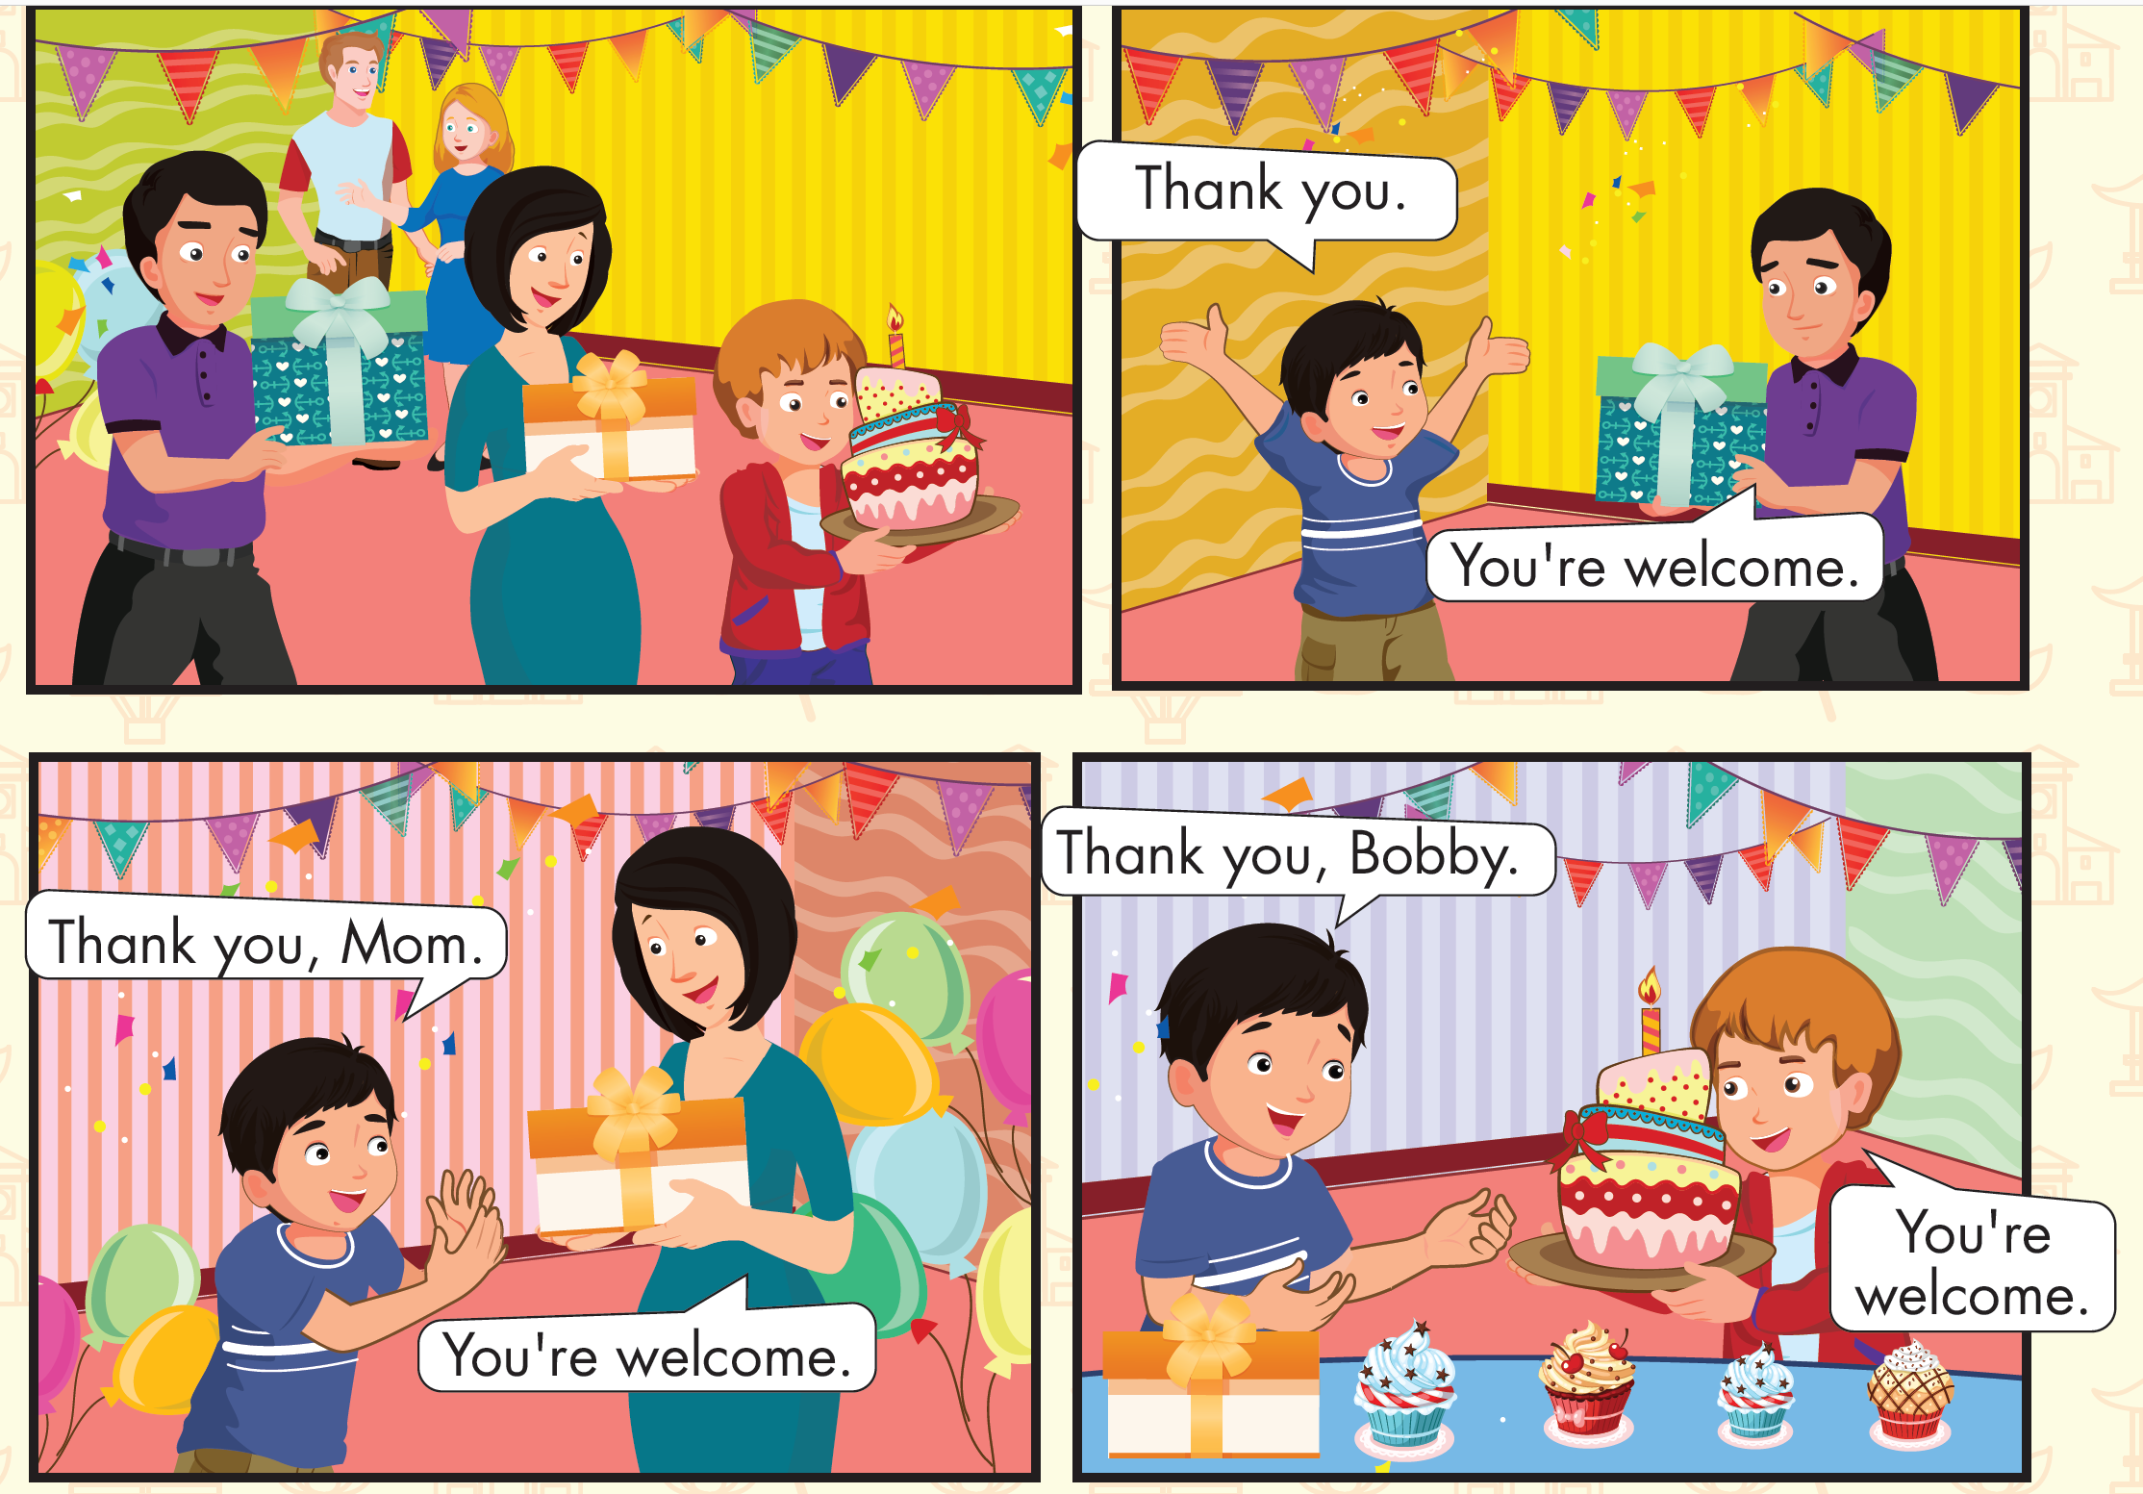
Click D to hear the sound.

Slide 16

Practice

Slide 17

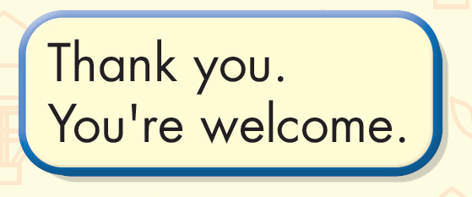
Click on the sentence to hear the sound.

Slide 18

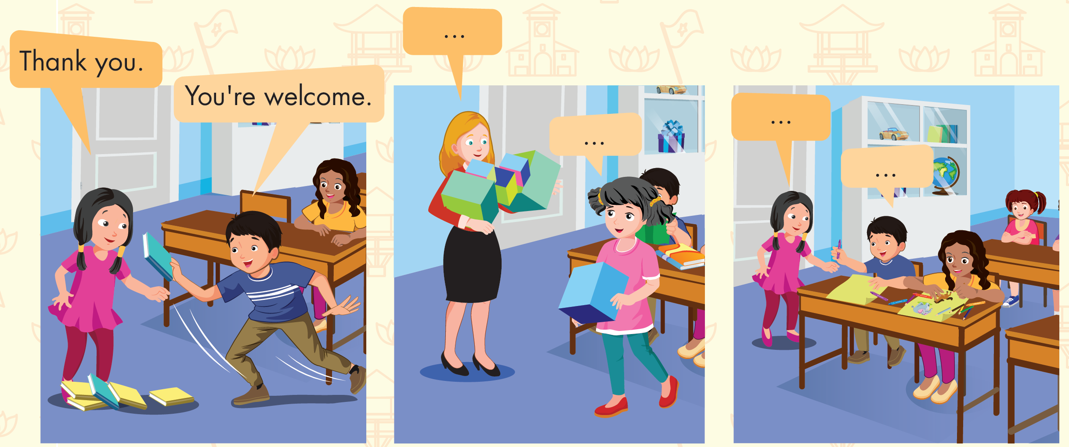

Slide 19
It’s time to play …

Slide 20


VƯỢT CHƯỚNG NGẠI VẬT

Slide 21





Slide 22
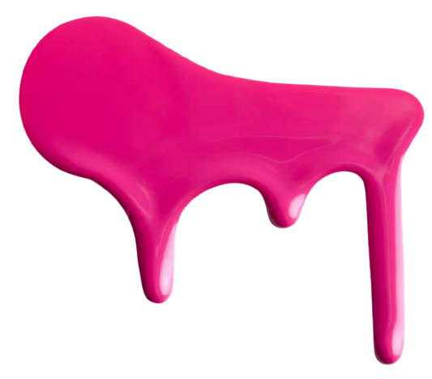





white
pink
blue
yellow

Slide 23




flowers
flowes
fower
flower

Slide 24
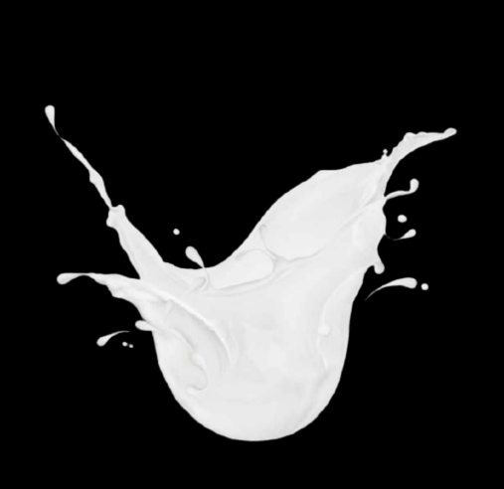


red
while
white
wite

Slide 25

Further Practice

Slide 26


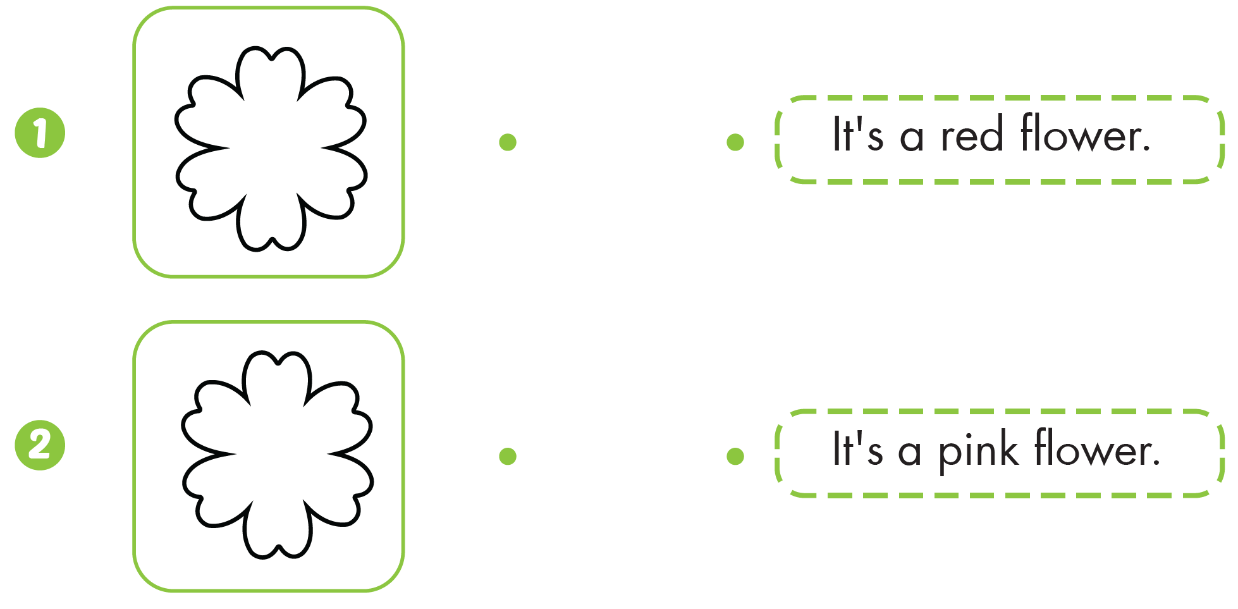

Click the numbers to hear the sound.

Slide 27


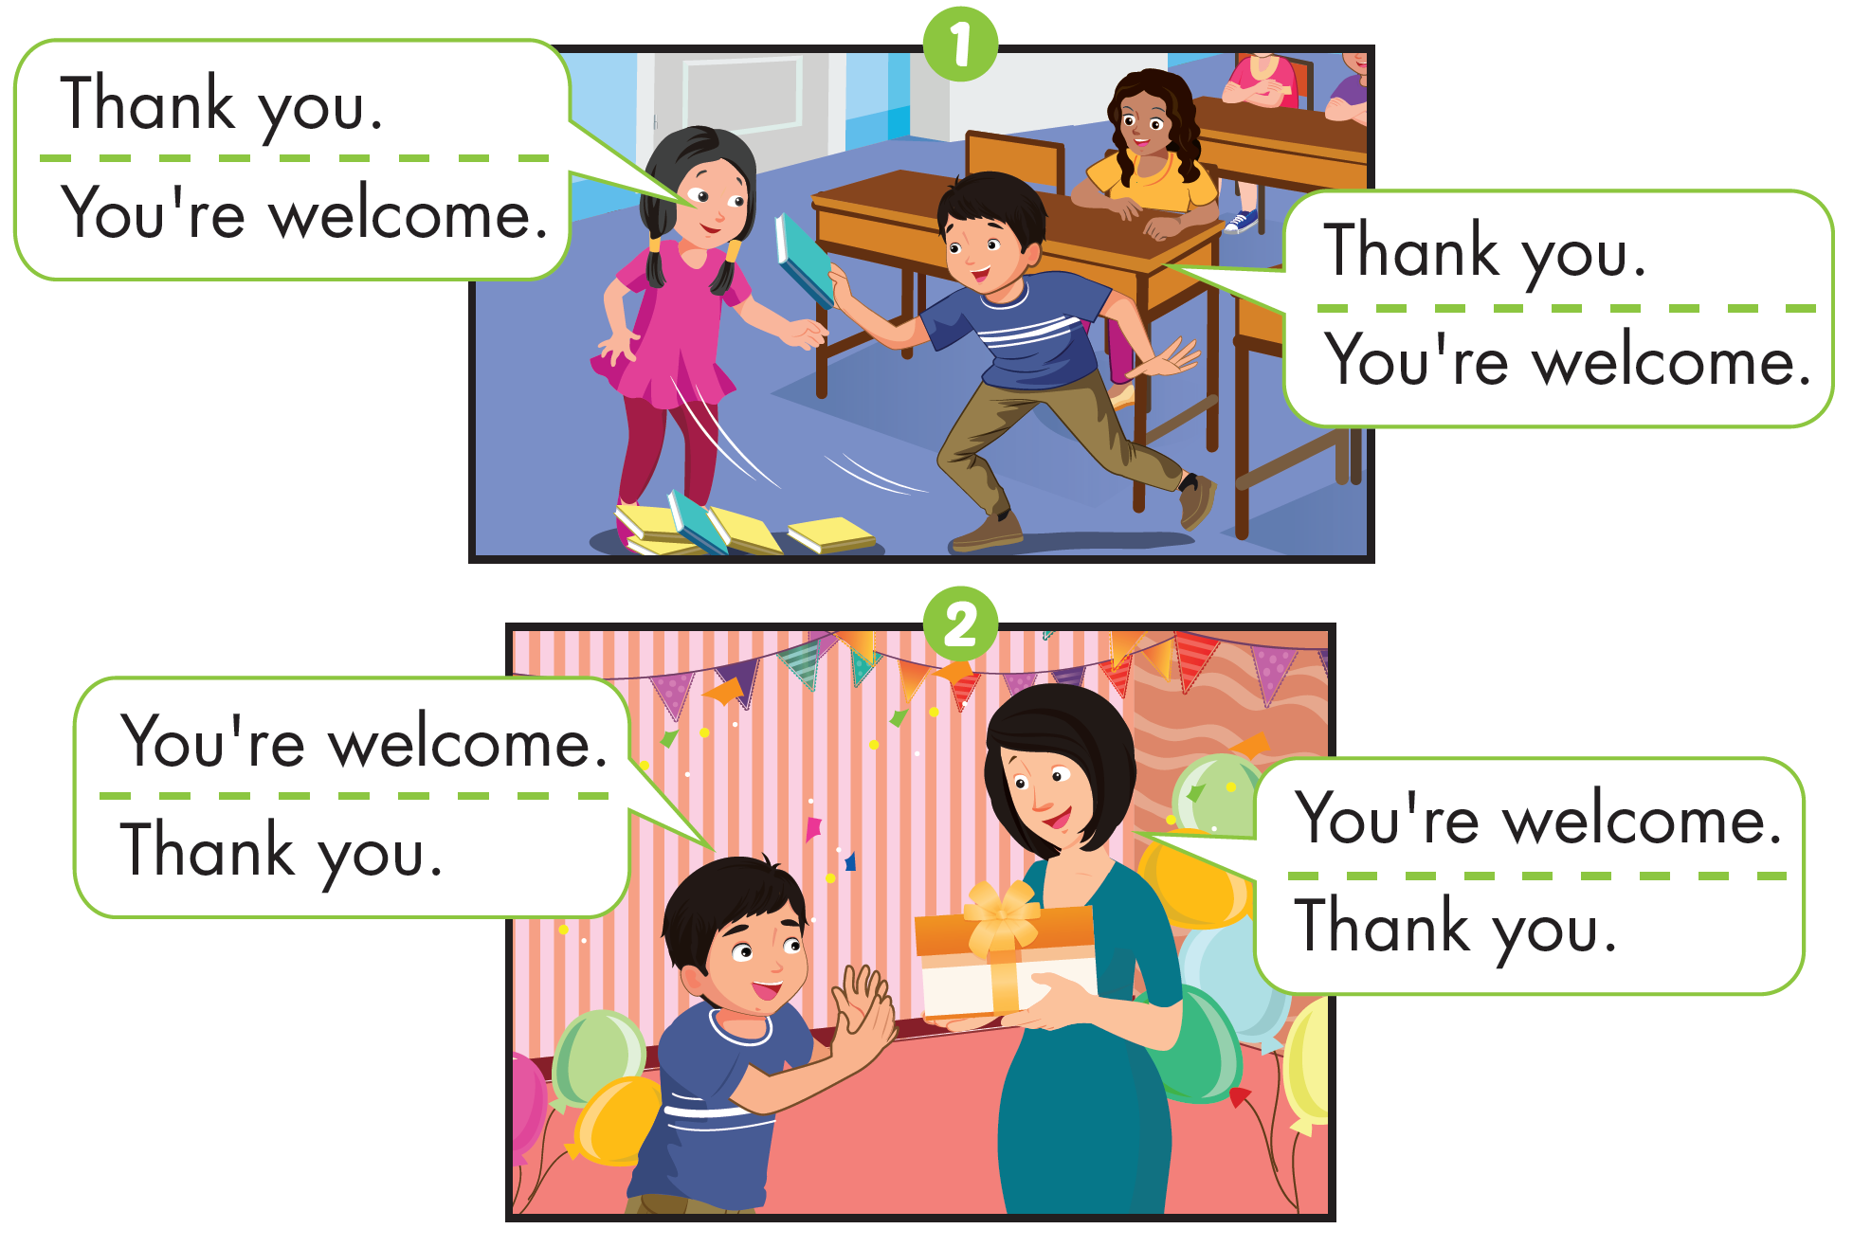

Slide 28

CONSOLIDATION

Slide 29
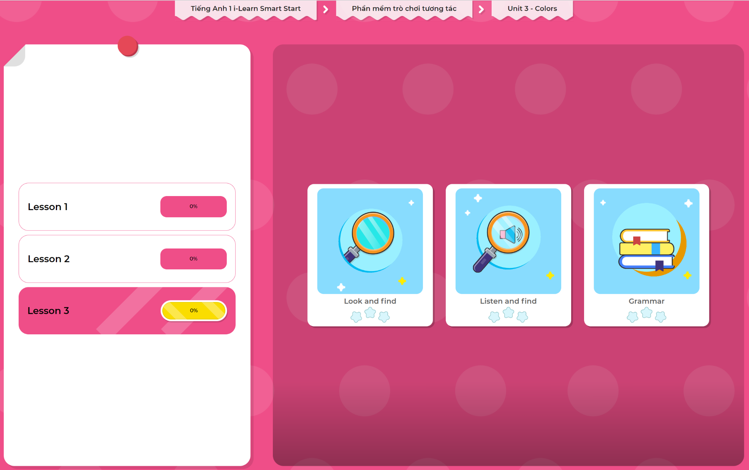
Extra Practice
DHA App
LET’S PLAY!
Click here to play the games

Slide 30

WRAP-UP

Slide 31
Today’s lesson
Structures/ Sentence patterns
Thank you.
You're welcome.
Vocabulary
Revise

Slide 32
Homework
Practice vocabulary and structure. Make sentences using them.
Practice the vocabulary and structure in Tiếng Anh 1 i-Learn Smart Start Notebook (page 19)
Do the exercises in Tiếng Anh 1 i-Learn Smart Start Workbook (page 23)
Play the consolidation games in Tiếng Anh 1 i-Learn Smart Start DHA App on www.eduhome.com.vn
Prepare the next lesson (page 26 SB)

Slide 33
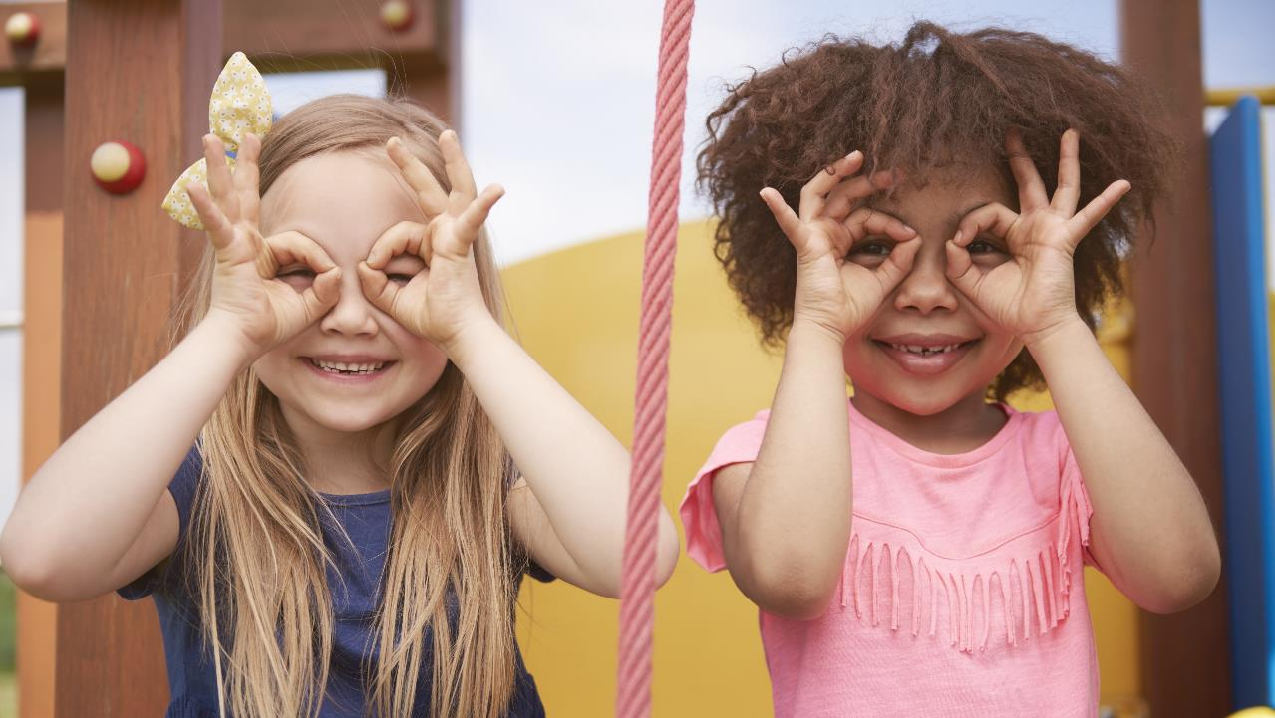
Enjoy your day!

