Slide 1
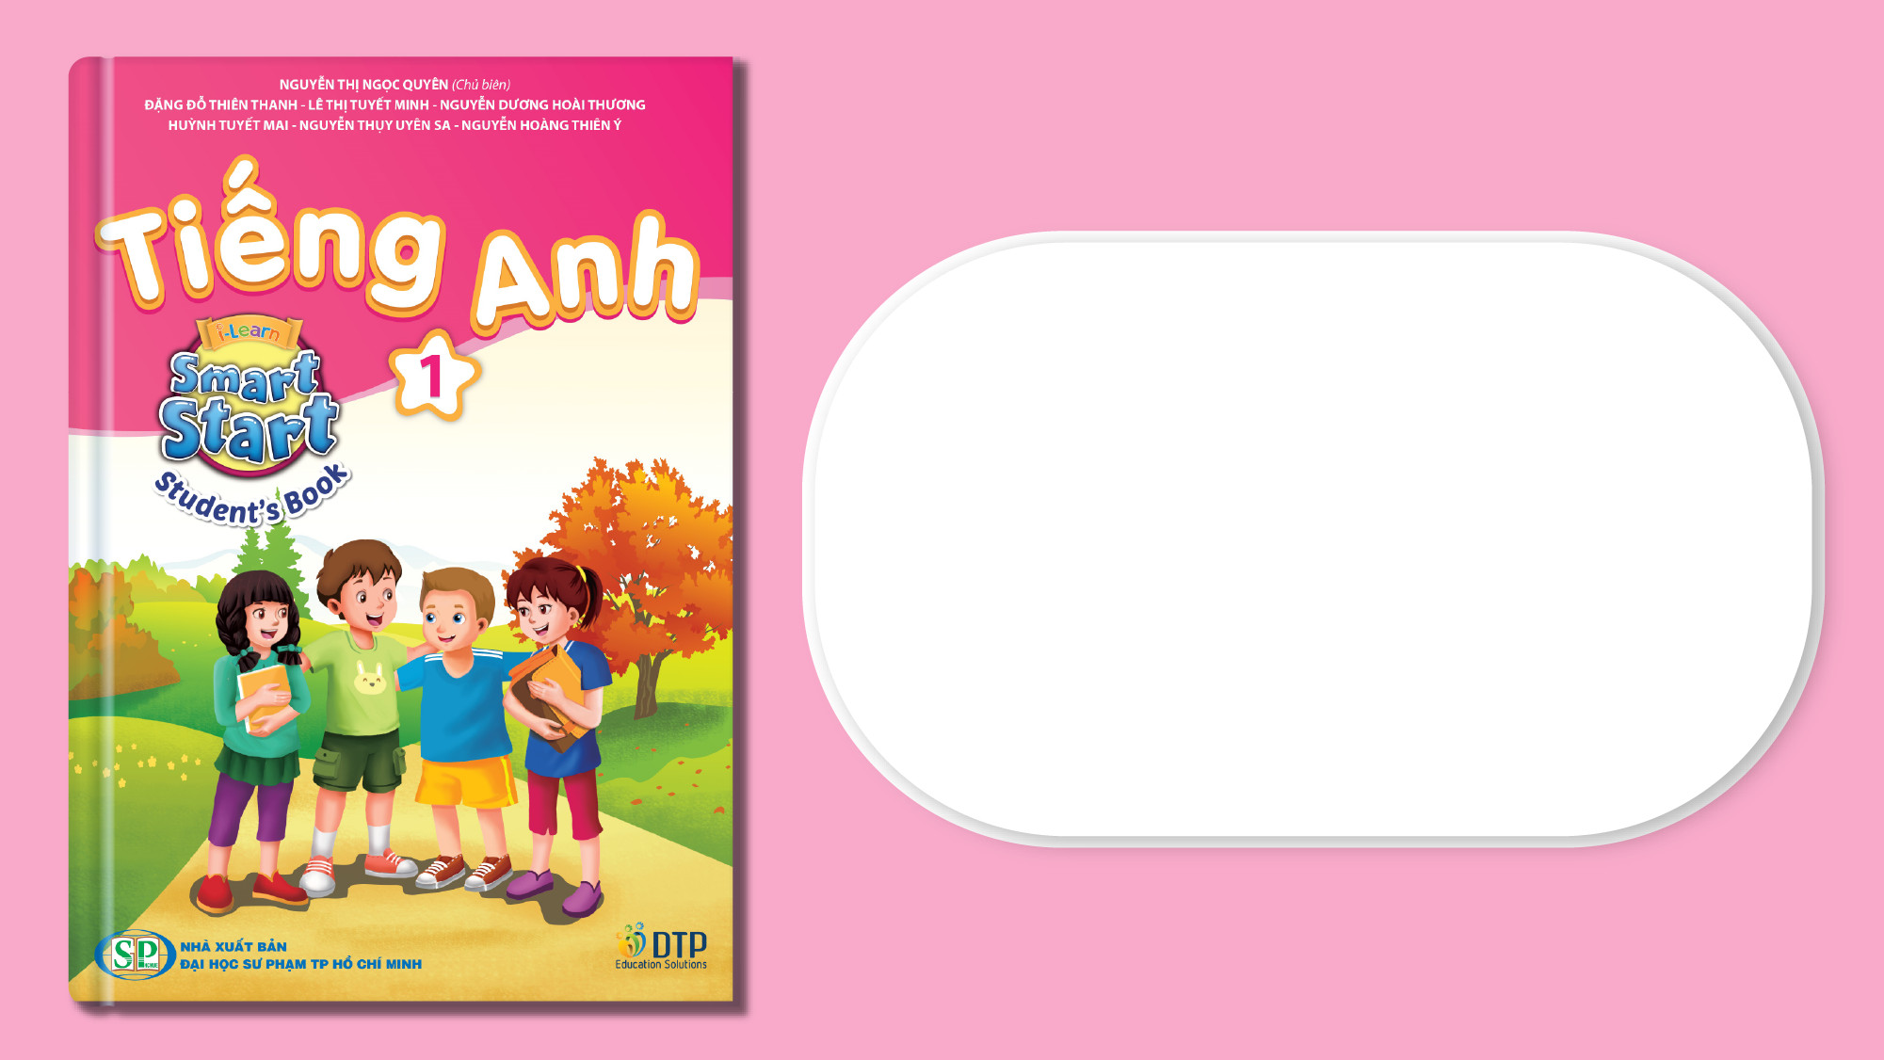
Unit 3: Colors
Lesson 3.1: Vocabulary & Sentence Patterns
Page: 24

Slide 2
Lesson Outline
Warm-up
Vocabulary
Structure
Practice
Consolidation
Wrap-up

Slide 3
Objectives
By the end of this lesson, students will be able to describe things, using the target language.
Vocabulary:
pink, white, flower
Sentence pattern:
It's a (pink) flower.

Slide 4

WARM UP

Slide 5

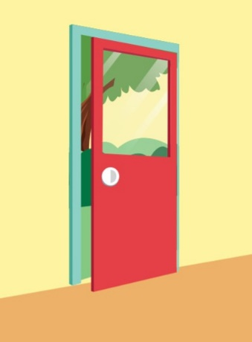



Listen and choose

Slide 6

Listen and choose

Slide 7


boy
ant

Slide 8

cap
cat

Slide 9

It’s time to learn …

Slide 10

New words
pink, white, flower

Slide 11


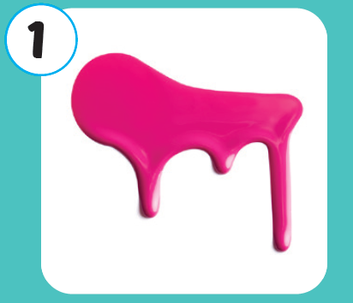
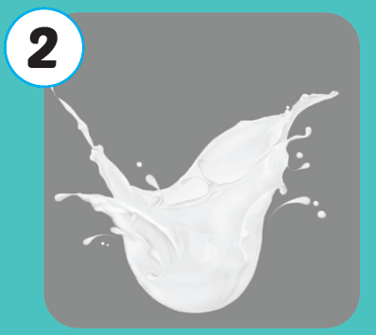
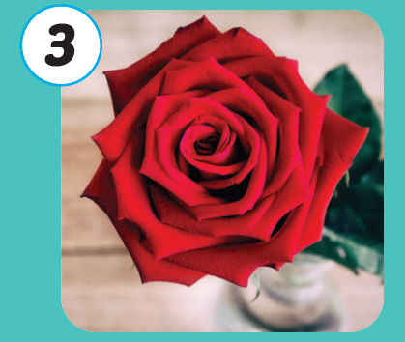



Click A to hear the sound

Slide 12
Click A to hear the sound
/pɪŋk/
màu hồng
/waɪt/
màu trắng
/ˈflaʊər/
hoa

Slide 13
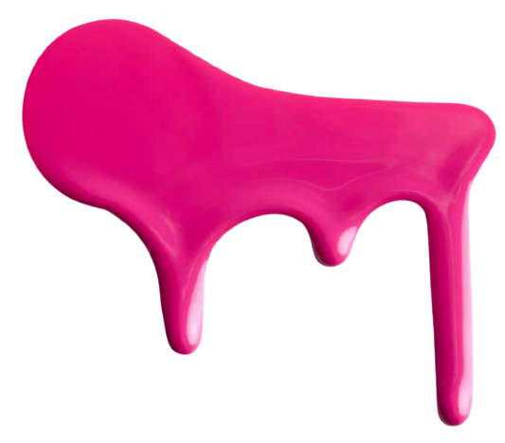
Click on the picture to hear the sound.
/pɪŋk/
màu hồng

Slide 14
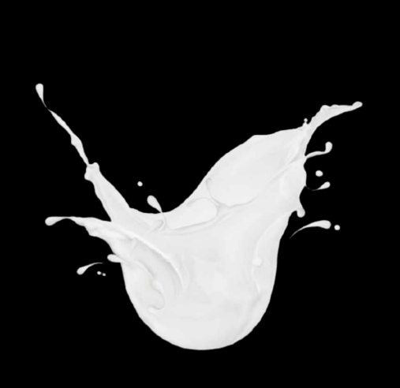
Click on the picture to hear the sound.
/waɪt/
màu trắng

Slide 15

Click on the picture to hear the sound.
/ˈflaʊər/
hoa

Slide 16

Structures
It's a (pink) flower.

Slide 17

Practice

Slide 18

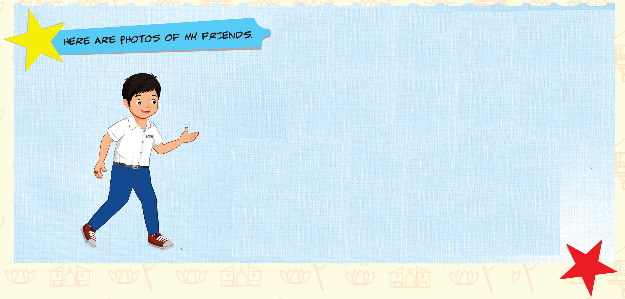
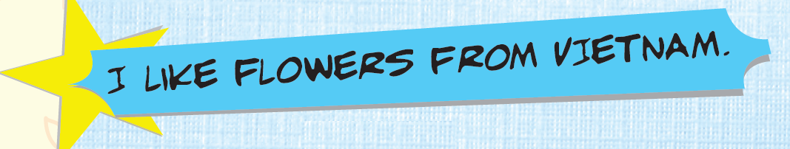
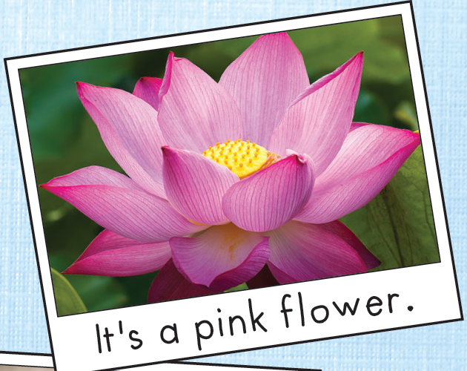
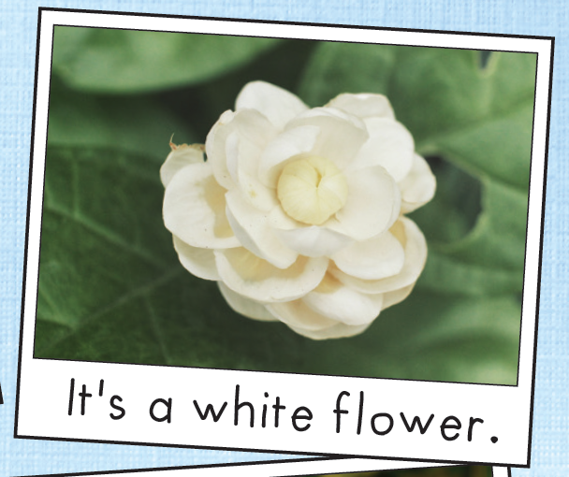
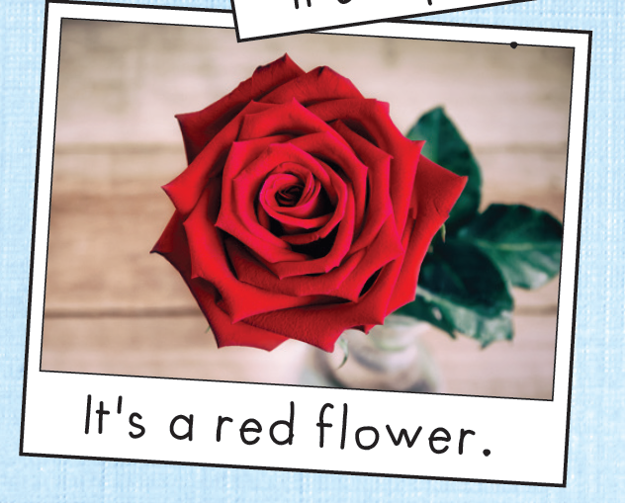
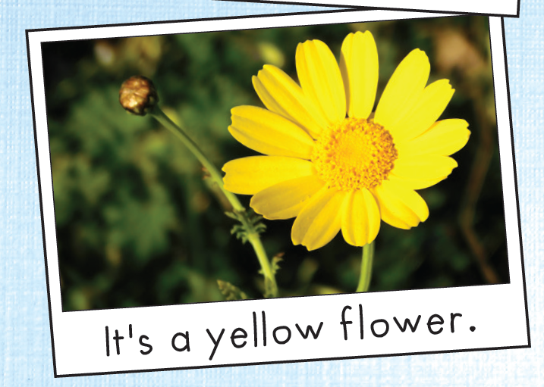
Click B to hear the sound.

Slide 19
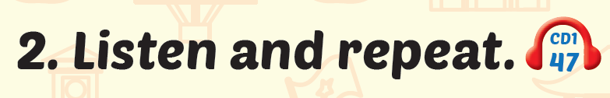
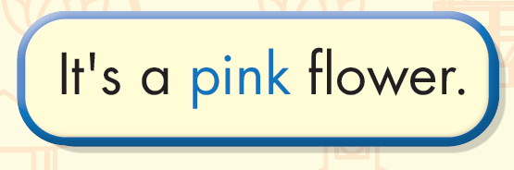
Click the sentence to hear the sound.

Slide 20
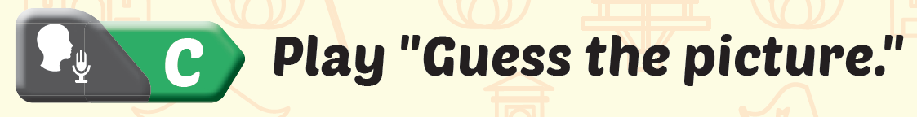
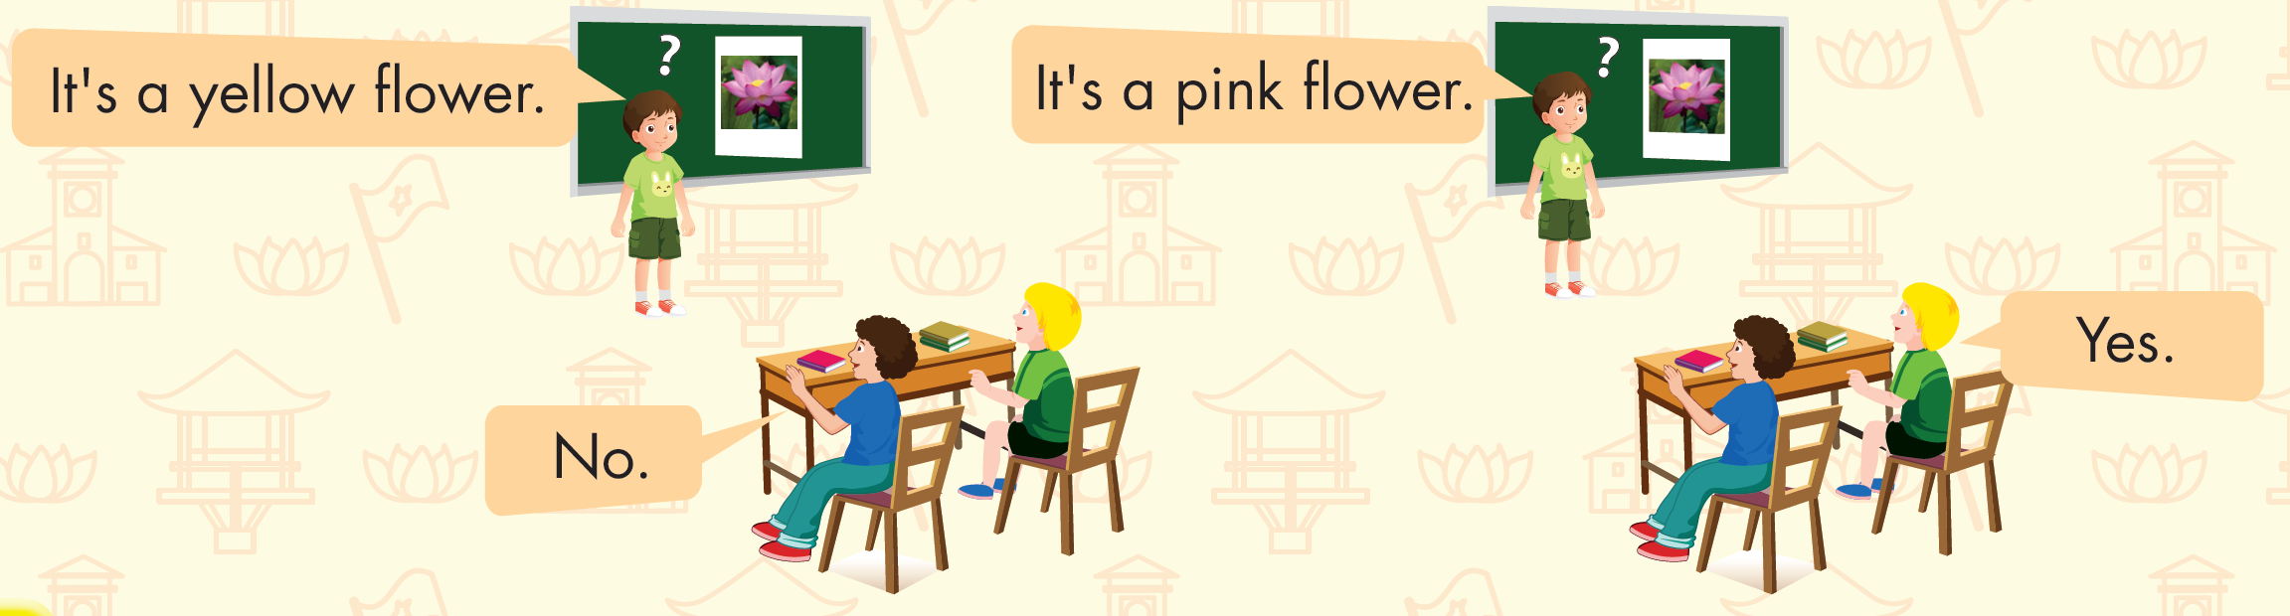

Slide 21
It’s time to play …

Slide 22


NEXT

Slide 23




It’s a red flower.

Slide 24

It’s a pink flower.

Slide 25

It’s a white flower.

Slide 26

It’s a yellow flower.

Slide 27

It’s a blue flower.

Slide 28

Further Practice

Slide 29

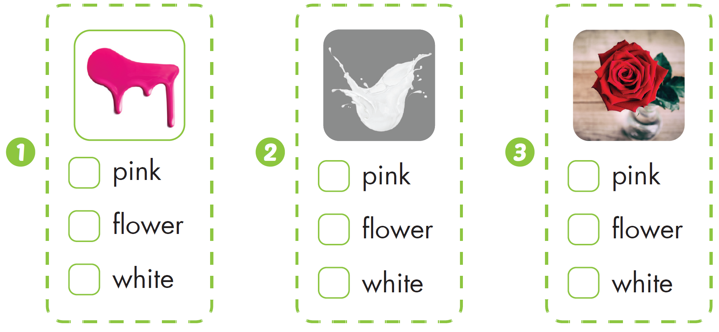


Slide 30

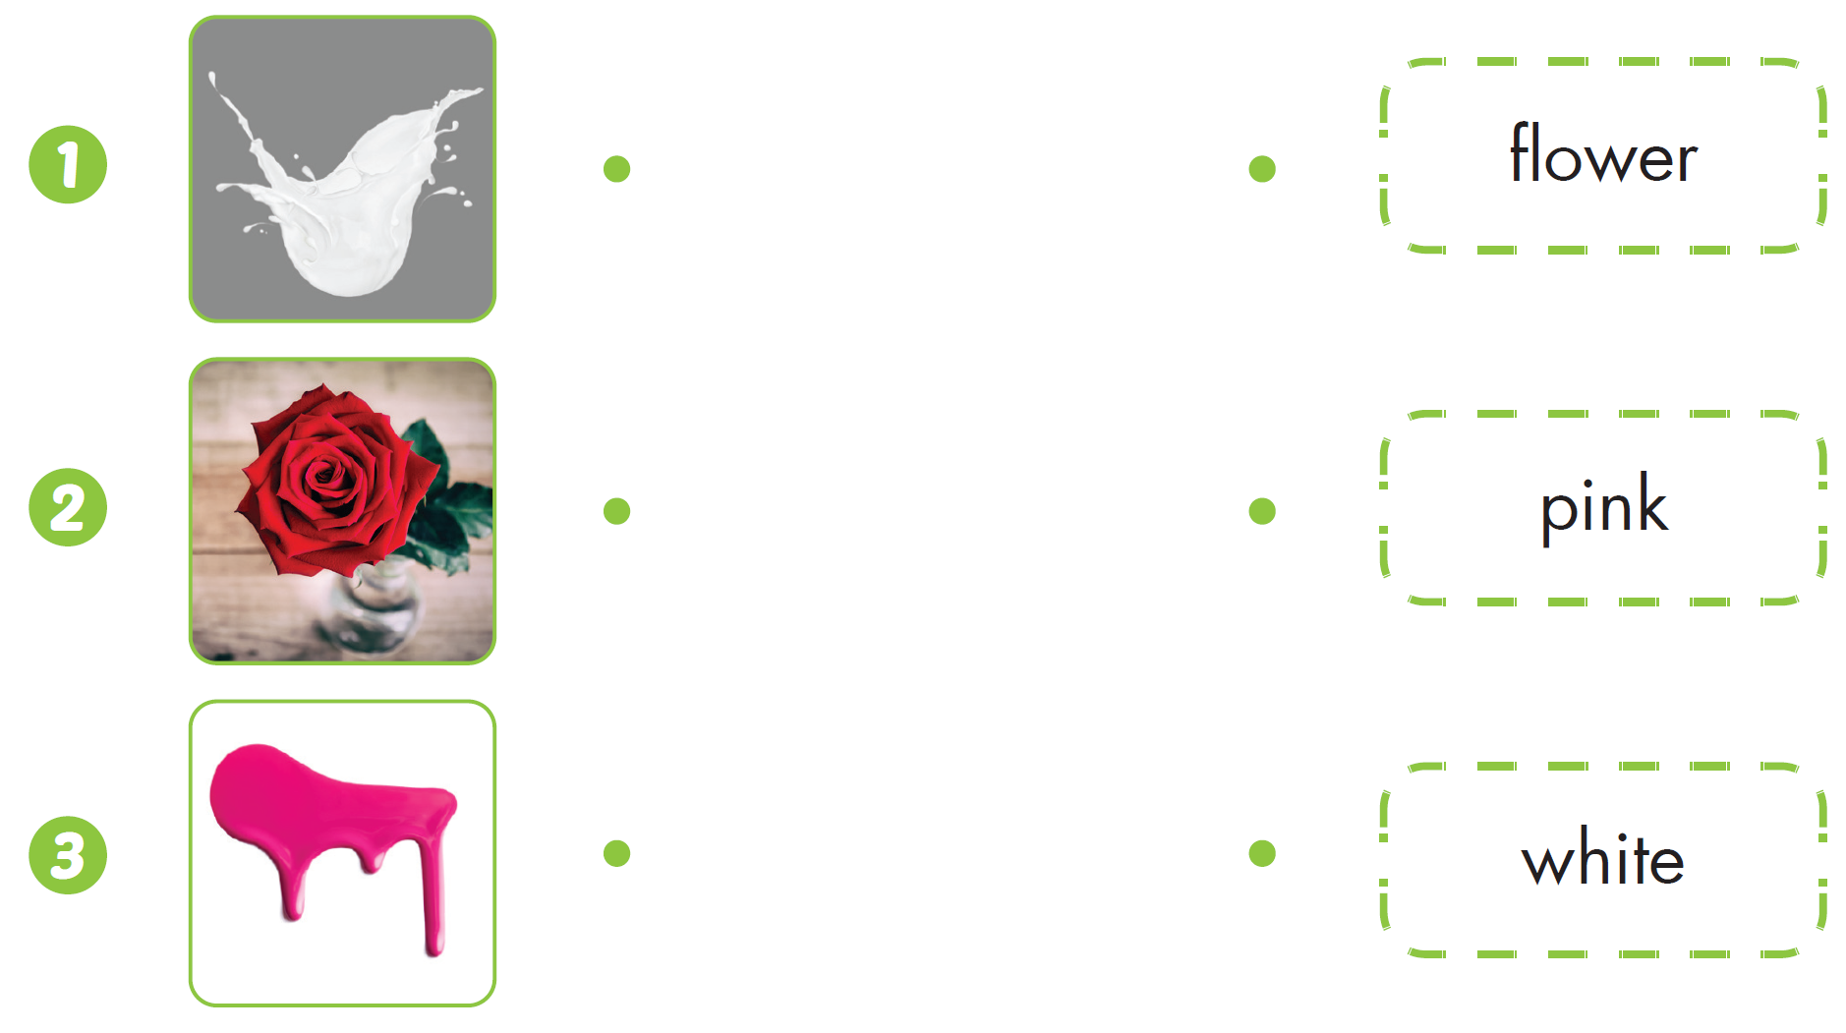

Slide 31

CONSOLIDATION

Slide 32
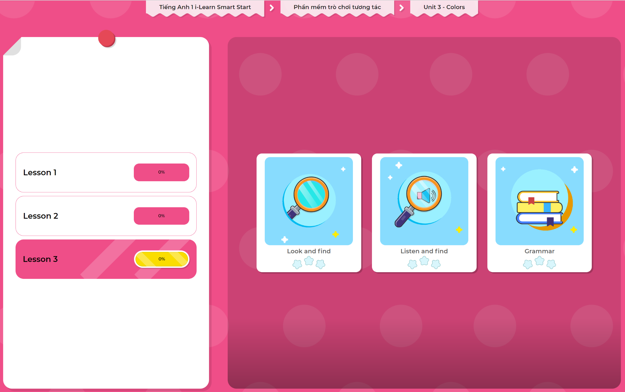
Extra Practice
DHA App
LET’S PLAY!
Click here to play the games

Slide 33

WRAP-UP

Slide 34
Today’s lesson
Structures/ Sentence patterns
It's a (pink) flower.
Vocabulary
pink, white, flower

Slide 35
Homework
Practice vocabulary and structure. Make sentences using them.
Practice the vocabulary and structure in Tiếng Anh 1 i-Learn Smart Start Notebook (page 18)
Do the exercises in Tiếng Anh 1 i-Learn Smart Start Workbook (page 22)
Play the consolidation games in Tiếng Anh 1 i-Learn Smart Start DHA App on www.eduhome.com.vn
Prepare the next lesson (page 25 SB)

Slide 36

Enjoy your day!

