Slide 1

Unit 3: Colors
Lesson 2.1: Vocabulary & Phonics
Page: 22

Slide 2

It’s time to learn …

Slide 3

Phonics
/æ/ and /b/

Slide 4


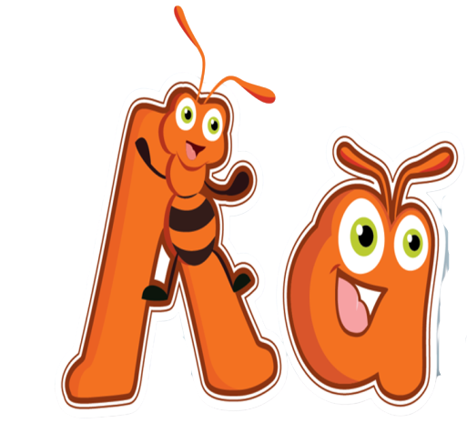
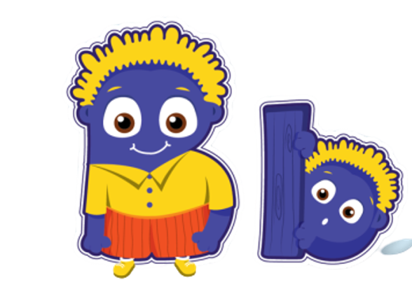
Click Alphabet to hear the sound

Slide 5

New words
Revise: ant, boy

Slide 6
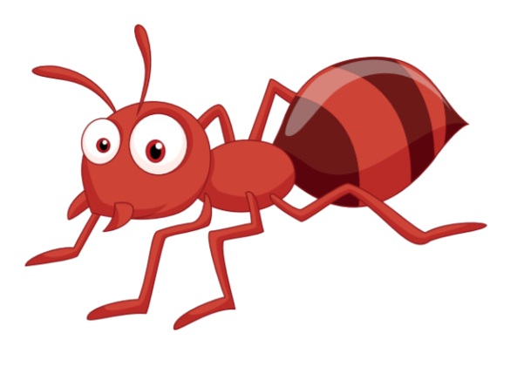

Click on the ant/each part of the word to hear the sound
a
a
ant

Slide 7
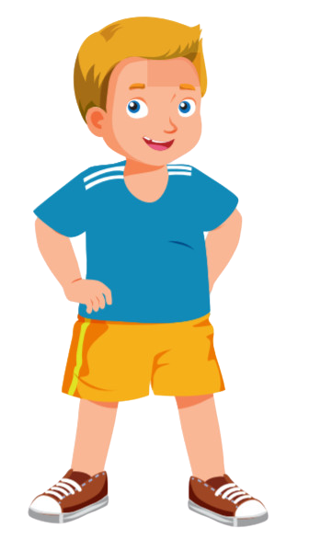
Click on the boy/each part of the word to hear the sound
boy
b
b

Slide 8

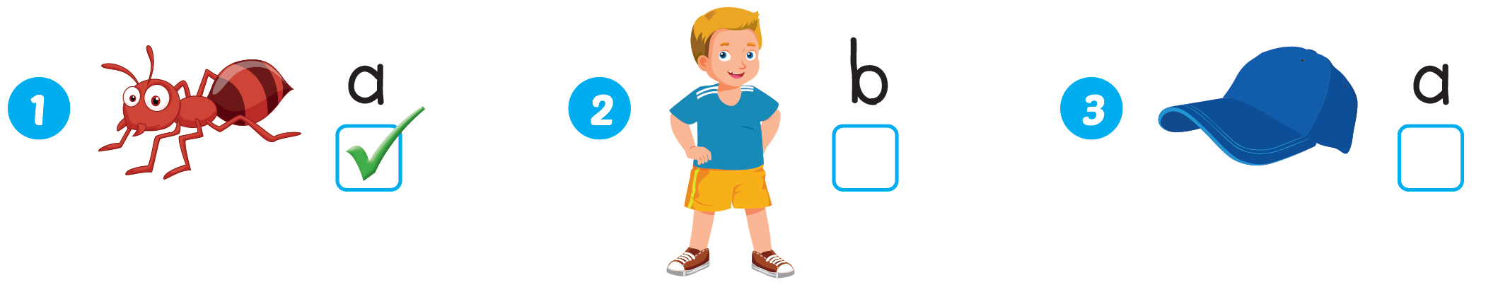



Slide 9

Practice

Slide 10

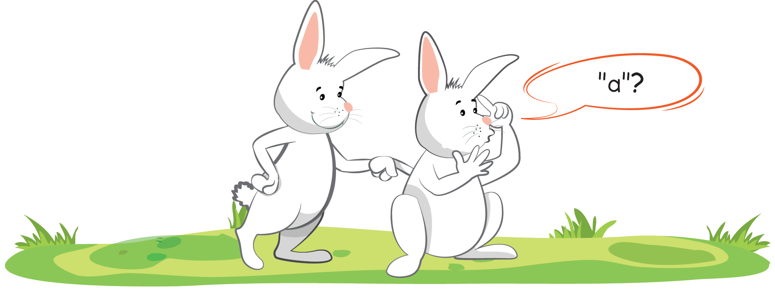

Slide 11
It’s time to play …

Slide 12

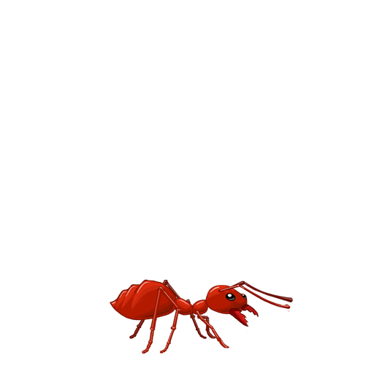
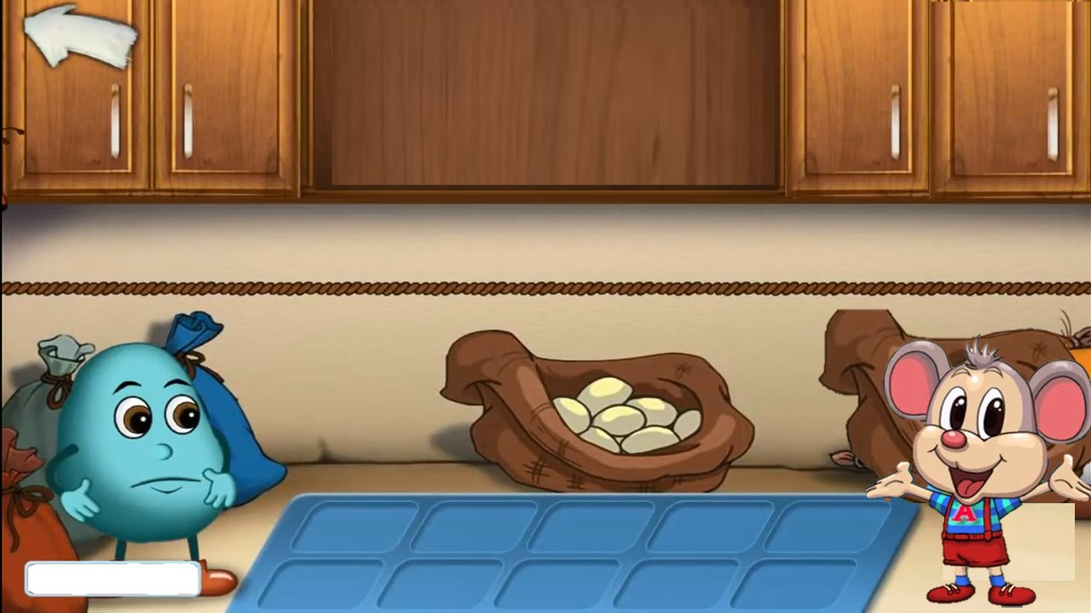
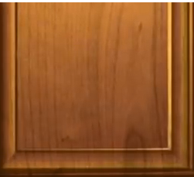
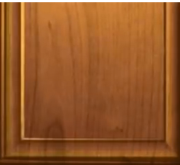
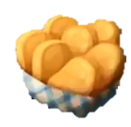



ant
aun
ent
aunt
HẾT GIỜ!

Slide 13
girl
boys
boy
sister
HẾT GIỜ!

Slide 14

Further Practice

Slide 15
Funtime
Let's draw an ant

Slide 16

CONSOLIDATION

Slide 17
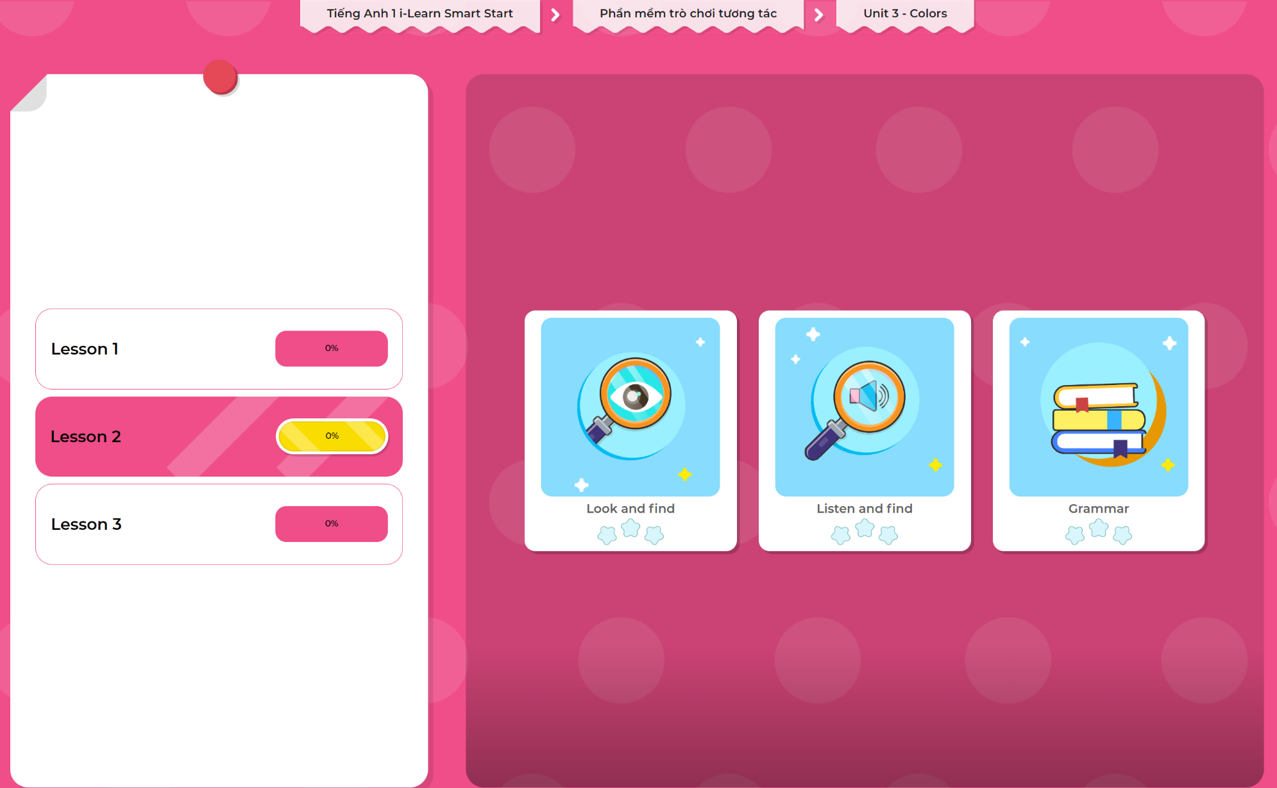
Extra Practice
DHA App
LET’S PLAY!
Click here to play the games

Slide 18

WRAP-UP

Slide 19
Today’s lesson
Phonics
Revise /æ/ and /b/
Vocabulary
Revise "ant, boy"

Slide 20
Homework
Practice vocabulary and phonics. Make sentences using them.
Practice the vocabulary and phonics in Tiếng Anh 1 i-Learn Smart Start Notebook (page 16)
Do the exercises in Tiếng Anh 1 i-Learn Smart Start Workbook (page 20)
Play the consolidation games in Tiếng Anh 1 i-Learn Smart Start DHA App on www.eduhome.com.vn
Prepare the next lesson (page 23 SB)

Slide 21
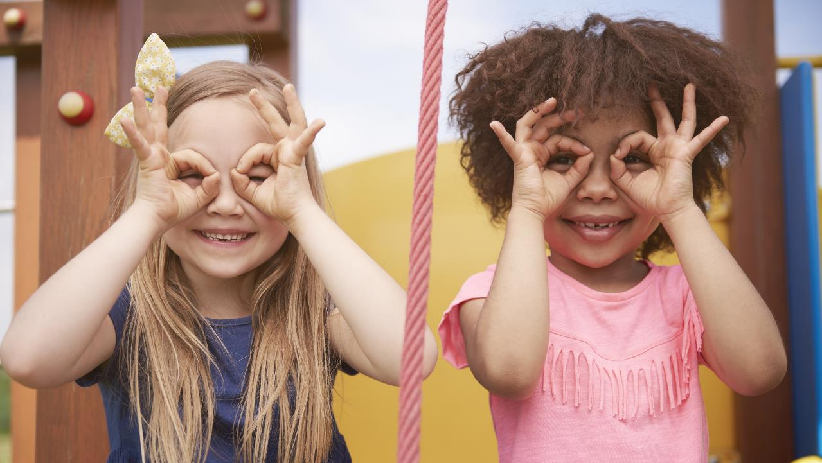
Enjoy your day!

