Slide 1


Unit 3: Colors
Lesson 1.2: Vocabulary & Sentence Patterns
Page: 21

Slide 2
Lesson Outline
Warm-up
Vocabulary
Structure
Practice
Consolidation
Wrap-up

Slide 3
Objectives
By the end of this lesson, students will be able to say what color it is, using the target language.
Vocabulary:
blue, yellow, red
Sentence pattern:
It's red.

Slide 4

WARM UP

Slide 5



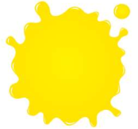
Where is ?
1
2
3

Slide 6

Where is ?
1
2
3

Slide 7

Where is ?
1
2
3

Slide 8
Where is ?
1
2
3

Slide 9
Where is ?
1
2
3

Slide 10
Where is ?
1
2
3

Slide 11

It’s time to learn …

Slide 12

Speaking

Slide 13

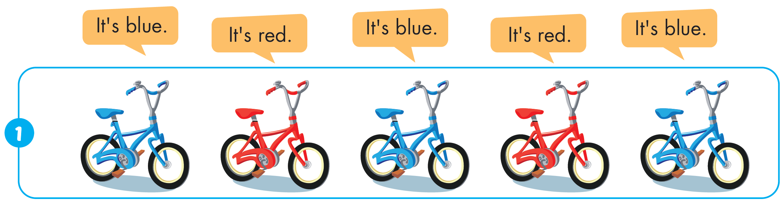

Slide 14
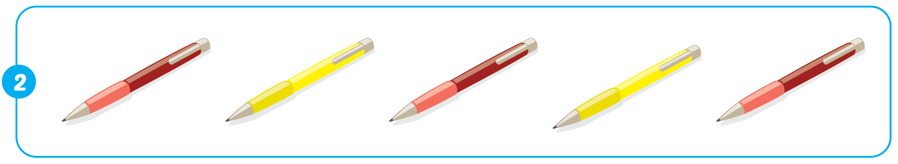
It's red.
It's yellow.
It's red.
It's yellow.
It's red.

Slide 15
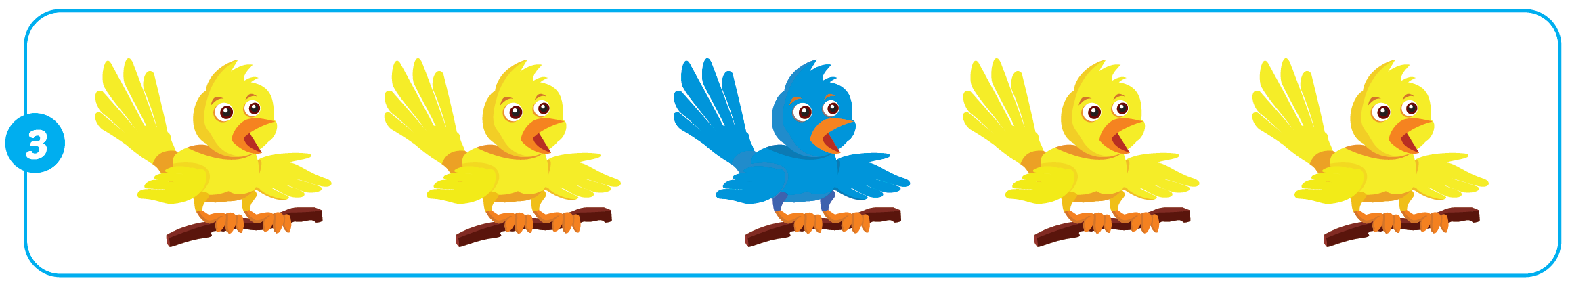
It's yellow.
It's yellow.
It's blue.
It's yellow.
It's yellow.

Slide 16
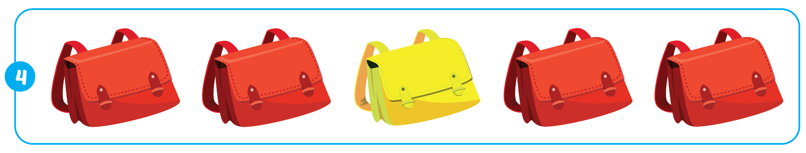
It's red.
It's red.
It's yellow.
It's red.
It's red.

Slide 17

Practice

Slide 18
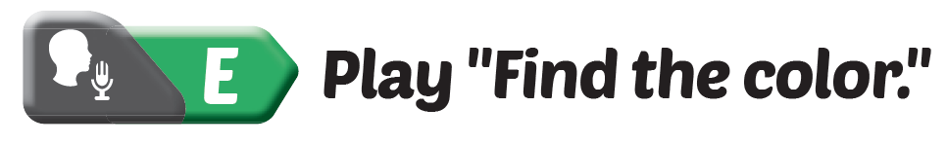
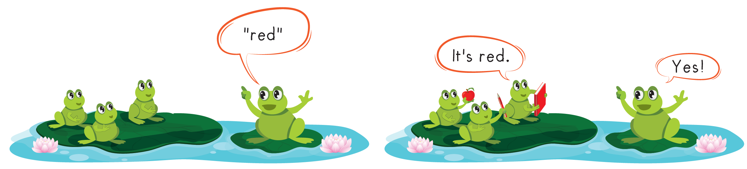

Slide 19
Further Practice

Slide 20

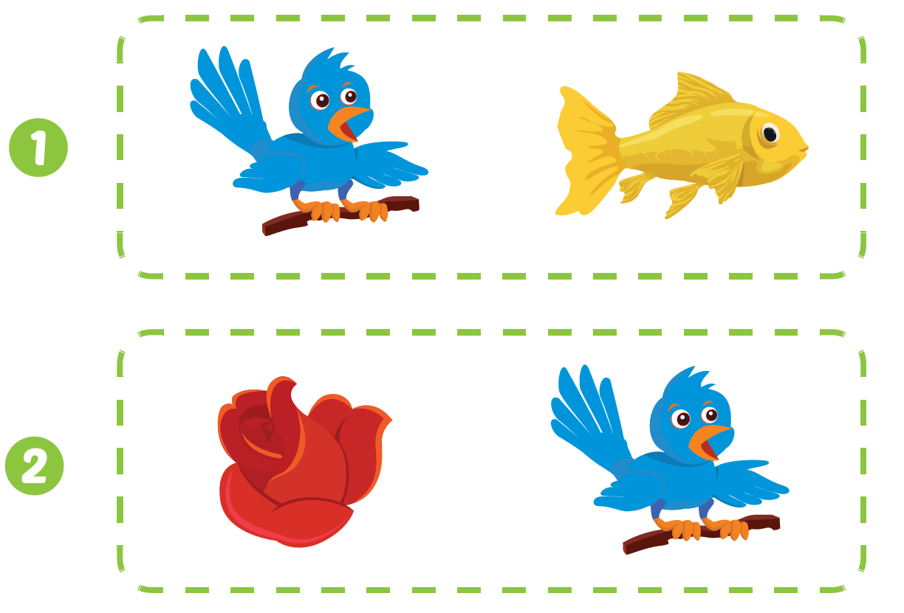

Click C to hear the sound.

Slide 21

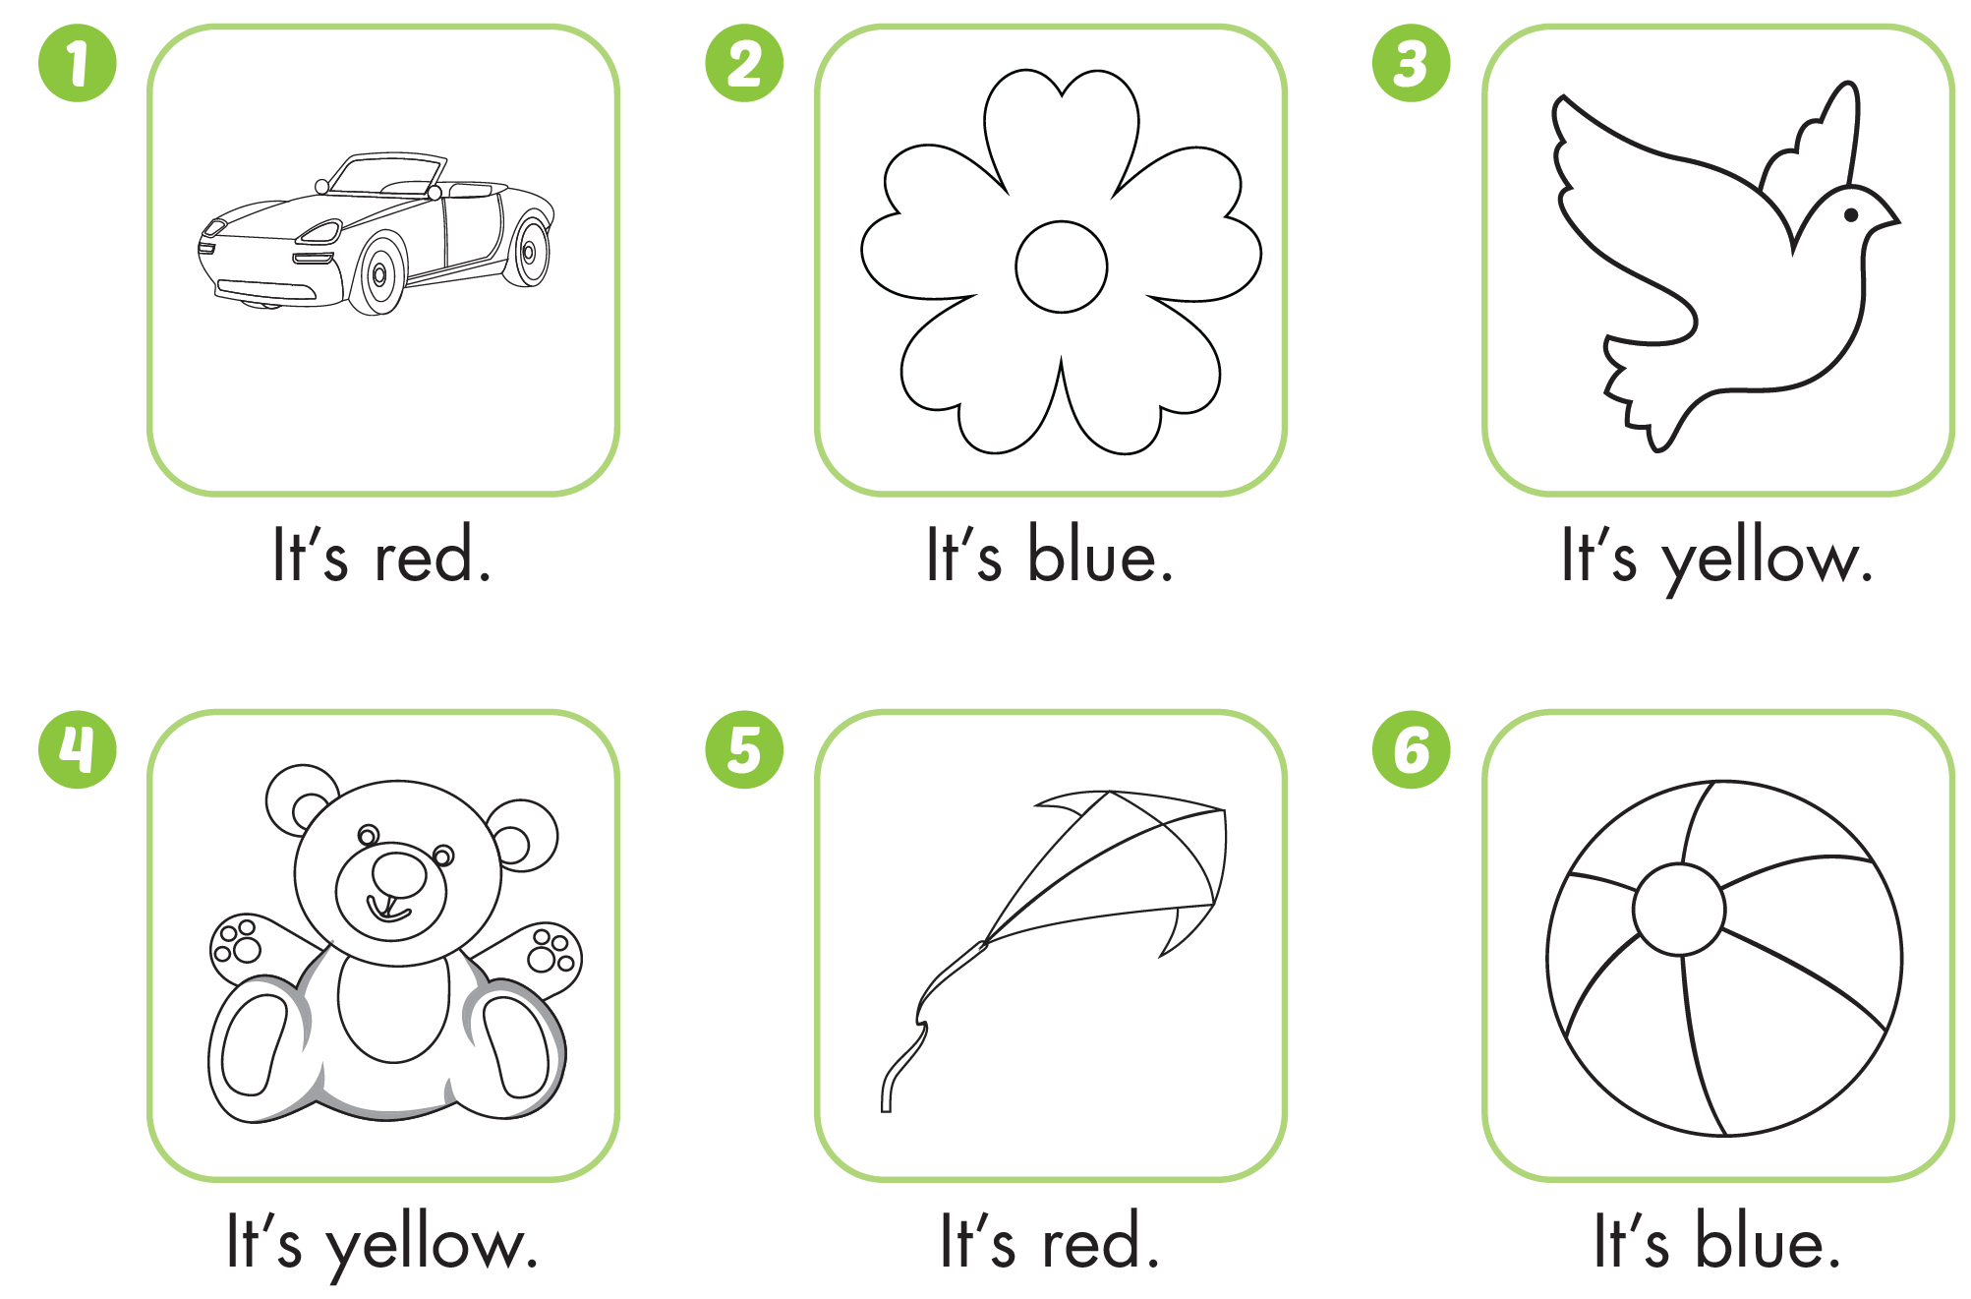

Slide 22
It’s time to play …

Slide 23

Listen and match
It’s blue
It’s red
It’s yellow

Slide 24


Look and write
r e d
b l u e

Slide 25
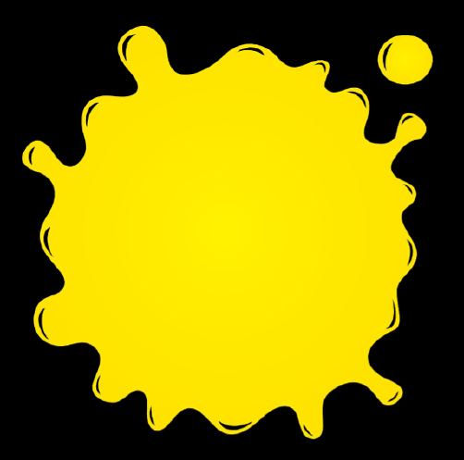
y e l l o w

Slide 26

CONSOLIDATION

Slide 27
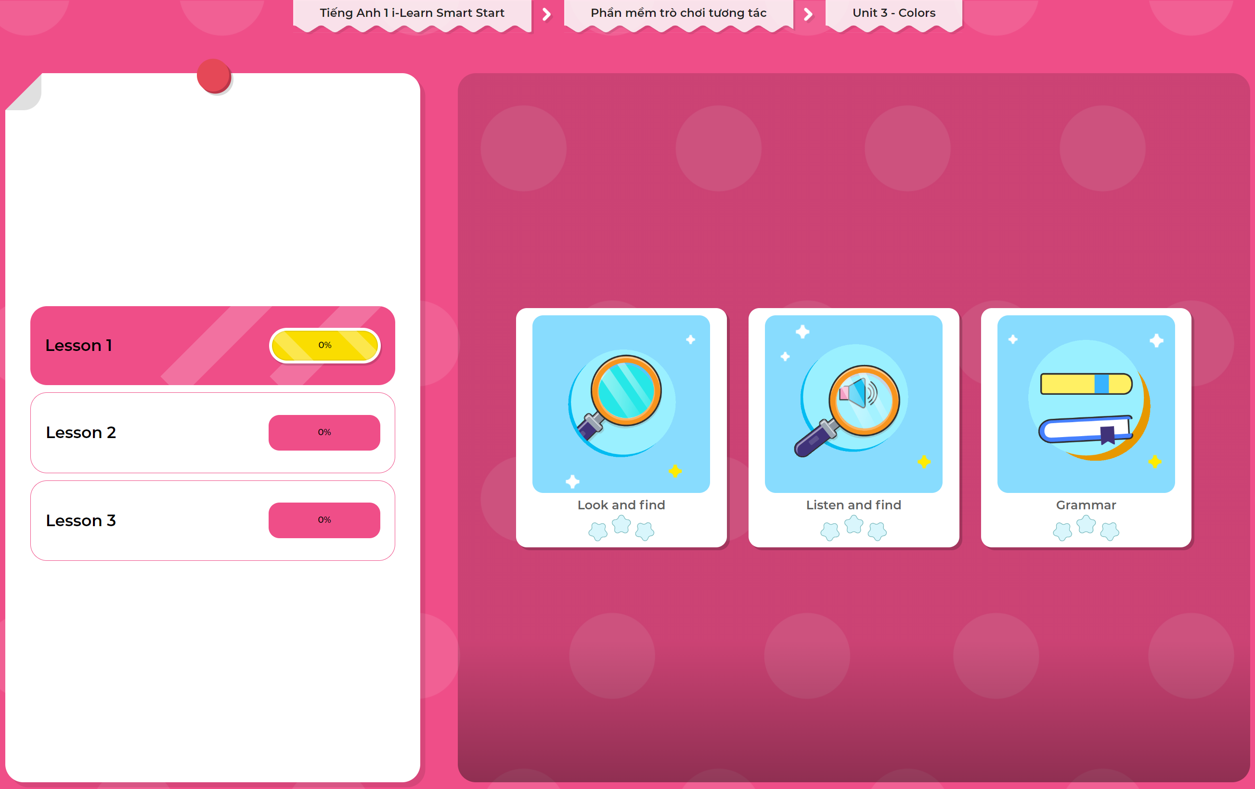
Extra Practice
DHA App
LET’S PLAY!
Click here to play the games

Slide 28

WRAP-UP

Slide 29
Today’s lesson
Structures/ Sentence patterns
It's red.
Vocabulary
blue, yellow, red

Slide 30
Homework
Review the vocabularies & structures and make sentences using them.
Practice the vocabulary and structure in Tiếng Anh 1 i-Learn Smart Start Notebook (page 15)
Do the exercises in Tiếng Anh 1 i-Learn Smart Start Workbook (page 19)
Play the consolidation games in Tiếng Anh 1 i-Learn Smart Start DHA App on www.eduhome.com.vn
Prepare the next lesson (page 22 SB)

Slide 31

Enjoy your day!

