Slide 1


Unit 1: Family
Lesson 2.2
Page 11

Slide 2
Lesson Outline
Warm-up
Listening
Consolidation
Wrap-up

Slide 3
Objectives
By the end of this lesson, students will be able to recognize the /b / sound and pronounce it correctly.
Vocabulary: boy
Phonic: /b /

Slide 4

WARM UP

Slide 5
Let’s sing!

Slide 6

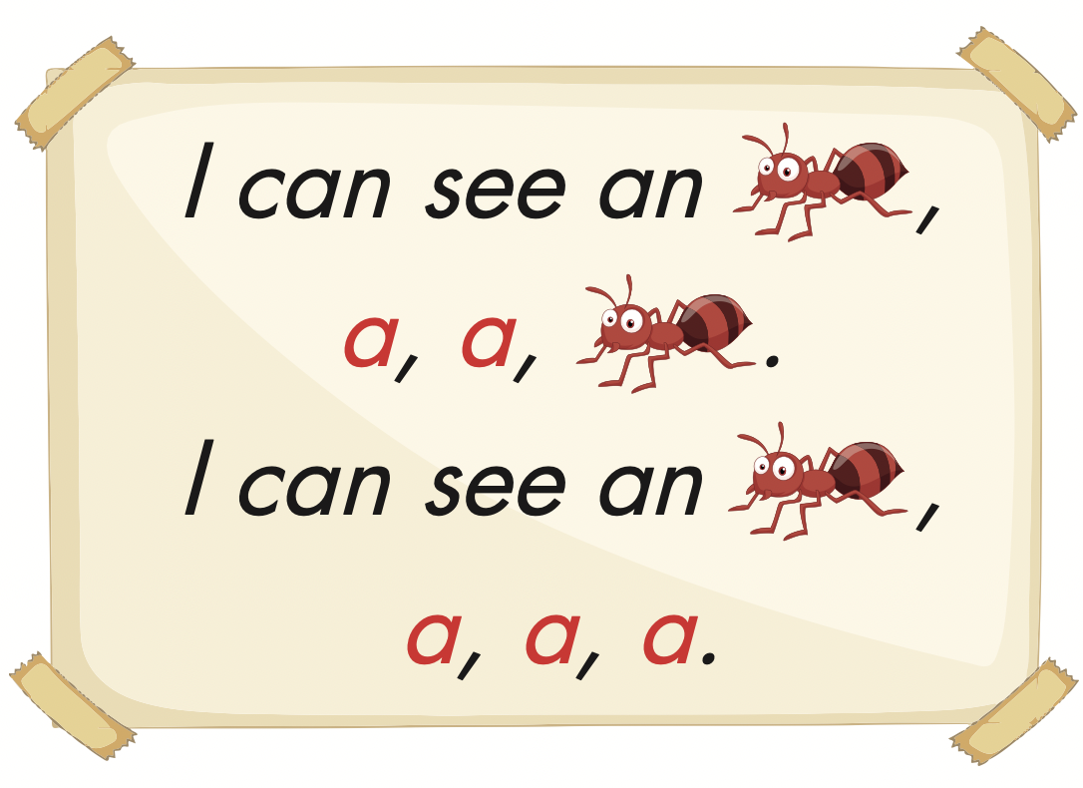
Click the icon to hear the sound.

Slide 7

It’s time to learn …

Slide 8

Phonics
/b/

Slide 9

Presentation

Slide 10

Click the icon to hear the sound.

Slide 11
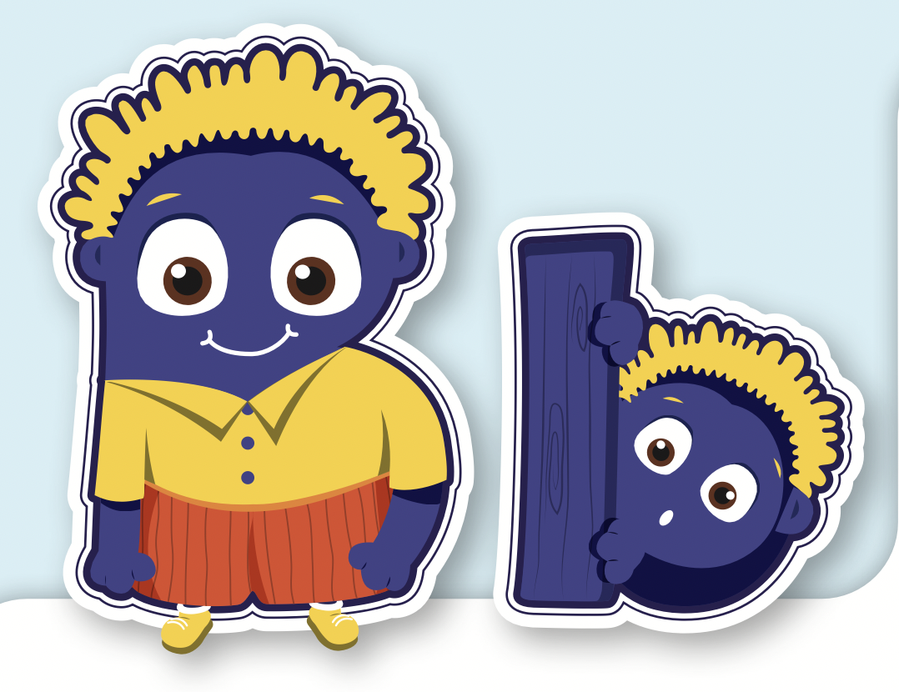
Click the icon to hear the sound.
B, b
/ b /

Slide 12
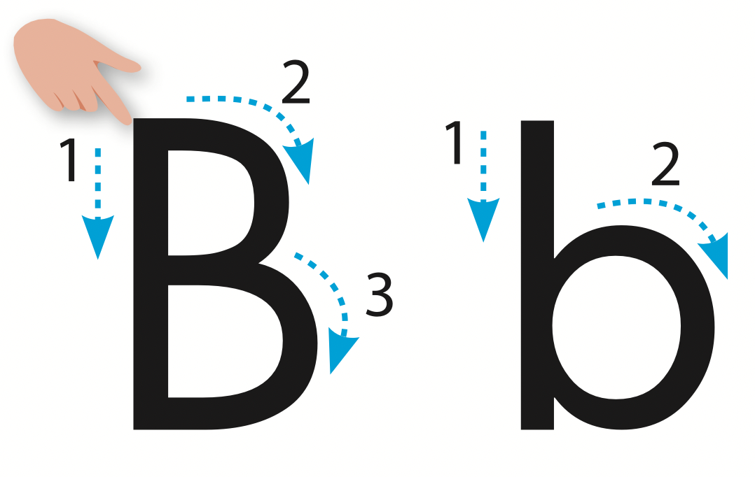
Let’s trace!

Slide 13

Practice

Slide 14

Listening

Slide 15



Click the icon to hear the sound.

Slide 16
Click the picture to hear the sound.
boy
/bɔɪ/
cậu bé

Slide 17

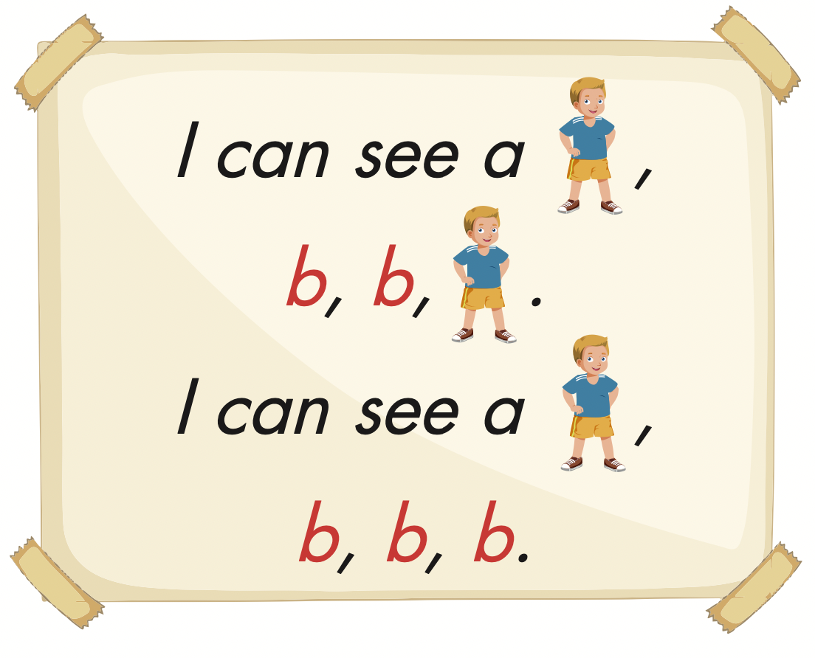
Click the picture to hear the sound.

Slide 18



Slide 19

Production

Slide 20
Let’s play!

Slide 21


Listen and match the letters correctly
a
b

Slide 22
Listen and match the letters correctly
a
b

Slide 23

Match the letters correctly
a
b

Slide 24
Match the letters correctly
a
b

Slide 25


Slide 26

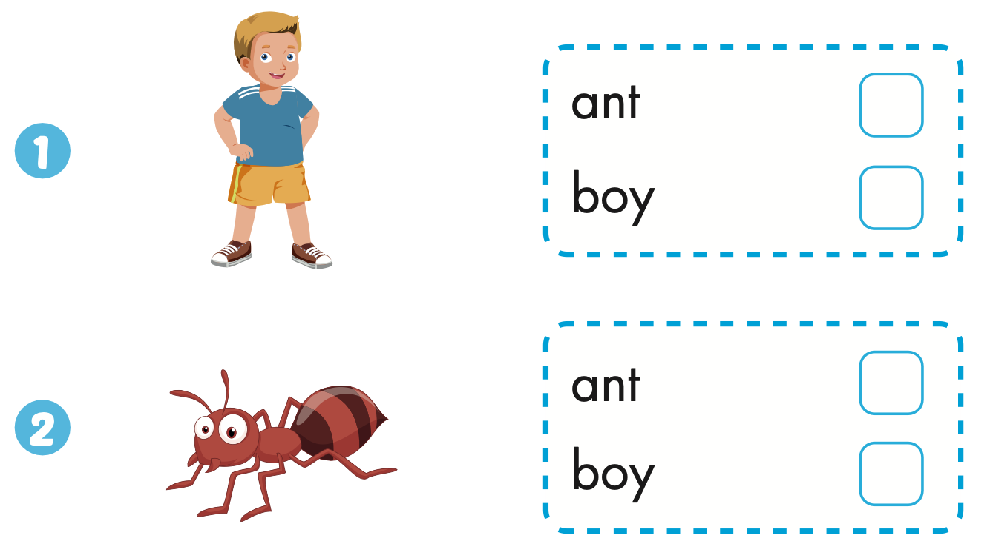

Extra Practice
WB, page 9

Slide 27

CONSOLIDATION

Slide 28
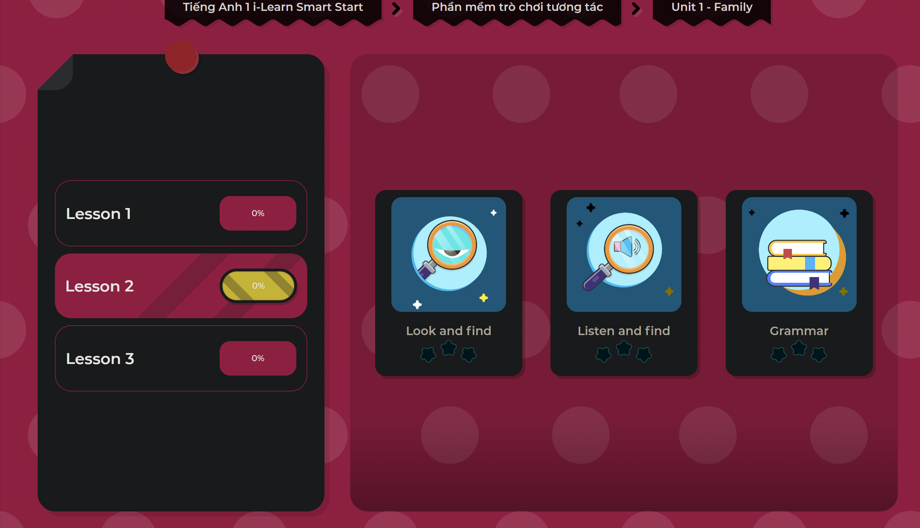
Extra Practice
DHA on Eduhome
LET’S PLAY!
Click on the picture below to play the games.

Slide 29

WRAP-UP

Slide 30
Today’s lesson
Vocabularies
boy
Phonics
/ b /

Slide 31
Lesson 3
Homework
Practice the /b/ sound.
Do the exercises in Tiếng Anh 1 i-Learn Smart Start WB (pages 8, 9).
Do the exercises in Tiếng Anh 1 i-Learn Smart Start Notebook (page 7).
Prepare the next lesson (page 12 SB)
Play the consolidation games in Tiếng Anh 1 i-Learn Smart Start DHA App on www.eduhome.com.vn

Slide 32

Enjoy your day!

Slide 33

Have a nice day!

