Slide 1

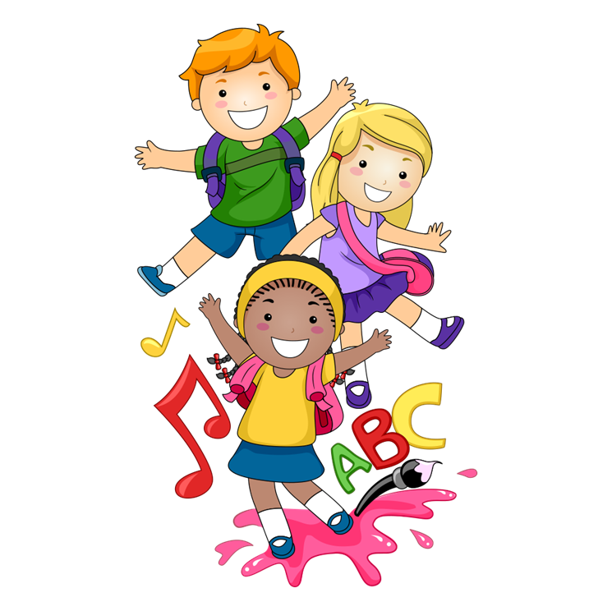

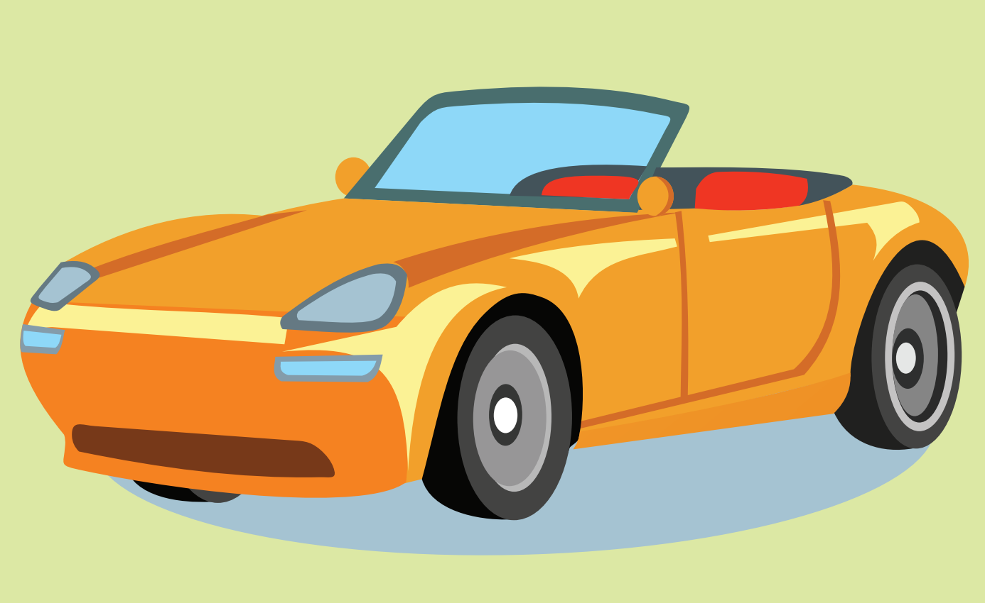
to class 2A

Slide 2
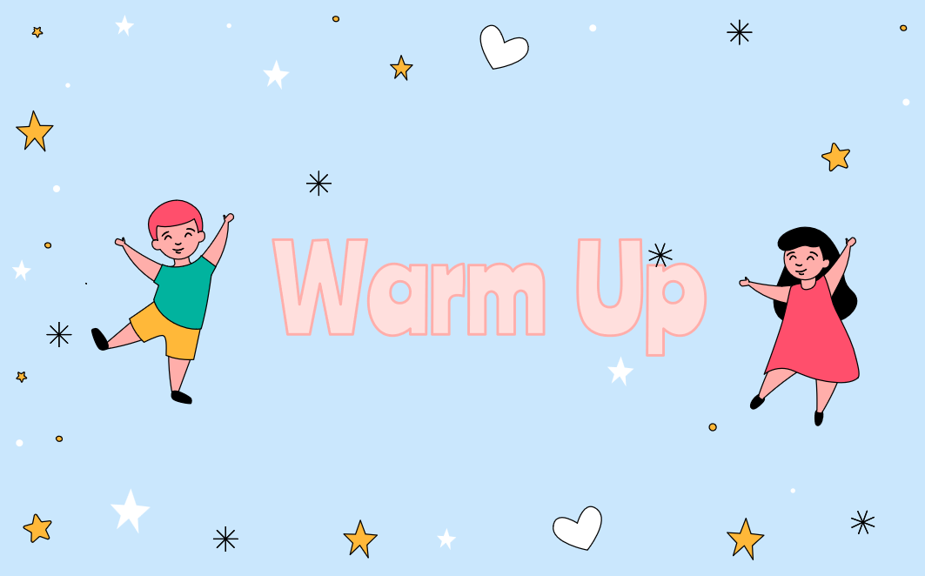

Slide 3
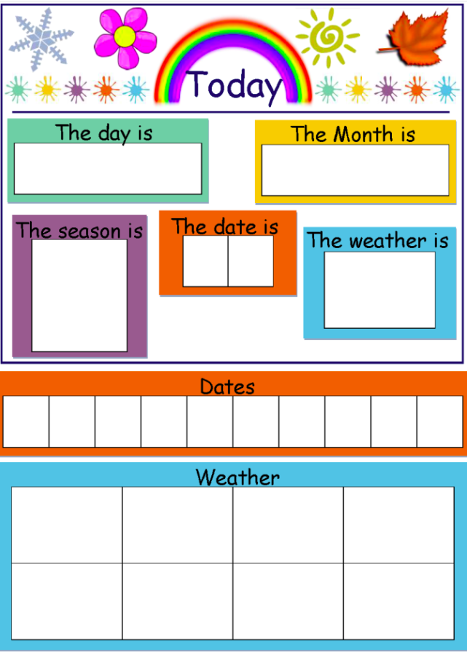


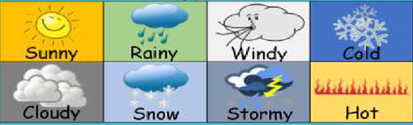
Thursday
November
2
7
0
1
2
3
4
5
6
7
8
9

Slide 4

WHAT CITY IS IT?
START

Slide 5


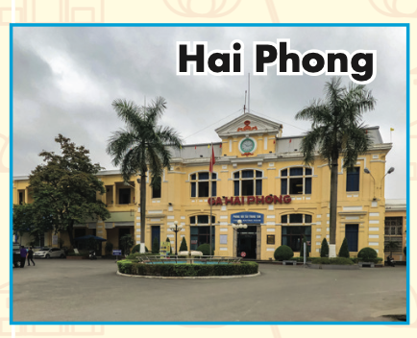

START
CHECK

Slide 6

START
CHECK

Slide 7
START
CHECK

Slide 8

START
CHECK

Slide 9

START
CHECK

Slide 10

START
CHECK

Slide 11
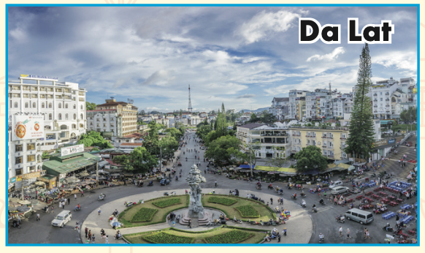
START
CHECK

Slide 12


Slide 13



Thursday, November 27th, 2025.
Unit 4:
Lesson1
ANIMALS

Slide 14


Slide 15
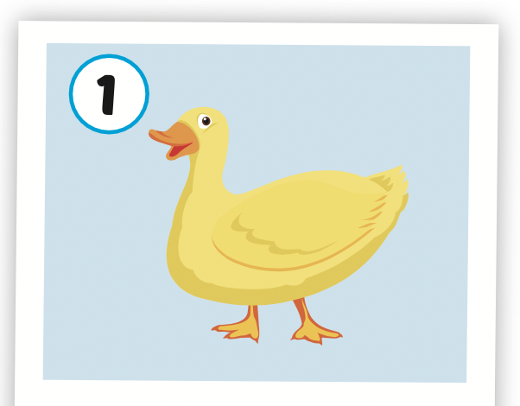

duck

Slide 16
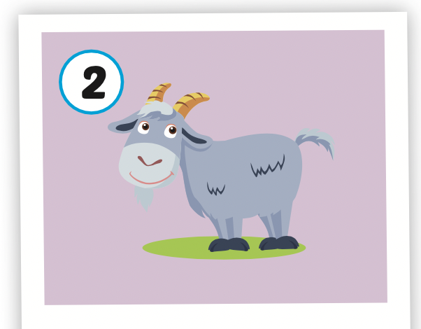
goat

Slide 17
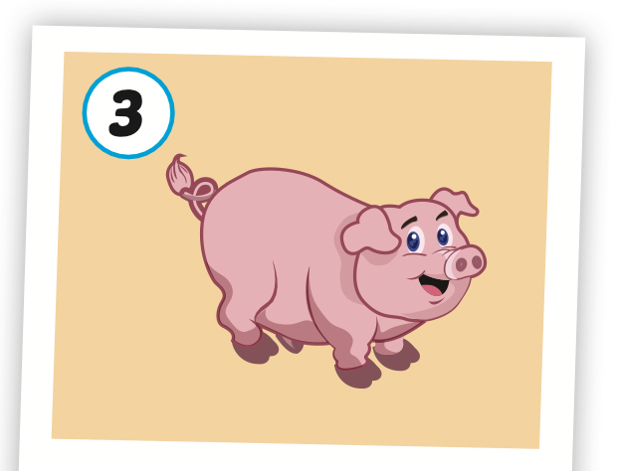
pig

Slide 18
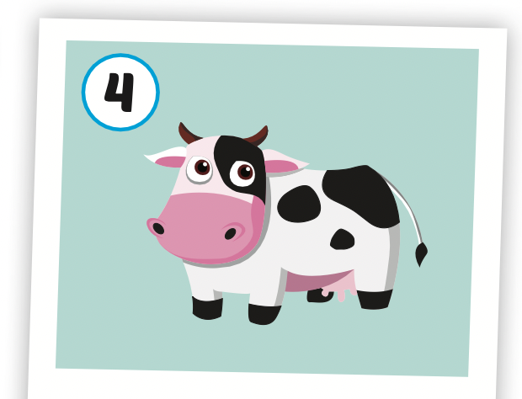
cow

Slide 19
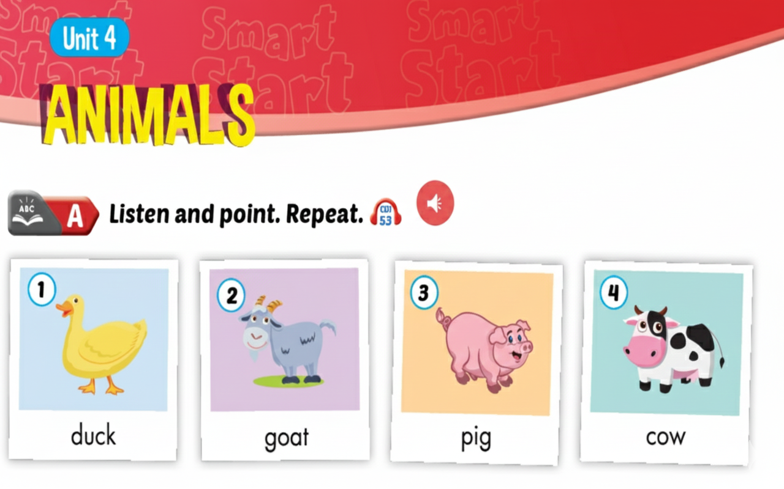

Slide 20
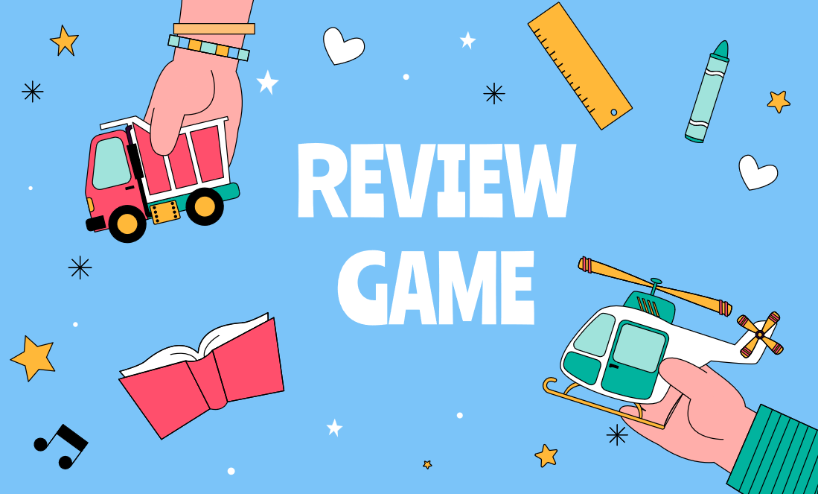

Slide 21






Animals
Word Quiz?
Teacher Hoai

Slide 22
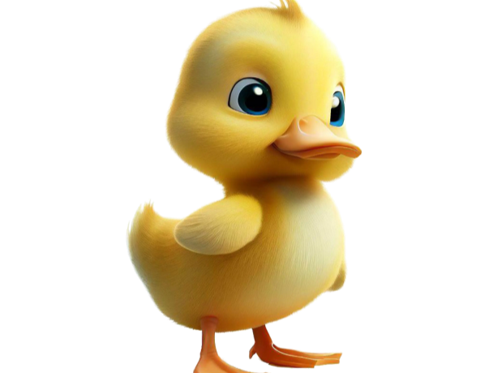


u
c
k
d _ _ _?
duck
uckd
dcuk

Slide 23
Animals
Word Quiz?
Teacher Hoai

Slide 24
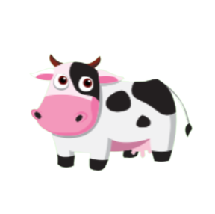



c
o
w
_ _ _ ?
ocw
cow
woc

Slide 25
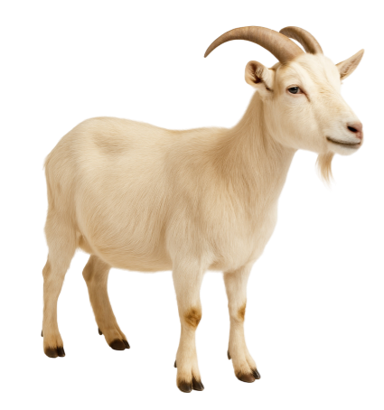

g
o
a
t
_ _ _?
oagt
goat
gota

Slide 26
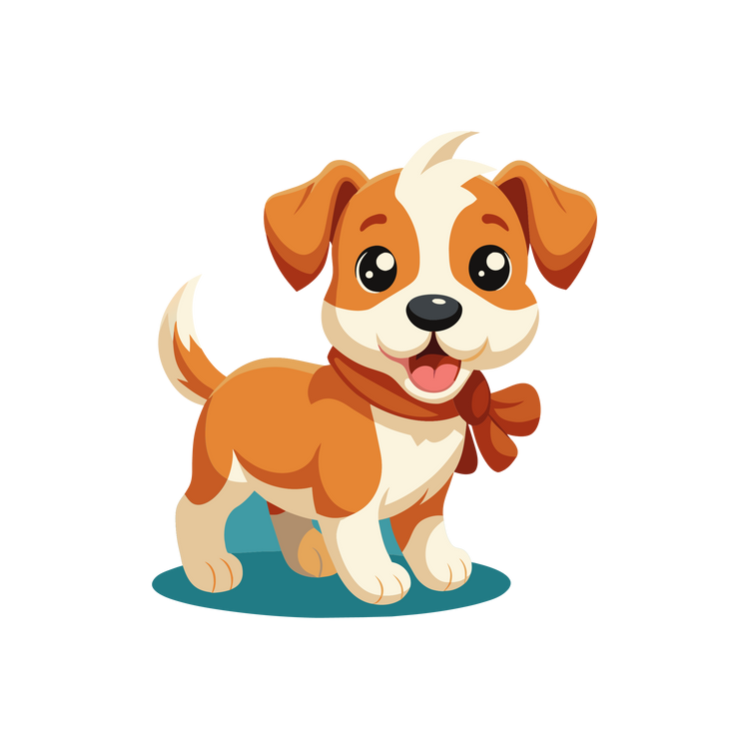

d
o
g
_ _ _?
dgo
god
dog

Slide 27



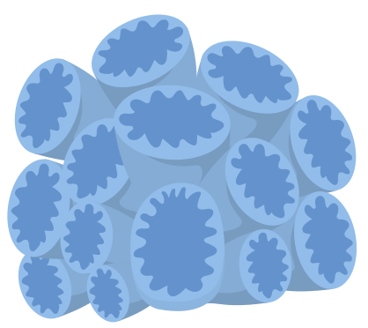

i
s
h
f_ _ _?
fish
fihs
fsih

Slide 28
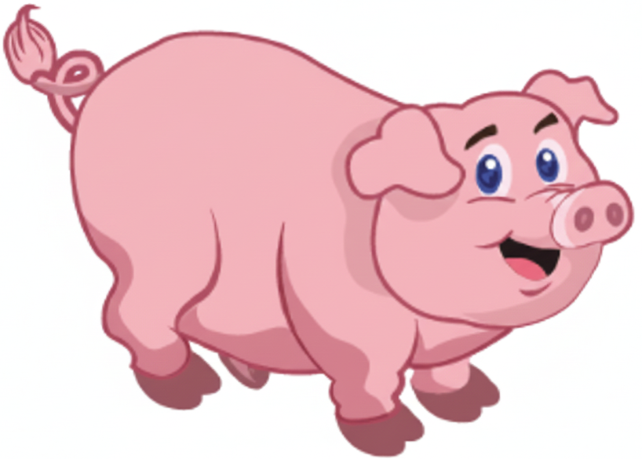


p
i
g
_ _ _?
pig
gip
igp

Slide 29

Great
Job!
Teacher Hoai

Slide 30
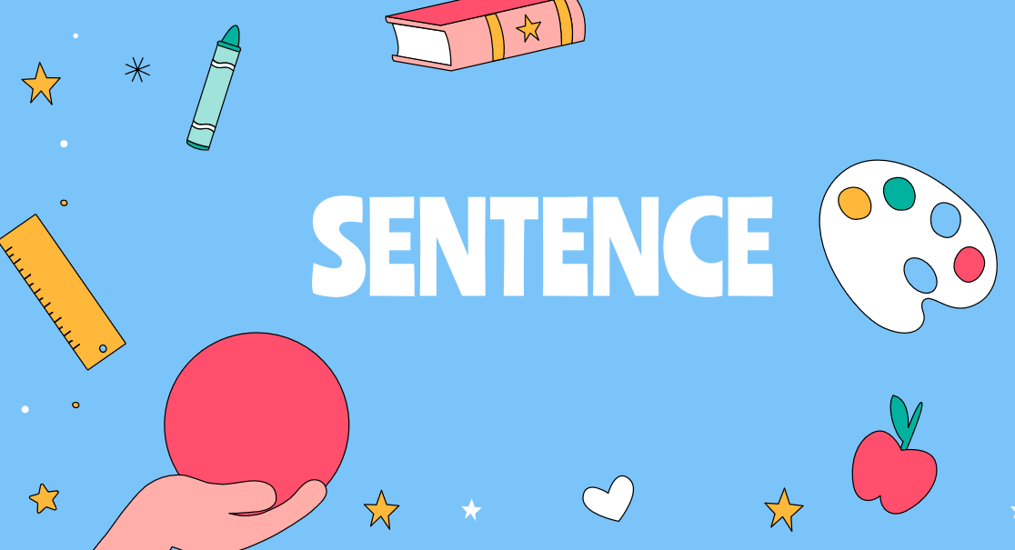

Slide 31
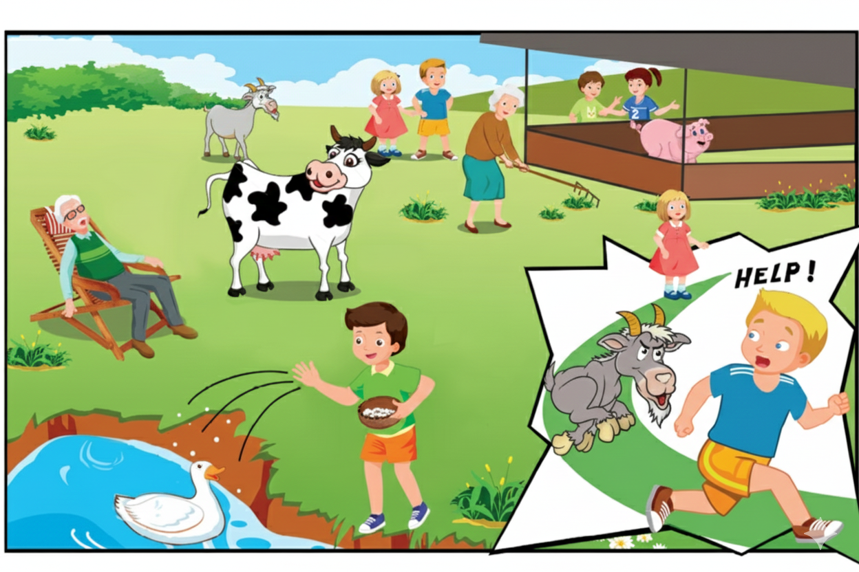

people and
animals
at the farm
talking about
animals

Slide 32


1. Sue: Hey, Bill, what’s that?
Bill: It’s a pig.
2. Sue: And what’s that?
Bill: It’s a cow.
Sue: A cow. OK
3. Bill: What’s that?
Sue: It’s a goat. Argh! Help!

Slide 33
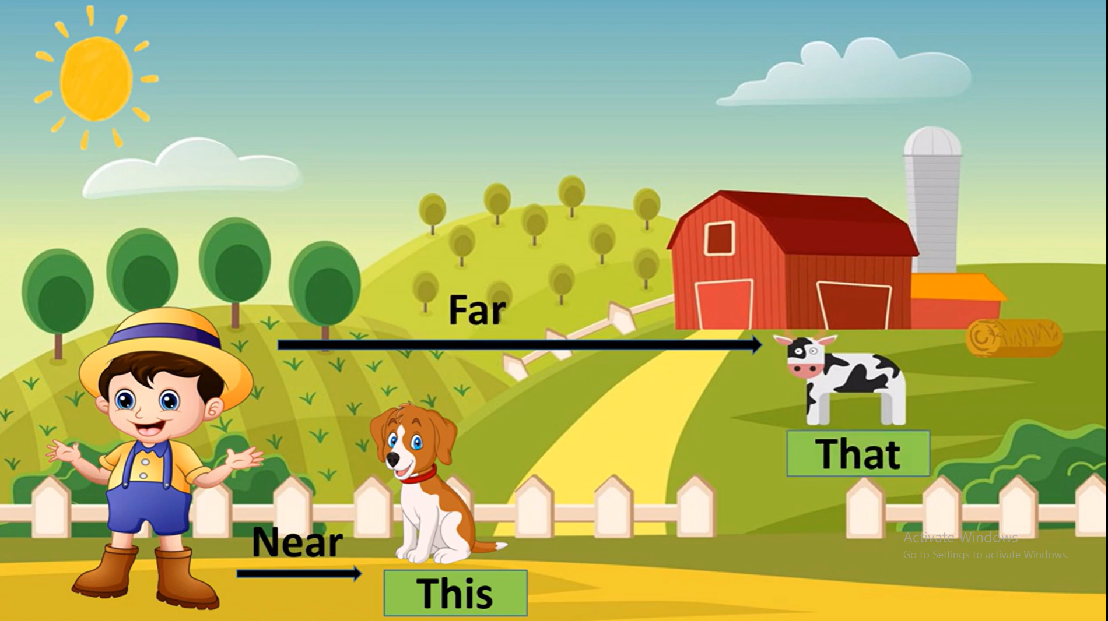
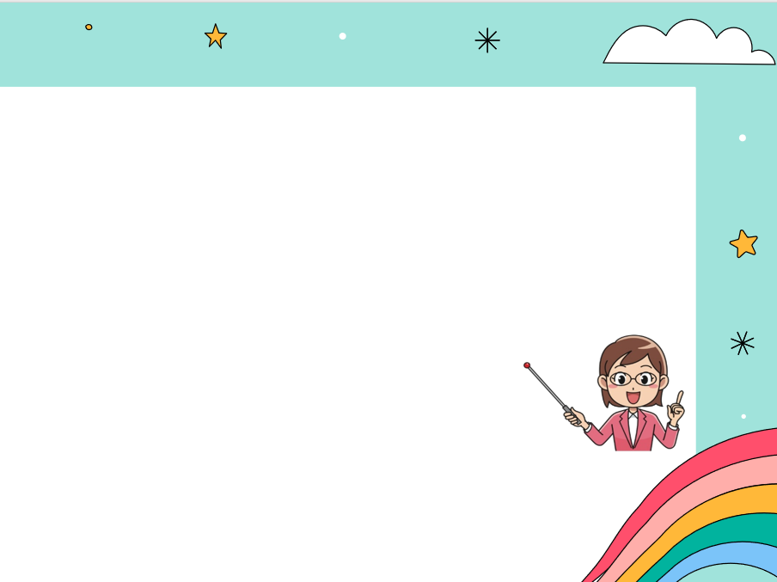
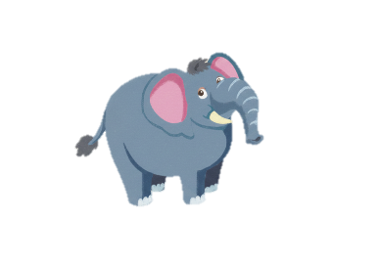
What’s that?
It’s a / an …..?
What’s that?
It’s a duck.
What’s that?
It’s an elephant.
Note: What is = What’s
It is = It’s
What’s that?

Slide 35
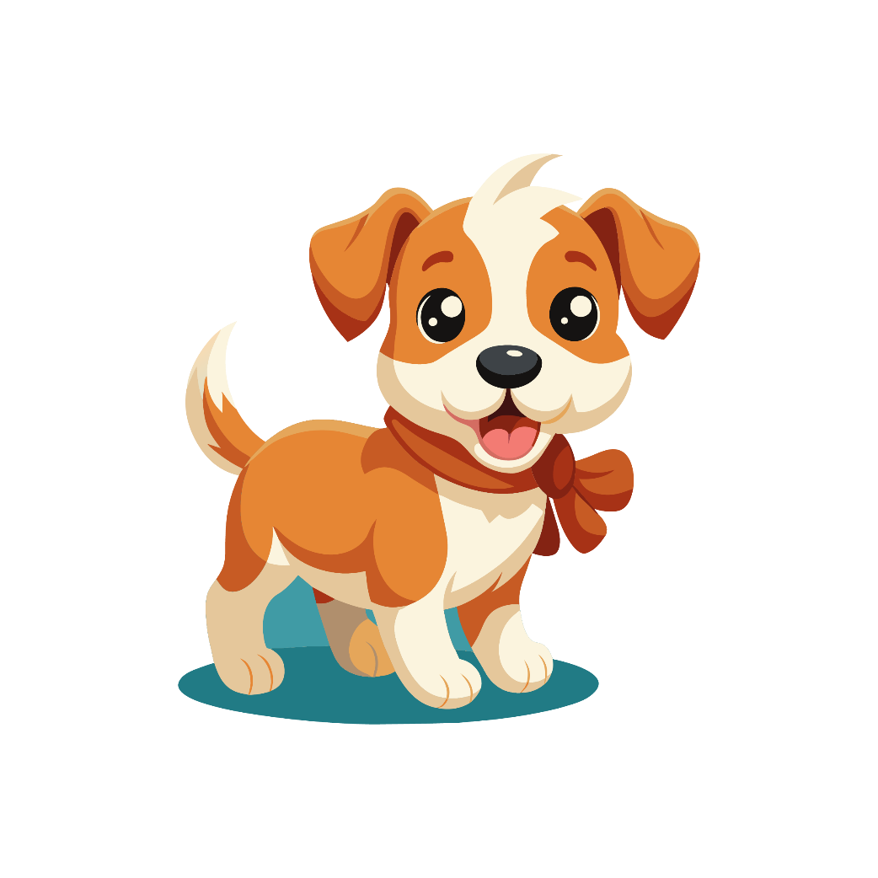




Click on the right word
A. It’s a cat.
B. It’s a frog.
C. It’s a dog.

Slide 36
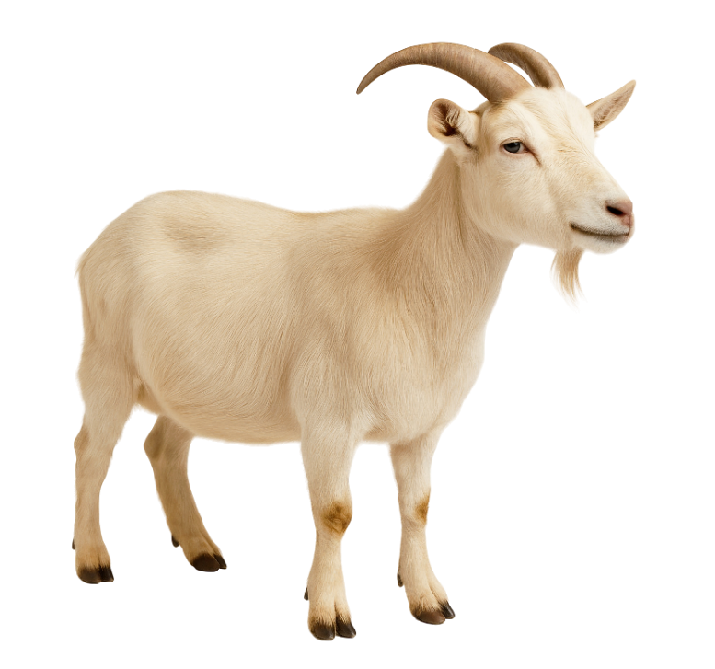
Click on the right word
A. It’s a dog.
B. It’s a cow.
C. It’s a goat.

Slide 37
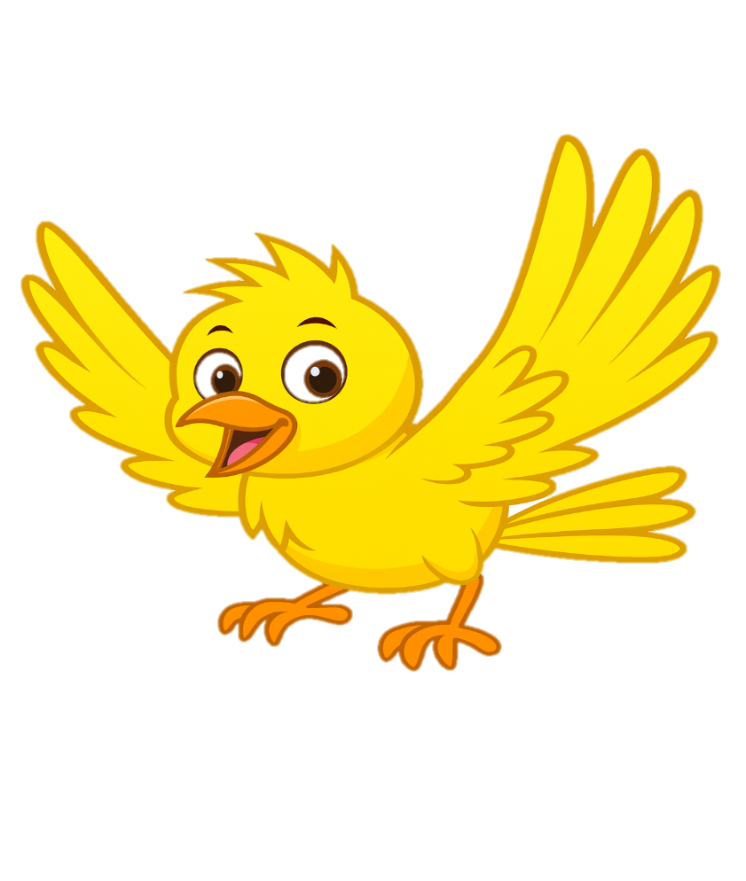
Click on the right word
A. It’s a cat.
B. It’s a bird.
C. It’s a pig.

Slide 38
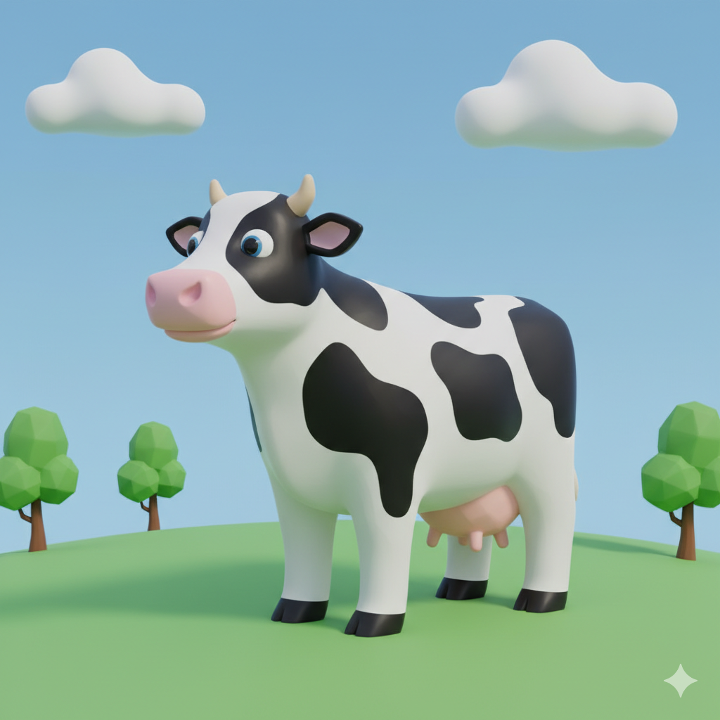
Click on the right word
A. It’s a duck.
B. It’s a cow.
C. It’s a pig.

Slide 39
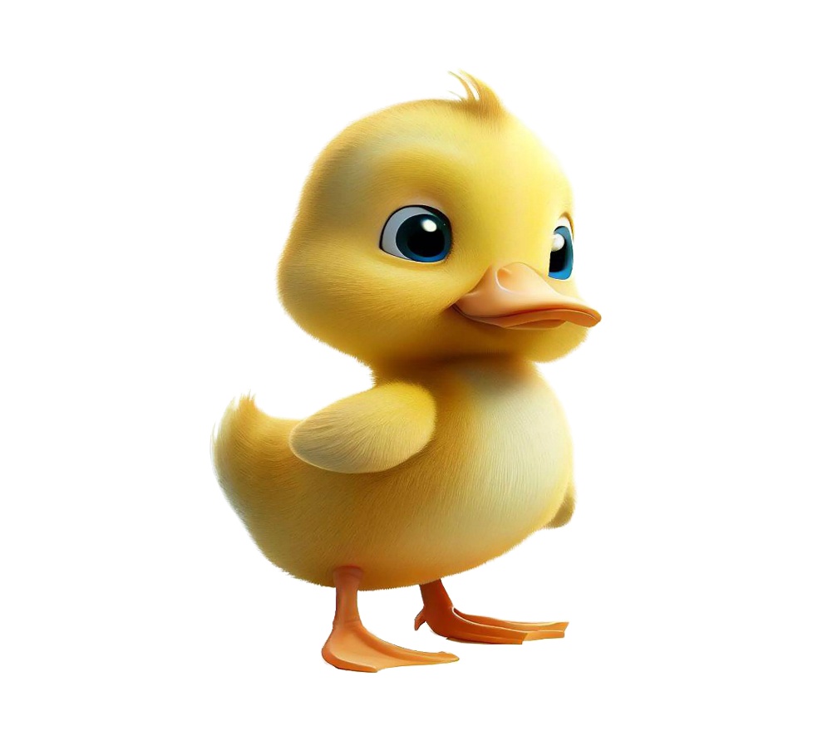
Click on the right word
A. It’s a cat.
B. It’s a duck.
C. It’s a goat.

Slide 40
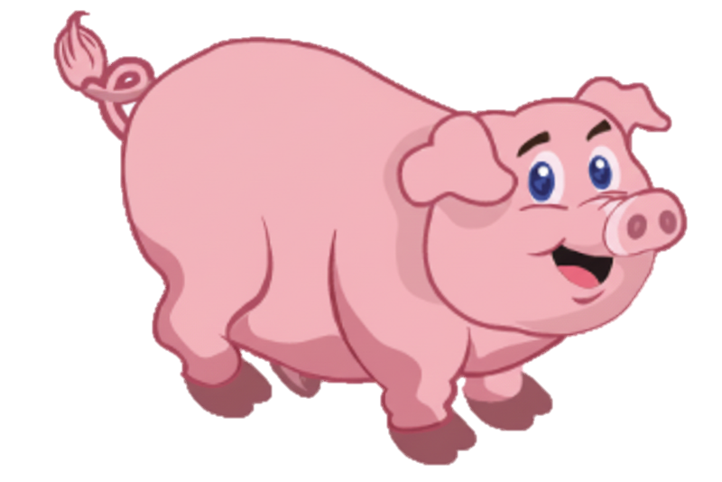
Click on the right word
A. It’s a pig.
B. It’s a cow.
C. It’s a goat.

Slide 41

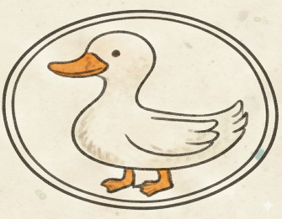
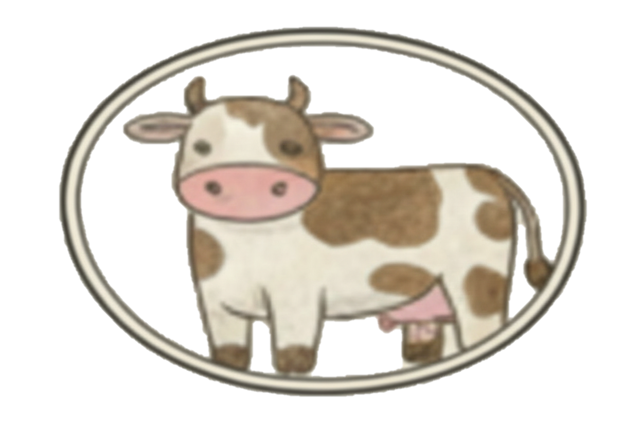
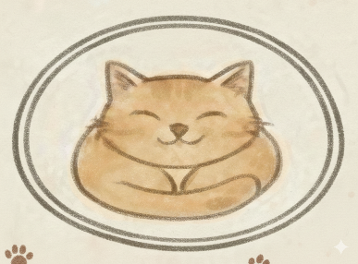
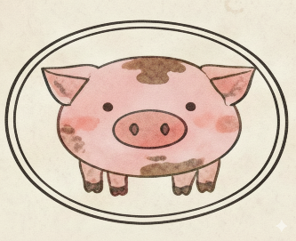

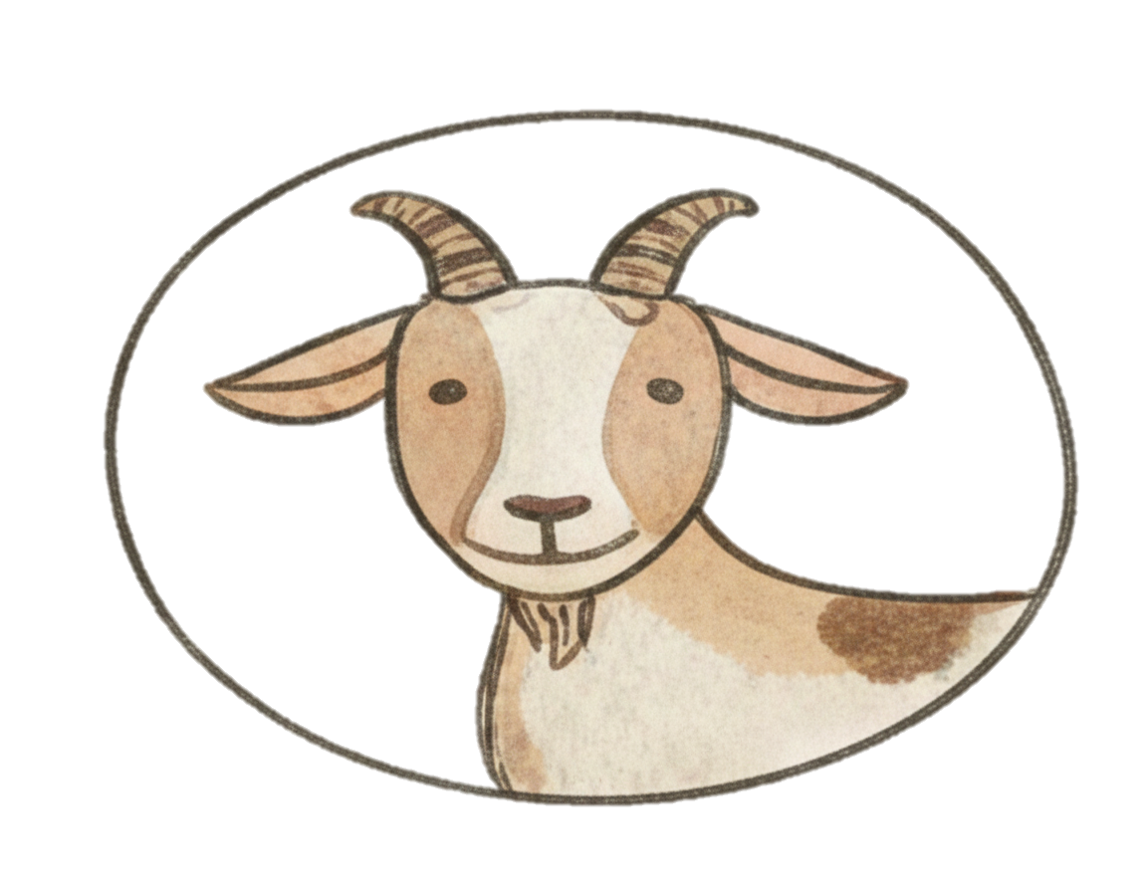
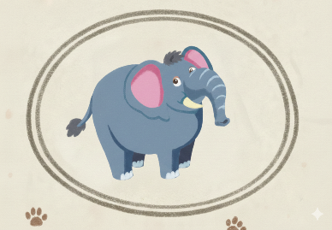
ANIMALS MIND MAP
ANIMALS

Slide 42
Moral Lesson
All animals can be friendly, but some may feel scared or excited.
Always keep a safe distance and never tease them.

Slide 43
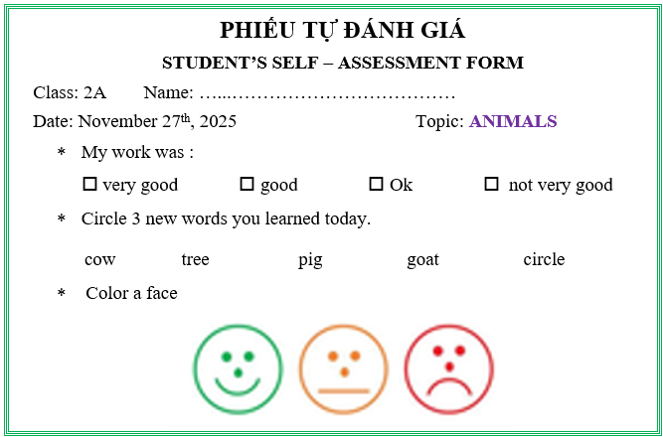

Slide 44
Homework:
- Sum up the points
Learn by heart the new words.
Prepare workbook page 26, 27.

Slide 45
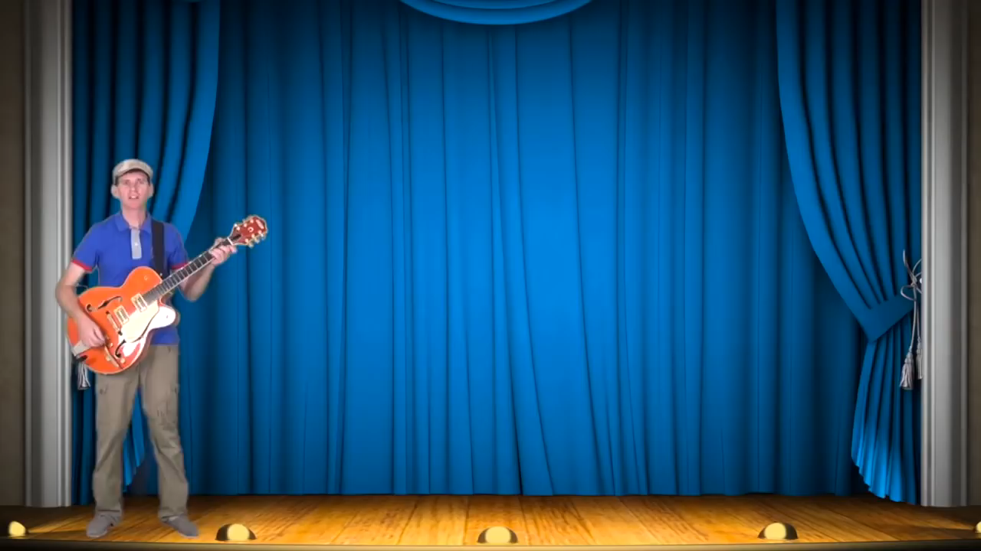
Goodbye

Slide 46



