Slide 1



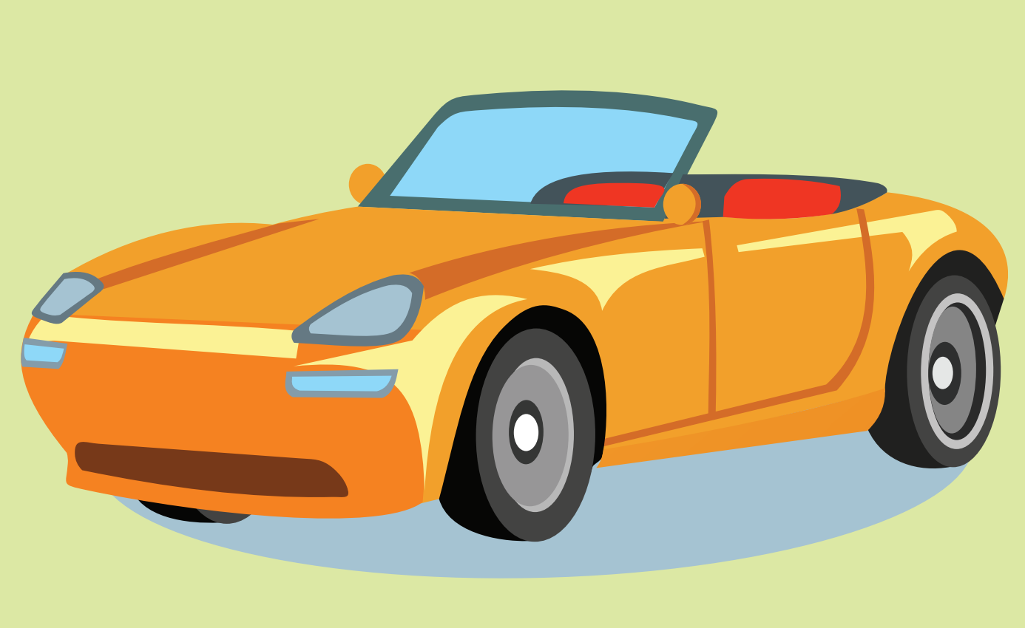
to class 2C

Slide 2
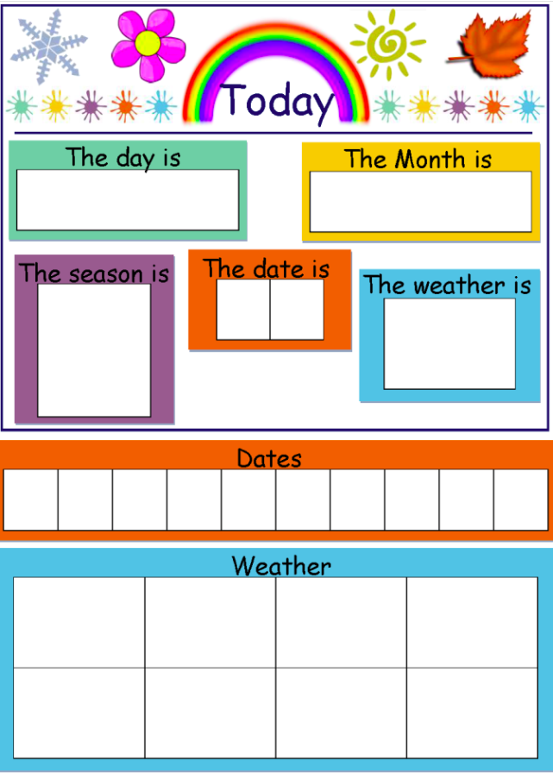


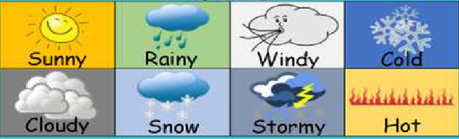
Thursday
October
3
1
0
1
2
3
4
5
6
7
8
9

Slide 3


Slide 4
What/ How
What
How
Câu 2
Câu 1
Câu 1
Câu 2
Câu 3
Câu 4
Câu 3
Câu 4
LESSON

Slide 5

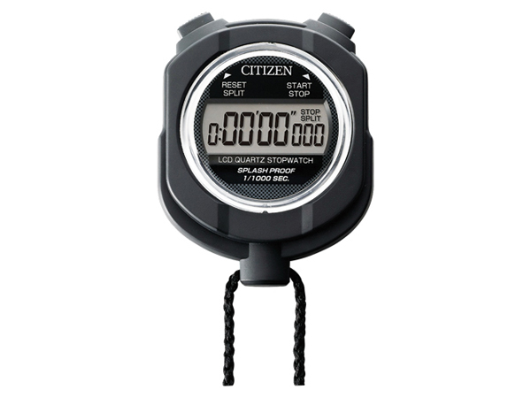
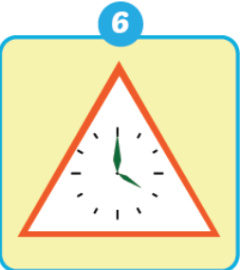
Câu 1:
01
02
03
06
09
10
08
04
05
07
What shape is it?
1
triangle/ It’s a triangle.
Answer
Home

Slide 6

Câu 2:
01
02
03
06
09
10
08
04
05
07
What shape is it?
2
square / It’s a square.
Answer
Home

Slide 7

Câu 3:
01
02
03
06
09
10
08
04
05
07
What shape is it?
3
circle/ It’s a circle.
Answer
Home

Slide 8


Câu 4:
01
02
03
06
09
10
08
04
05
07
4
rectangle/ It’s a rectangle.
Answer
Home

Slide 9

Câu 1:
01
02
03
06
09
10
08
04
05
07
How are you?
I’m happy.
Answer
Home

Slide 10
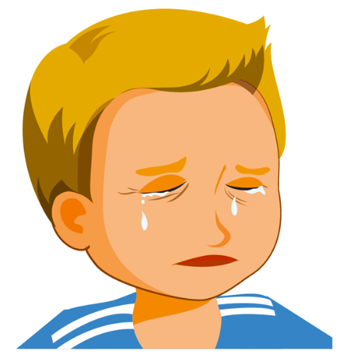
Câu 2:
01
02
03
06
09
10
08
04
05
07
How are you?
I’m sad.
Answer
Home

Slide 11

Câu 3:
01
02
03
06
09
10
08
04
05
07
How are you?
I’m fine.
Answer
Home

Slide 12

Câu 4:
01
02
03
06
09
10
08
04
05
07
How are you?
I’m great.
Answer
Home

Slide 13
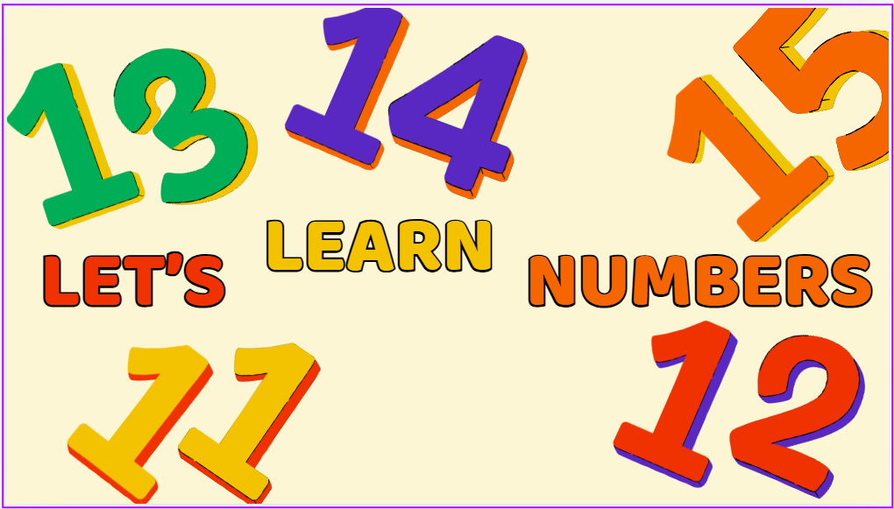

Slide 14
Thursday, October 31st, 2024.
Unit 3
NUMBERS
Lesson1

Slide 15


Slide 16
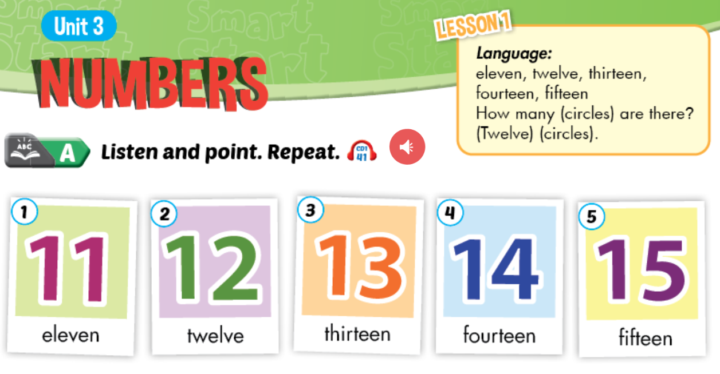


Slide 17
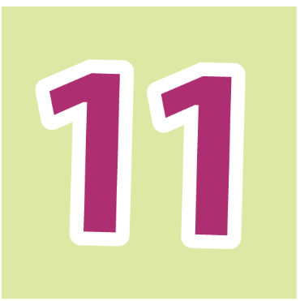
eleven

Slide 18
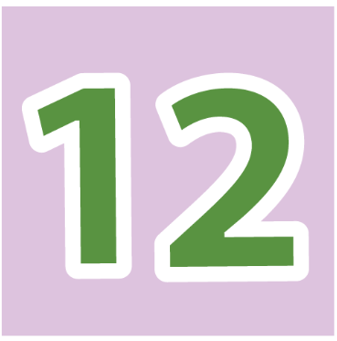
twelve

Slide 19
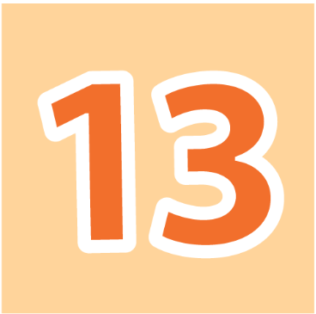
thirteen

Slide 20
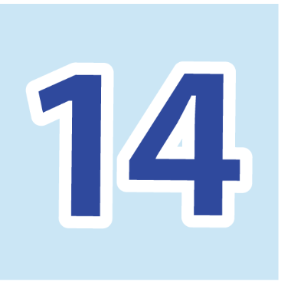
fourteen

Slide 21
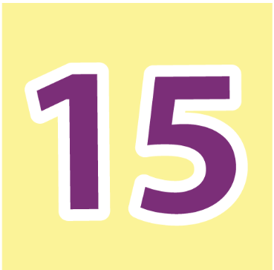
fifteen

Slide 23


Slide 24



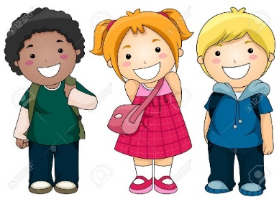
PLAY
REVIEW
WORDS

Slide 25


Click on the SPIN buttons and guess the word which is refered.

Slide 26


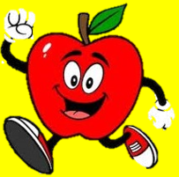

eleven
Which word is it?
NEXT
ven
ar
fast
dr
fa
le
nvs
br
bre
st
e
mes
ak
fast
br
Check

Slide 27
fifteen
NEXT
Which word is it?
fif
ar
fast
dr
fa
en
nvs
br
bre
st
te
mes
ak
fast
br
Check

Slide 28
thirteen
Which word is it?
NEXT
en
ar
fast
dr
fa
thi
nvs
br
bre
st
rte
mes
ak
fast
br
Check

Slide 29
ten
NEXT
Which word is it?
e
ar
fast
dr
fa
n
nvs
br
bre
st
t
mes
ak
fast
br
Check

Slide 30
twevle
NEXT
Which word is it?
ev
ar
fast
dr
fa
tw
nvs
br
bre
st
le
mes
ak
fast
br
Check

Slide 31
fourteen
NEXT
Which word is it?
fou
ar
fast
dr
fa
en
nvs
br
bre
st
rte
mes
ak
fast
br
Check

Slide 32
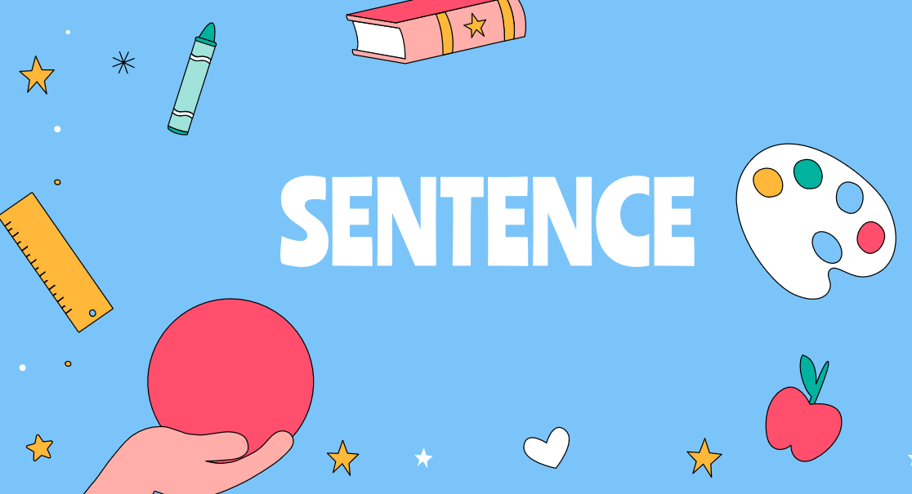

Slide 33
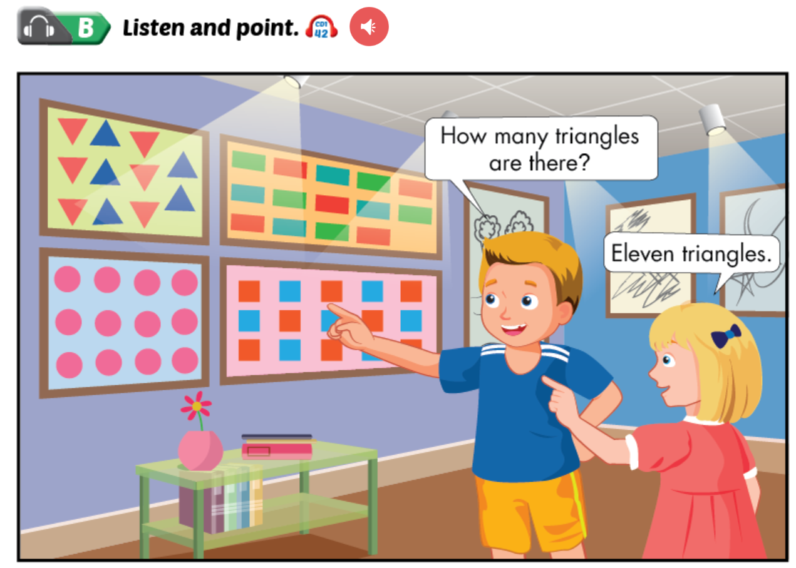

Slide 34

1. Bill: How many triangles are there?
Sue: Eleven triangles
2. Bill: How many rectangles are there?
Sue: Hmm. Fourteen rectangles
3. Bill: How many circles are there?
Sue: Ten, eleven, twelve circles

Slide 35
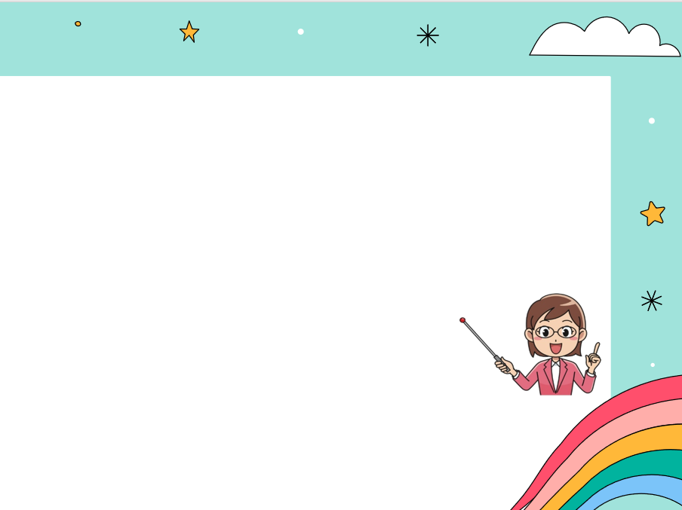
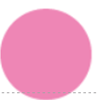
How many + Noun(plural) + are there?
How many circles are there?
Số đếm + Noun singular / Noun plural
There is + a/ an/ one + Noun (singular).
There are + số đếm từ 2 + Noun(plural).
one circle
1
There is one circle.
twevle circles
12
There are twevle circles.

Slide 37
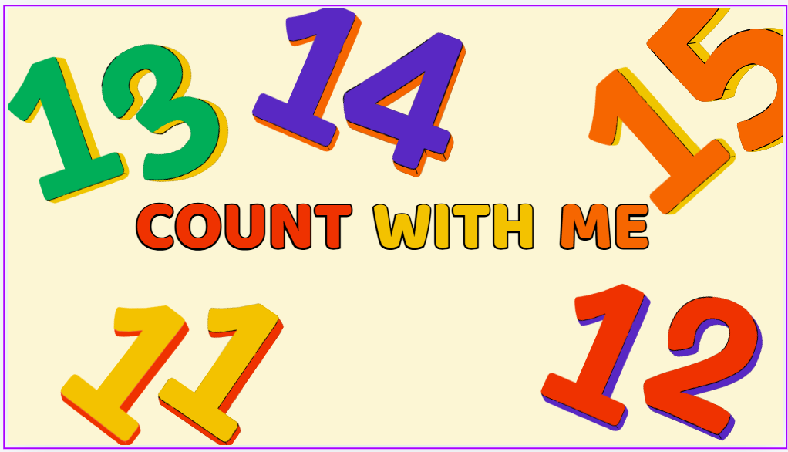

Lucky numbers

Slide 38

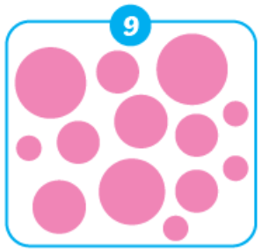

                How many circles are there?
A. Fourteen circles
B. Thirteen circles
C. Ten circles

Slide 39
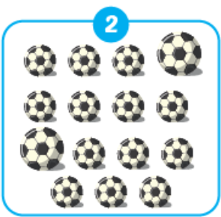

                2.How many balls are there?
A. Fifteen balls
B. Eleven balls
C. Fourteen balls

Slide 40

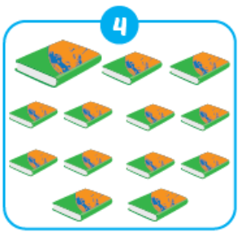
                3.How many books are there?
A. Twelve books
B. Thirteen books
C. Eleven books

Slide 41

1 mark
Congratulation!

Slide 42

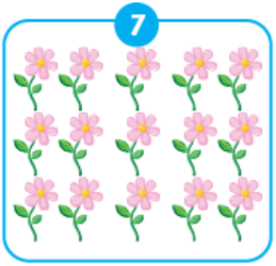
                5.How many flowers are there?
A. Thirteen flowers
B. Fifteen flowers
C. Fourteen flowers

Slide 43

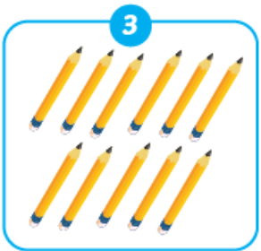
                6.How many pencils are there?
A. Fourteen pencils
B. Eight pencils
C. Eleven pencils

Slide 44
2 marks
Congratulation!

Slide 45
2 marks
Congratulation!

Slide 46
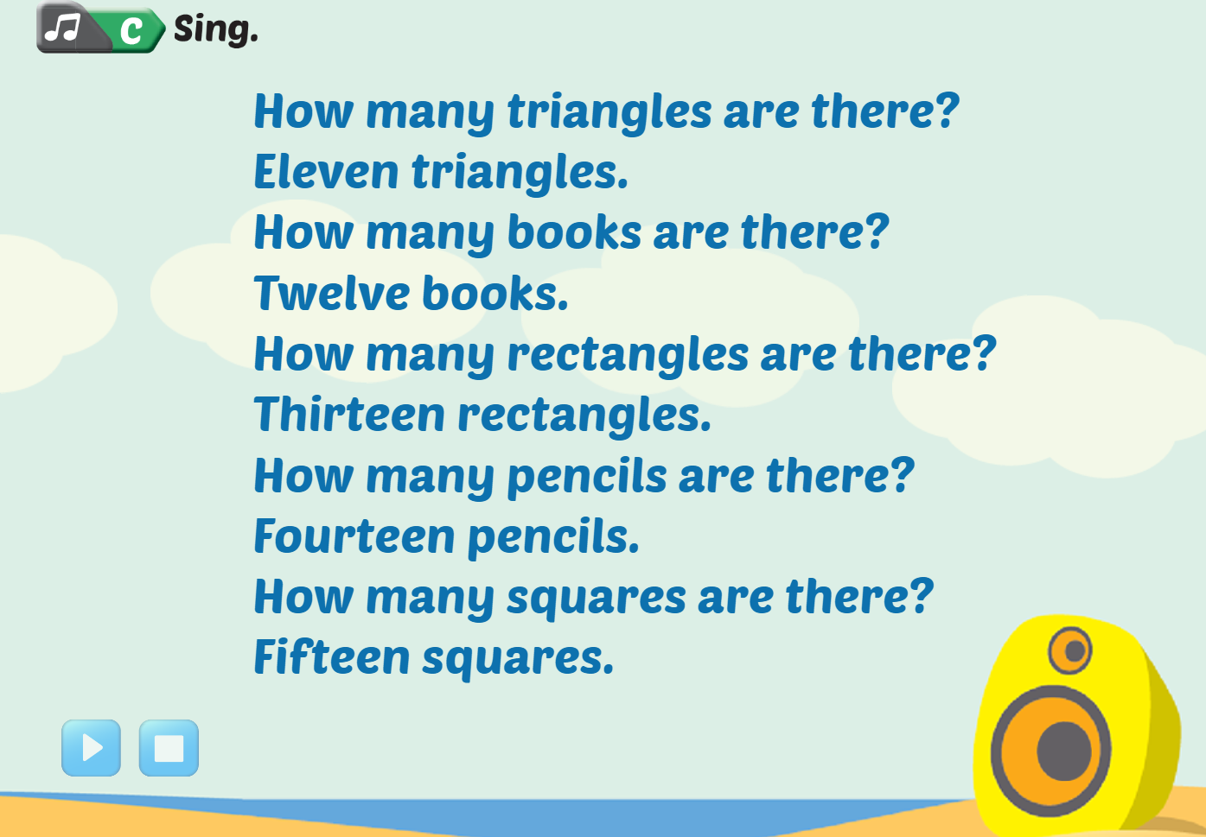

Slide 47
Homework:
- Sum up the points
  Learn by heart the new words.
Prepare workbook page 20, 21.

Slide 48
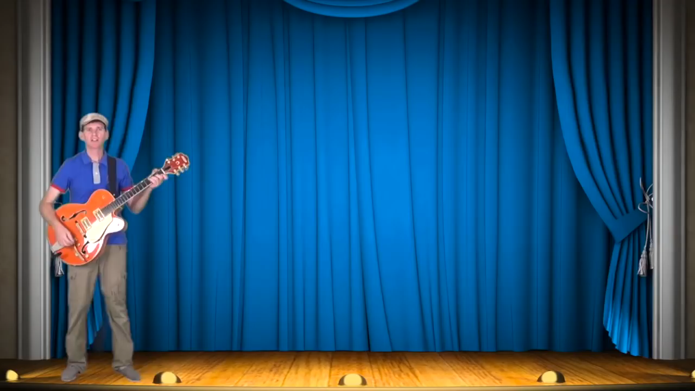
GOOD BYE

Slide 49



