Slide 1




to class 1B

Slide 2
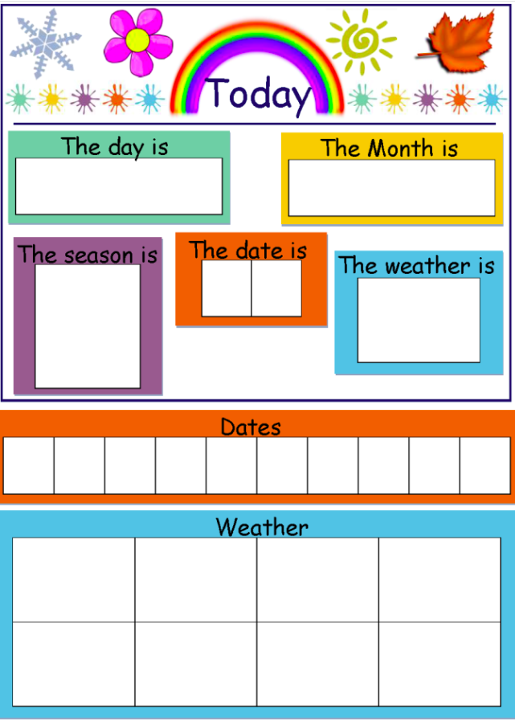


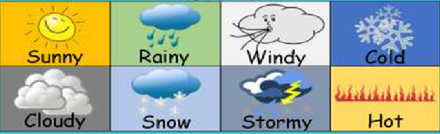
Wednesday
March
0
5
0
1
2
3
4
5
6
7
8
9

Slide 3


Slide 4
What/ How
What
How
Câu 2
Câu 1
Câu 1
Câu 2
Câu 3
Câu 3
LESSON

Slide 5


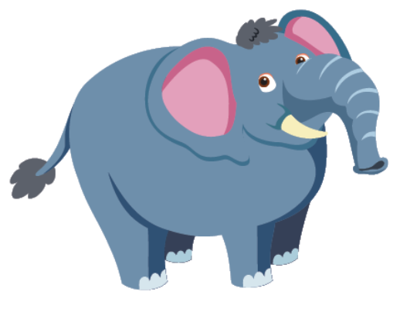
Câu 1:
01
02
03
06
09
10
08
04
05
07
What animal is it?
elephant/ It’s an elephant.
Answer
Home

Slide 6
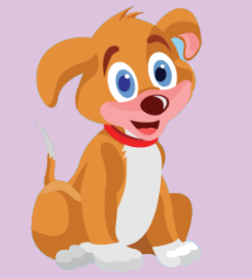
Câu 2:
01
02
03
06
09
10
08
04
05
07
What animal is it?
dog / It’s a dog.
Answer
Home

Slide 7
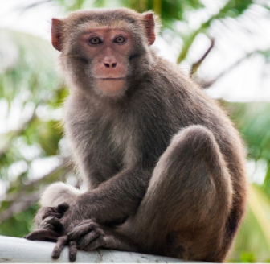
Câu 3:
01
02
03
06
09
10
08
04
05
07
What animal is it?
monkey/ It’s a monkey.
Answer
Home

Slide 8


Câu 2:
01
02
03
06
09
10
08
04
05
07
How old are you?
I’m two.
Answer
Home

Slide 9
Câu 1:
01
02
03
06
09
10
08
04
05
07
How old are you?
I’m six.
Answer
Home

Slide 10

Câu 3:
01
02
03
06
09
10
08
04
05
07
How old are you?
I’m five.
Answer
Home

Slide 11
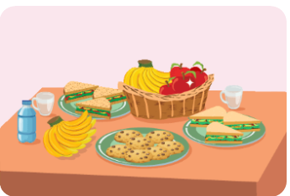

Slide 12
Wednesday, March 05th, 2025.
Unit 8
Food
Lesson1- New words

Slide 13


Slide 14
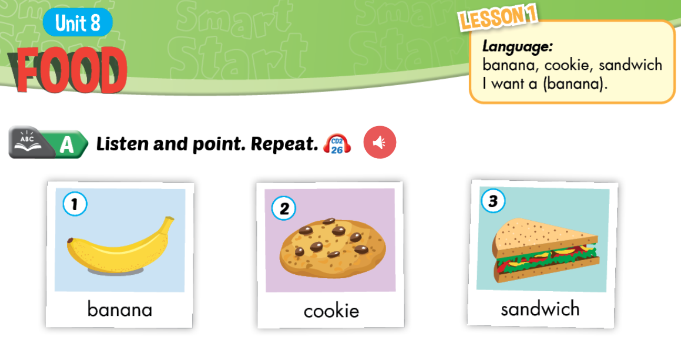


Slide 15
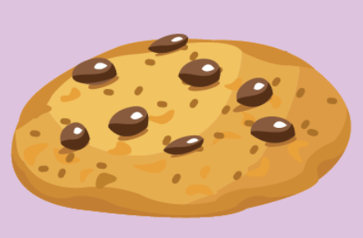
cookie

Slide 16
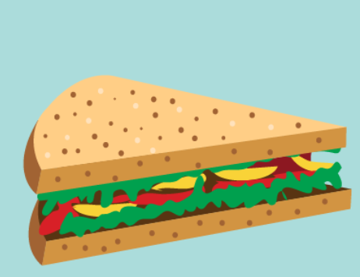
sandwich

Slide 17
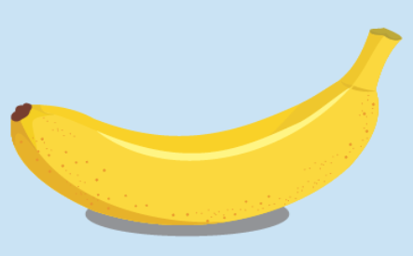
banana

Slide 19


Slide 20
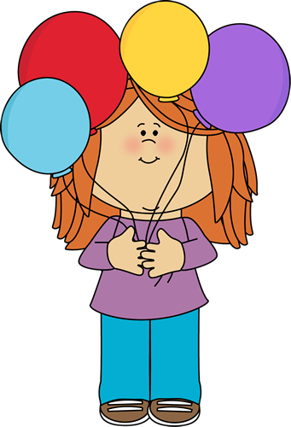
What?
banana
Notes:
student choose any colors, look at the piece of main picture and guess correctly the hidden picture.

Slide 21

What?
cookie

Slide 22
What?
sandwich

Slide 23
What?
cookie

Slide 24
What?
sandwich

Slide 25
What?
banana

Slide 26
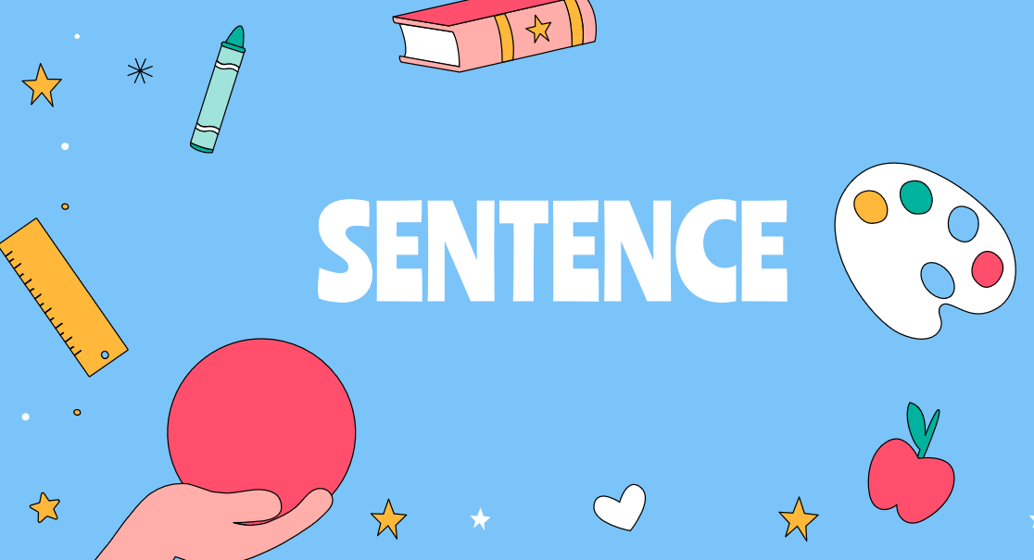

Slide 27
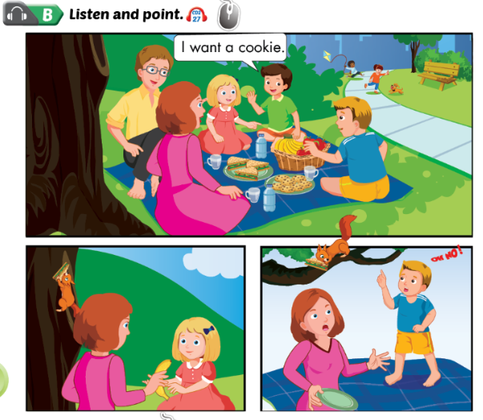

Slide 28

1. Ben: I want a cookie.
Bill: Me too
2. Sue: I want a banana.
3. Bill: I want a sandwich.
Oh no!

Slide 29
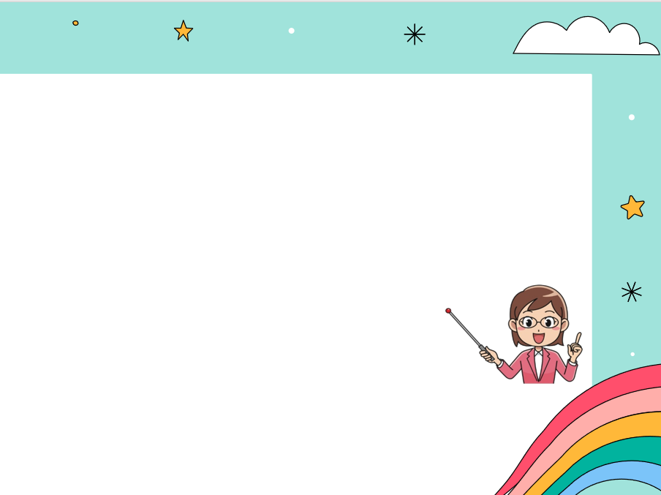
I want + a / an + từ chỉ đồ ăn?
I want a cookie.
an + u, e, o, a, i
an apple an orange
an umbrella an insect
an egg

Slide 31
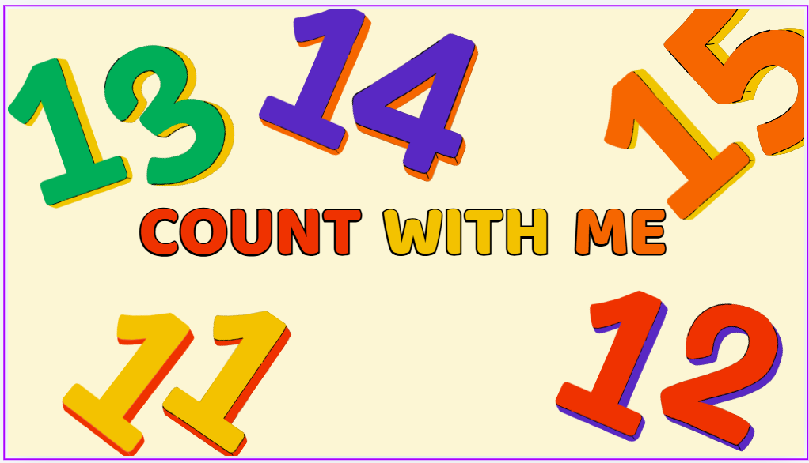

Lucky numbers

Slide 32
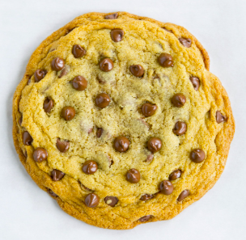

                I want a _________.
A. banana
B. cookie
C. sandwich

Slide 33
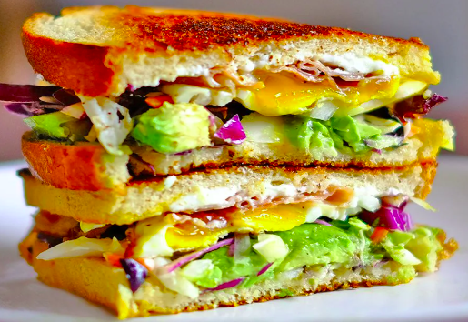
                2. I want a _________.
A. sandwich
B. cookie
C. apple

Slide 34
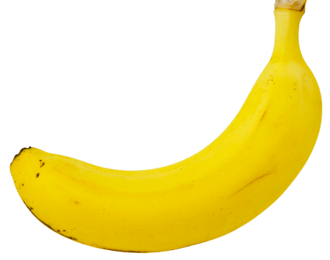
                3. I want a _________.
A. cookie
B. banana
C. sandwich

Slide 35

1 mark
Congratulation!

Slide 36
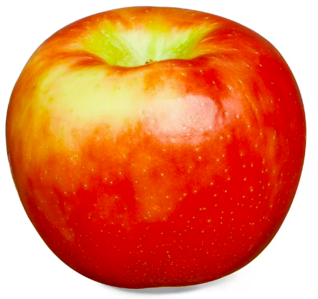
                5. I want an _________.
A. sandwich
B. apple
C. banana

Slide 37
                6. I want a _________.
A. cookies
B. banana
C. cookie

Slide 38
2 marks
Congratulation!

Slide 39
2 marks
Congratulation!

Slide 40
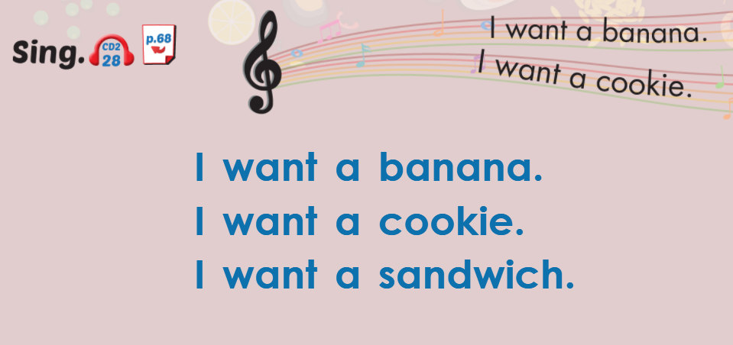

Slide 41
Homework:
- Sum up the points
  Learn by heart the new words.
Prepare workbook page 48, 49.

Slide 42
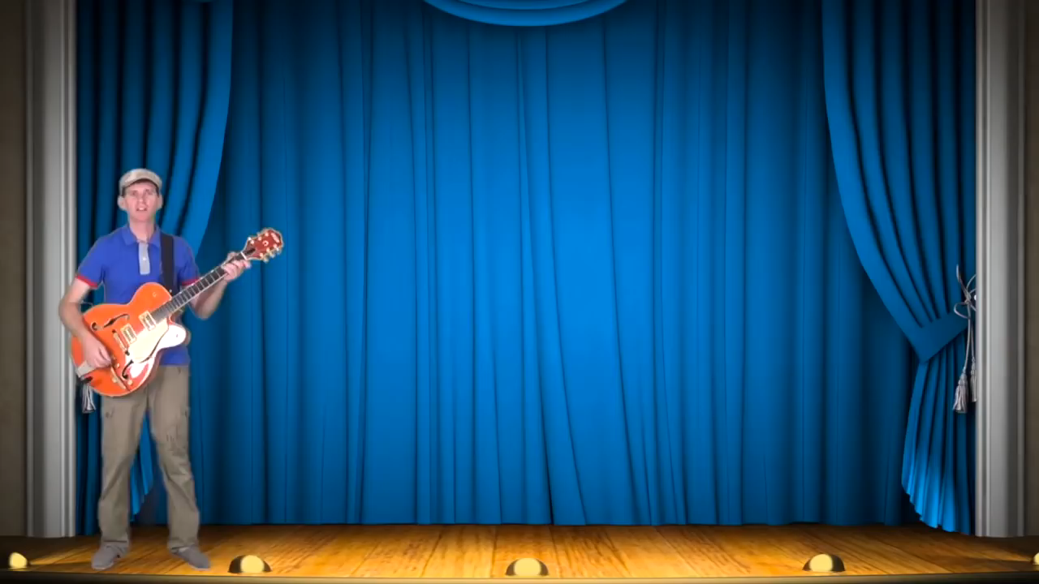
GOOD BYE

Slide 43



