Slide 1
Welcome to our class
SMART START 5
Unit 6: FOOD AND DRINKS
Grade: 5.1
Teacher: Ms. Thuy

Slide 2
WARM-UP

Slide 4
Question 1:Listen, choose and write
Ok. I’ll bring ________
milk
a. milk
b. tea

Slide 5
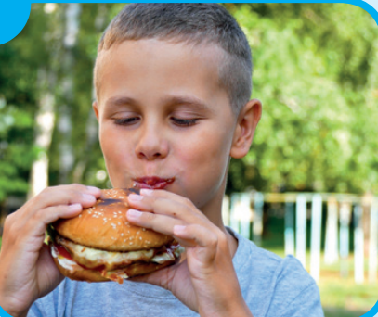
Question 2: Look, listen and answer



Slide 6
It’s time to learn …

Slide 7
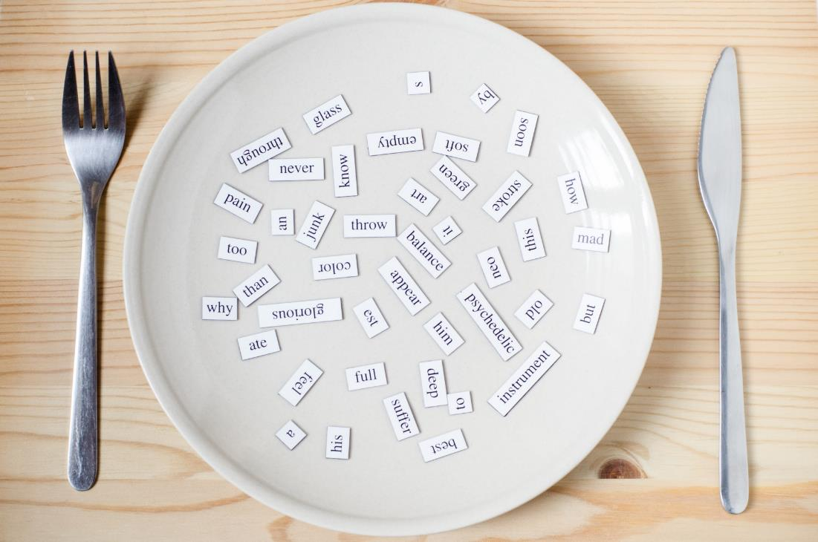
New words
hamburger, sandwich, steak, pie, rice, curry.

Slide 8
Presentation

Slide 9
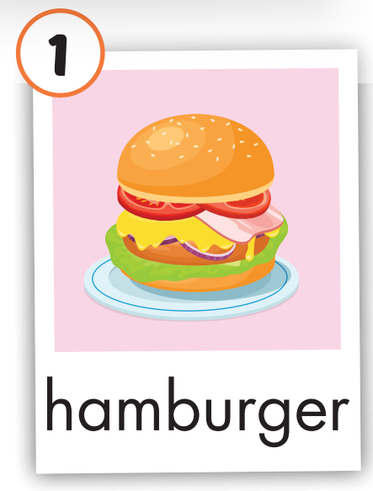
Click on the picture to hear the sound.
hamburger
/ˈhæmˌbɜːrɡər/
bánh hamburger

Slide 10
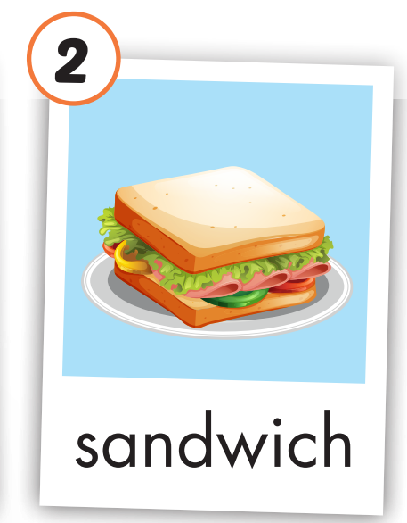
Click on the picture to hear the sound.
sandwich
/ˈsænwɪtʃ/
bánh mì sandwich

Slide 11
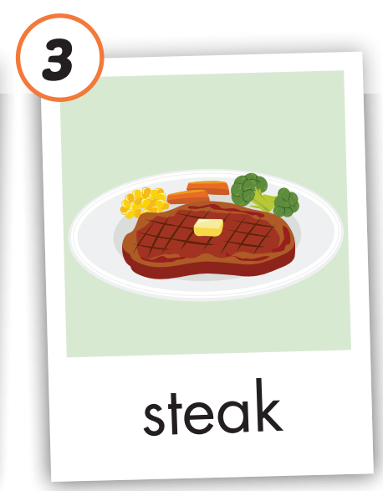
Click on the picture to hear the sound.
steak
/steɪk/
bít tết

Slide 12
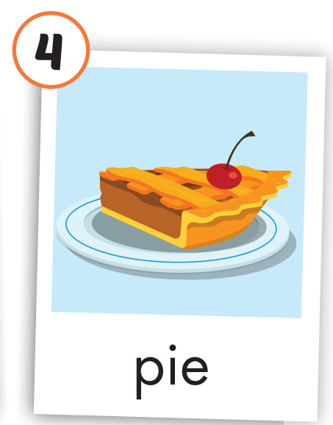
Click on the picture to hear the sound.
pie
/paɪ/
bánh nướng

Slide 13
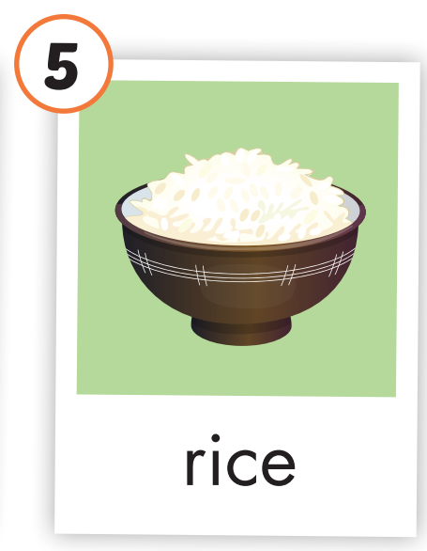
Click on the picture to hear the sound.
rice
/raɪs/
cơm

Slide 14
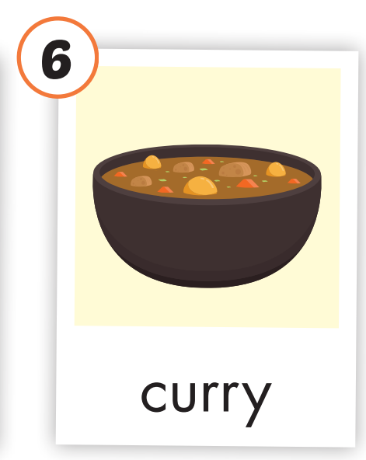
Click on the picture to hear the sound.
curry
/ˈkɜːri/
cà ri

Slide 15
Click on the picture to hear the sound.
/ˈhæmˌbɜːrɡər/
bánh hamburger
/ˈsænwɪtʃ/
bánh mì sandwich
/steɪk/
bít tết
/paɪ/
bánh nướng
/raɪs/
cơm
/ˈkɜːri/
cà ri
Notes:
Click vào hình A. 1. Listen and point. Repeat để cho cả audio full chạy

Slide 16
Practice

Slide 17
Look, read and choose

Slide 18
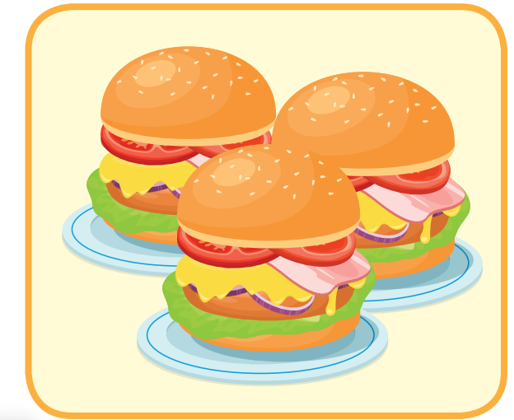
Look, read and choose
a hamburger
A
B
C

Slide 19
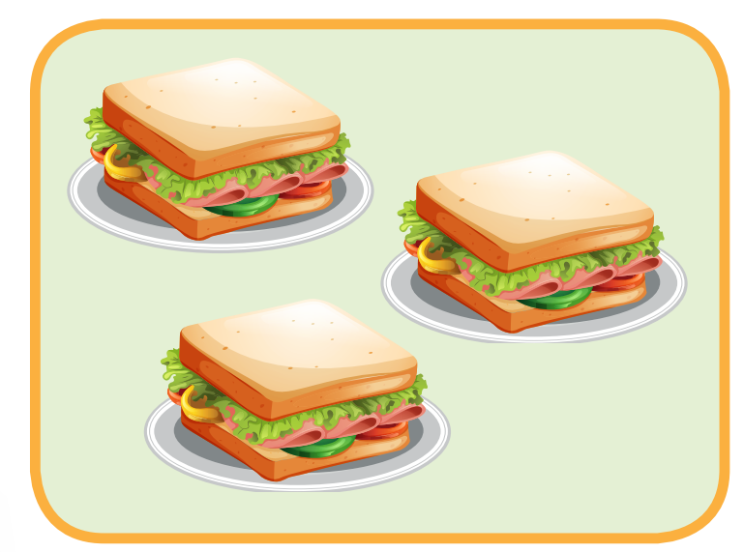
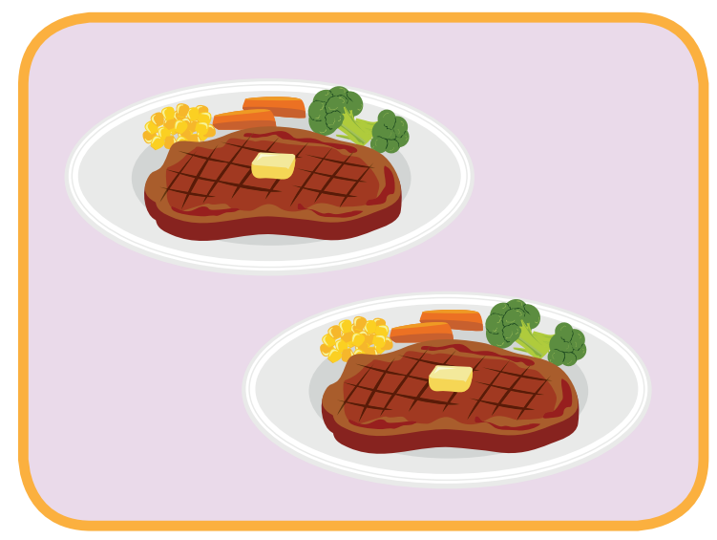
Look, read and choose
steak
A
B
C

Slide 20
Look, read and choose
a sandwich
A
B
C

Slide 21
Look, read and choose
curry
A
B
C

Slide 22
Look, read and choose
pie
A
B
C

Slide 23
Listen and chant:
/ˈhæmˌbɜːrɡər/
bánh hamburger
/ˈsænwɪtʃ/
bánh mì sandwich
/steɪk/
bít tết
/paɪ/
bánh nướng
/raɪs/
cơm
/ˈkɜːri/
cà ri
Notes:
Click vào hình A. 1. Listen and point. Repeat để cho cả audio full chạy

Slide 24
WHAT’S MISSING?
1
2
3
?
?
?
4
5
6
?
?
?

Slide 25
Practice

Slide 26
Work in pairs:
/ˈhæmˌbɜːrɡər/
bánh hamburger
/ˈsænwɪtʃ/
bánh mì sandwich
/steɪk/
bít tết
/paɪ/
bánh nướng
/raɪs/
cơm
/ˈkɜːri/
cà ri
Notes:
Click vào hình A. 1. Listen and point. Repeat để cho cả audio full chạy

Slide 27
Look and write:
rice / sandwich

Slide 28
Look and write:
curry / steaks

Slide 29
Look and write:
sandwiches / hamburgers

Slide 30
Look and write:
pie / steaks

Slide 31
Look and write:
sandwiches / steaks

Slide 32
Look and write:
sandwiches / steaks

Slide 33
Today’s lesson
Vocabularies
hamburger, sandwich, steak, pie, rice, curry.

Slide 34
Homework
Practice the vocabularies and make sentences using them.
Do the exercises.
Do the exercises in Notebook.
Prepare the next lesson.

Slide 35
Enjoy your day!

Slide 36
Lesson 3
Stay positive and have a nice day!

