Slide 1
Let’s sing a song.

Slide 2
WARM-UP

Slide 3
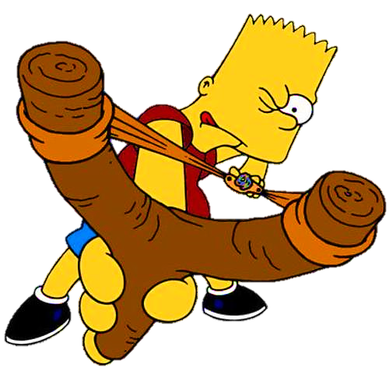

Slide 4
egg
countable
uncountable
NEXT
Click on the right can

Slide 5
lemonade
countable
uncountable
Click on the right can
NEXT

Slide 6
soda
uncountable
countable
NEXT
Click on the right can

Slide 7
pizza
countable
uncountable
NEXT
Click on the right can

Slide 8
chocolate chip
countable
uncountable
NEXT
Click on the right can

Slide 9
flour
uncountable
countable
NEXT
Click on the right can

Slide 10
It’s time to learn …

Slide 11
Unit 6: FOOD AND DRINKS
Lesson 3. A
Page 84

Slide 12
Presentation

Slide 13
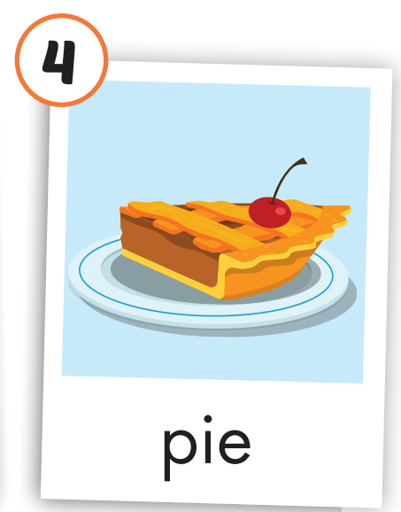
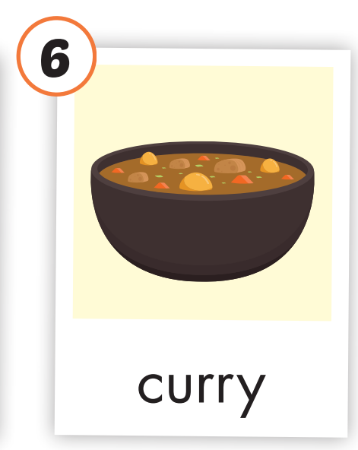
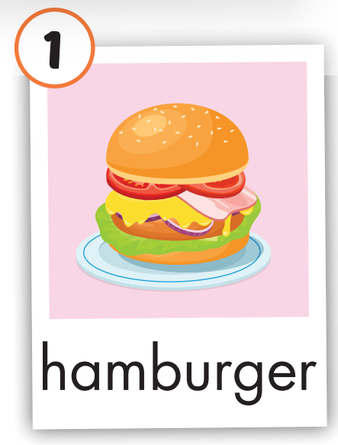
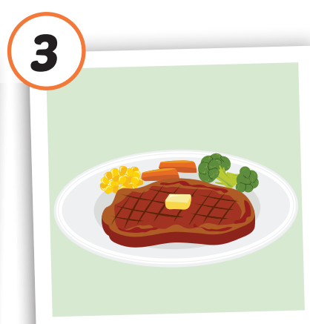
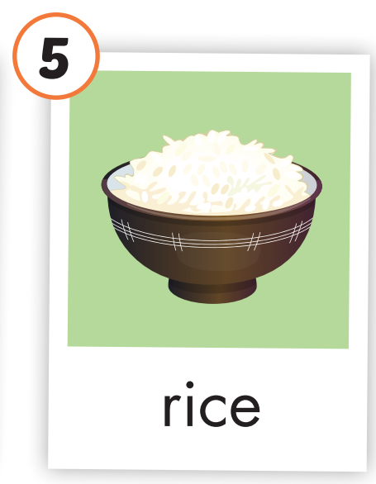
Click on the picture to hear the sound.
hamburger
/ˈhæmˌbɜːrɡər/
sandwich
/ˈsænwɪtʃ/
steak
/steɪk/
pie
/paɪ/
rice
/raɪs/
curry
/ˈkɜːri/

Slide 14
Click on the picture to hear the sound.
Notes:
Click vào hình A. 1. Listen and point. Repeat để cho cả audio full chạy

Slide 15
Click on the picture to hear the sound.
Notes:
Click vào hình A. 1. Listen and point. Repeat để cho cả audio full chạy

Slide 16
Practice

Slide 17
Let’s chant!
Burger, hamburger, I need some burgers.
Sandwich, sandwich, I’d like a sandwich!
Steak, pie, rice – They’re my interest!
Let’s make curry! I’ll bring some oil!

Slide 18
All of you read the new words aloud.
Try speed reading!
Notes:
Click vào hình A. 1. Listen and point. Repeat để cho cả audio full chạy

Slide 19
Checking understanding and pronunciation.
Look at the flash cards and some sts answer
Teacher’s questions.
Notes:
Click vào hình A. 1. Listen and point. Repeat để cho cả audio full chạy

Slide 20
Game: What’s missing?
20
19
18
17
16
15
14
13
12
11
10
9
8
7
6
5
4
3
2
1
0
TIME
Hết giờ

Slide 21
5
Game: What’s missing?
Notes:
Click vào hình A. 1. Listen and point. Repeat để cho cả audio full chạy

Slide 22
4
Game: What’s missing?
Notes:
Click vào hình A. 1. Listen and point. Repeat để cho cả audio full chạy

Slide 23
3
Game: What’s missing?
Notes:
Click vào hình A. 1. Listen and point. Repeat để cho cả audio full chạy

Slide 24
2
Game: What’s missing?
Notes:
Click vào hình A. 1. Listen and point. Repeat để cho cả audio full chạy

Slide 25
1
Game: What’s missing?
Notes:
Click vào hình A. 1. Listen and point. Repeat để cho cả audio full chạy

Slide 26
4
9
5
10
pizza
Food and Drinks
Countable
1
Uncountable
6
2
3
11
8
13
7
12

Slide 27
Writing Practice
The monitor will read aloud one word.
Listen carefully.
Say “stop” when you see the word read by your monitor.
- Write it down on your mini board.

Slide 28
WRAP-UP

Slide 29
Click on the picture to hear the sound.
/ˈhæmˌbɜːrɡər/
bánh hamburger
/ˈsænwɪtʃ/
bánh mì sandwich
/steɪk/
bít tết
/paɪ/
bánh nướng
/raɪs/
cơm
/ˈkɜːri/
cà ri
Food and dinks are important to our lives, so
Remember to eat and drink healthy to keep yourselves fit and healthy!!!
Notes:
Click vào hình A. 1. Listen and point. Repeat để cho cả audio full chạy

Slide 30
Today’s lesson
Vocabularies
hamburger, sandwich, steak, pie, rice, curry.
Homework

Slide 31
Enjoy your day!

Slide 32
Lesson 3
Stay positive and have a nice day!

