Slide 1
Unit Starter
Lesson 2
Grammar and Song

Slide 2
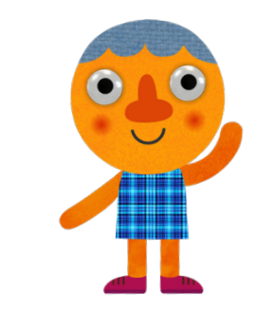
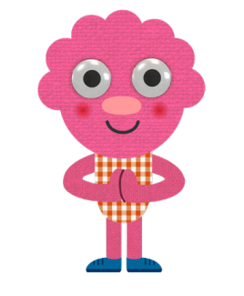
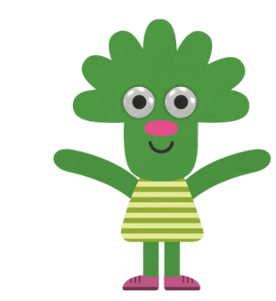
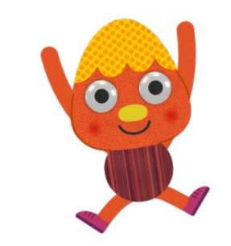
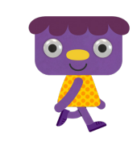
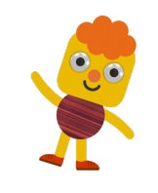
Let’s watch and sing together

Slide 3
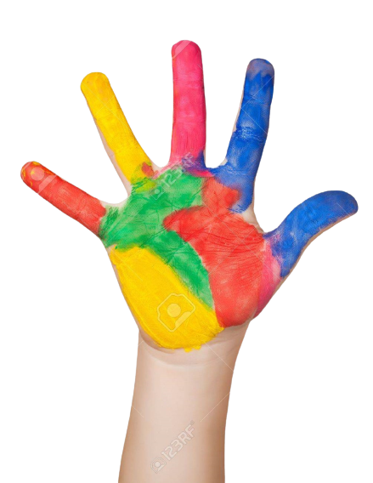
Give me Five

Slide 4
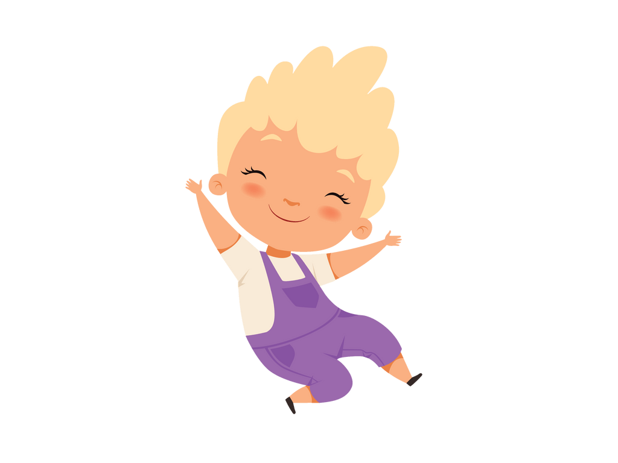
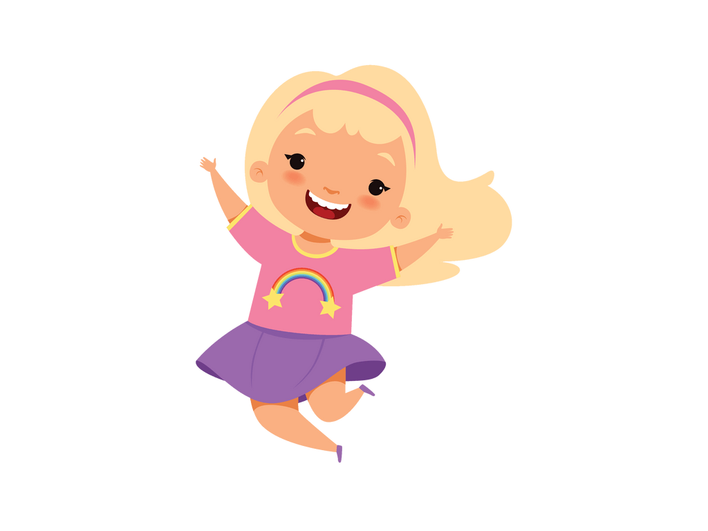
How are you today?
good
great
Notes:
- click How are you today để nghe âm thanh
- click cô gái, chàng trai nghe âm thanh

Slide 5
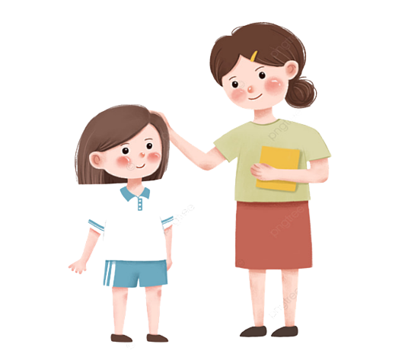
Let’s say Hello!!!
hello
hello
Notes:
- Click Hello to hear sound

Slide 6
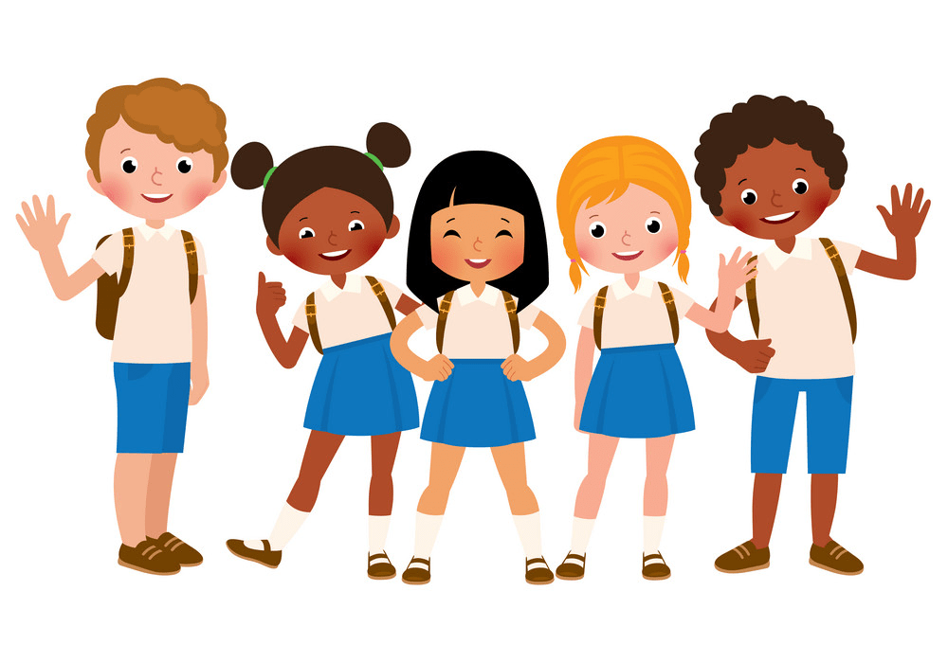
Now, it’s your turn!
Hello!!!
Notes:
- Click Hello to hear sound

Slide 7
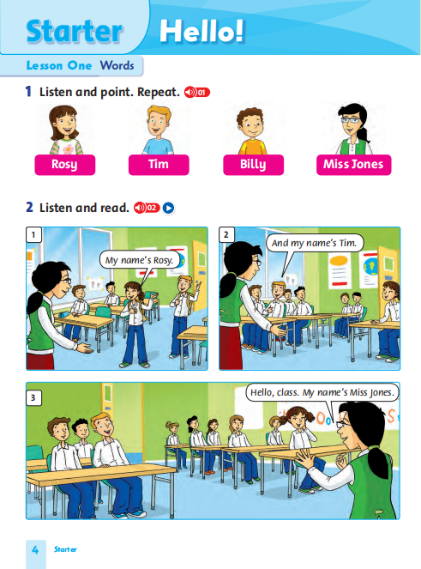
Open Your Book.
Page 4
Let’s read the story again.

Slide 8
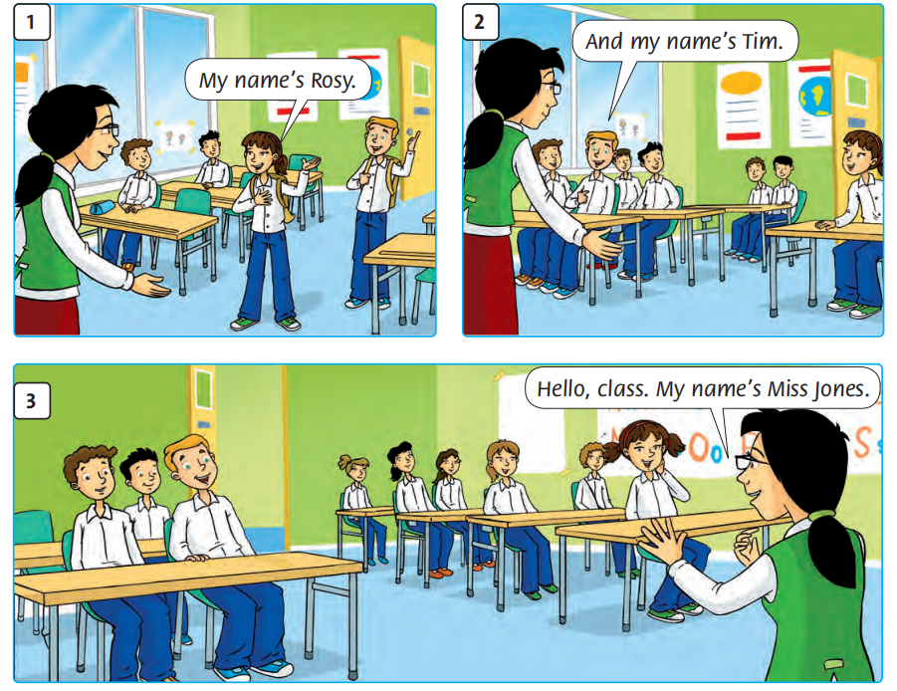
Listen and Repeat.
Notes:
- Click chuột theo tiến trình của từng hình.

Slide 9
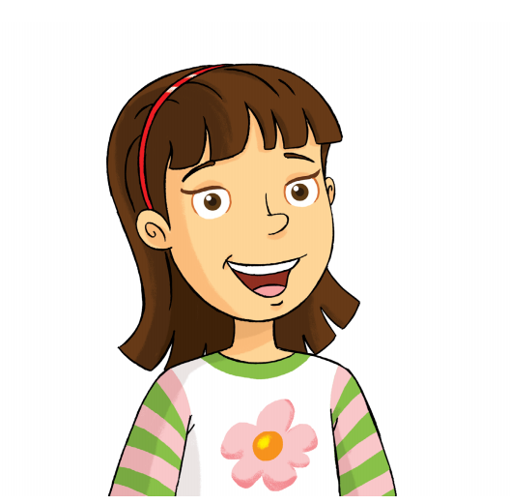
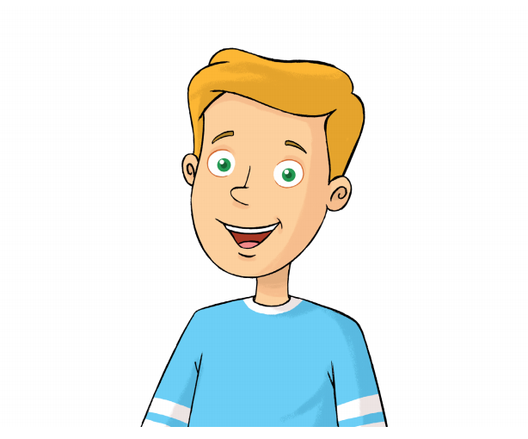
Story Actions!
Rosy
Tim
Ms Jones

Slide 10
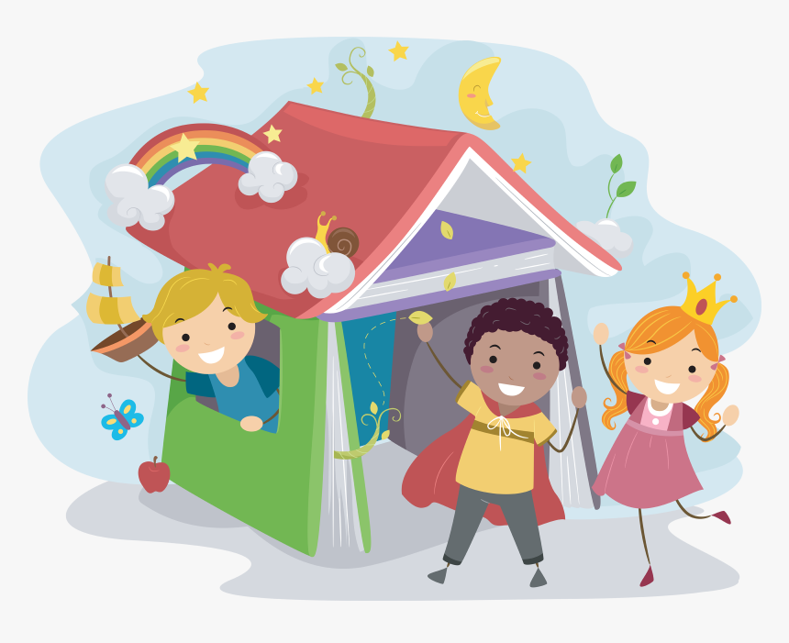
Story Actions!
Practice Time!!!

Slide 11
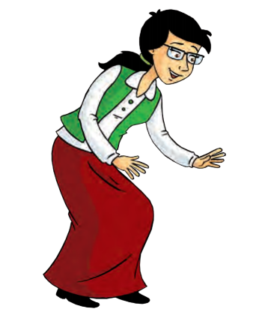
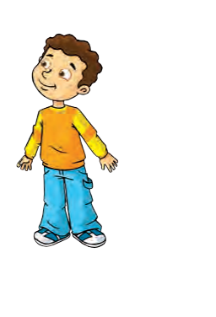
Look at the picture.
Hello. My name’s Ms Jones.
What’s your name?
Hi. My name’s Billy.
Notes:
- Click Techer and Billy to hear sound

Slide 12
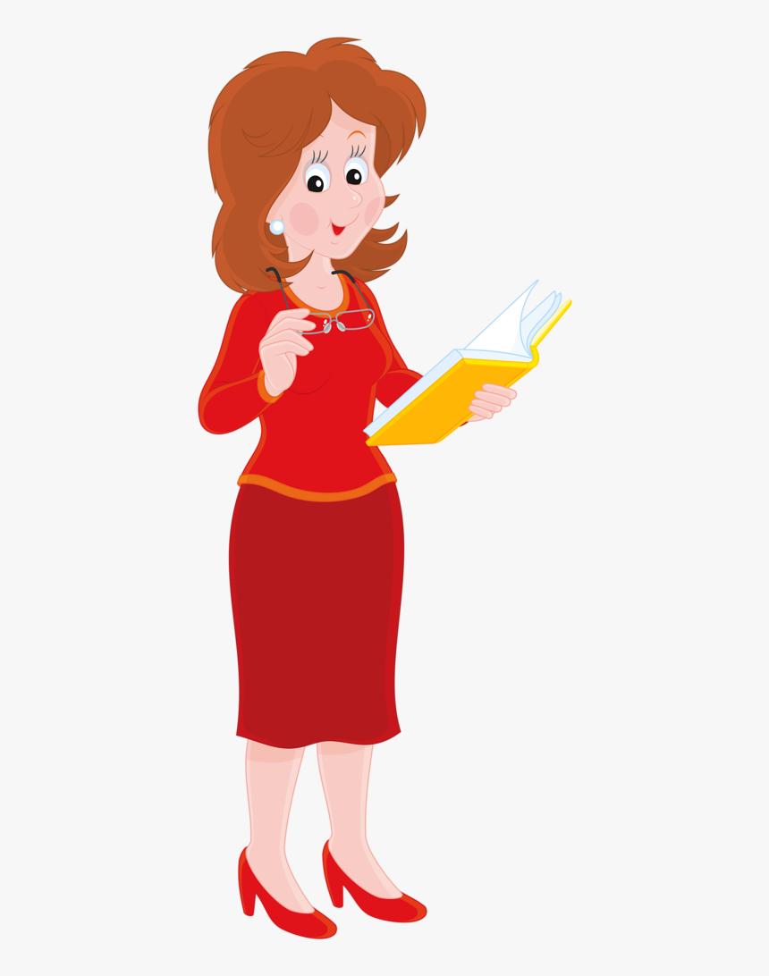
How about you?
Hello. My name’s...
What’s your name?
Hi. My name’s...
Notes:
- Click Techer and Billy to hear sound

Slide 13
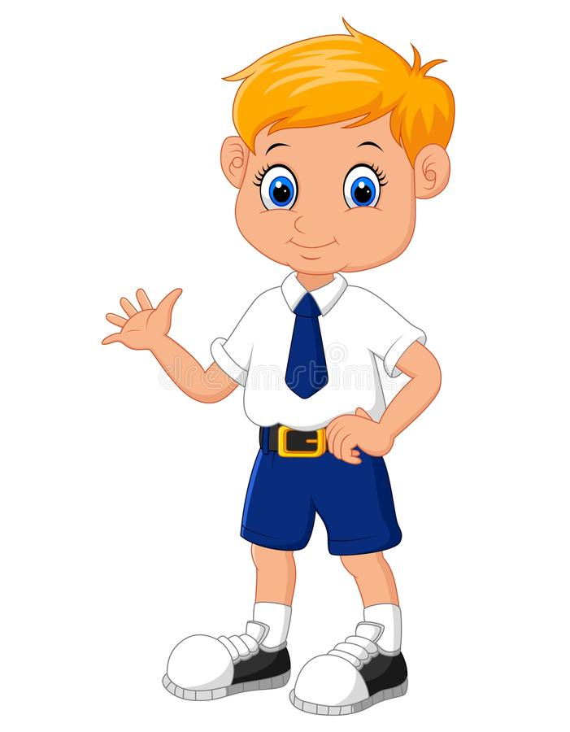
Practice Time!!!
Work with your friend.
Notes:
- Click Clock to hear sound

Slide 14
Listen again.
Notes:
- Click chuột theo tiến trình của từng hình.

Slide 15
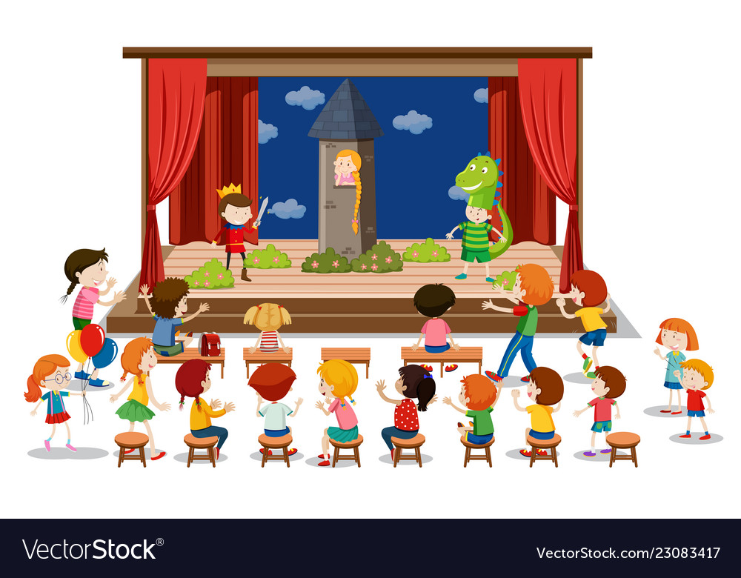
Welcome on stage!!!

Slide 16
Ask the question.
What’s
your name?
Notes:
- Click Teacher to hear sound

Slide 17
Listen and Sing.
Listen
Sing
Notes:
- Click Boy and Girl to hear sound

Slide 18
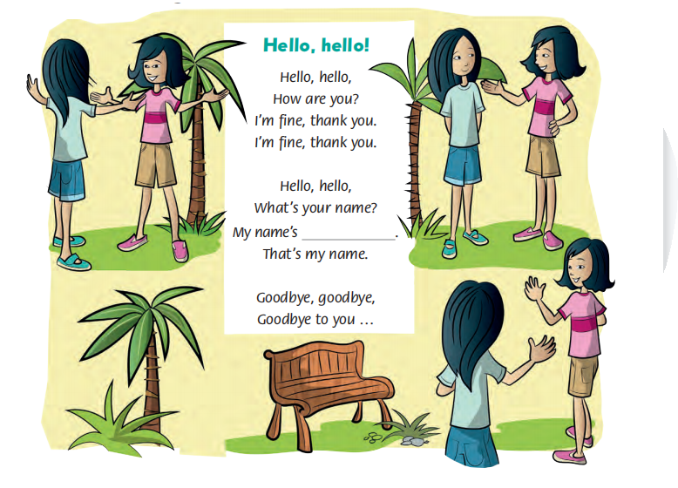
Look and Listen.
How are you?
Fine
What’s
your nme?
Thank you.
Goodbye.
Notes:
- Click Words to hear sound.

Slide 19
Listen to the song!!!
Notes:
- Click Boy to hear sound
- Click chuot theo tung cau hat de hien mui ten

Slide 20
Listen to the song!!!
Add your name in the blank.
Notes:
- Click Boy to hear sound
- Click chuot theo tung cau hat de hien mui ten

Slide 21
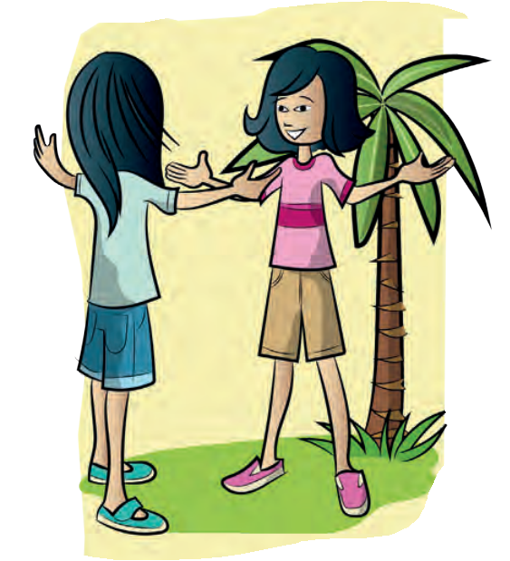
Look and Listen.
Hello
How are you?
I’m fine.
Thank you.
Notes:
The children greet each other by smiling and waving.

Slide 22
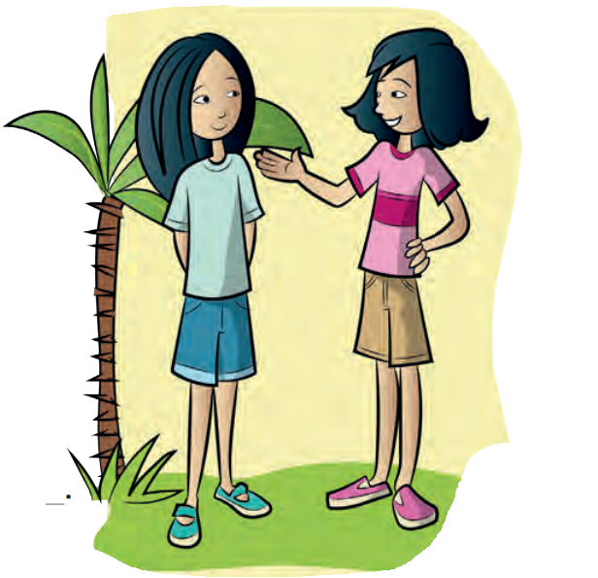
Look and Listen.
What’s your name?
My name’s ...
Notes:
The children ask and answer the question.

Slide 23
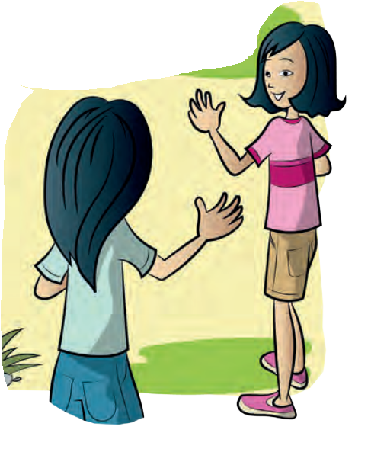
Look and Listen.
Goodbye!
Goodbye to you!
Notes:
The children greet each other by smiling and waving.

Slide 24
Game Time!!!

Slide 25
Lucky Numbers!
1
2
3
4
What’s your name?
How are you?
Goodbye.
My name’s...
Notes:
- Click Book to see question.
- Click Arrow to see points

Slide 26
Remember!!!
HELLO!
GOODBYE!
Notes:
- Show students how to give gestures of saying Hello and Goodbye.

Slide 27
Let’s say......
Goodbye!!!
Notes:
- Click The picture of students to play the Goodbye song on YouTube.

