Slide 1






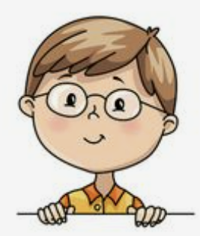
I’m dancing with dad.
Unit 8
Lesson 4: Phonics

Slide 2


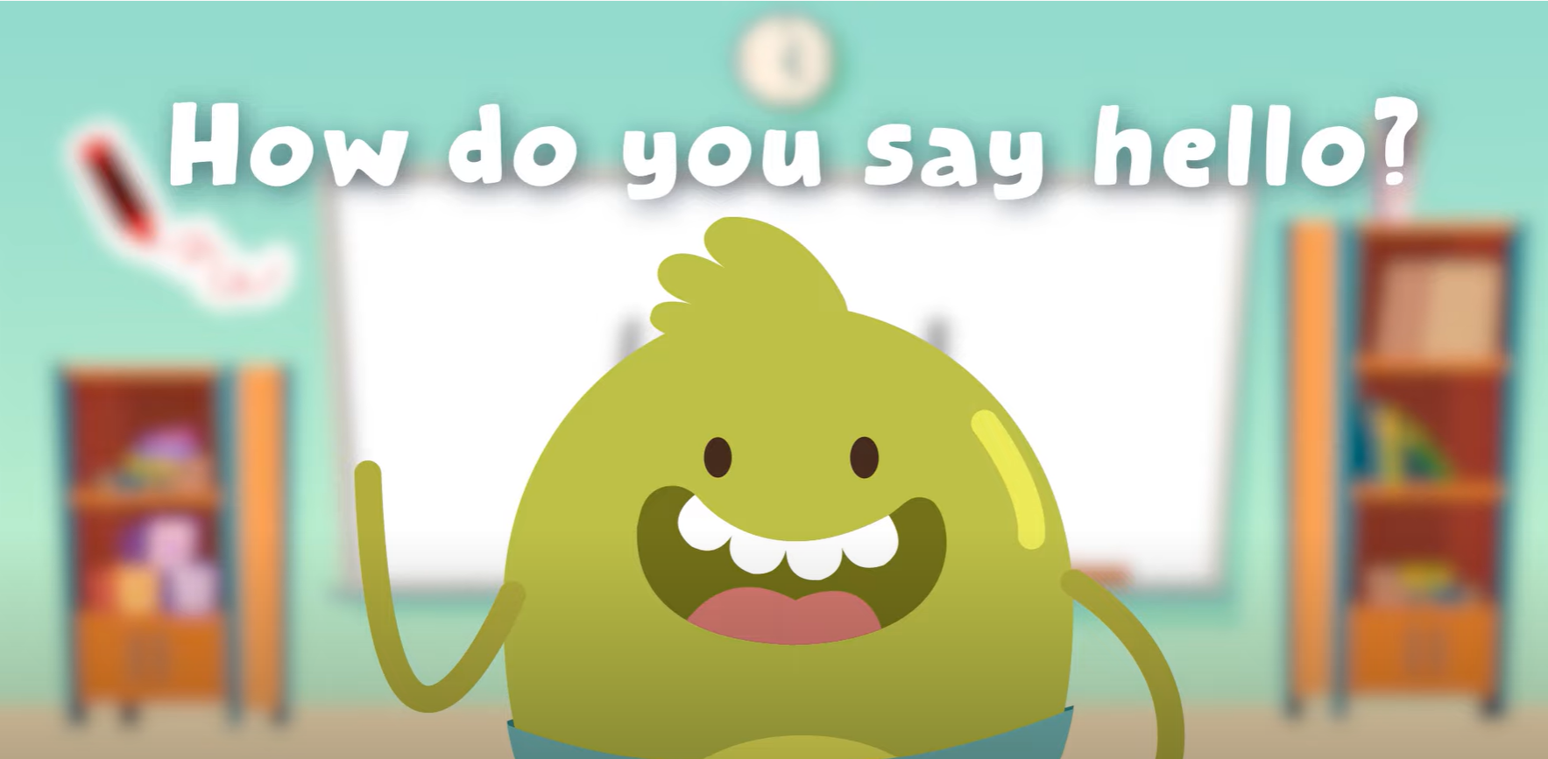
HELLO SONG

Slide 3



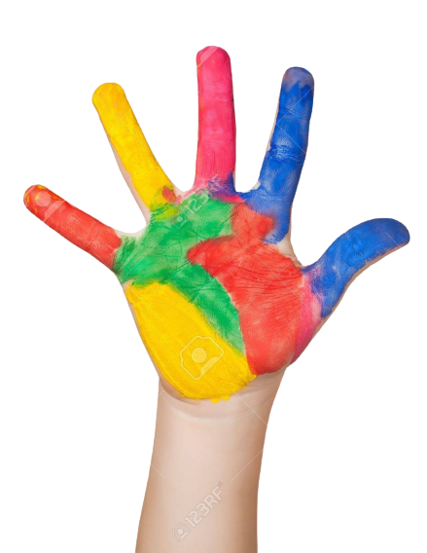



Give me Five

Slide 4

Game
SENTENCE PUZZLE

Slide 5
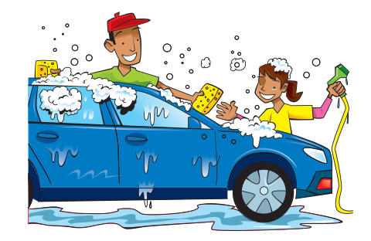

Game
SENTENCE PUZZLE
is
car.
Dad
the
washing
Dad is washing the car.

Slide 6

Game
SENTENCE PUZZLE
photos.
My
taking
is
brother
My brother is taking photos.

Slide 7
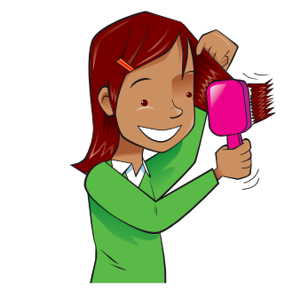
Game
SENTENCE PUZZLE
hair.
I’m
brushing
my
I’m brushing my hair.

Slide 8
Thank you for playing!

Slide 9


Listen and Point

Slide 10
Listen and Repeat

Slide 11
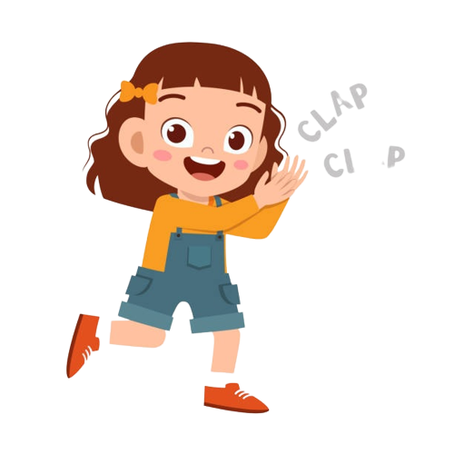
Good job!

Slide 12
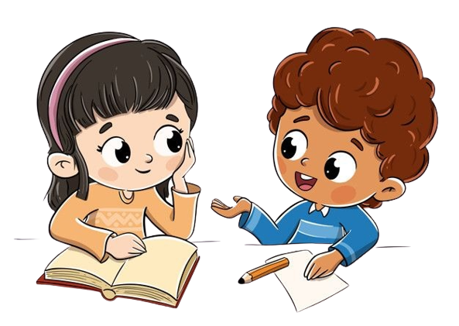
Work in Pairs
Notes:
Point and Say

Slide 13
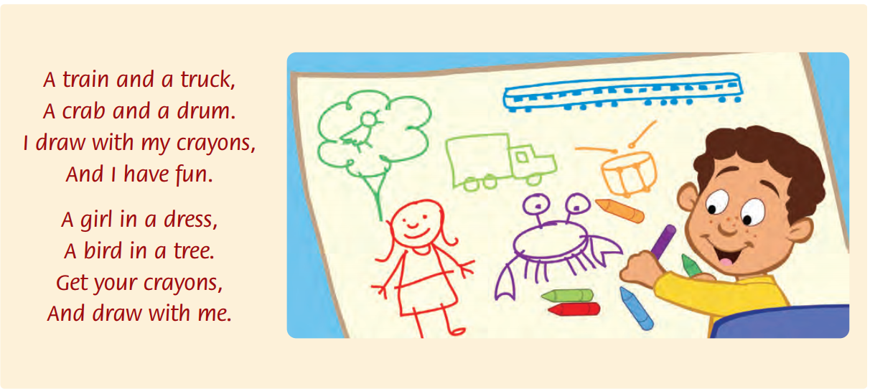
Listen and Point

Slide 14
Listen and Repeat

Slide 15
Listen and Chant

Slide 16
Work in Pairs
Notes:
Point and Say
Read the chant again. Say the words with dr, tr, and cr.

Slide 17
Good job!

Slide 18
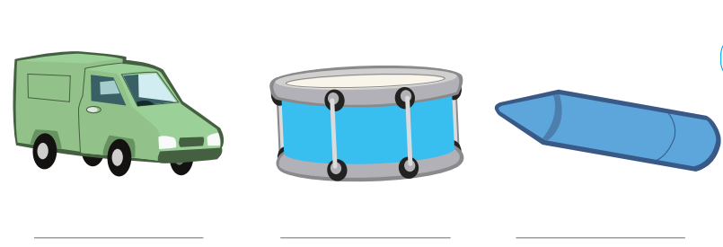
Listen and Write
truck
drum
crayon

Slide 19
Good job!

Slide 20
Game
PICTURE GUESSING

Slide 21




Game
PICTURE GUESSING
truck

Slide 22

Game
PICTURE GUESSING
crayon

Slide 23

drum

Slide 24
Thank you for playing!

Slide 25


THANK YOU!

