Slide 1






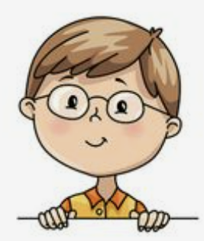
I’m dancing with dad.
Unit 8
Lesson 3: Song

Slide 2


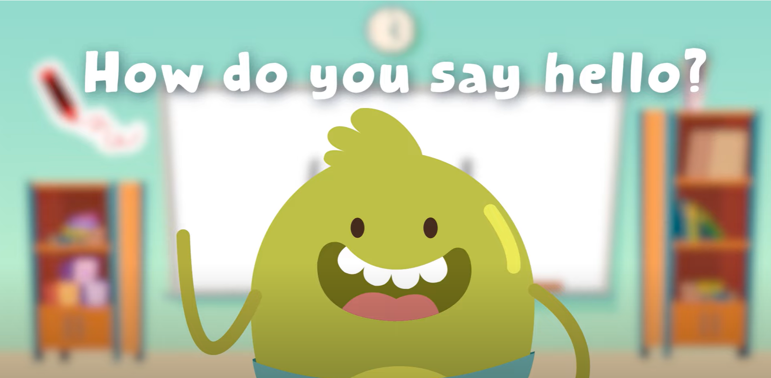
HELLO SONG

Slide 3



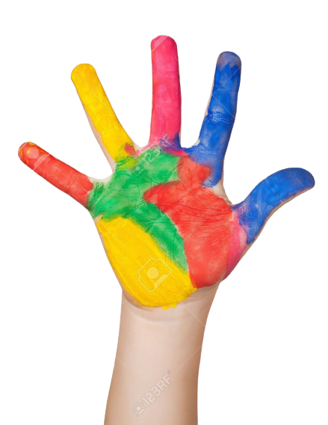



Give me Five

Slide 4

Game
What’s missing?

Slide 5
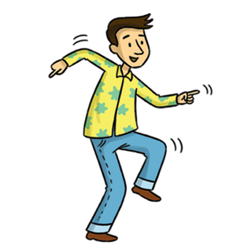

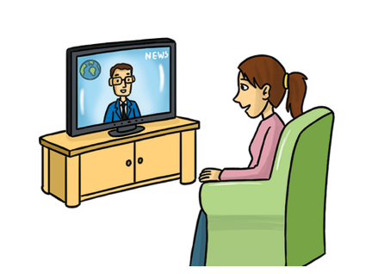

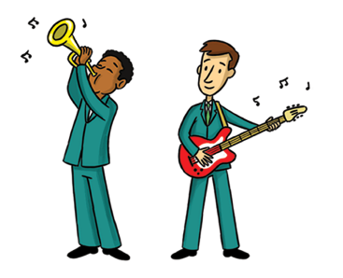
Game
What’s missing?
watch

Slide 6

Game
What’s missing?
play

Slide 7

Game
What’s missing?
dance

Slide 8
Game
What’s missing?
sing

Slide 9
Game
What’s missing?
talk

Slide 10
Game
What’s missing?
eat

Slide 11


Thank you for playing!

Slide 12


Listen and Point

Slide 13
Listen and Repeat

Slide 14
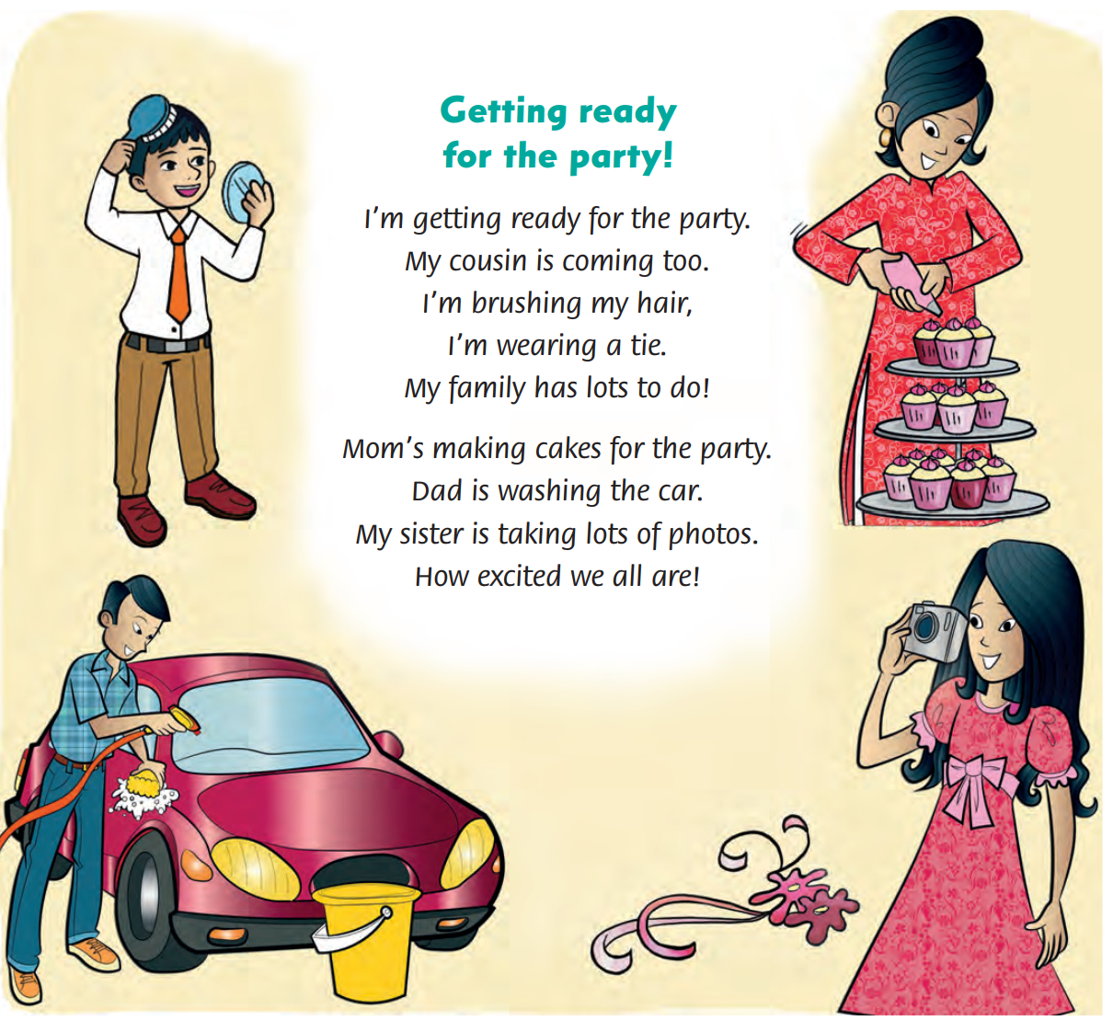
Look and Answer

Slide 15
Listen and Point
62

Slide 16
Listen and Repeat
62

Slide 17
Listen and Sing
62

Slide 18

Watch and Sing
Notes:
Point and Say

Slide 19

Sing in Groups
Notes:
Point and Say

Slide 20

Live on Stage

Slide 21
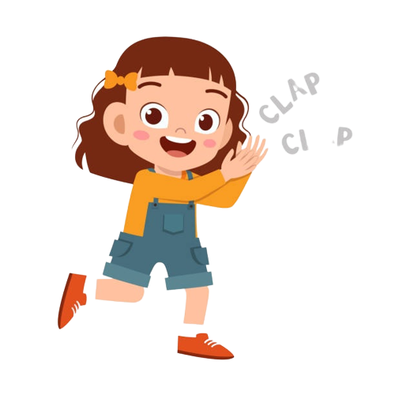
Good job!

Slide 22
Game
MATCHING

Slide 23

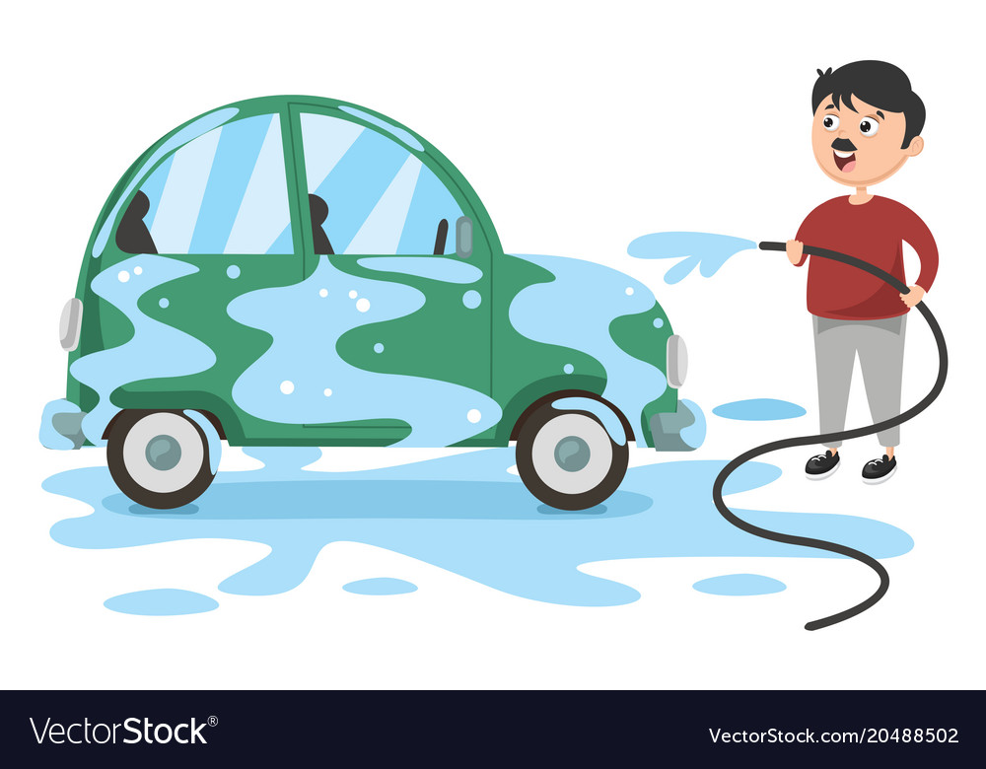
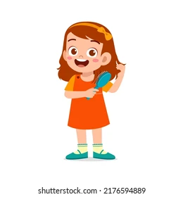


Match the phrases to make a sentence.
1
He’s wearing
washing the car.
a
2
Dad is
taking photos.
b
3
I’m brushing
a tie.
c
4
My sister is
cakes.
d
5
Mom’s making
my hair.
e

Slide 24
Thank you for playing!

Slide 25


THANK YOU!

