Slide 1

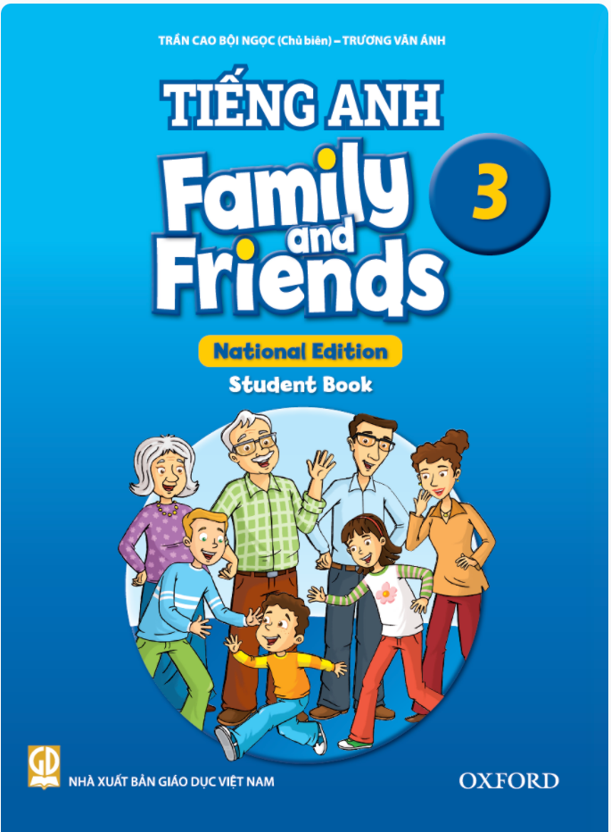




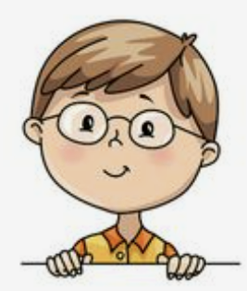
I’m dancing with dad.
Unit 8
Lesson 2: Grammar

Slide 2


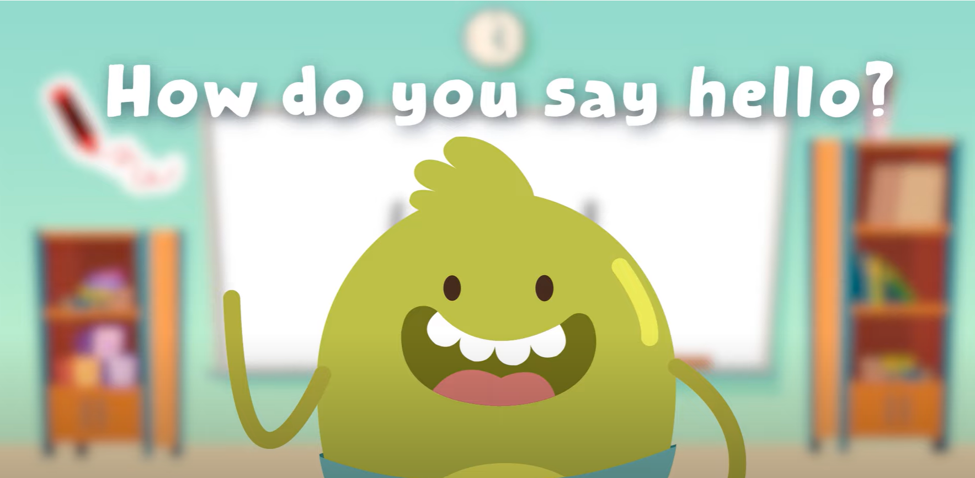
HELLO SONG

Slide 3
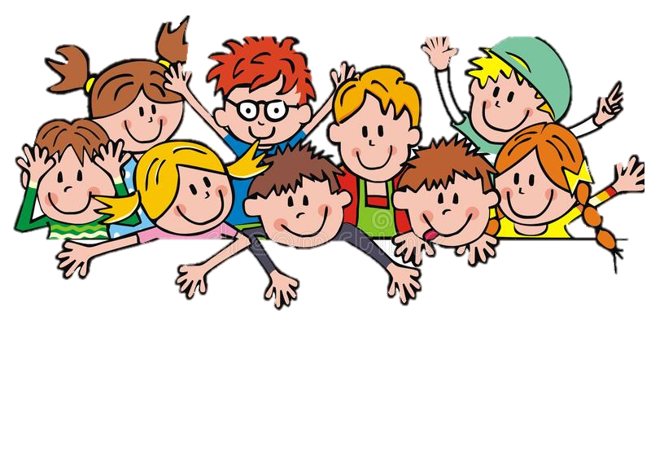
Game
Actions Quiz

Slide 4
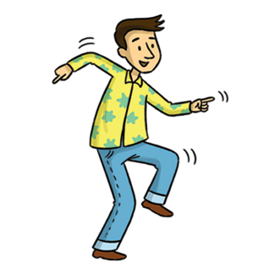

Which one is correct?
eat
A
B
dance
C
D
watch
play

Slide 5
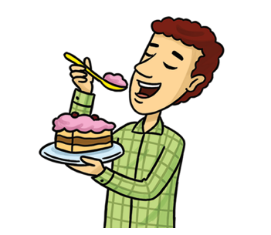
Which one is correct?
A
B
watch
play
sing
eat
C
D

Slide 6
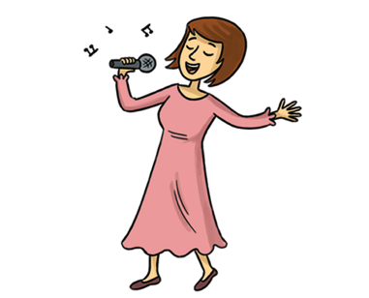
Which one is correct?
A
B
eat
watch
C
D
sing
talk

Slide 7
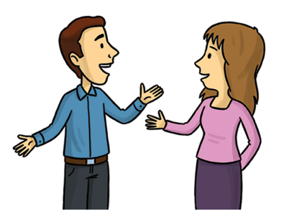
Which one is correct?
dance
A
B
talk
C
D
play
watch

Slide 8
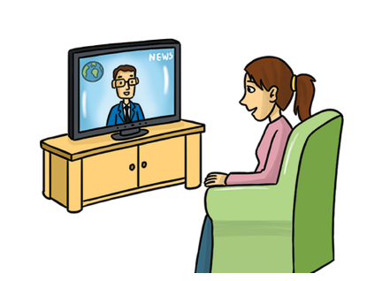
Which one is correct?
eat
A
B
watch
C
D
dance
sing

Slide 9
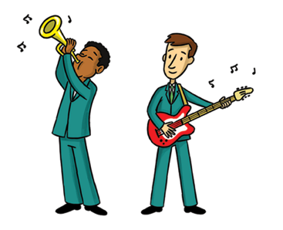
Which one is correct?
A
B
talk
sing
C
D
play
dance

Slide 10


Thank you for playing!

Slide 11

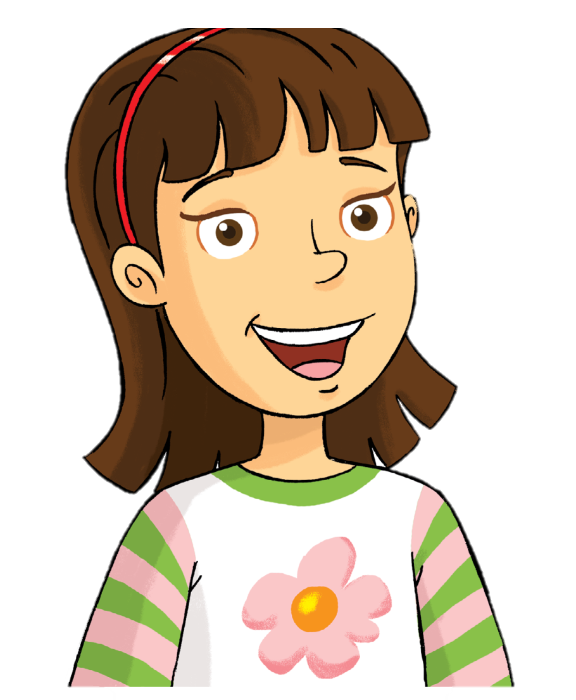
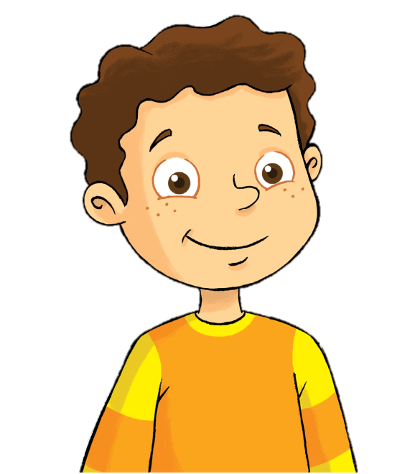
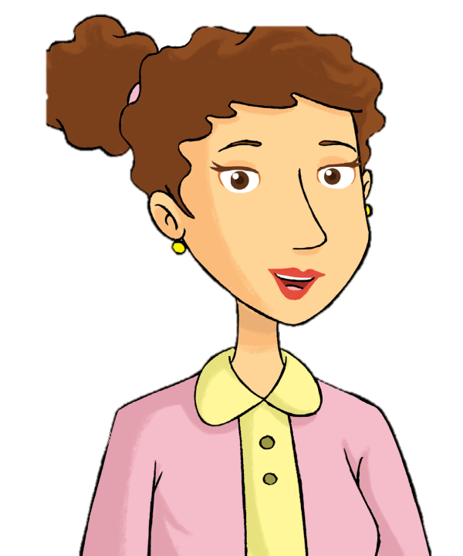

Remember
Rosy
Billy
mom
dad

Slide 12

Watch and Say

Slide 13
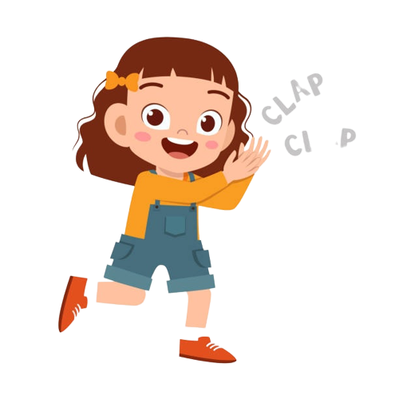
Good job!

Slide 14
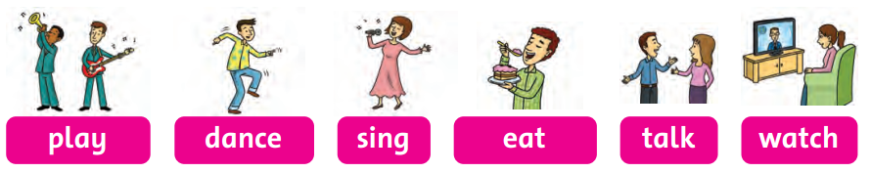
Listen and Chant

Slide 15
Good job!

Slide 16
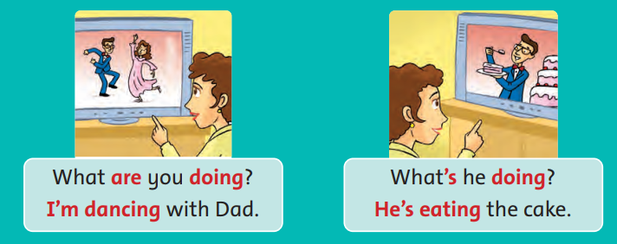
Listen and Point
What are you doing?
I’m dancing with Dad.

Slide 17
Listen and Point
What’s he doing?
He’s eating the cake.

Slide 18
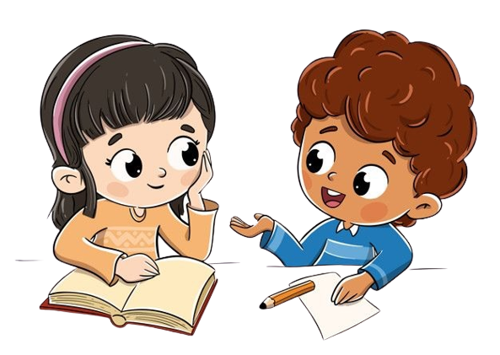
Work in Pairs
Notes:
Point and Say

Slide 19
Good job!

Slide 20
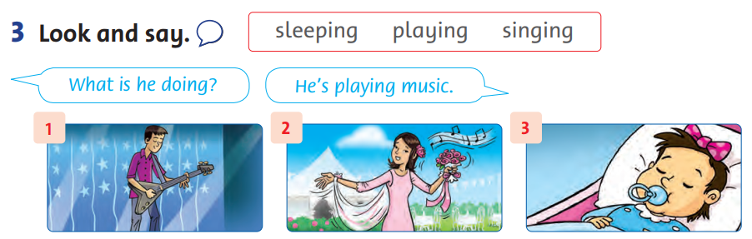
Look and Say

Slide 21
Work in Pairs
Notes:
Point and Say

Slide 22
Good job!

Slide 23
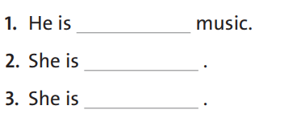
Look and Write
playing
singing
sleeping

Slide 24
Good job!

Slide 25
Game
SECRET BOXES

Slide 26
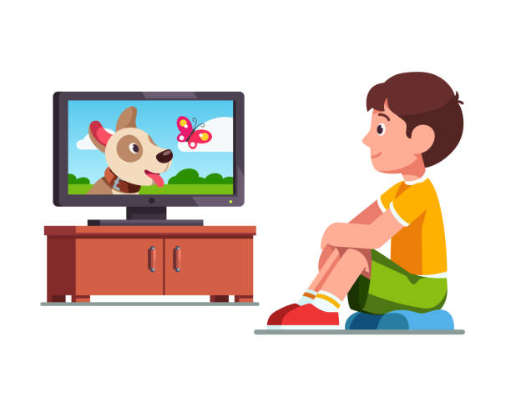



Game
SECRET BOXES
What’s he doing?
watching
He’s ____________.

Slide 27
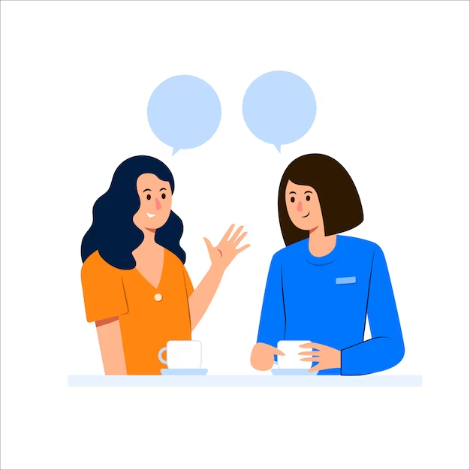
Game
SECRET BOXES
What’s she doing?
talking
She’s ____________.

Slide 28
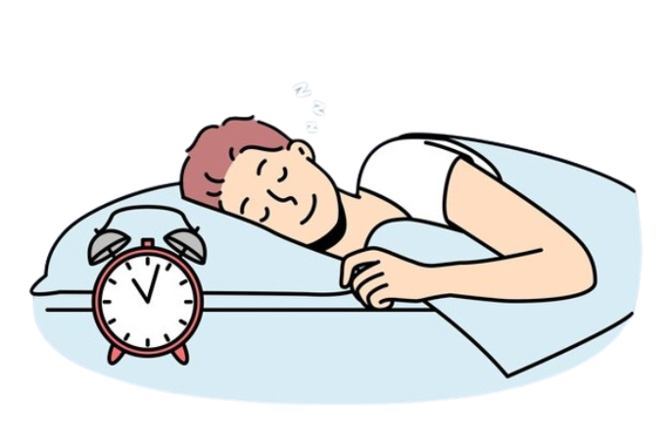
Game
SECRET BOXES
What’s he doing?
sleeping
He’s ____________.

Slide 29
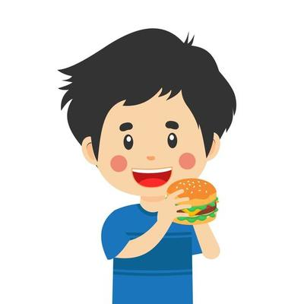
Game
SECRET BOXES
What’s he doing?
eating
He’s ____________.

Slide 30
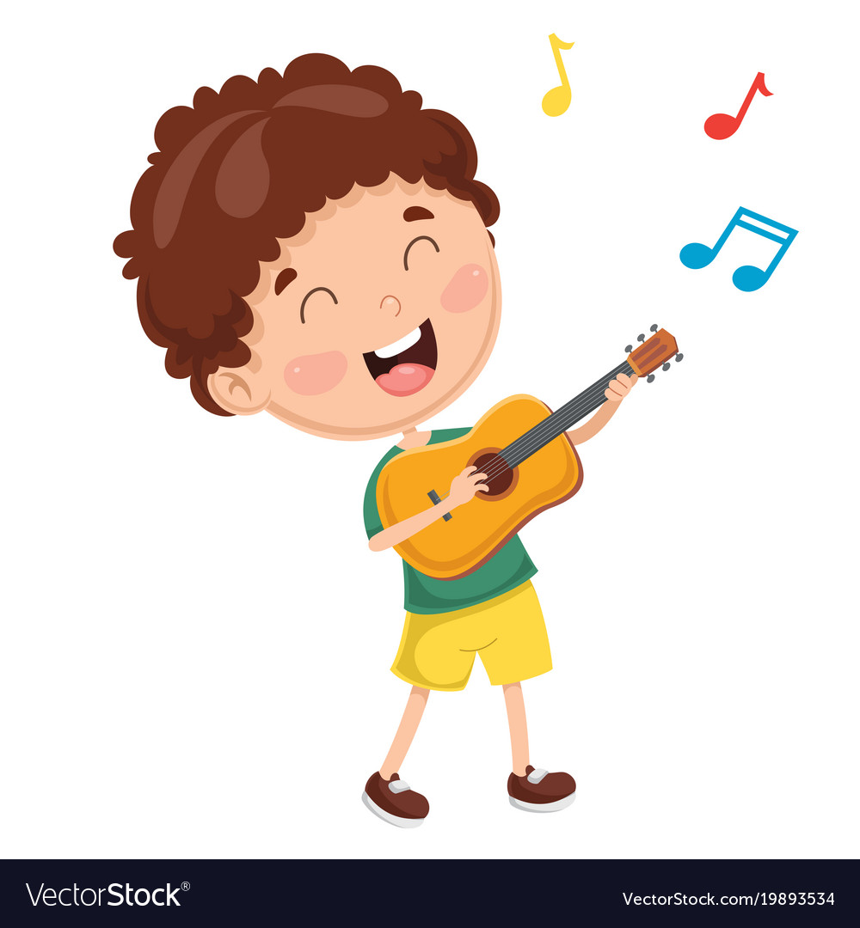
Game
SECRET BOXES
What’s he doing?
playing
He’s ____________.

Slide 31
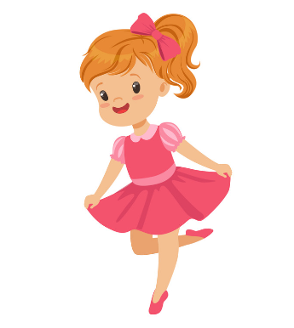
Game
Secret boxes
What’s he doing?
dancing
She’s ____________.

Slide 32
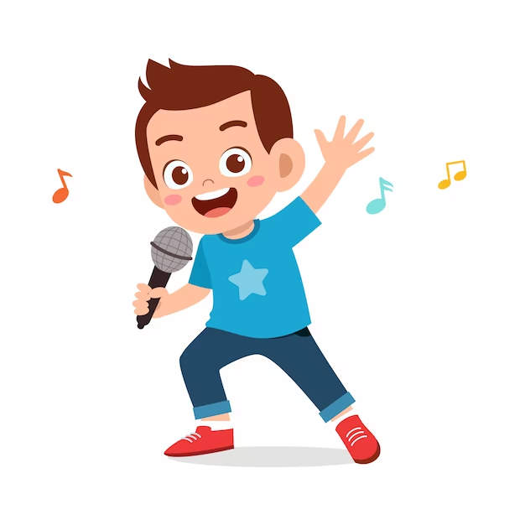
Game
SECRET BOXES
What’s he doing?
singing
He’s ____________.

Slide 33
Thank you for playing!

Slide 34


THANK YOU!

