Slide 1
Unit 5
Do you like yogurt?
Lesson 1

Slide 2
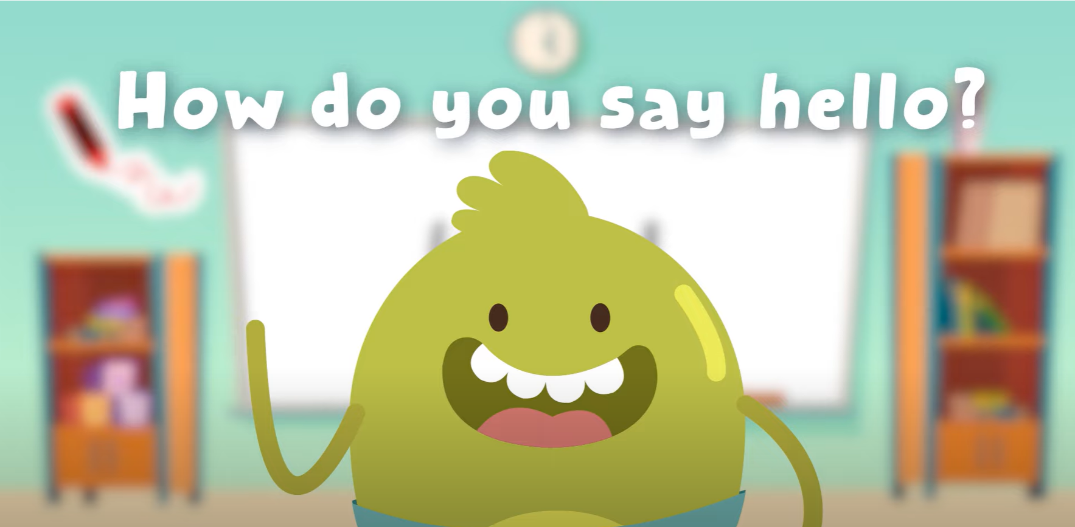
Hello song

Slide 3
Give Me Five
Notes:
Class Rules

Slide 4
What food and drinks can you see?
Notes:
Use Story Animation of Unit 5 to lead in the new topic.
Ask students to watch the video and think about the question What food and drinks can you see?
Students raise hands to give ideas.
Lead to the Food and Drinks topic.

Slide 5
Puzzle Time
Notes:
Students work in groups to do a puzzle.

Slide 6
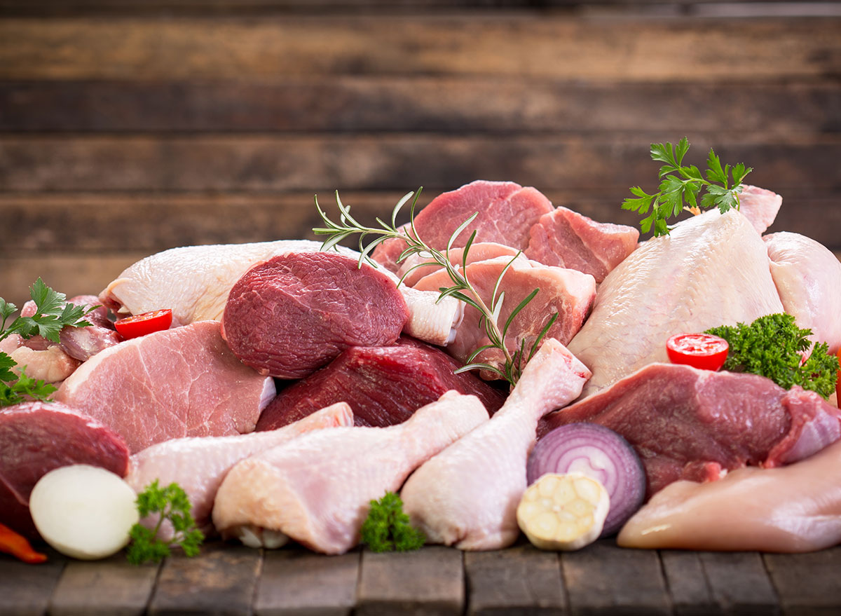
Notes:
Chấp nhận câu trả lời bằng tiếng Việt của HS
MEAT

Slide 7
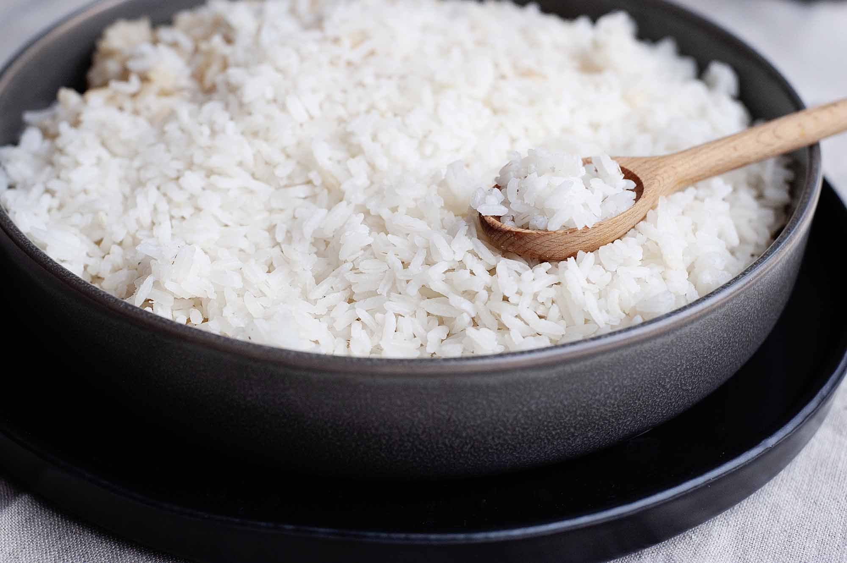
Notes:
RICE

Slide 8
Notes:
CARROTS

Slide 9
Notes:
YOGURT

Slide 10
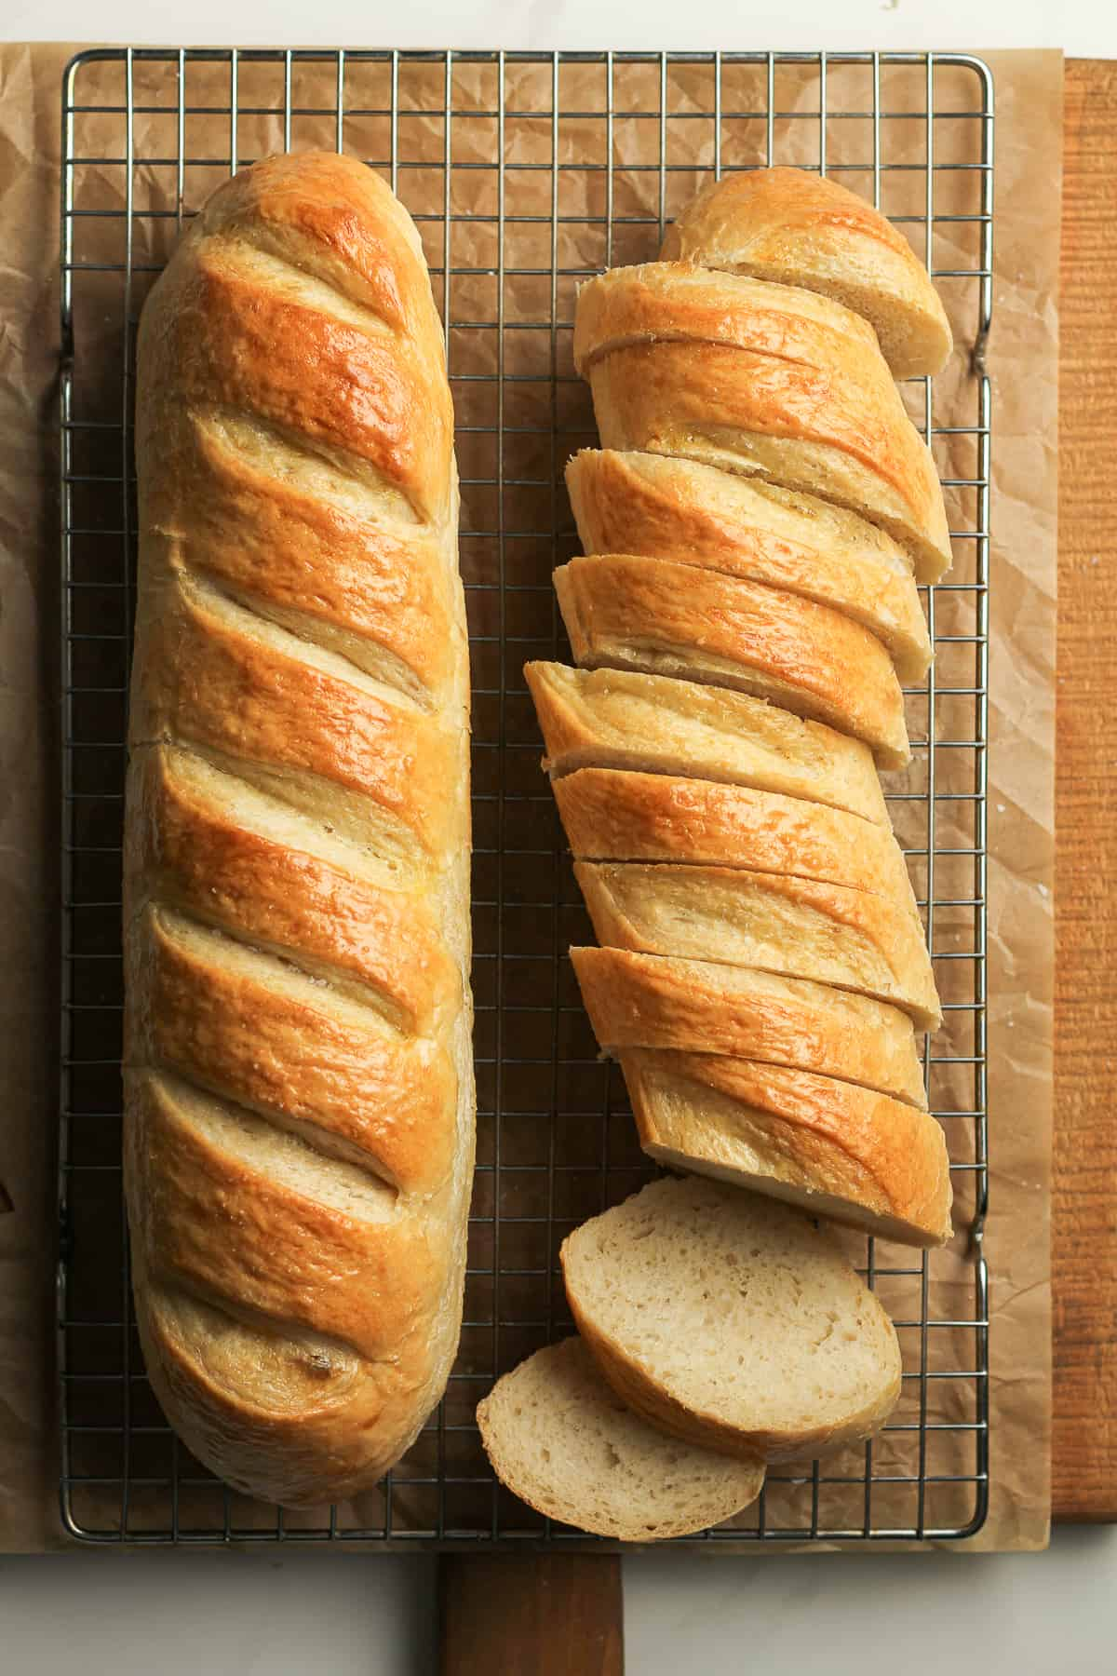
Notes:
BREAD

Slide 11
Notes:
CHIPS

Slide 12
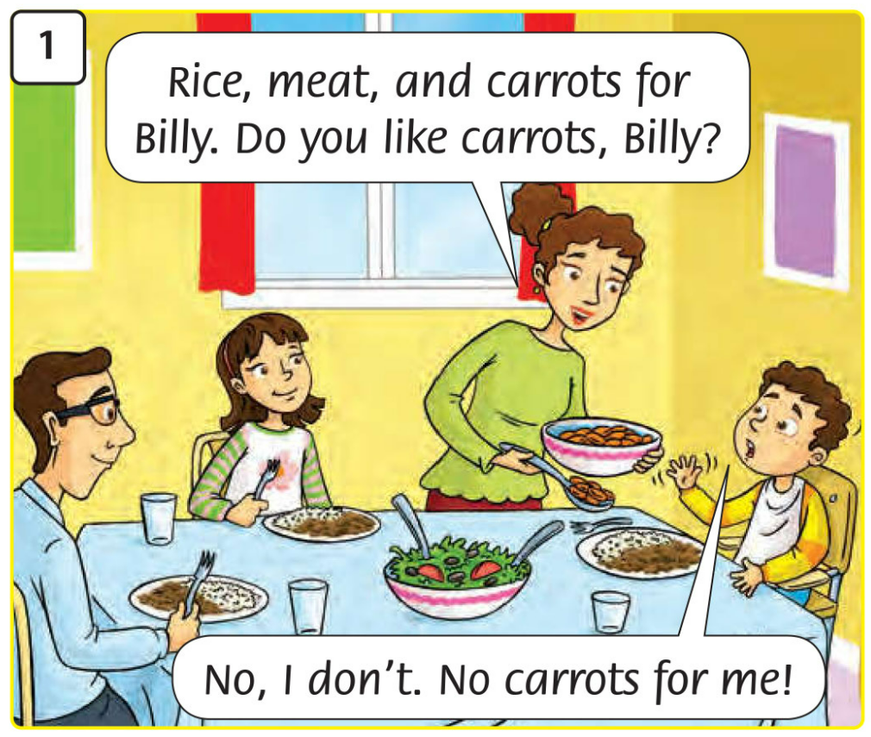
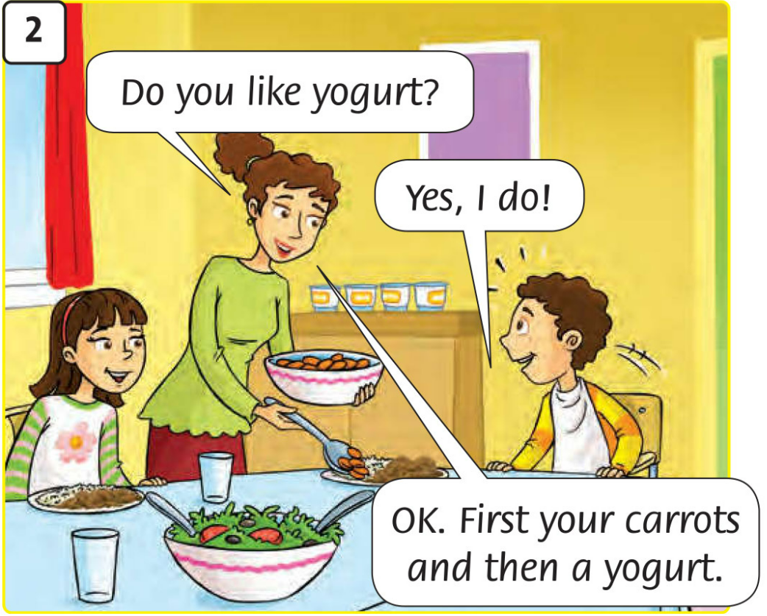
Look and answer.
Notes:
Show pictures of the dialogue one by one.
Ask students to look at the picture and answer these questions:
Who can you see in the picture?
Where are they?
What are they doing?
What food and drinks can you see?
- Play Story Animation on sachso.edu.vn or move to the next slide for the video.

Slide 13
Notes:
- Play the video for students to watch while thinking about the above questions.

Slide 14
Listen, repeat and act.
Notes:
Students listen, repeat and act in chorally and practice reading and acting in groups.

Slide 15
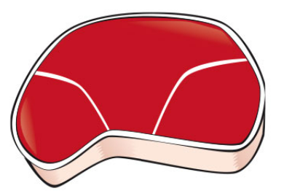
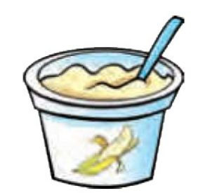
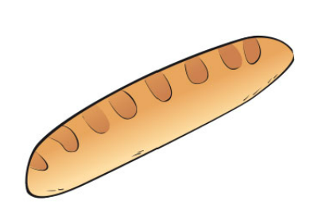
Listen.
rice
meat
carrots
yogurt
bread
Notes:
- Click mouse to move to the next pictures.

Slide 16
Listen and point.
rice
meat
carrots
yogurt
bread
Notes:
Click mouse one time and then wait for the picture show.
Teacher may use sachso.edu.vn to have students listen, point and repeat.

Slide 17
Listen, point and repeat.
rice
meat
carrots
yogurt
bread
Notes:
- Click mouse one time and then wait for the picture show.
- Teacher may use sachso.edu.vn to have students listen, point and repeat.

Slide 18
Listen and chant.
rice
meat
carrots
yogurt
bread
Notes:
- Teacher may use sachso.edu.vn to have students listen and chant.

Slide 19
Work in groups – Let’s chant together!
Notes:
- Play trach 59 again and ask students practice chanting in groups.

Slide 20
Listen and chant.
rice
meat
carrots
yogurt
bread
Notes:
- Teacher may use sachso.edu.vn to have students listen and chant.

Slide 21
Presentation
Notes:
- Invite a few groups to role-play in the front.

Slide 22
Work in pairs
Notes:
- Students work in pairs for Production Activity 1.

Slide 23
Listen, repeat and act.
Notes:
Students listen, repeat and act in chorally and practice reading and acting in groups.

Slide 24
Healthy or Unhealthy food?
HEALTHY FOOD (1) | UNHEALTHY FOOD (2)
Notes:
Ask students to identify healthy and unhealthy food (explain the meaning of these word but it’s not necessary to ask students to master them).
Show the answers and ask students to talk about these food and drinks in pairs.
Example: Yogurt - healthy food.
Chips – unhealthy food.

Slide 25
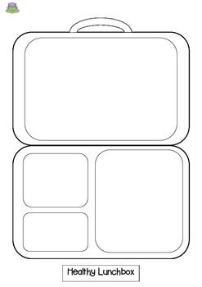
My lunch is …….
Notes:
Ask students to draw their healthy lunchbox in the limit time while listening to music.
Then move around to talk to their friends about it.
Example: My lunchbox is …………………………

Slide 26
Goodbye and See you later!
Notes:
- Sing Goodbye song altogether - https://www.youtube.com/watch?v=STMl4yjPpoM (click on the background).

