Slide 1
FLUENCY TIME 1
EVERYDAY ENGLISH

Slide 2
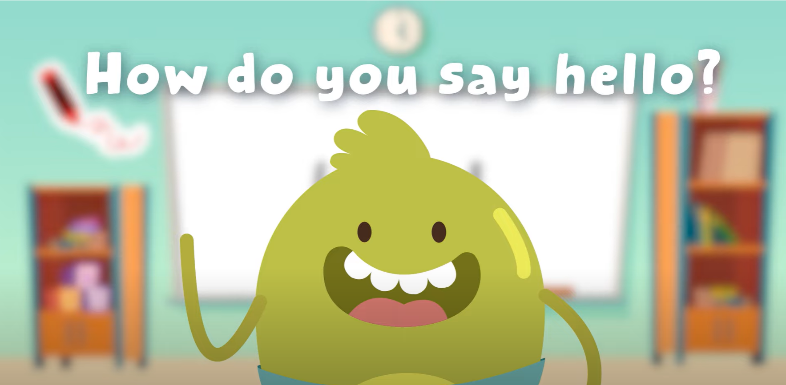
HELLO SONG

Slide 3
GIVE ME FIVE

Slide 4
Chatting Circles

Slide 5
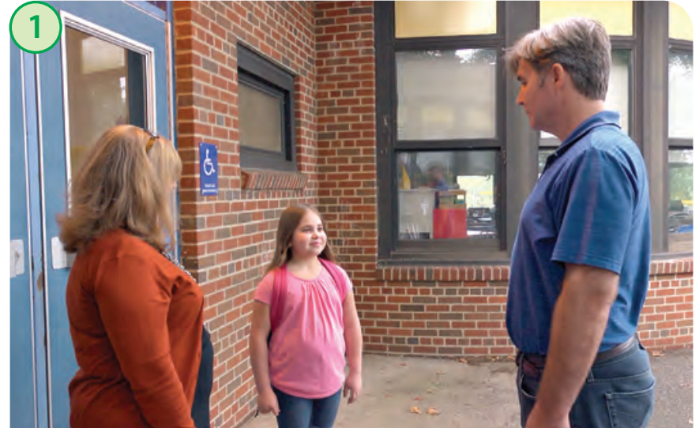
Look and Say
Notes:
Look at the picture and ask:
Where are the people?
Who is the girl talking to?

Slide 6
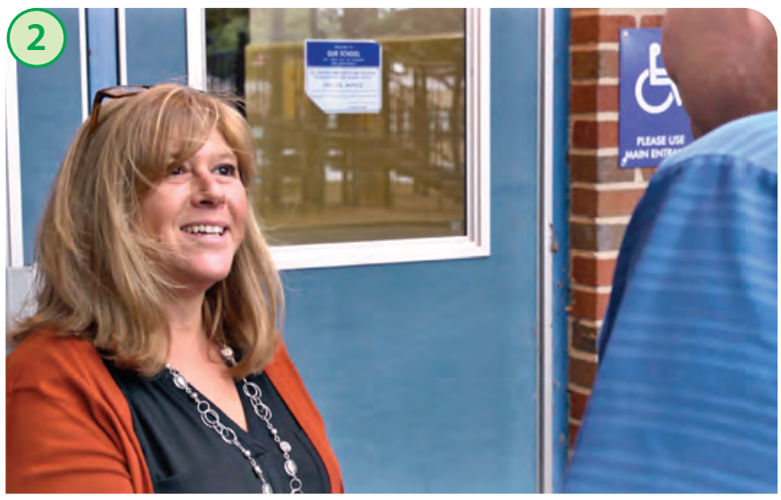
Look and Say
Notes:
Look at the picture and ask:
What does the teacher say?
What does Dad say?

Slide 7
Listen and Point

Slide 8
Listen and Repeat

Slide 9
Work in groups
Role-Play

Slide 10
Good job!

Slide 11
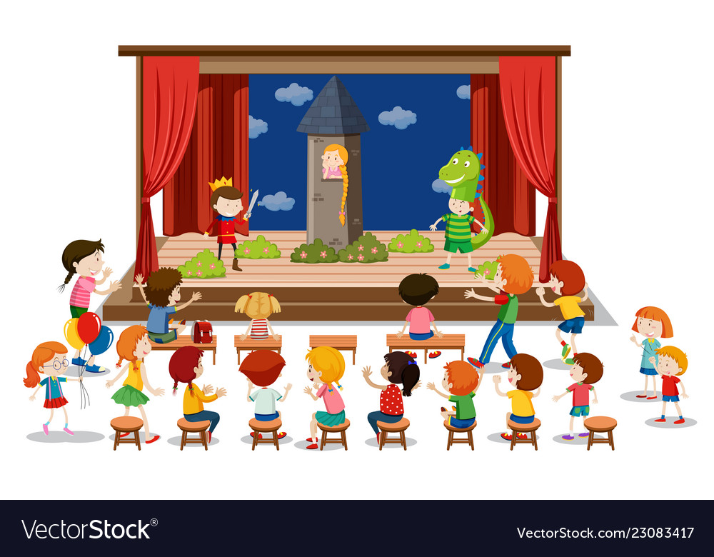
Welcome on stage!!!

Slide 12
Good job!

Slide 13
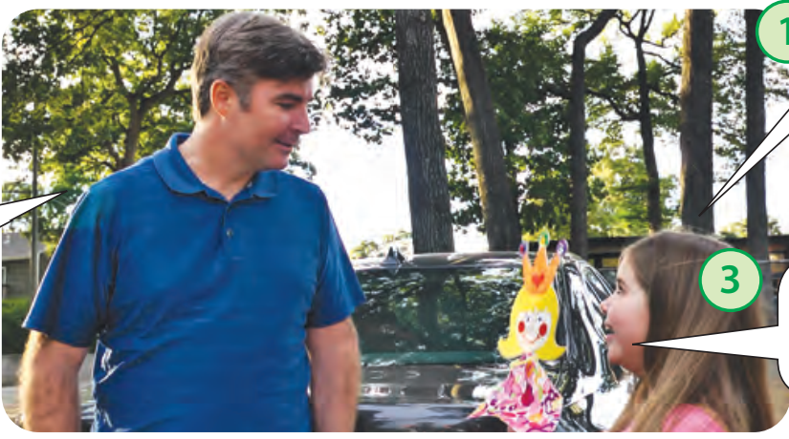
name
Listen and Write
meet
too
Her
Nice
………….
is Molly.
Hello, Molly. ……….to ……… you.
Nice to meet you, ………..

Slide 14
Good job!

Slide 15
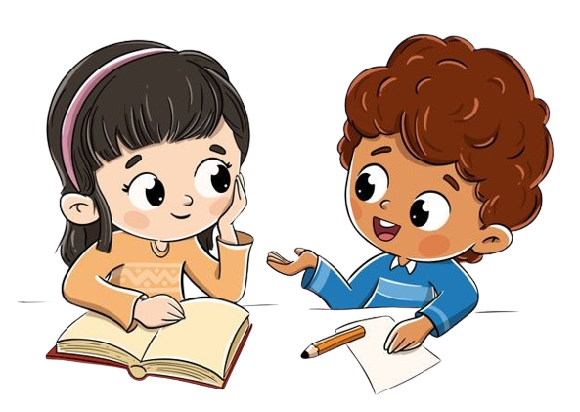
Talk about YOU!
Work
in pairs

Slide 16
Good job!

Slide 17
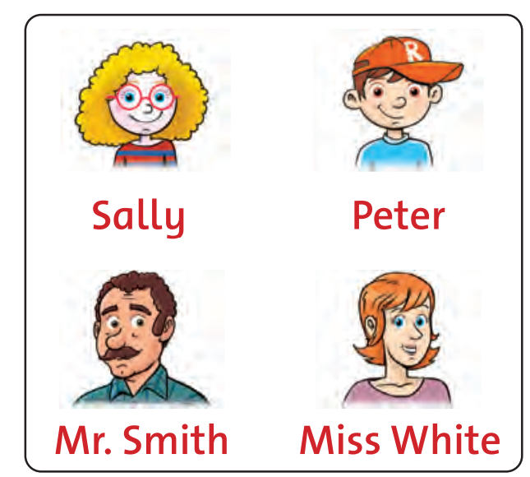
Work in groups of three – Point and Say
Role-Play
This is Sally.
Nice to meet you.

Slide 18
Good job!

Slide 19
Goodbye! See you later!
Notes:
Click to the picture of a smiley face to play the Goodbye song.

