Slide 1
I like monkeys!
Unit 4
Lesson Three - Song

Slide 2
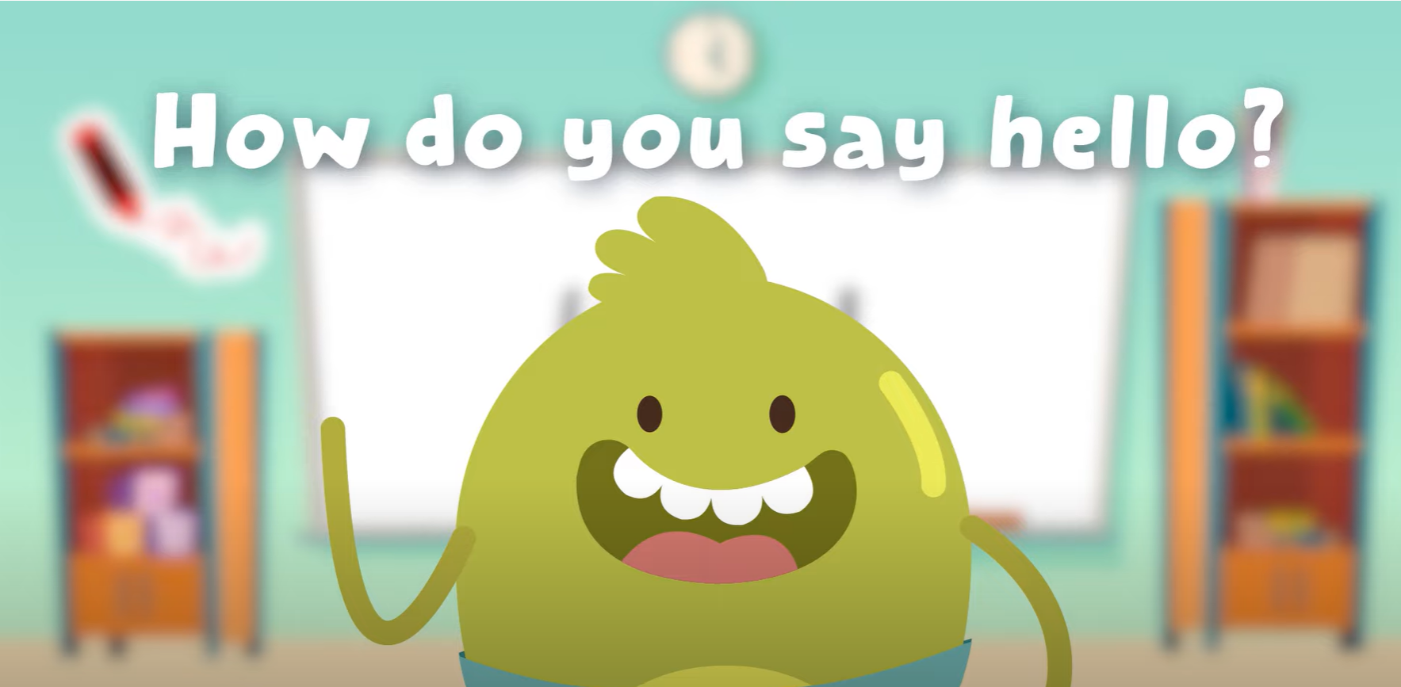
Hello song

Slide 3
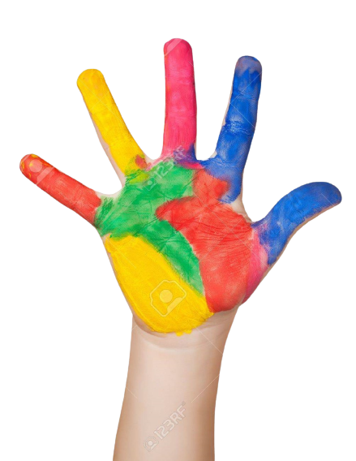
Give me five

Slide 4
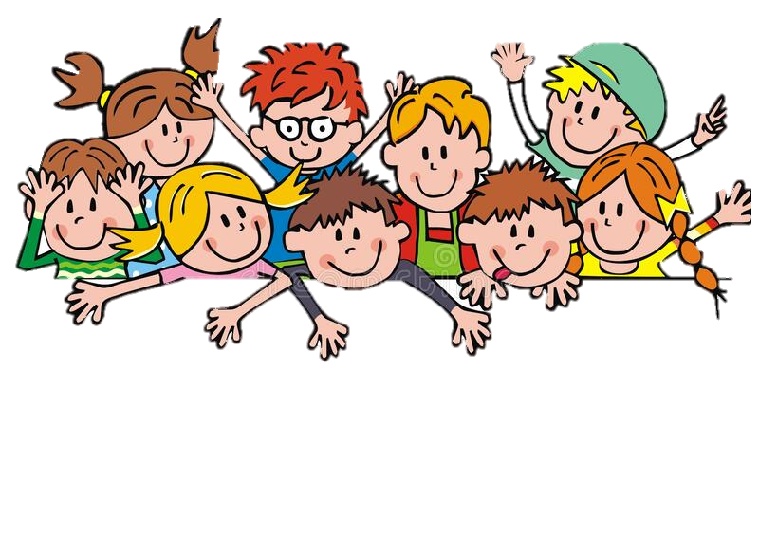
Game

Slide 5
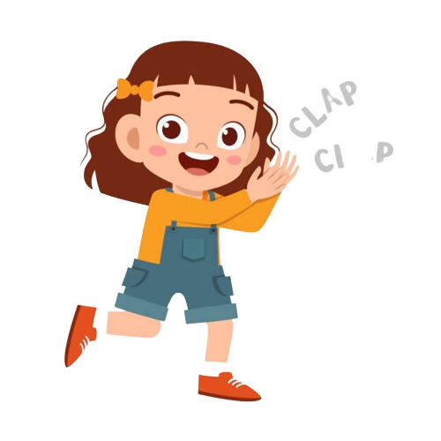
Good job!

Slide 6
Listen and Point

Slide 7
Listen and Repeat

Slide 8
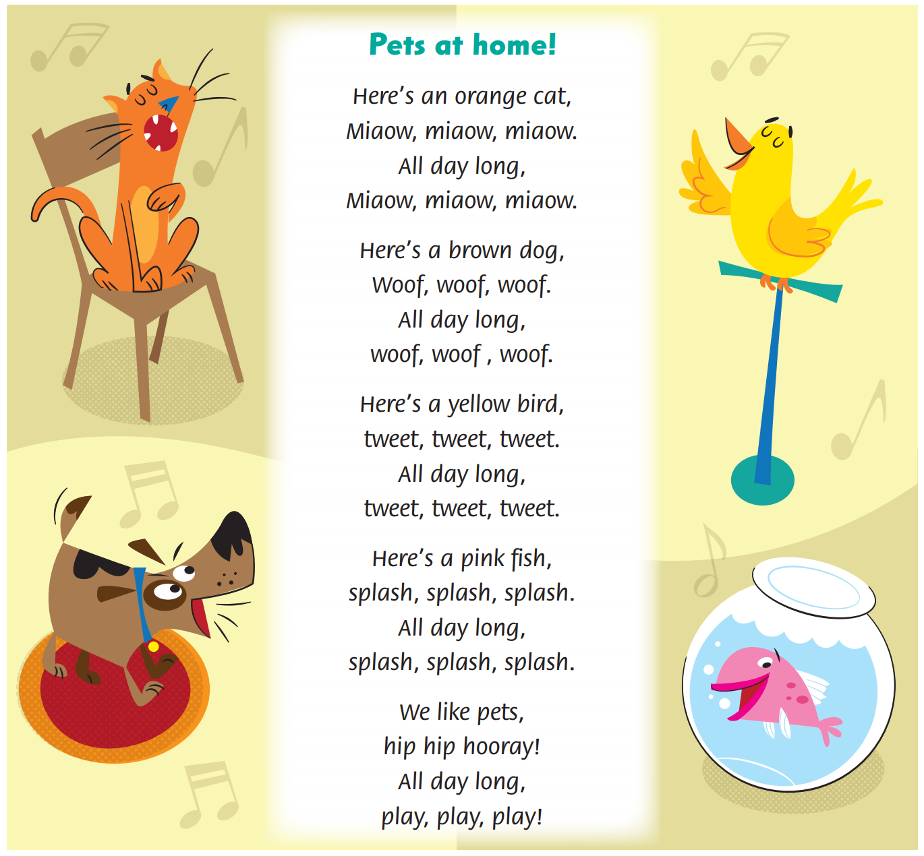
Look and Answer

Slide 9
Listen and Point

Slide 10
Listen and Repeat

Slide 11
Listen and Sing

Slide 12
Sing in groups

Slide 13
Good job!

Slide 14
Live on stage

Slide 15
Good job!

Slide 16
Game

Slide 17
Good job!

Slide 18
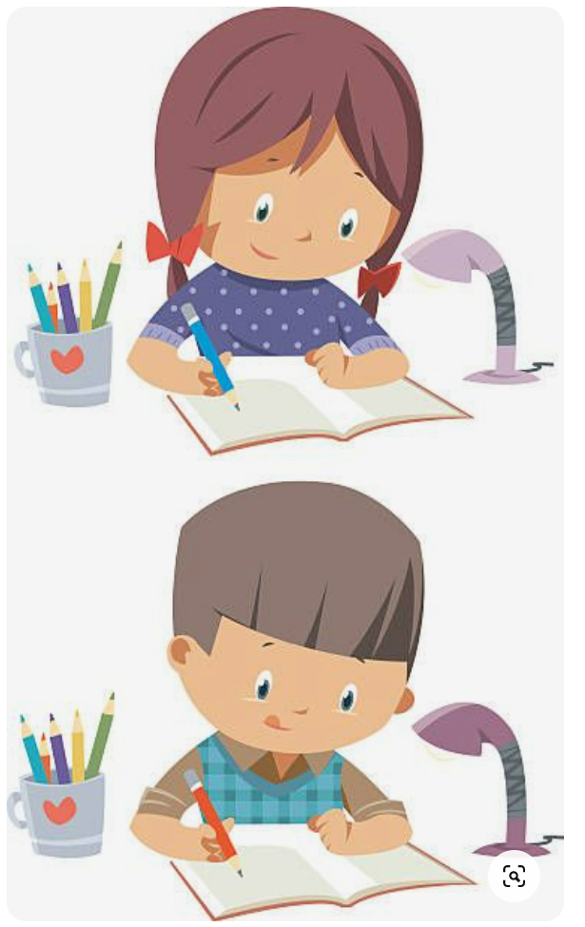
homework

Slide 19
Goodbye!
Please keep this slide for attribution

