Slide 1
I like monkeys!
Unit 4
Lesson Two - Grammar

Slide 2
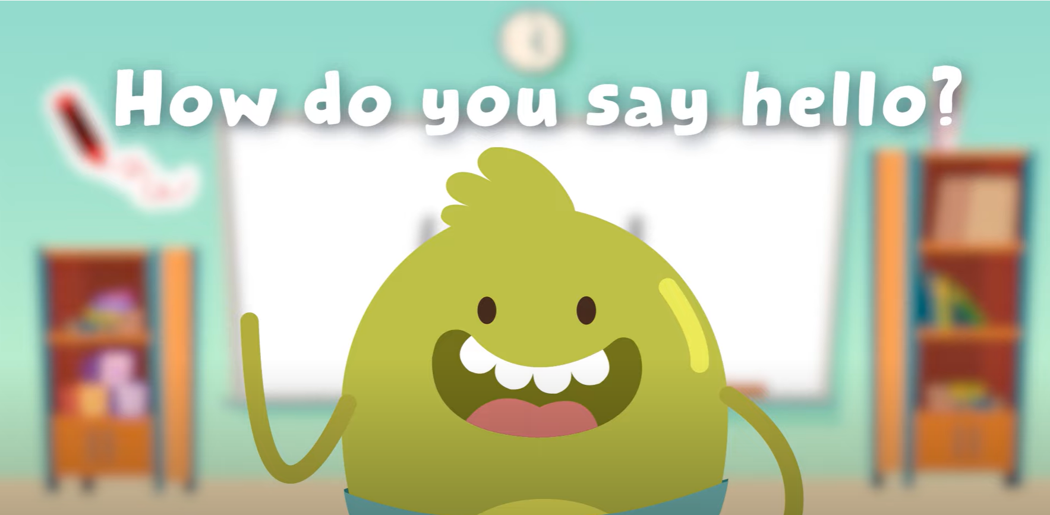
Hello song

Slide 3



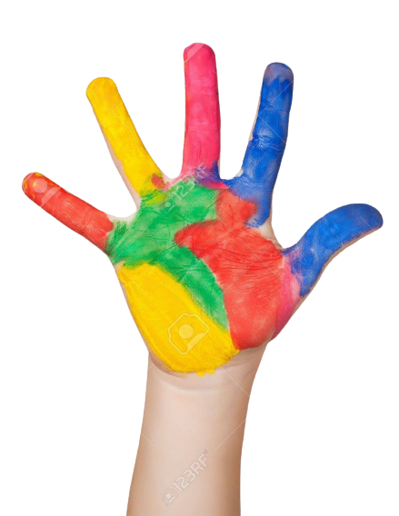


Give me five

Slide 4
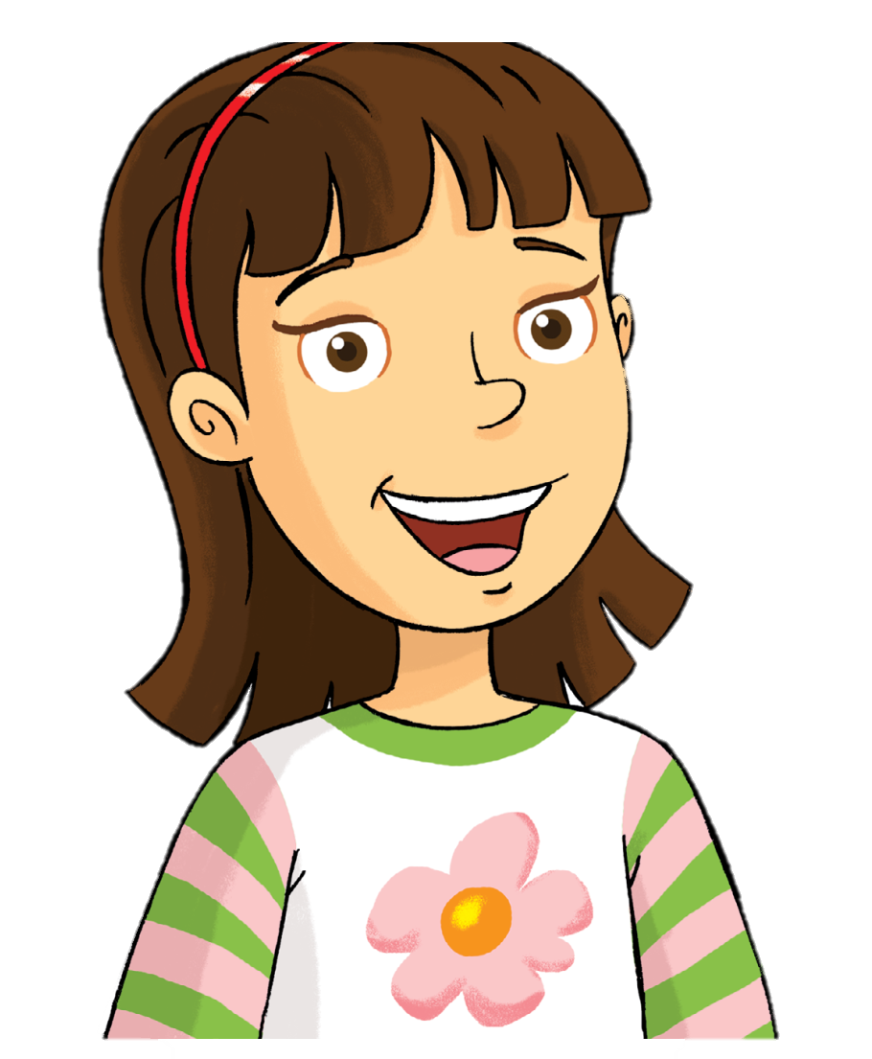
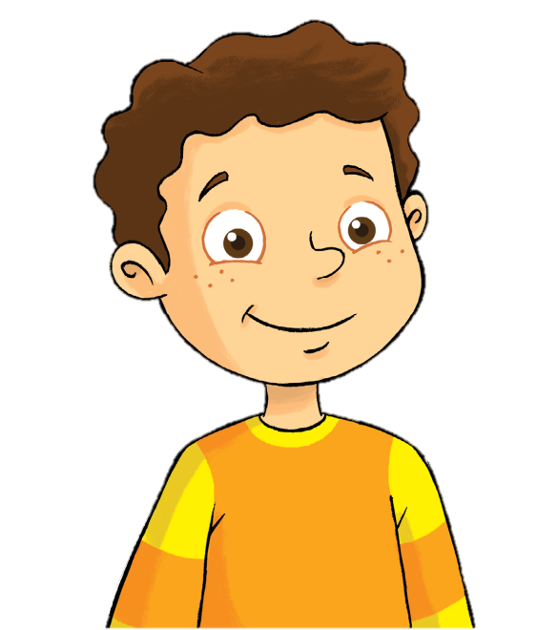
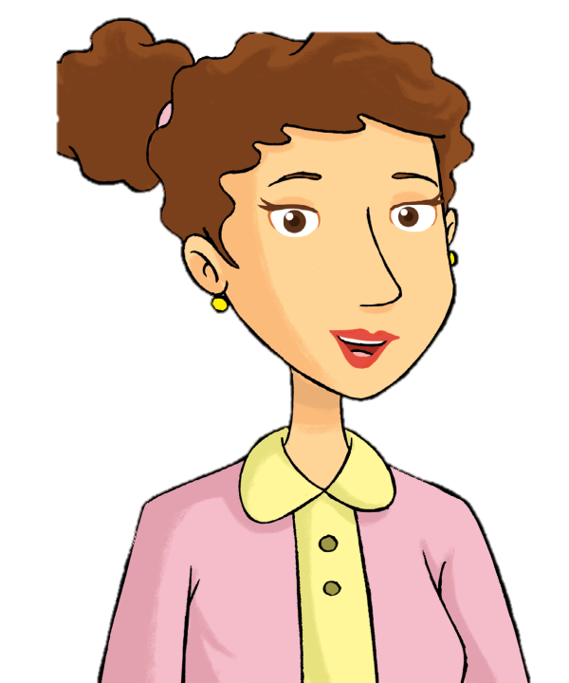

Remember
Rosy
Billy
mom
dad

Slide 5
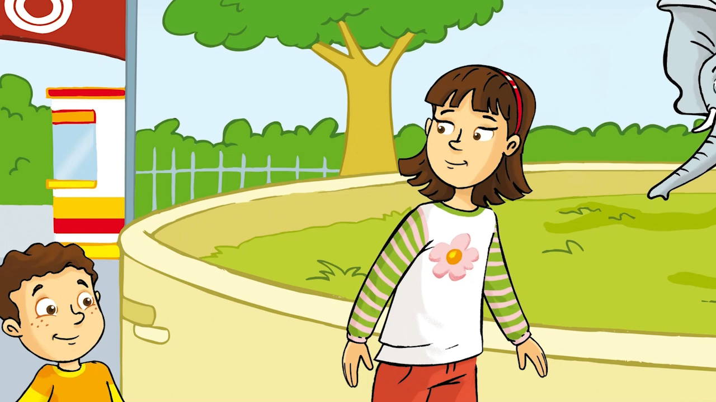
Watch and Say

Slide 6

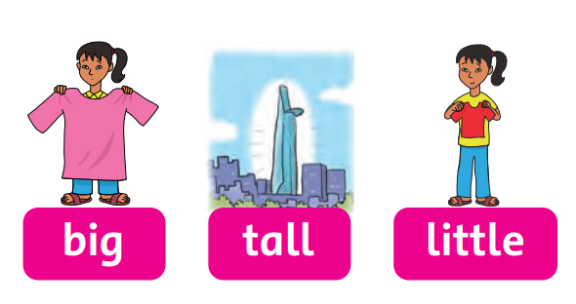

Listen and Chant

Slide 7
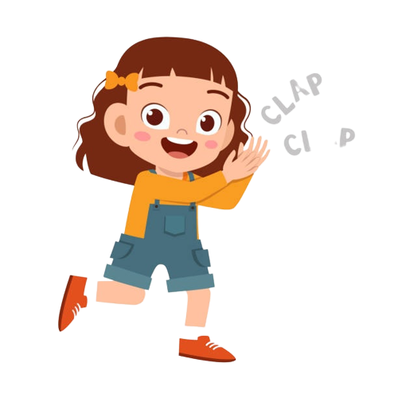
Good job!

Slide 8
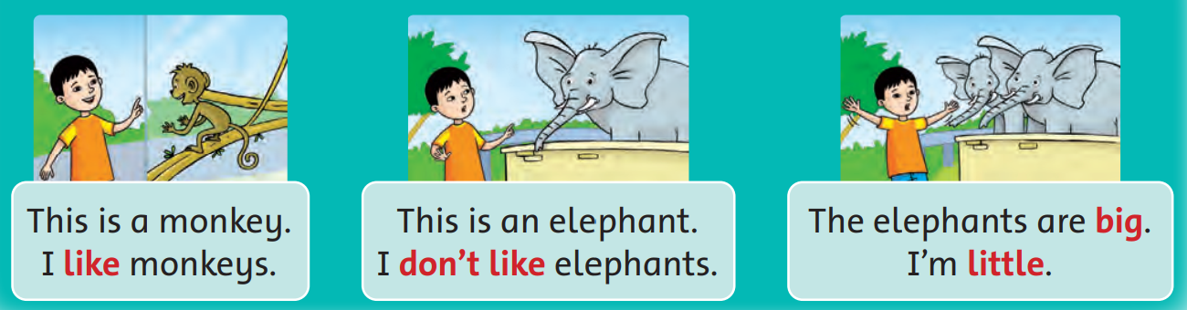
Listen and Point

Slide 9
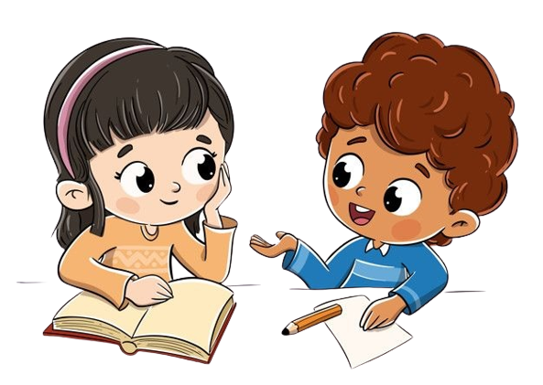
Work in Pairs
Point and Say

Slide 10
Good job!

Slide 11
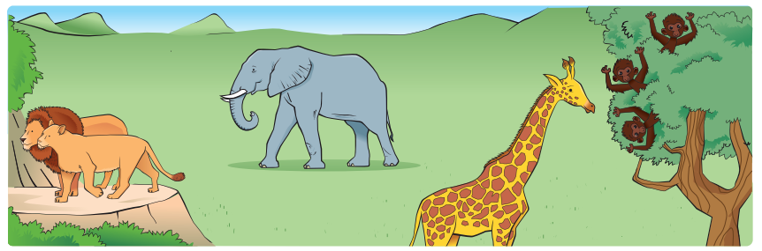
Look and Say

Slide 12
Work in Pairs
Point and Say

Slide 13
Good job!

Slide 14

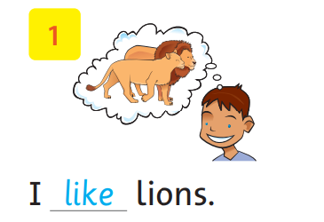
Write

Slide 15
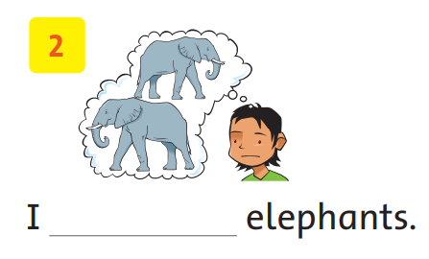
Write
don’t like

Slide 16
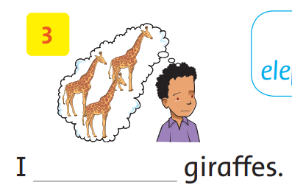
Write
don’t like

Slide 17
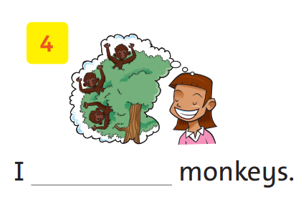
Write
like

Slide 18
Good job!

Slide 19
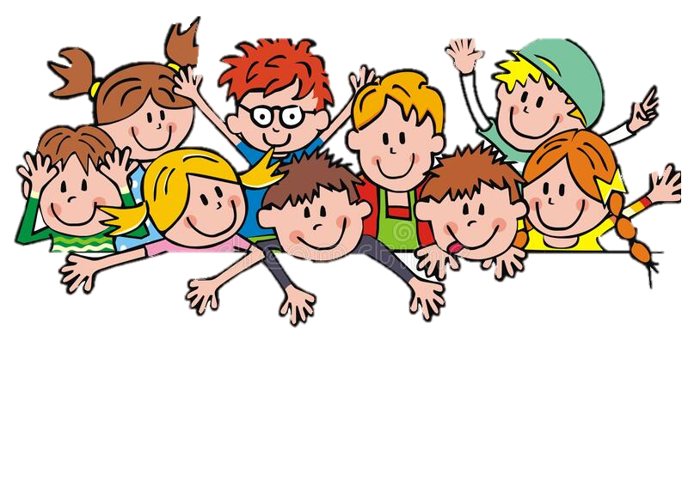
Game

Slide 20
Good job!

Slide 21
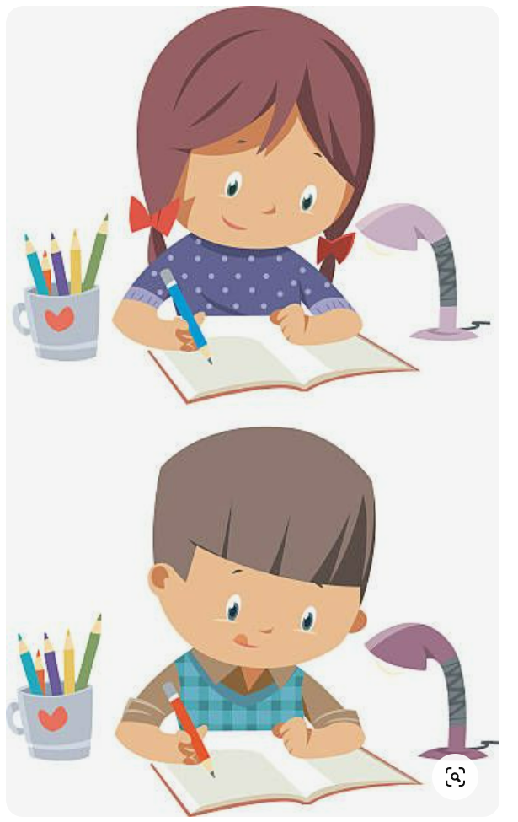
homework

Slide 22


Goodbye!
Please keep this slide for attribution

