Slide 1
Let’s find Mom!
Unit 3
Lesson Six – Skills Time

Slide 2
Hello song

Slide 3
Give me FIVE

Slide 4
Look and Say
Rosy
Tim
Billy
mom
dad

Slide 5
Watch and Answer

Slide 6
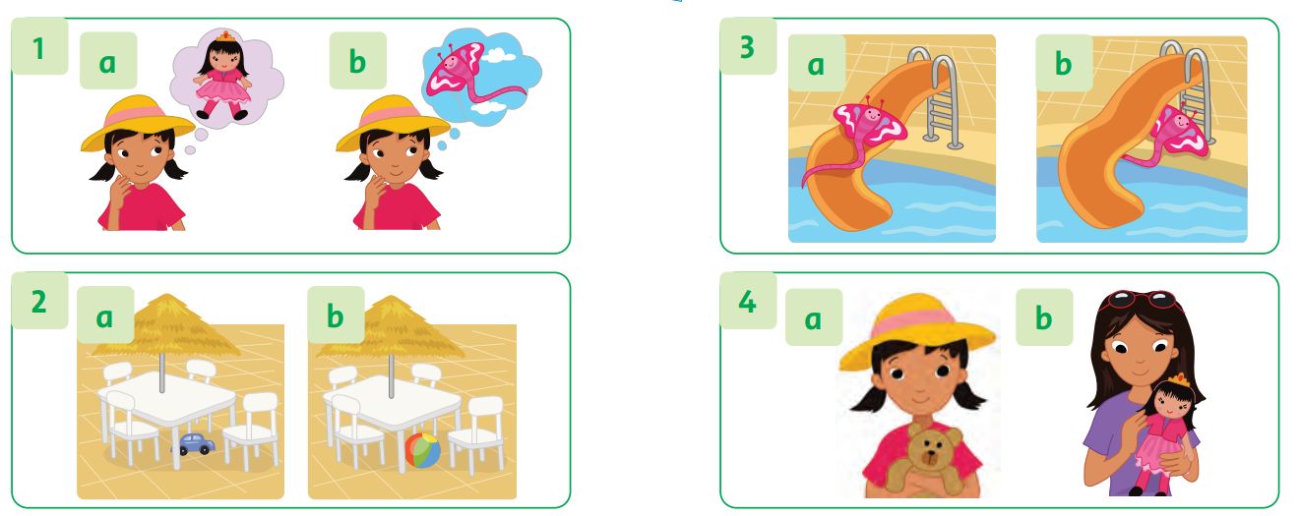
Listen and Write a or b

Slide 7
Work in Pairs
Point and Say

Slide 8
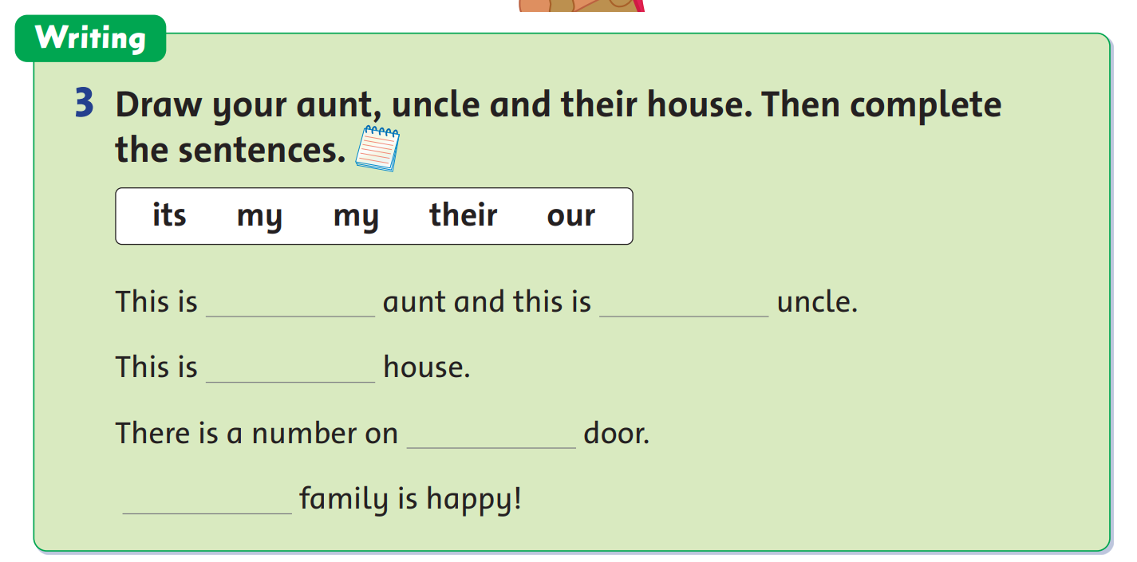
Write

Slide 9
Let’s draw!
Let’s write!
my
my
their
its
Our

Slide 10
Good job!

Slide 11
Let’s Talk!
Talk about your picture.

Slide 12
Good job!

Slide 13
Game

Slide 14
Good job!

Slide 15
Homework

Slide 16
Goodbye!
Tieng Anh 3 Family and Friends National Edition

