Slide 1
Let’s find Mom!
Unit 3
Lesson Four - Phonics

Slide 2

Hello song

Slide 3






Give me FIVE

Slide 4

Game

Slide 5

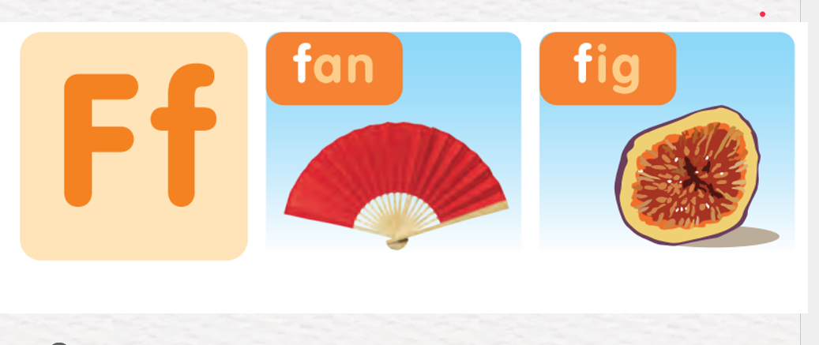

Listen and Point

Slide 6
Listen and Repeat

Slide 7

Good job!

Slide 8

Work in Pairs
Point and Say

Slide 9


Listen and Circle

Slide 10


Listen and Circle

Slide 11


Listen and Circle

Slide 12
Good job!

Slide 13

Let’s Talk
This is an elephant.

Slide 14
Work in Pairs
Point and Say

Slide 15
Good job!

Slide 16

Homework

Slide 17



Goodbye!
Tieng Anh 3 Family and Friends National Edition

