Slide 1
Let’s find Mom!
Unit 3
Lesson One - Words

Slide 2

Hello song

Slide 3






Give me FIVE

Slide 4





Look and Say
Rosy
Tim
Billy
mom
dad

Slide 5

Watch and Answer

Slide 6


Listen and Point

Slide 7
Listen and Repeat

Slide 8
Listen and Chant

Slide 9
Who’s this?
Rosy
Tim
Billy
mom
dad

Slide 10
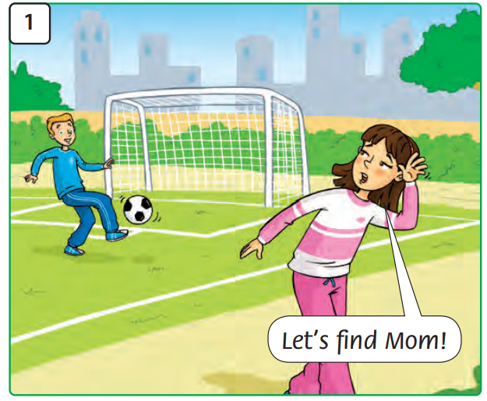
What’s happening?

Slide 11
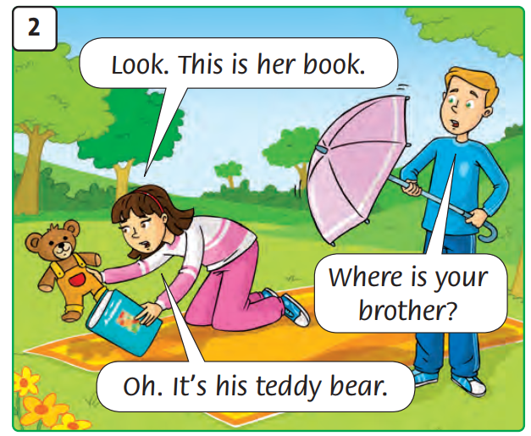
What’s happening?

Slide 12
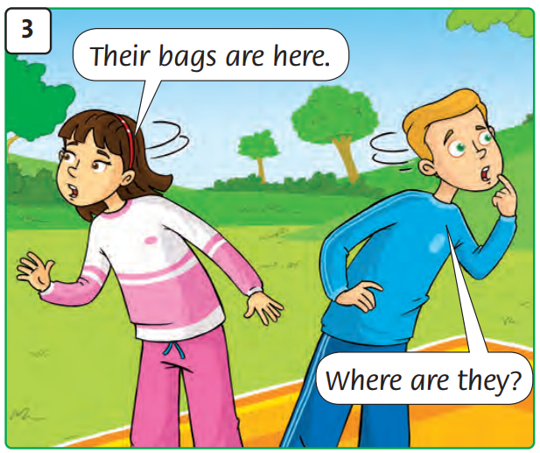
What’s happening?

Slide 13
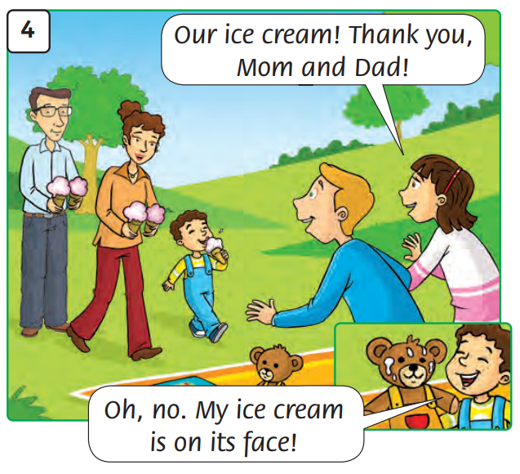
What’s happening?

Slide 14
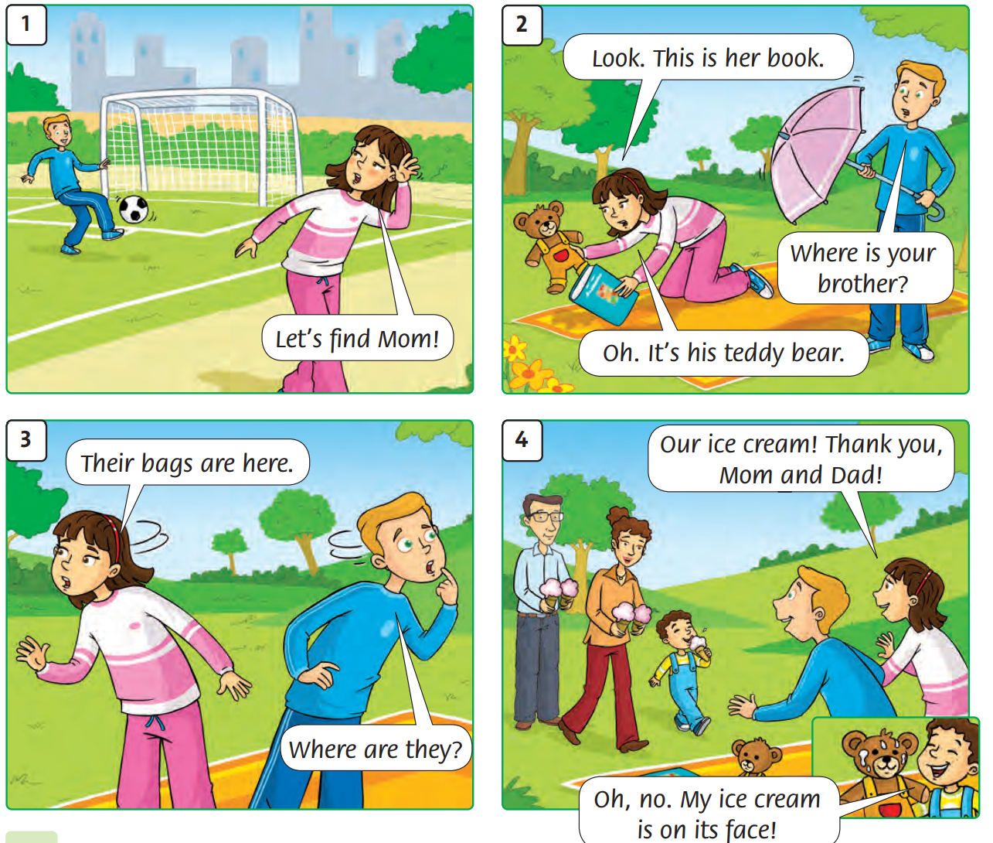
Listen and Point

Slide 15
Listen and Repeat

Slide 16
ANSWER
Raise your hands

Slide 17
Listen and Point

Slide 18

Work in groups
Role – Play Activity

Slide 19

Good job!

Slide 20

Homework

Slide 21



Goodbye!
Tieng Anh 3 Family and Friends National Edition

