Slide 1
That is his ruler.
Unit 2
Lesson Five – Skills Time

Slide 2
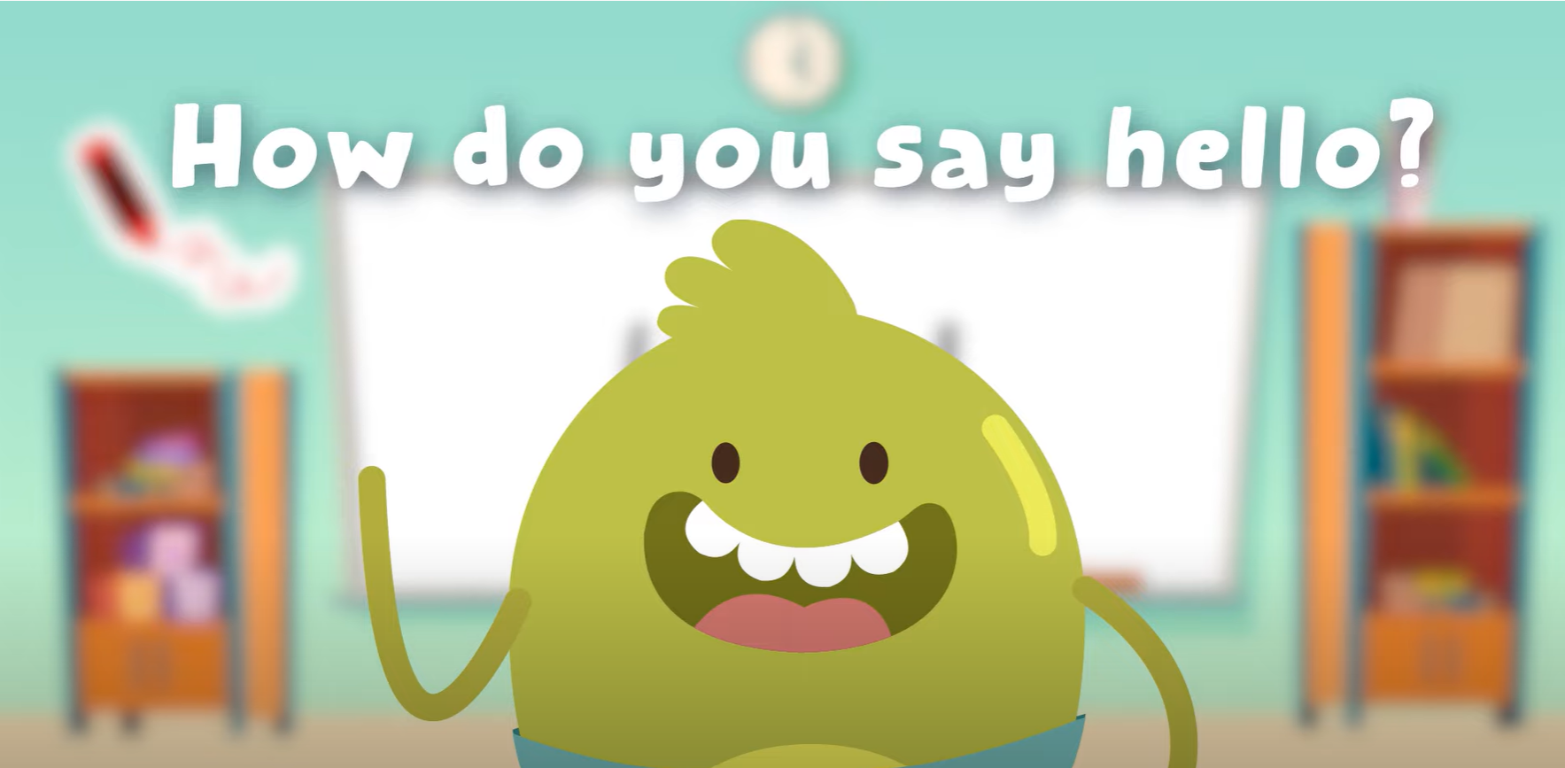
Hello song

Slide 3
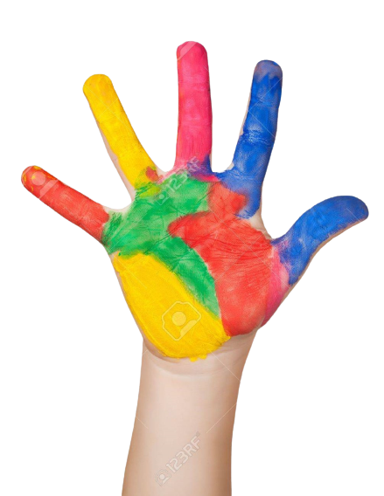
Give Me Five

Slide 4
Look and Say
Rosy
Tim
Billy

Slide 5
Watch and Answer

Slide 6
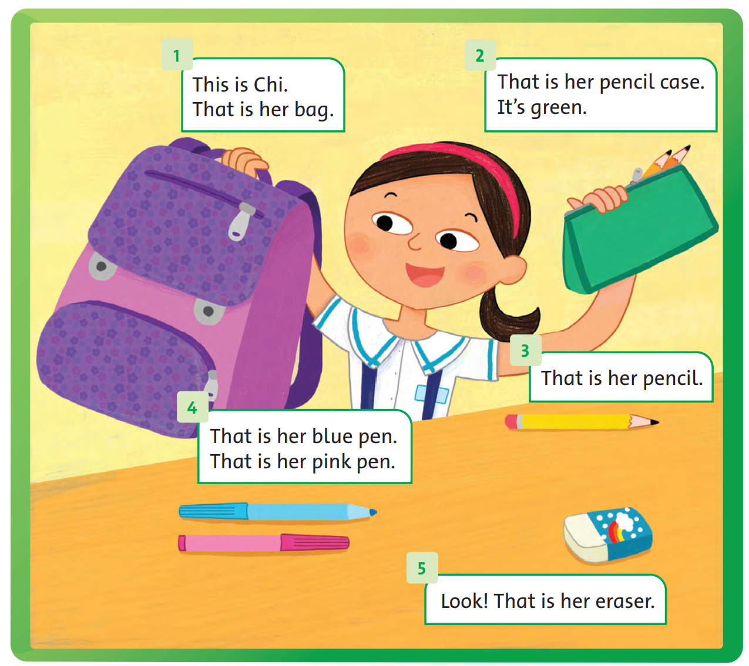
Listen and point

Slide 7
Listen and repeat

Slide 8
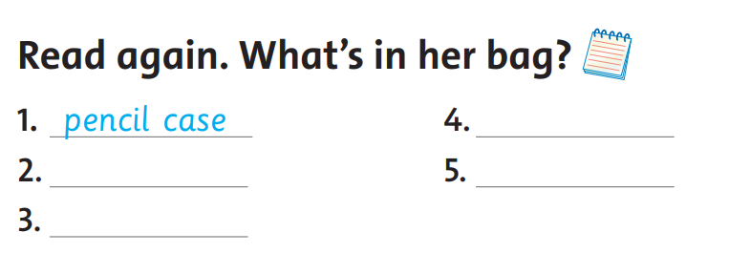
Read and Answer
a pencil
a blue pen
an eraser
a pink pen

Slide 9
Game

Slide 10
Goodbye! See you later!
Notes:
Click to the picture of a smiley face to play the Goodbye song.

