Slide 1

That is his ruler.
Unit 2
Lesson Four - Phonics

Slide 2
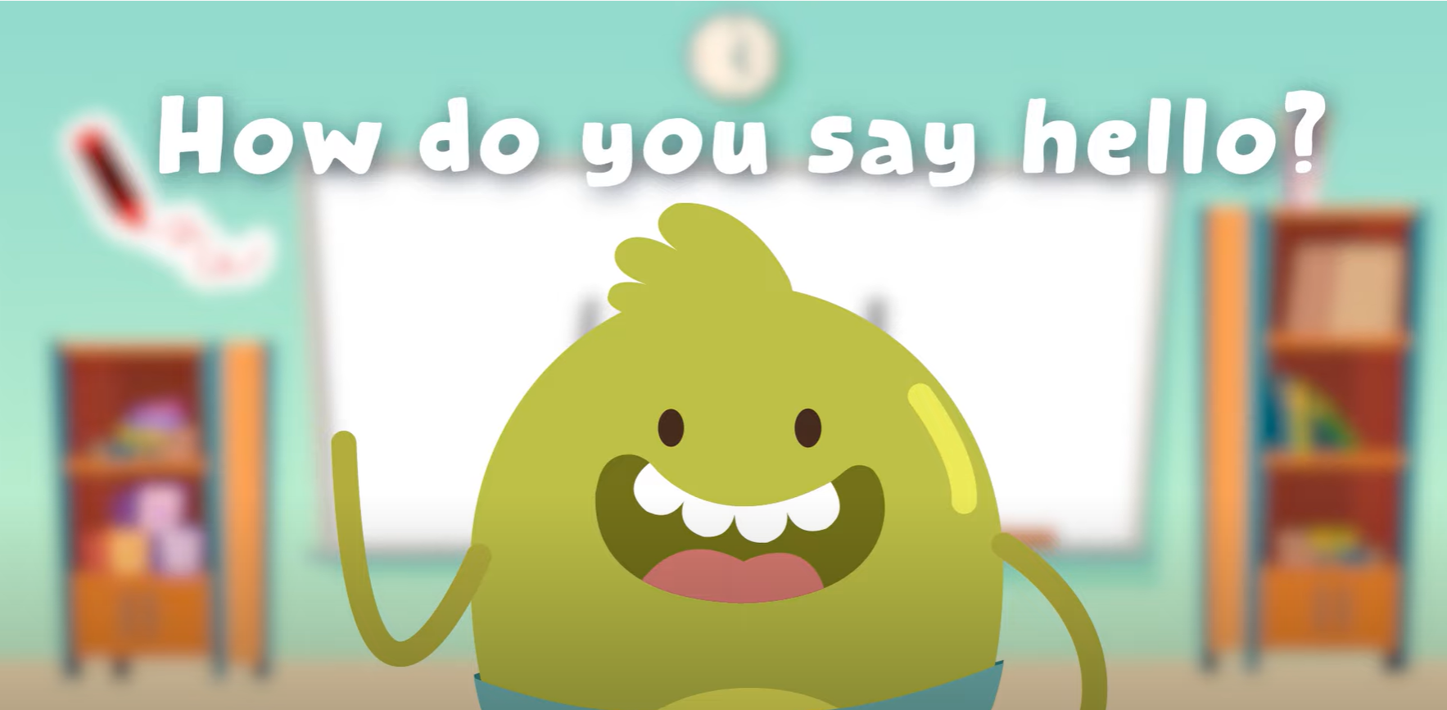
Hello song

Slide 3






Give Me Five

Slide 4

Game

Slide 5


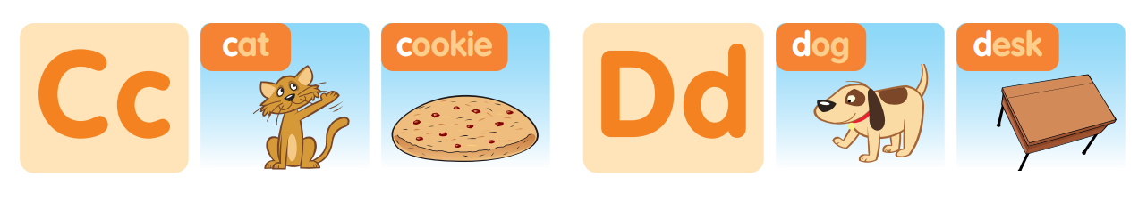
Listen and point

Slide 6
Listen and Repeat

Slide 7

Good job!

Slide 8
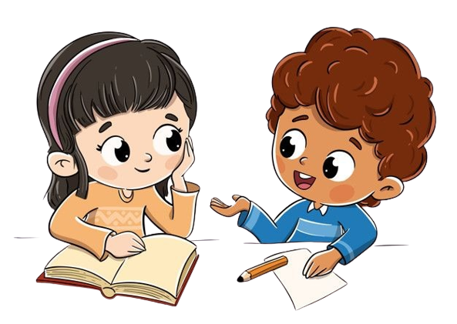

Work in pairs

Slide 9
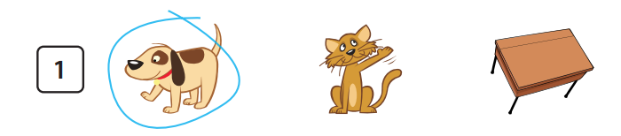

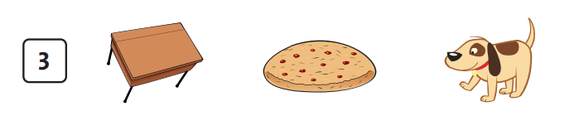
Listen and circle

Slide 10
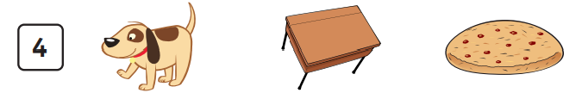
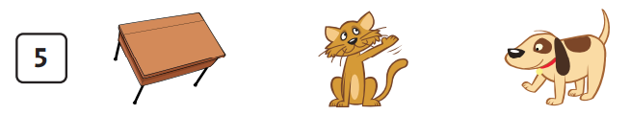
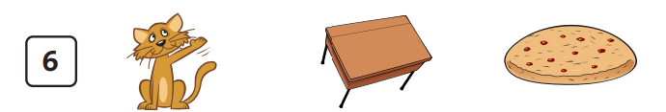
Listen and circle

Slide 11
Good job!

Slide 12

Let’s Talk!

Slide 13
Work in pairs

Slide 14
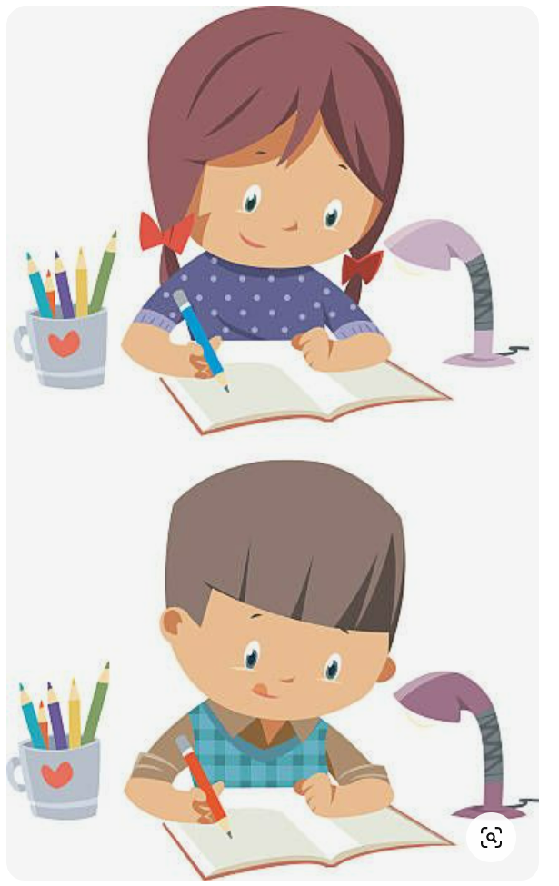
Homework

Slide 15

Goodbye!
See you later!
Notes:
Click to the picture of a smiley face to play the Goodbye song.

