Slide 1
That is his ruler.
Unit 2
Lesson Three - Song

Slide 2
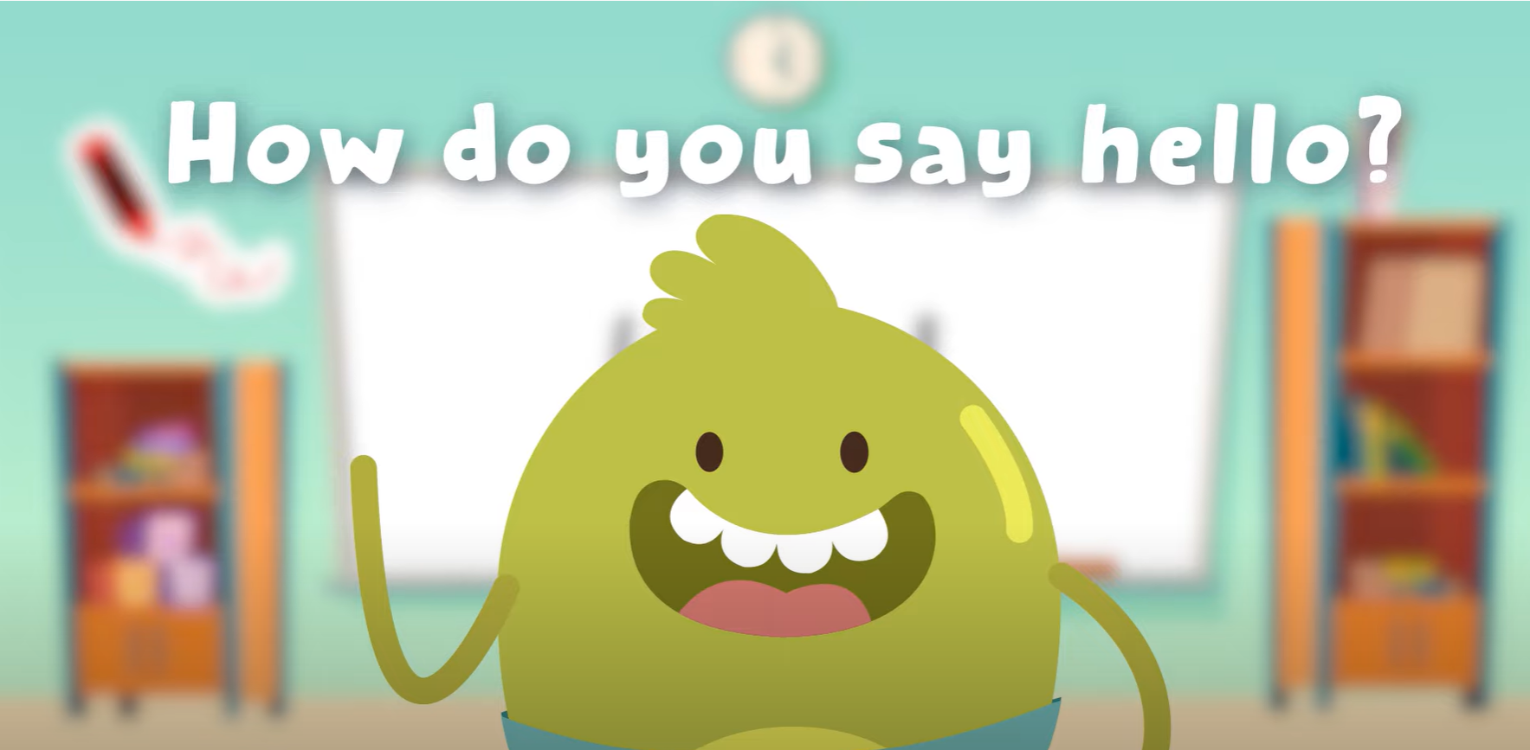
Hello song

Slide 3
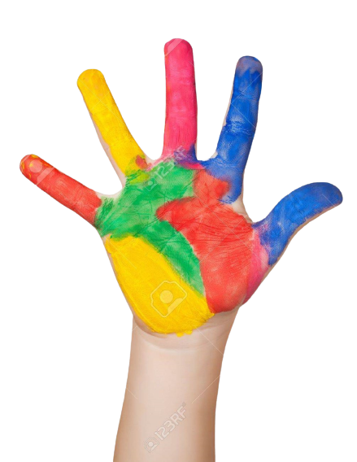
Give Me Five

Slide 4
Game

Slide 5
Good job!

Slide 6
Listen and chant

Slide 7
Watch and Answer

Slide 8
Listen and point

Slide 9
Listen and repeat

Slide 10
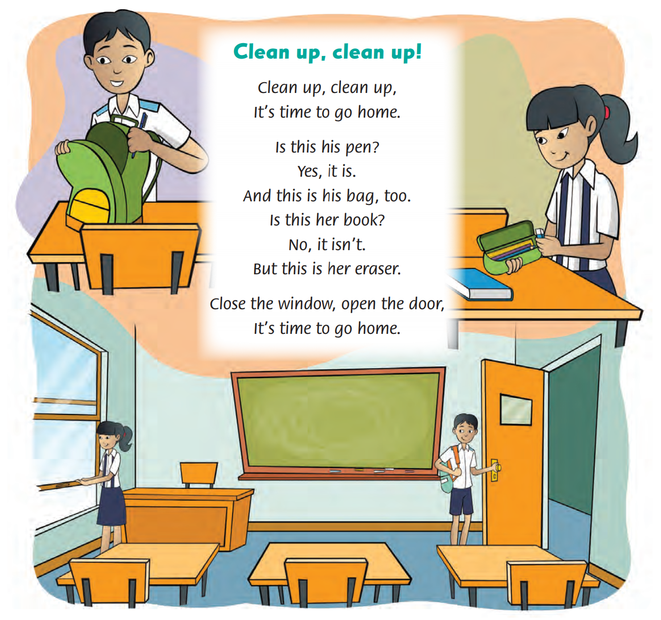
Look and Answer

Slide 11
Listen and point

Slide 12
Listen and repeat

Slide 13
Listen and sing

Slide 14
Sing in groups

Slide 15
Live on Stage

Slide 16
Good job!

Slide 17
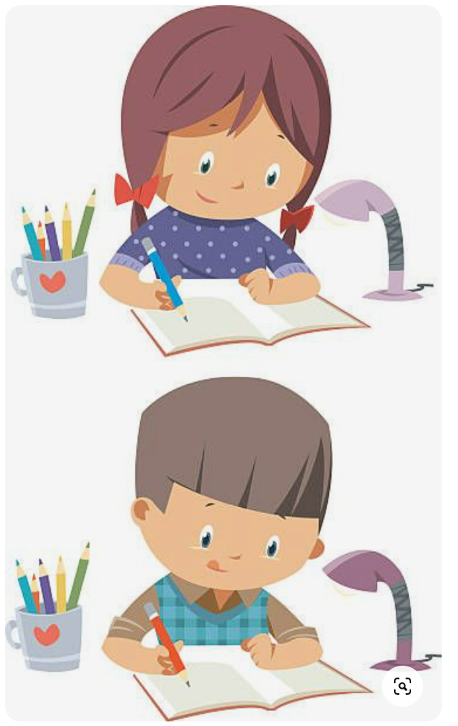
Homework

Slide 18
Goodbye! See you later!
Notes:
Click to the picture of a smiley face to play the Goodbye song.

